Slide 1
Enzora: mutations for the next experiment
Many possible substitutions. A limited budget for prediction and wet-lab testing.
Starting enzyme and substrate
A ranked shortlist with traceable evidence
Define the property you want to improve
Keep the sequence, predictions and design decisions together
01 Construct the mutation library
02 Predict and balance scores
03 Inspect and export candidates
CO2 substrate
Phenom
Activity and native uncertainty
O = C = O
EpHod
Optimal pH and disagreement
UniStab
544 aa carbonic anhydrase
Stability change and variation
Predicted input fold, residues 65–544
ProteinDPO
Inverse folding
Enzora Assistant
Real 10-candidate UMAP example
EnzGFM
Enzyme-adapted PLM
MiniMax tool use
The changed residue stays visible
Reads predictions and uncertainty
WT
A
A
A
M
N
T
R
N
T
R
VESM3
Distilled ESM3
N32A
A
A
A
M
A
T
R
N
T
R
Requests bounded changes to weights
Validate and record the policy
Top-K proteins and report
Align single-substitution effects
CSV, FASTA, JSON, GenBank, SBOL
Keep the minimum across models
Optional host-specific coding DNA
1,000 unique variants by default
Rank against a fixed WT reference
Synonymous codons preserve identity
Choose mutation order and allowed sites
Uncertain gains shrink towards neutral
Ready for the next experimental design
Combine sites without full enumeration
Apply target and threshold filters
Computational workflow. Predicted structures and ranked candidates still require wet-lab validation.
Notes:
Three stages connect a starting enzyme and substrate to predicted candidates. The UMAP inset uses ten real computational candidates, not experimental observations.
Sources: Enzora production workflow and fixed WT-reference scoring. UMAP coordinates come from the verified ten-candidate computational integration run. Input-fold component is coordinate-derived from the project prediction. Design direction: AnewOmni figure composition, DOI 10.64898/2026.03.12.711044. Equations: native PowerPoint LaTeX-to-OMML conversion, screenshot after conversion. The separate formula source preserves editable equations.

Slide 2
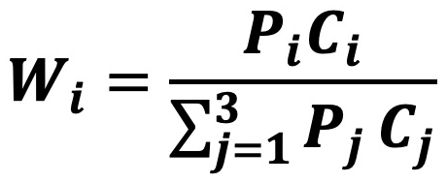
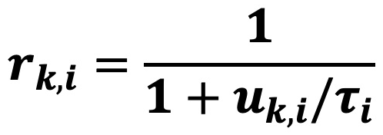
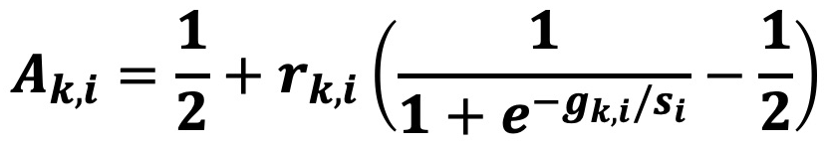
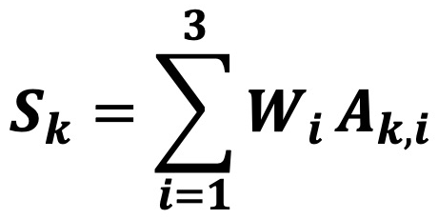
How model evidence becomes a candidate score
Global priorities and candidate-specific uncertainty play different roles.
a Global priorities
b Candidate-specific uncertainty
Larger uncertainty reduces the size of a predicted gain or loss.
Preference sets the importance of each property.
Confidence changes how much a predictor influences ranking.
The three effective weights sum to one.
Gain compares the candidate with WT. Scales stay frozen.
c Final candidate score
d Increasing uncertainty softens the evidence
Combine the three
normalized components.
Threshold filters remain separate from ranking.
Analytical explanation of the implemented policy, not a calibration result.
Notes:
Four formula screenshots were created from LaTeX in PowerPoint. Curves show exact analytical functions, not measured model calibration.
Sources: Enzora production workflow and fixed WT-reference scoring. UMAP coordinates come from the verified ten-candidate computational integration run. Input-fold component is coordinate-derived from the project prediction. Design direction: AnewOmni figure composition, DOI 10.64898/2026.03.12.711044. Equations: native PowerPoint LaTeX-to-OMML conversion, screenshot after conversion. The separate formula source preserves editable equations.

Slide 3
Enzora as a software system
A stable execution path with typed tools, persistent results and live progress.
Browser workspace
Authenticated API
Job scheduler
Sequence input
Screening controls
Maps, reports and exports
Validated requests
Live progress over SSE
Session-scoped Assistant
Persisted stage state
Explicit execution gates
Independent model jobs
Data and tool contracts
Fixed computational stages
BioArtifact keeps sequences, predictions
and provenance together.
VESM library construction
ToolSpec and Tool Registry describe
supported capabilities.
Phenom, EpHod and UniStab
Scoring, Top-K, UMAP and reporting
Adapters prepare model inputs
and validate returned outputs.
Shared model weights stay separate from each run. Temporary graphs and logits are cleared after completion.
MiniMax requests tools through a bounded interface. The API validates parameters before changing a run.
Notes:
The browser communicates with an authenticated API. A persistent job scheduler runs fixed stages, while typed tools expose validated operations to the Assistant.
Sources: Enzora production workflow and fixed WT-reference scoring. UMAP coordinates come from the verified ten-candidate computational integration run. Input-fold component is coordinate-derived from the project prediction. Design direction: AnewOmni figure composition, DOI 10.64898/2026.03.12.711044. Equations: native PowerPoint LaTeX-to-OMML conversion, screenshot after conversion. The separate formula source preserves editable equations.

