Slide 1
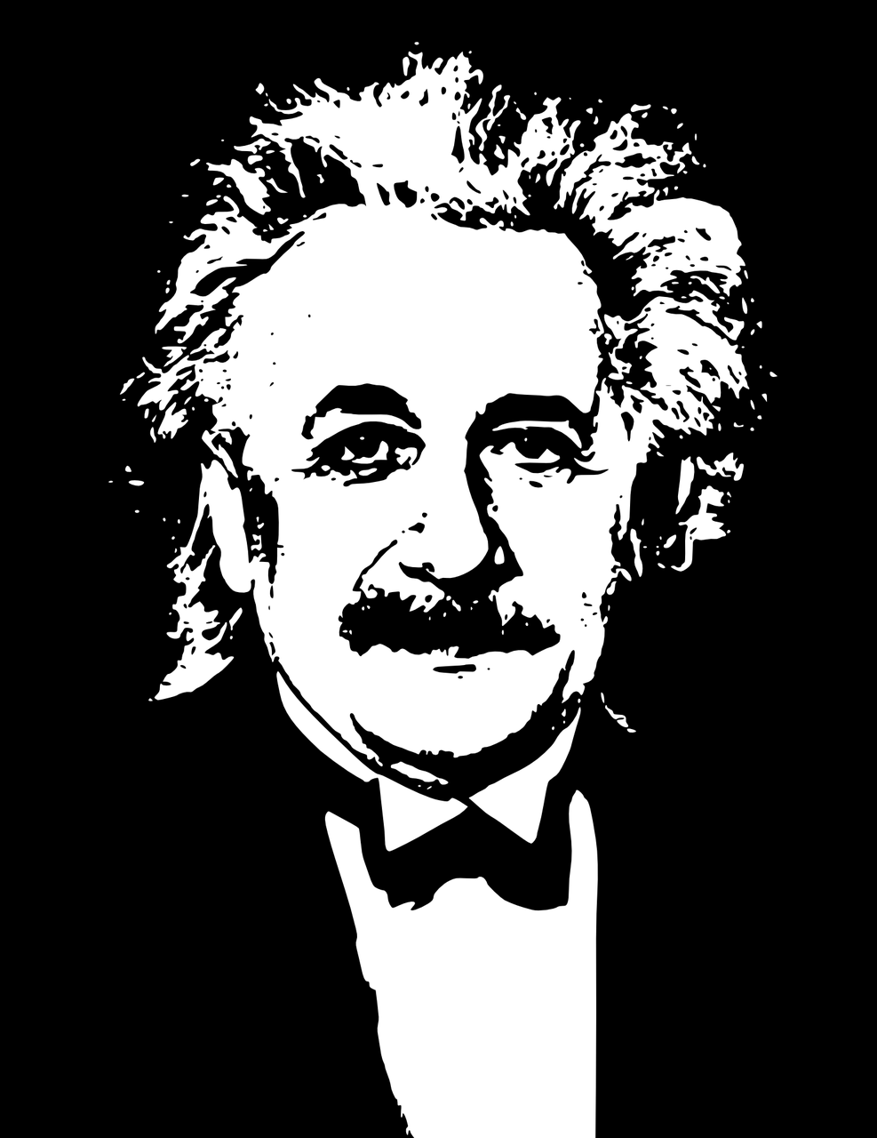
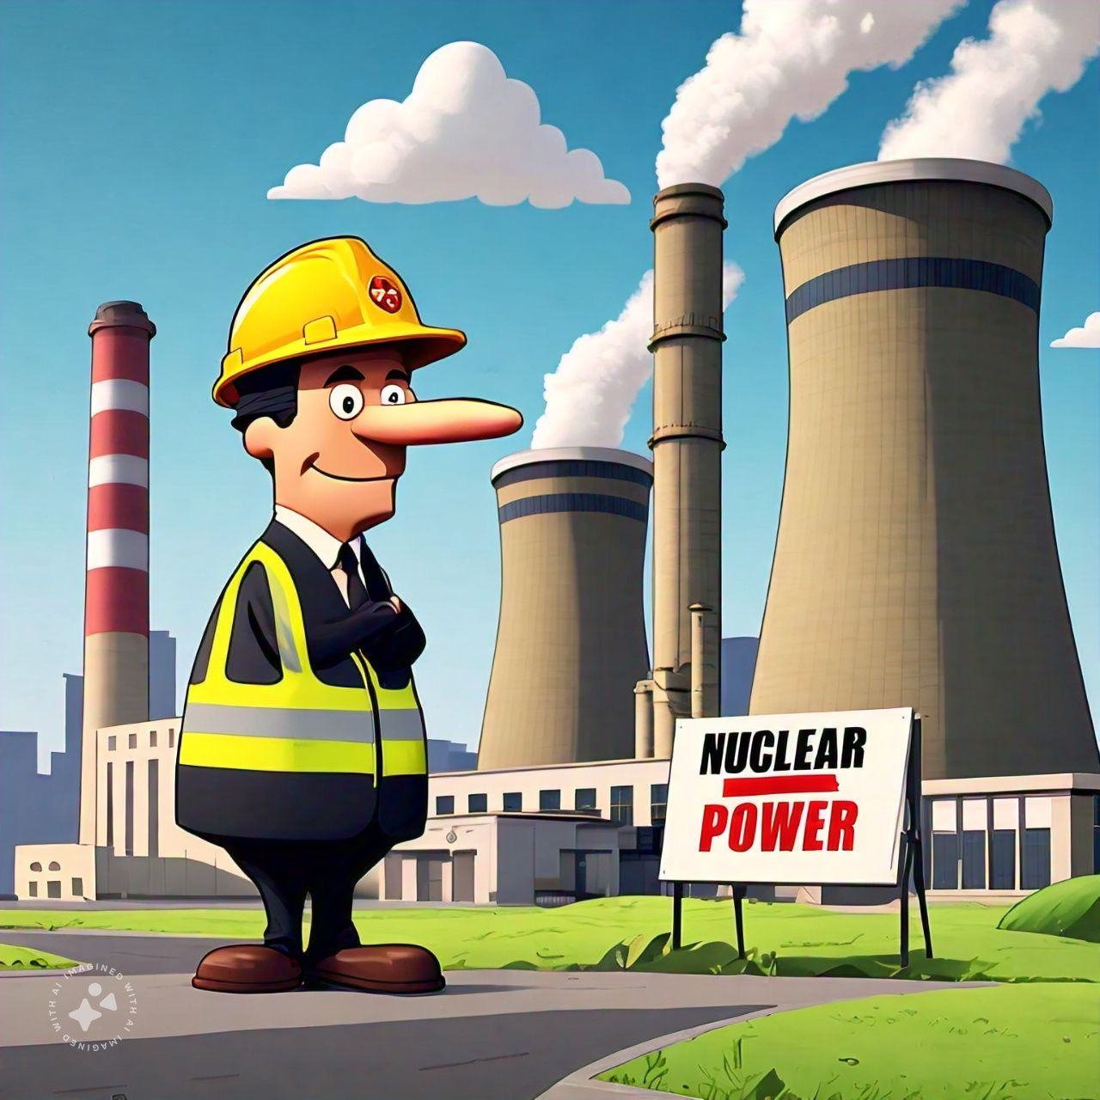
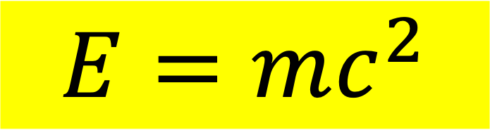
Mass-energy equivalence
Speed of light
$$E=mc^{2}$$
Rest Energy
Particle mass
Connects mass and energy
Energy release in nuclear reactions
  Fission and fusion
  Stellar energy source
  Nuclear power
Albert Einstein
Picture Credit: Pixabay
With AI imagined

