Slide 1





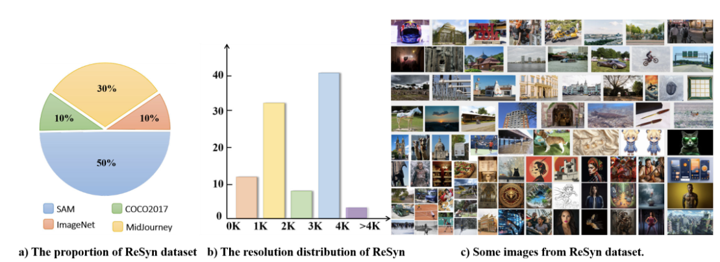
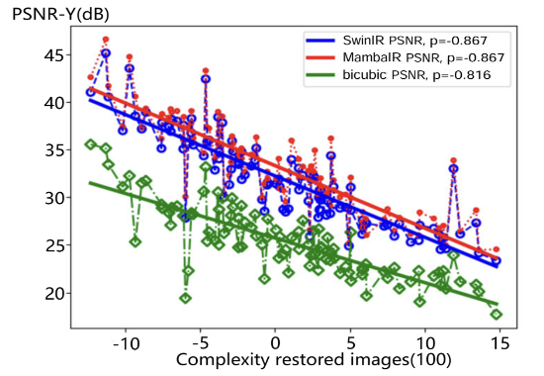
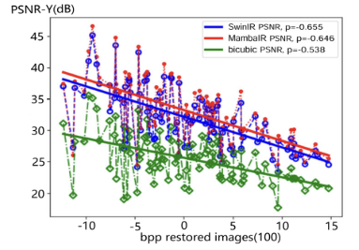
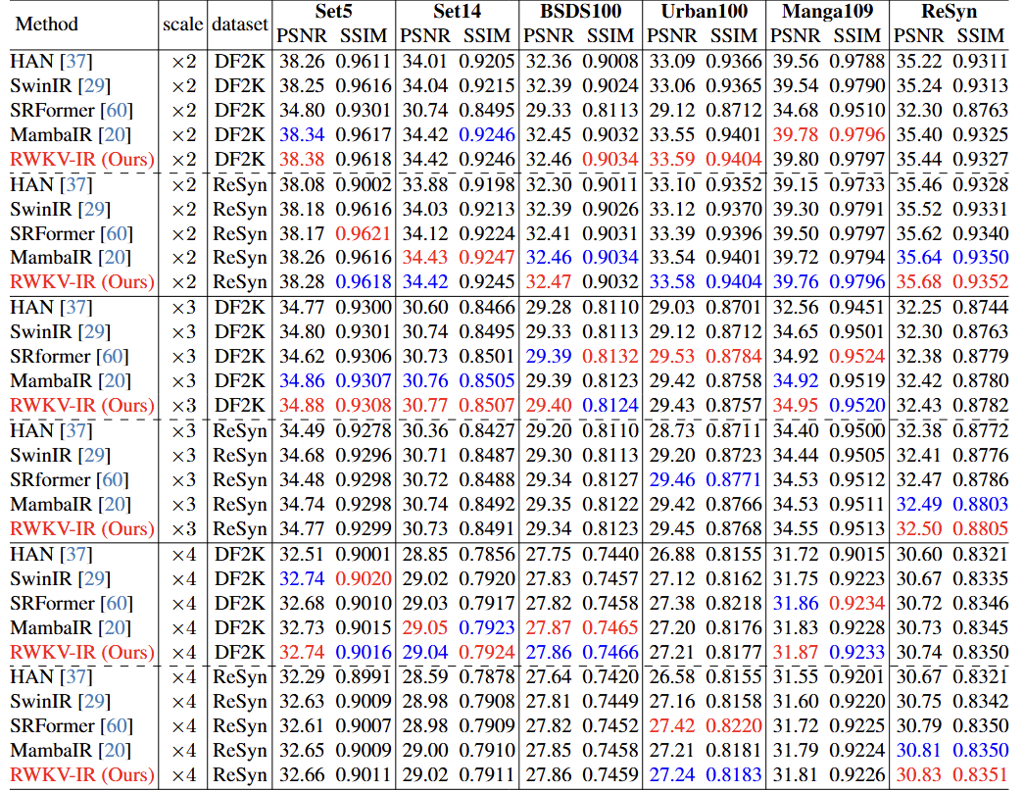
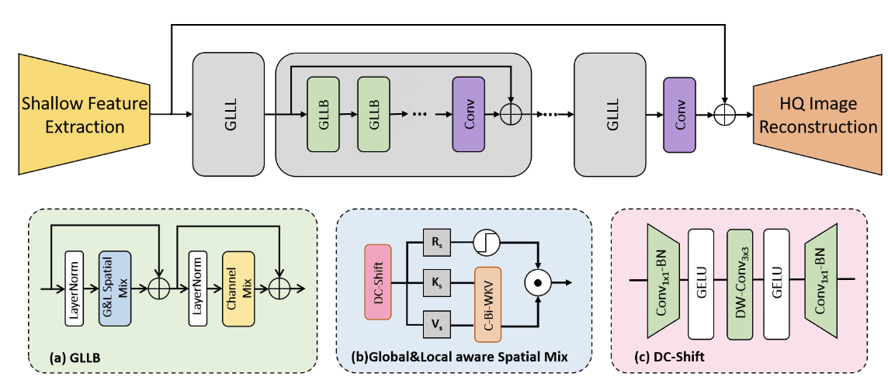
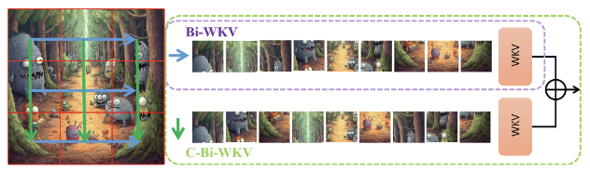
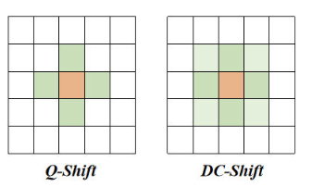
Exploring Real&Synthetic Dataset and Linear Attention in Image Restoration
Yuzhen Du^{1∗}, Teng Hu^{1*}, Jiangning Zhang^{2,3}, Ran Yi^{1†}, Chengming Xu², Xiaobin Hu², Kai Wu², Donghao Luo², Yabiao Wang², Lizhuang Ma¹
¹Shanghai Jiao Tong University ²Youtu Lab, Tencent ³Zhejiang University
Task
ReSyn Dataset
Image restoration (IR) aims to recover high-quality imagesfrom degraded inputs.
We utilize the GLCM, which is closelyrelated to the complexity of image texture and representedby the luma component, to construct an image complexityanalysis metric.
Data Source. The images are shuffled and low-qualityimages are discarded, only 9K images are retained. To in-troduce the AI-generated images into this dataset, we auto-matically crawl images from Midjourney, and after filteringwe retain 3K synthetic images for our dataset.
There are 12K images left, of which 9K are real images and 3Kare synthetic images.
Motivation
A bias between the image complexity distributionsof commonly used IR training and testing datasets, leadingto suboptimal restoration results.
We explore how to enhancethe performance of transformer-based image restorationmodels based on linear attention mechanisms.
Existing methods lack a unified trainingbenchmark specifying training iterations and configurations.
Contribution
We propose a comprehensive benchmark for image restoration tasks, which includes a novel large-scale benchmark dataset, and a unified training standard that specifies the number of training iterations and the configuration of batch size. We conduct a comprehensive evaluation of SOTA IR models using the unified training standard on the new dataset and other common IR datasets.
We construct a large-scale dataset called ReSyn, that integrates both real and synthetic images. This dataset encompasses a variety of data sources and utilizes novel image filter methods based on our newly proposed GLCM-based image complexity metric.
We design RWKV-IR, a novel image restoration model with both global and local receptive fields, which can effectively restore low-quality images with linear computational complexity. We replace the original token-shift method (Q-shift) with Depth-wise Convolution shift for local dependencies modeling, and proposes Cross-Bi-WKV to replace Bi-WKV for more balanced attention for horizontal and vertical directions, which enables RWKV to be effectively transferred to IR models.
PSNR (×2 SR on Urban100 )performance can bepredicted by the proposed GLCM image complexity and BPP [ 41].We conduct this analysis on MambaIR, SwinIR, and bicubic up-sampling restored images.
RWKV-IR
llustration of Cross-Bi-WKV, which consists of twocross scanning Bi-WKV modules.

