Slide 1

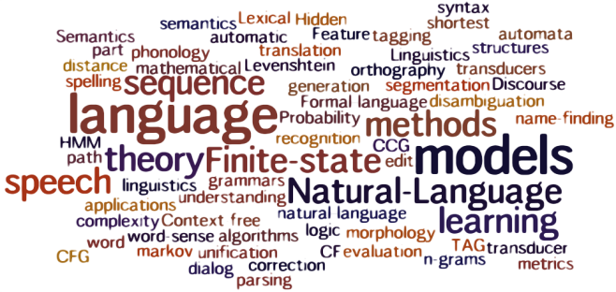
Multiple Choice Question Answering Using a Deep LSTM Attentive Reader Model
Tianhui Huang, Laura McCrackin and Yuzhou Wang

Slide 2

MCTest: Sample Story
James the Turtle was always getting in trouble. Sometimes he'd reach into the freezer and empty out all the food. Other times he'd
sled on the deck and get a splinter. His aunt Jane tried as hard as she could to keep him out of trouble, but he was sneaky and got
into lots of trouble behind her back.
One day, James thought he would go into town and see what kind of trouble he could get into. He went to the grocery store and
pulled all the pudding off the shelves and ate two jars. Then he walked to the fast food restaurant and ordered 15 bags of fries. He
didn't pay, and instead headed home. His aunt was waiting for him in his room. She told James that she loved him, but he would
have to start acting like a well-behaved turtle.
After about a month, and after getting into lots of trouble, James finally made up his mind to be a better turtle.
1) What is the name of the trouble making turtle?
A) Fries
B) Pudding
C) James
D) Jane
2) What did James pull off of the shelves in the grocery store?
A) pudding
B) fries
C) food
D) splinters
3) Where did James go after he went to the grocery store?
A) his deck
B) his freezer
C) a fast food restaurant
D) his room
4) What did James do after he ordered the fries?
A) went to the grocery store
B) went home without paying
C) ate them
D) made up his mind to be a better turtle

Slide 3
MCTest Dataset
“MCTest: A Challenge Dataset for the Open-Domain Machine Comprehension of Text” (Richardson et al., Microsoft, 2013)
Easy to understand
Limited vocabulary
Fictional
Contains both questions with answers from one sentence, and those from multiple sentences

Slide 4
Baseline Methods for Question Answering
Majority baseline
Picks the entity most frequently observed in the context document
Exclusive majority
Chooses the entity most frequently observed in the context
but not observed in the query
Word Distance Benchmark
Calculates a distance measure between the question and the context around the aligned entity

Slide 5
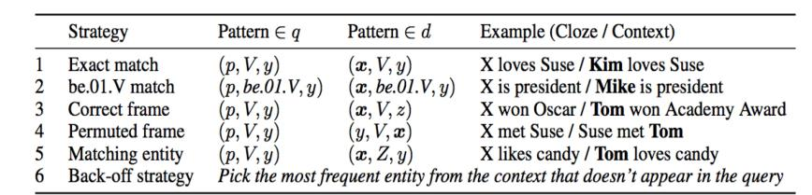
Frame-Semantic Parsing
Allows models access to information about “who did what to whom”

Slide 6
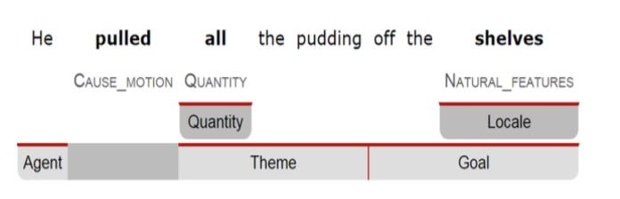
Other Question Answering Methods
Machine Comprehension with Syntax, Frames, and Semantics (Hai Wang et al, 2013)

Slide 7
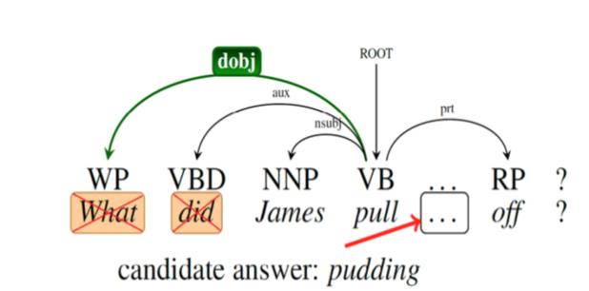
Other Question Answering Methods
Machine Comprehension with Syntax, Frames, and Semantics (Hai Wang et al, 2013)

Slide 8
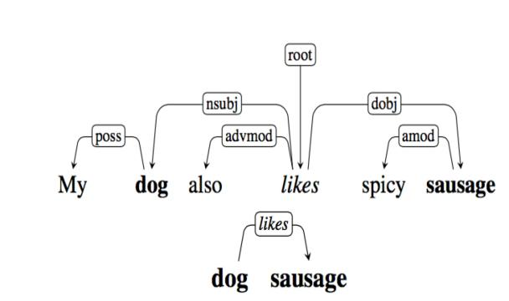
Other Question Answering Methods
Machine Comprehension with Syntax, Frames, and Semantics (Hai Wang et al, 2013)
Machine Comprehension with Discourse Relations
(Karthik Narasimhan, Regina Barzilay, 2015)

Slide 9
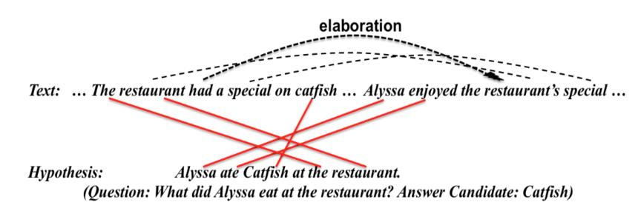
Other Question Answering Methods
Machine Comprehension with Syntax, Frames, and Semantics (Hai Wang et al, 2013)
Machine Comprehension with Discourse Relations
(Karthik Narasimhan, Regina Barzilay, 2015)
Learning Answer-Entailing Structures for Machine Comprehension (Mrinmaya Sachan et al, 2015)

Slide 10
Limitations
Machine Comprehension with Syntax, Frames, and Semantics (Hai Wang et al, 2013)
Poor degree of coverage with many relations.
Machine Comprehension with Discourse Relations
(Karthik Narasimhan, Regina Barzilay, 2015)
Accuracy varies significantly according to the question type
Learning Answer-Entailing Structures for Machine Comprehension (Mrinmaya Sachan et al, 2015)
Lack the ability to deeply reason about facts or numbers

Slide 11
Comparison of Results
Method | MCTest Accuracy (%)
Baseline (sliding window + word distance) | 57.75
Learning Answer-Entailing Structures for Machine Comprehension (Sachan et. al, 2015) | 67.83
Machine Comprehension with Discourse Relations (Narasimhan et. al, 2015) | 63.75
Machine Comprehension with Syntax, Frames and Symantics (Wang et. al, 2015) | 69.94
Our Method | ???

Slide 12

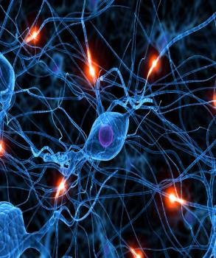
Neural Network Models
LSTM
Long Short Term Memory
Type of RNN designed to remember information over long periods of time
Google DeepMind (2015):
Proposed new LSTM models featuring attention mechanisms:
The Impatient Reader
The Attentive Reader

Slide 13
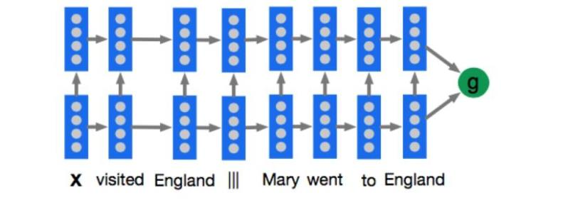
The Deep LSTM Reader (Baseline)
This model processes each document query pair as a single long sequence

Slide 14
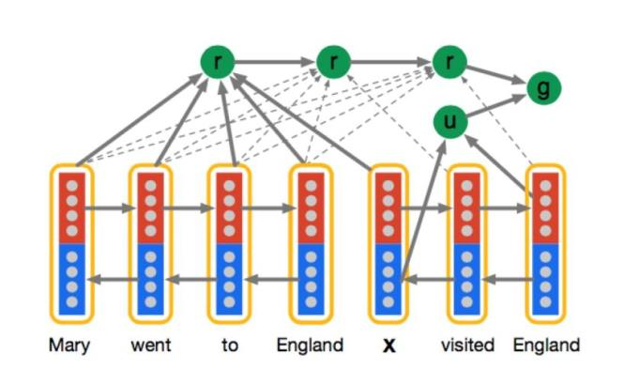
The Impatient Reader
Allows reading forwards and backwards to accumulate information from the document

Slide 15
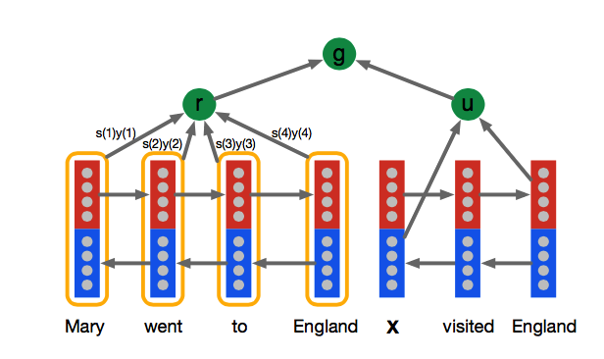
The Attentive Reader
Only reading forwards (but very similar performance)
Used as a basis for our method

Slide 16




Main Frameworks Used
NLTK
Python library for natural language processing
Python library for efficiently declaring and evaluating mathematical expressions for multi-dimensional arrays
Includes NVIDIA CUDA integration
Blocks + Fuel
Blocks
Framework for annotating Theano computation graphs for neural network training using a hierarchy of “Bricks”
Fuel
Data processing pipeline and data interface for Blocks

Slide 17
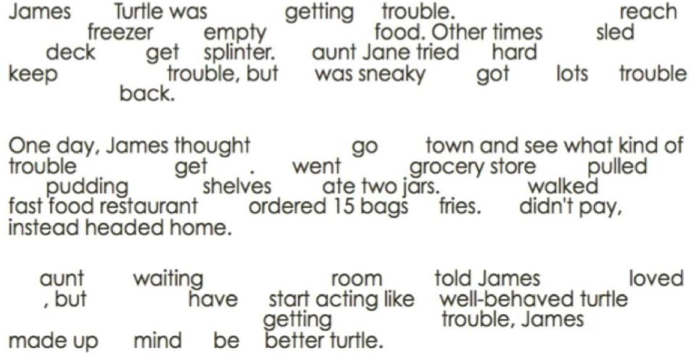
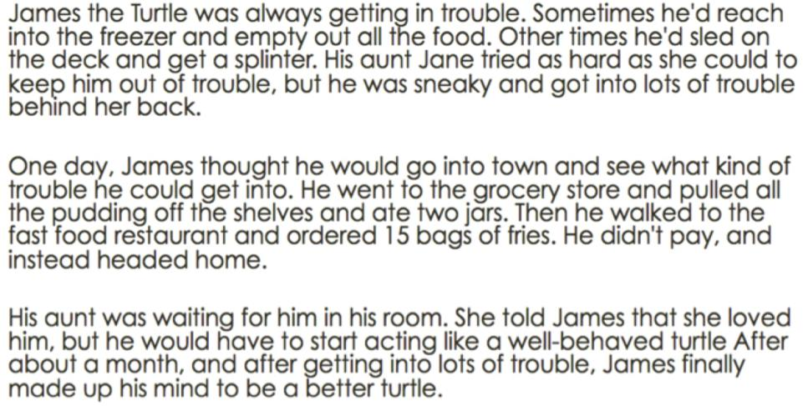
Data Processing (NLTK)
Delete stop words: a, an, the, etc.

Slide 18
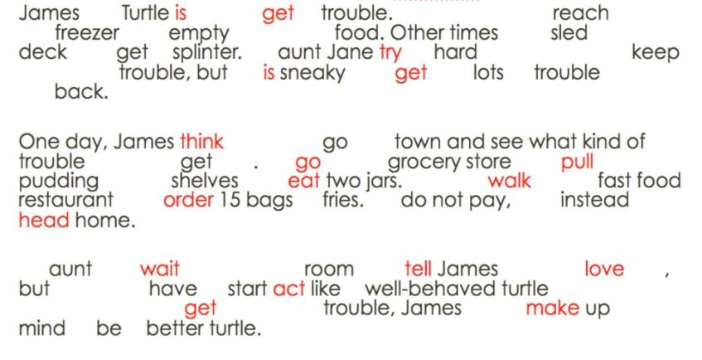
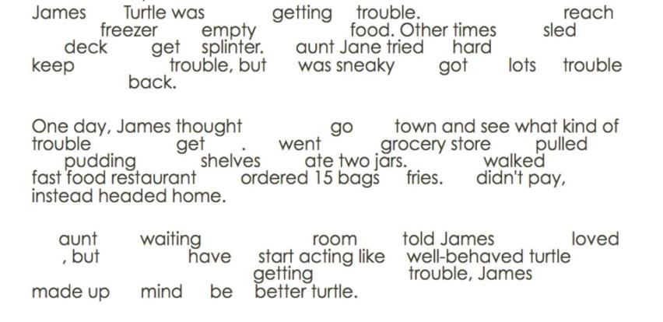
Data Processing (NLTK)
Stemming: cooking to cook, running to run, etc.

Slide 19
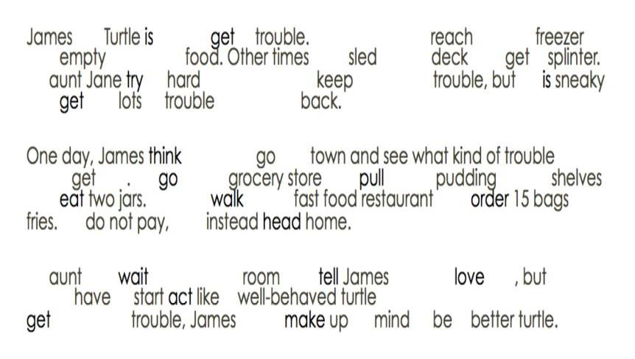
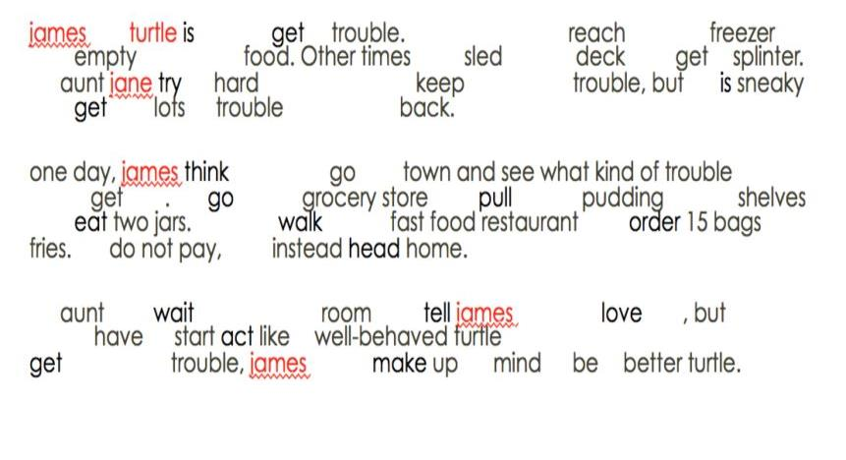
Data Processing (NLTK)
Change the passage into all lower case

Slide 20
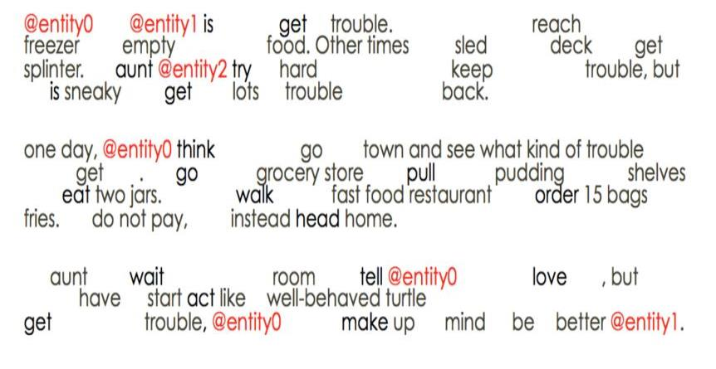
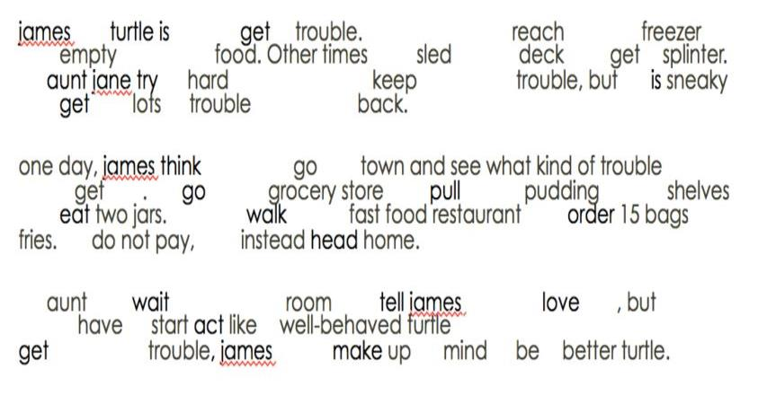
Data Processing (NLTK)
Replace entities

Slide 21
Data Processing (NLTK)
Replace words that are in an answer but not in the story with a synonym that is in the story
e.g.
Story: @entity7 was talking on the telephone.
Question: What was @entity7 doing?
Making a phone call
Having dinner
Swimming
Reading

Slide 22
Preprocessing Versions
Heavy preprocessing can improve performance, but also causes information loss
Google DeepMind performed very little preprocessing to demonstrate their method’s versatility
We use multiple versions to compare performance:
Version 1:
Only entity and synonym replacement
Version 2:
With stemming and stop word removal as well

Slide 23
Additional Preprocessing
Create a list of the total vocabulary of all stories
For each story:
Extract questions and context, replace each word with its vocabulary word number
Pad questions and context with null words (0) to ensure uniform length
Create masks to show which words are non-null

Slide 24
Deep LSTM Methodology
Based off the incomplete third-party implementation of the Google DeepMind Attentive Reader by Github user thomasmesnard
Initialize Attentive Reader model:
Create Blocks functions for each layer interconnection, question and context encoding, attention mechanisms, cost and prediction calculation
Parameters used from original paper (Hermann et. al, 2015)
Initialize training and validation Fuel datastreams
Create main Blocks training loop:
Perform model updates using training datastream for many epochs
Test performance on validation dataset after every epoch
Save model updates to a file after each epoch
Perform testing:
Load in saved trained model, derive Theano computation graph
Create testing datastream using Fuel
Evaluate test performance for each test file

Slide 25
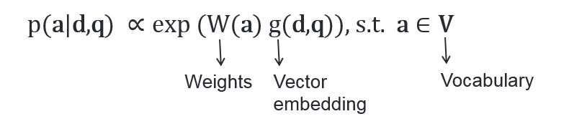
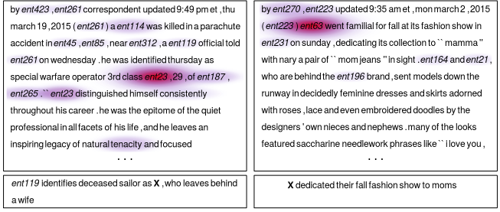
Model Output: DeepMind
For a given document (d) and query (q) pair, estimate the probability of word a being the correct answer:
$$\text{p}\text{(}\text{a}\text{|}\text{d}\text{,}\text{q}\text{)} ∝\text{exp}\text{ (}\text{W}\text{(}\text{a}\text{)} \text{g}\text{(}\text{d}\text{,}\text{q}\text{))}\text{, }\text{s}\text{.}\text{t}\text{. }\text{a}∈\text{V}$$
Vector
embedding
Vocabulary
Weights

Slide 26
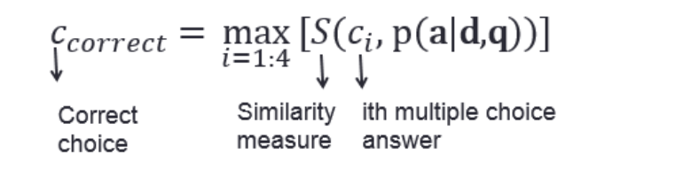
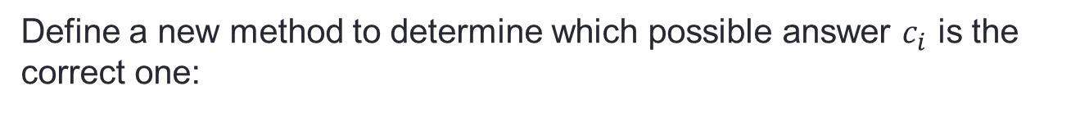
Modified Model Output
Define a new method to determine which possible answer $c_{i}$ is the correct one:
ith multiple choice answer
Correct choice
Similarity
measure
That is, the correct answer should be the most similar to the most highly attended words in the story.

Slide 27
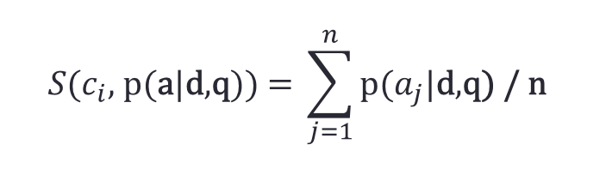
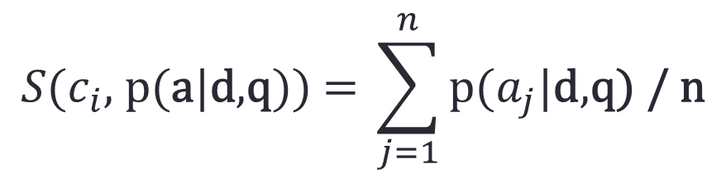
Modified Model Output
Similarity metric (for a multiple choice answer of length n words):
$$S\text{(}c_{i}\text{, }\text{p}\text{(}\text{a}\text{|}\text{d}\text{,}\text{q}\text{))} \text{= }\sum_{j=1}^{n}{\text{p}\text{(}a_{j}\text{|}\text{d}\text{,}\text{q}\text{) / }\text{n}}$$
Take the weighted average of the attention each word from the multiple choice answer has within the story
If a word in the answer is not in the story:
use word distance from the closest attended word as a penalty

Slide 28
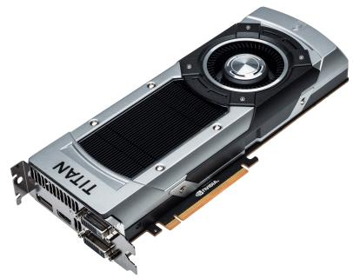
Computational Complexity
Computational Setup:
Original Attentive Reader: trained for 2-4 days using two NVIDIA Titan Black GPUs (PassMark score 8,667 each)
Our setup: one NVIDIA GTX 660 GPU (PassMark score 4,120) inside older machine: Core 2 Quad Q8300, 8GB DDR2 PC6400 RAM
Dataset Comparison:
DeepMind: 1 million stories/questions
MCTest: 600 stories, 2400 questions
Training Time Estimate:
<1 Day

Slide 29
Comparison of Results
We will test:
Both preprocessing models
Variations on correct answer model
Our method is the first that we know of to use an attention-based LSTM model on this dataset and question type
Method | MCTest Accuracy (%)
Baseline (sliding window + word distance) | 57.75
Learning Answer-Entailing Structures for Machine Comprehension (Sachan et. al, 2015) | 67.83
Machine Comprehension with Discourse Relations (Narasimhan et. al, 2015) | 63.75
Machine Comprehension with Syntax, Frames and Symantics (Wang et. al, 2015) | 69.94
Our Method | ???

Slide 30

Thank you! Questions?

