Slide 1
TensorFlow vs PyTorch

Slide 2
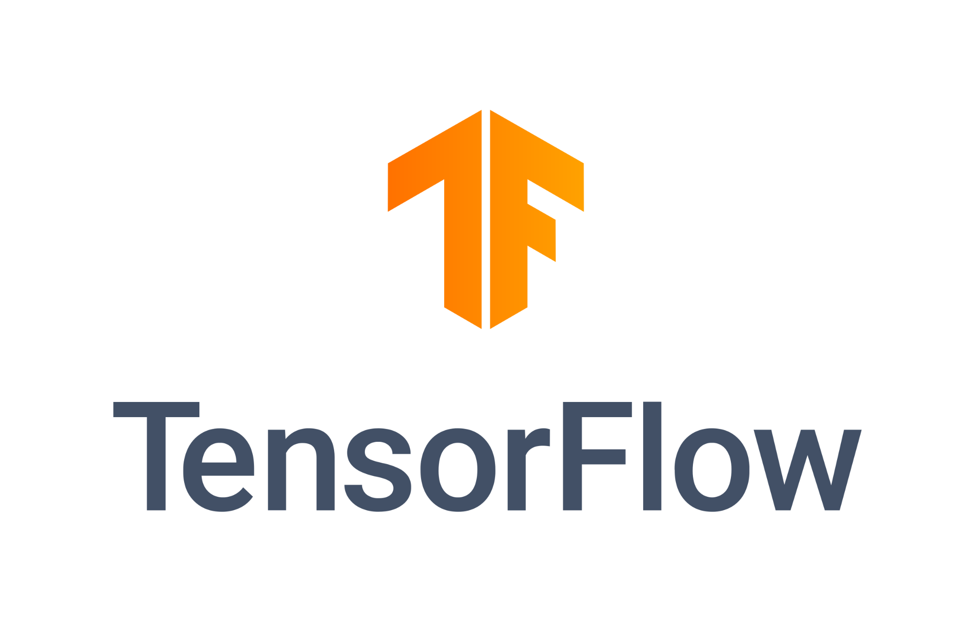

Background
Deep learning frameworks simplify model training and deployment
TensorFlow (Google, 2015): built for production & scalability
PyTorch (Meta/FAIR, 2016): built for flexibility & research
Both dominate today’s deep learning landscape
Notes:
A deep learning framework is a set of tools and libraries that make it easier to build, train, and test neural networks. Instead of coding everything from scratch, frameworks like TensorFlow and PyTorch handle the heavy math and let us focus on designing and improving models.
TensorFlow and PyTorch each have different strengths.
TensorFlow was designed to handle big machine learning projects and make it easier to put models into real-world products.
PyTorch is Python-based and has become very popular with researchers and students because it’s easy to use and experiment with.

Slide 3
Key Features
Wide ecosystem (Lite, Serving, Hub)
Runs on CPU, GPU, and TPU
Optimized for enterprise production
Large community with Google support
Python, beginner-friendly
Dynamic computation graphs
Hugely popular in academia/research
Deployment with TorchScript & ONNX
Notes:
TensorFlow has more than just the main library. It comes with extra tools — Lite for mobile, Serving for deployment, and Hub for pre-trained models.
TensorFlow Lite → lets you run models on mobile phones or small devices (like Android apps or IoT).
TensorFlow Serving → a tool for putting models into production, so apps/websites can use them in real time.
TensorFlow Hub → an online library of pre-trained models you can download and reuse instead of starting from scratch.
PyTorch is great for flexibility. It uses dynamic graphs, which makes it easier to debug and experiment with new models.
PyTorch also has tools for deployment. TorchScript makes models run outside of Python, and ONNX lets you export models to other platforms.

Slide 4
Key Features (Continue)
TensorBoard visualization tool
  - Visualizes training metrics and model structure for easier monitoring.
Keras high-level API
  - Simplifies model building, reducing code complexity and development time.
Cross-platform (mobile, web)
  - Allows deployment on mobile devices and web browsers.
Distributed multi-GPU/TPU
  - Supports large-scale model training across multiple GPUs or TPUs.
Strong debugging support
  - Integrates with Python tools to debug and test models efficiently.
TorchVision, TorchAudio, TorchText
  - Provides ready-made libraries for vision, audio, and NLP tasks.
Fast research prototyping
  - Enables quick experimentation with new model designs.
Widely used in papers
  - Dominates research publications, keeping models relevant in academia.
Notes:
TensorFlow has more than just the main library. It comes with extra tools — Lite for mobile, Serving for deployment, and Hub for pre-trained models.
TensorFlow Lite → lets you run models on mobile phones or small devices (like Android apps or IoT).
TensorFlow Serving → a tool for putting models into production, so apps/websites can use them in real time.
TensorFlow Hub → an online library of pre-trained models you can download and reuse instead of starting from scratch.
PyTorch is great for flexibility. It uses dynamic graphs, which makes it easier to debug and experiment with new models.
PyTorch also has tools for deployment. TorchScript makes models run outside of Python, and ONNX lets you export models to other platforms.

Slide 5






Real-world Applications
Google Translate
Airbnb recommendations
Twitter ML systems
Hugging Face Transformers
Tesla Autopilot
Meta AI research projects
Notes:
TensorFlow:
Google Translate → handles the neural networks that translate text between languages.
Airbnb → runs recommendation models to match guests with the best listings.
Twitter → helps filter feeds and detect spam with ML pipelines.
PyTorch:
Hugging Face → builds popular language models like GPT-style chatbots.
Tesla Autopilot → trains vision systems that recognize roads, cars, and pedestrians.
Meta AI → develops new research models in vision and language.

Slide 6
Side-by-Side Comparison
Category | TensorFlow | PyTorch
Ease of Use | Steeper learning curve | Pythonic, easier to learn
Performance | Optimized for large systems/TPUs | Great for prototyping, GPUs
Community | Large, Google-backed industry use | Strong academic/research base
Deployment | TF Serving, Lite, TensorFlow.js | TorchScript, ONNX expor
Notes:
TensorFlow takes a more structured approach, while PyTorch feels more interactive when you’re building models.
TensorFlow is better tuned for scaling up to really large systems, but PyTorch makes it faster to try out smaller ideas.
TensorFlow’s community is strongest in companies, while PyTorch’s is strongest in research labs.
For deployment, TensorFlow has cloud and mobile tools, while PyTorch focuses on portability across platforms.

Slide 7
Category | TensorFlow | PyTorch
Advantages | Strong production pipeline with TFX; excellent multi-platform deployment (cloud, mobile, web) | Dynamic graph design enables faster experimentation; highly intuitive for Python developers
Disadvantages | Higher entry barrier for beginners; slower iteration in research | Limited enterprise-level tools until recently; historically weaker TPU support
Ecosystem | Integrated ecosystem (TensorFlow Hub, TensorFlow.js, TensorFlow Lite); strong Google Cloud support | Rich open-source research ecosystem (Hugging Face, Detectron2, Fairseq); strong Linux Foundation backing
Trend | Still widely adopted in enterprises; strong in healthcare, finance, and production ML pipelines | Research community dominance; majority of NeurIPS/ICML papers now use PyTorch; industry adoption growing (e.g., Pinterest, OpenAI)
Notes:
TensorFlow takes a more structured approach, while PyTorch feels more interactive when you’re building models.
TensorFlow is better tuned for scaling up to really large systems, but PyTorch makes it faster to try out smaller ideas.
TensorFlow’s community is strongest in companies, while PyTorch’s is strongest in research labs.
For deployment, TensorFlow has cloud and mobile tools, while PyTorch focuses on portability across platforms.

Slide 8
Reference
Abadi, M., et al. (2016). TensorFlow: A system for large-scale machine learning. OSDI.
Paszke, A., et al. (2019). PyTorch: An imperative style, high-performance deep learning library. NeurIPS.
Wolf, T., et al. (2020). Transformers: State-of-the-art natural language processing. EMNLP 2020: System Demonstrations, 38–45. https://doi.org/10.18653/v1/2020.emnlp-demos.6
Meta AI. (2022, September 12). PyTorch joins the Linux Foundation. https://ai.meta.com/blog/pytorch-foundation/
Official docs: tensorflow.org & pytorch.org

