Slide 1
Bayesian Categorical Multiple Regression for Computer-aided Diagnosis
Spring22 STAT 431
Yuzuki Ishikawa

Slide 2
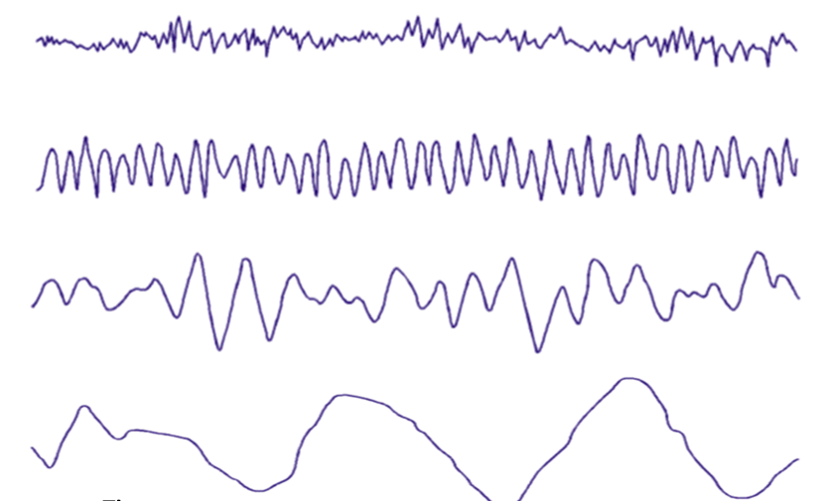


What is computer-aided diagnosis?
Classification of patients based on biological data
This project aims to classify individuals with subclinical depression using EEG (electroencephalography) data
Subclinical depression: not being diagnosed with depression but have high scores on clinical tests
EEG data: Frequencies of neural activity in the brain
EEG data
Machine Learning
Classification
A: minimal
B: minimal
C: mild
D: moderate
E: mild …
→
→

Slide 3

Model
g prior Multiple regression
$P\left(α,β,σ,g \right| y)=P\left(y \right|α,β,σ,g)$ $P\left(α,β,σ,g\right)$
Prior
$$α_{i} \sim N\left(0, {10}^{−4}\right)$$
$$β_{i} \sim N_{p}\left(0, gσ^{′2}{{(X}^{T}X)}^{−1}\right)$$
$$g \sim IG\left(\frac{1}{2},\frac{n}{2}\right)$$
$$σ^{2}\sim IG\left(\frac{1}{2},\frac{1}{2}\right)$$
Initialization (chains = 3)
$τ^{2}$ <- 0.1 ~ 1.0
$α_{i}$ <- -0.5 ~ 0.5
$β_{i}$ <- rnorm(length(data), sd = 0.1 ~ 0.5)

Slide 4
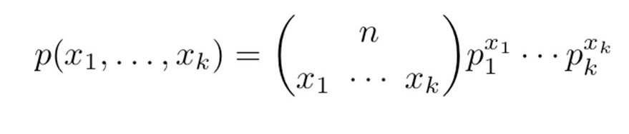
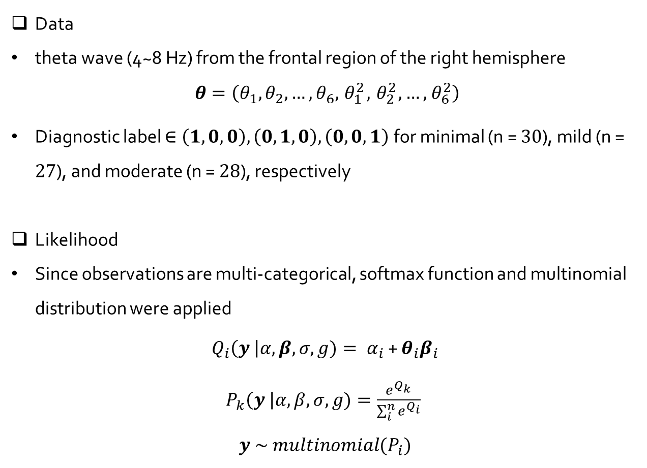
Model
Data
theta wave (4~8 Hz) from the frontal region of the right hemisphere
$θ=\left(θ_{1},θ_{2}, …, θ_{6},{ θ}_{1}^{2},{ θ}_{2}^{2}, …,{ θ}_{6}^{2}\right)$
Diagnostic label $∈\left(1,0,0\right), \left(0,1,0\right),\left(0,0,1\right)$for minimal (n = $30$), mild (n = $27$), and moderate (n = $28$), respectively
Likelihood
Since observations are multi-categorical, softmax function and multinomial distribution were applied
$Q_{i}\left(y \right|α,β,σ,g)= α_{i}$ + $θ_{i}β_{i}$
$P_{k}\left(y \right|α,β,σ,g)=\frac{e^{Q_{k}}}{\sum_{i}^{n}{e^{Q_{i}}}}$
$$y \sim multinomial(P_{i})$$

Slide 5
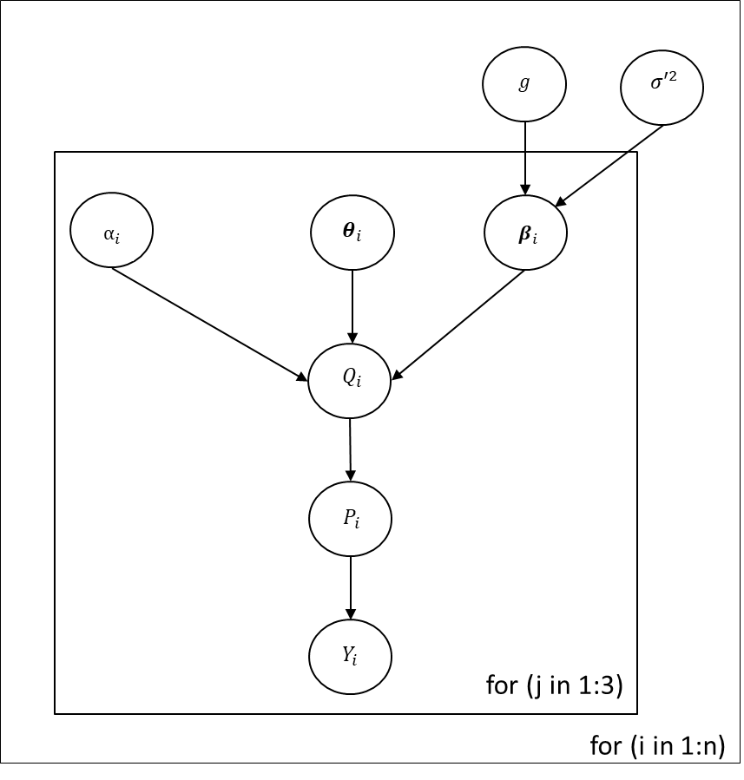

Slide 6
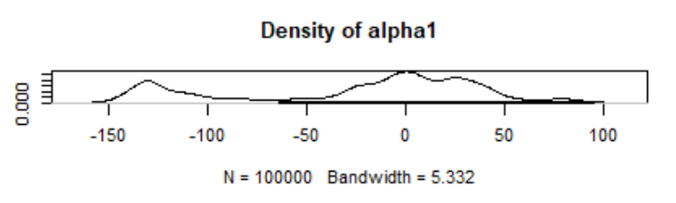
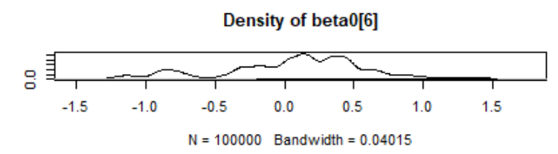
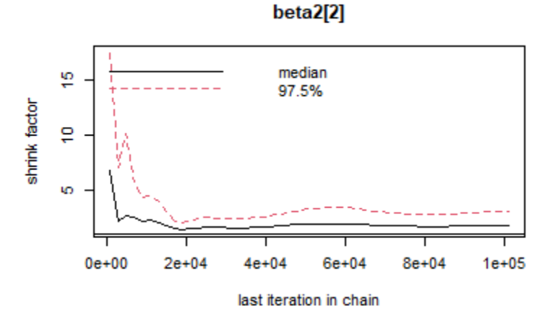

Model Output
Distributions for $α$ and $β$ ($3$ labels × $13$ coefficients)
Convergence Diagnosis
Some of the coefficients ($5$ / $39$) did not converge within $100000$ iterations
Run $100000$ iterations and the last $20000$ iterations were chosen for analyses based on Gelman-Rubin plots

Slide 7

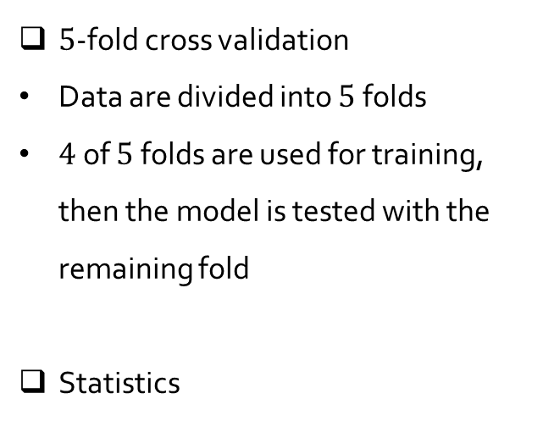
Result and Analysis
$5$-fold cross validation
Data are divided into $5$ folds
$4$ of $5$ folds are used for training, then the model is tested with the remaining fold
Statistics
Scikit-learn.org (2022)
 | Accuracy | F-measure
Minimal | 0.833 | 0.633
Mild | 0.227 | 0.312
Moderate | 0.473 | 0.515

Slide 8
References
1. H. Yoon and S. Chung, EEG-based Emotion Estimation Using Bayesian Weighted-log-posterior Function and Perceptron Convergence Algorithm, Computers in Biology and Medicine, Catholic University of Daegu, 2013
2. M. Cohen, Where does EEG come from and what does it mean? Trends in Neuroscience, Donders Center for Neuroscience, 2017
3. S. Rachamanee and P. Wongupparaj, Resting-state EEG datasets of adolescents with mild, minimal, and moderate depression, BMC Research Notes, Burapha University, 2021

