Slide 1
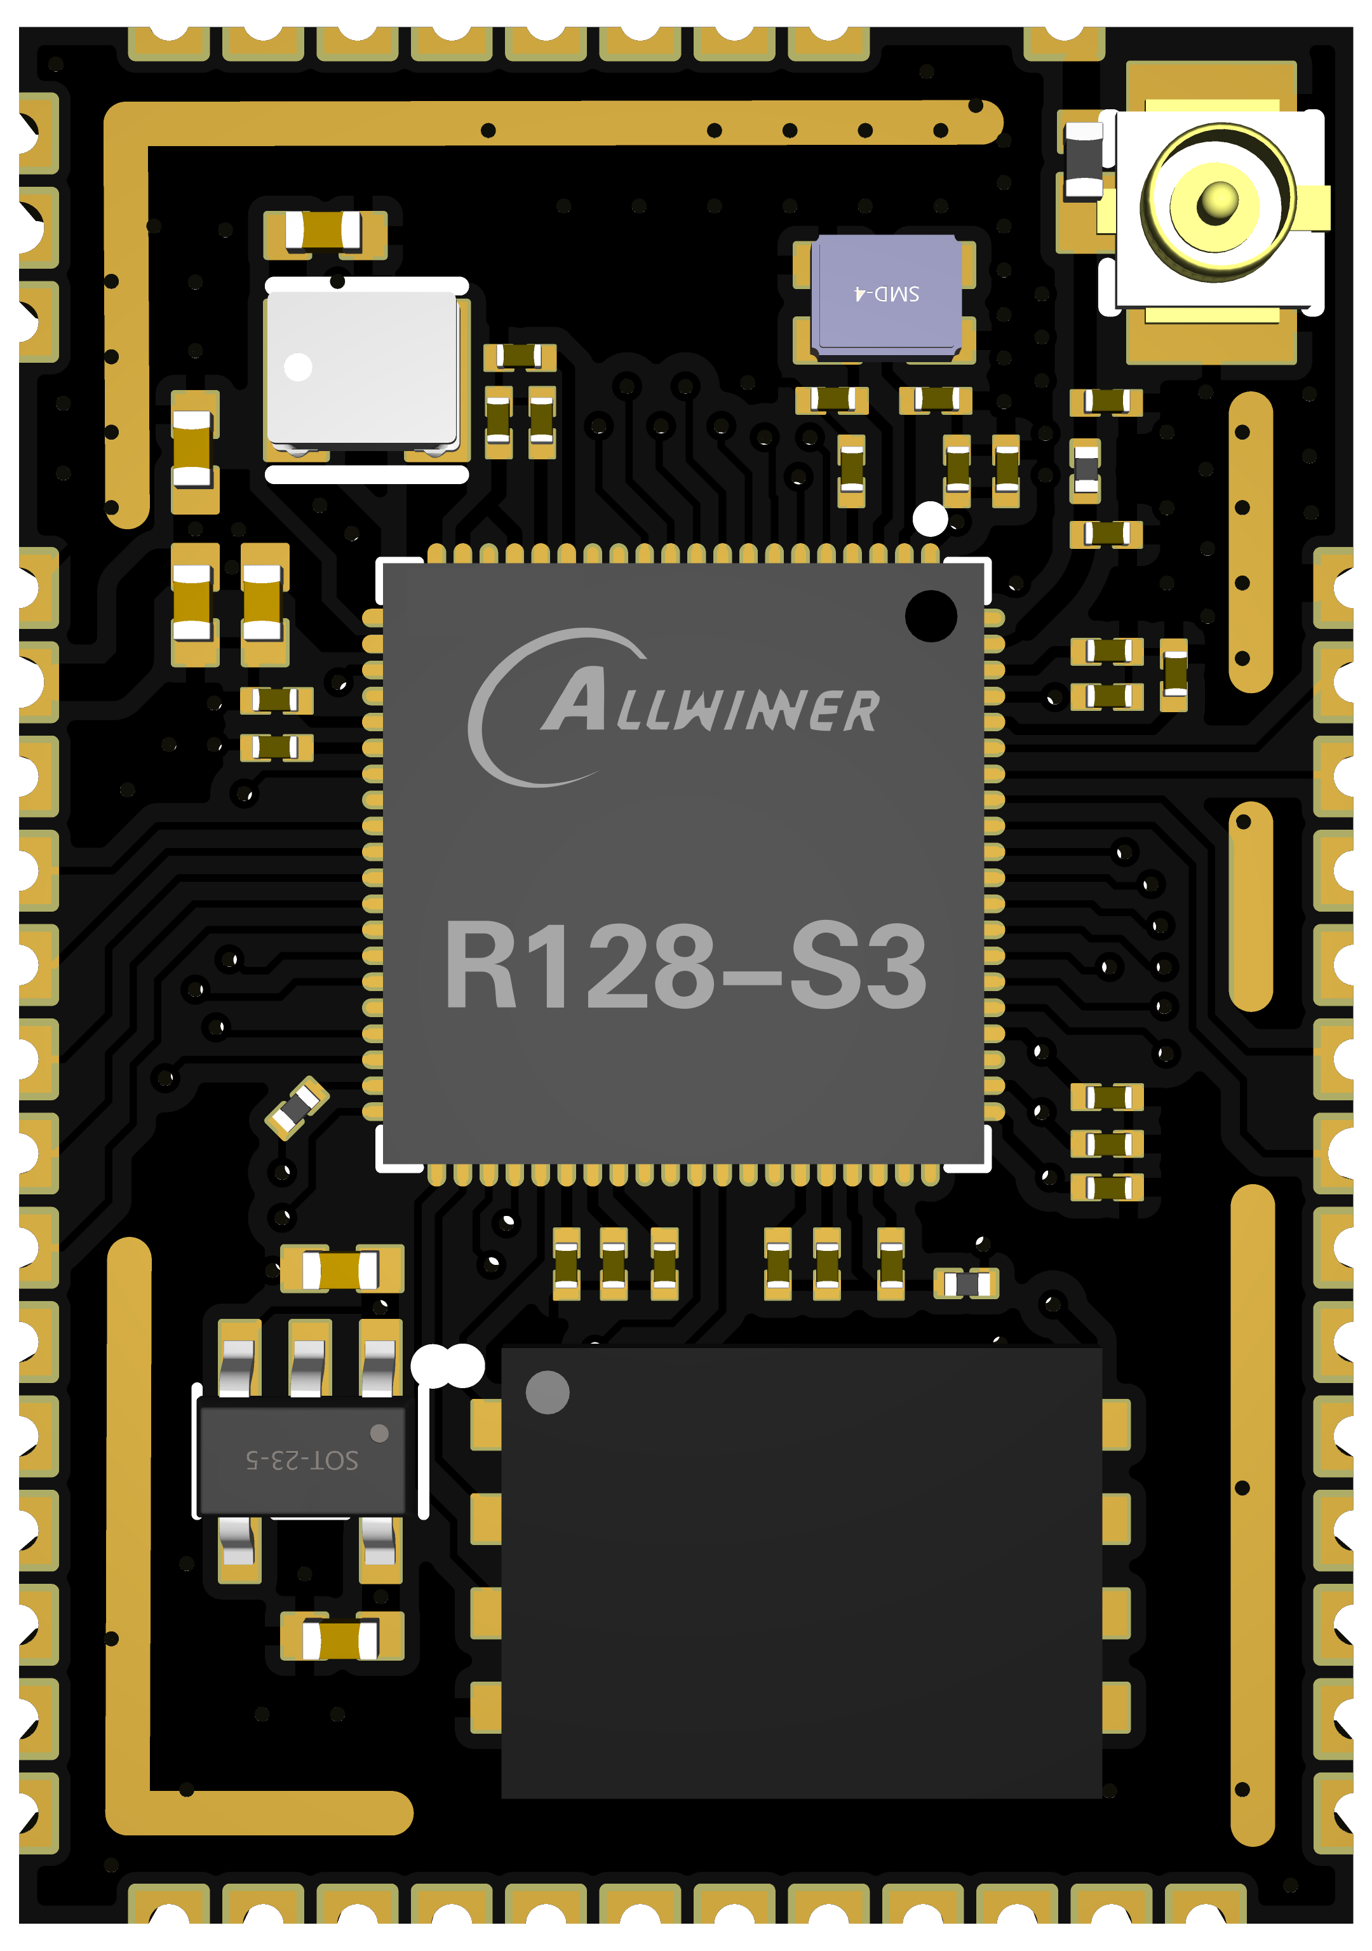
XuanTie 64Bit RISC-V [GCV] C906 CPU@600MHz, Support Vector 0.7
Arm Cortex-M33 Star MCU@240MHz
HiFi5 Audio DSP Xtensa LX7@400MHz
1MB SRAM
32MB SiP OSPI HS_PSRAM@800MHz
8MB SiP OSPI LS_PSRAM@AHB Clock with DMA
128MB QSPI NAND
RGB666, i8080, BT656, SPI Display up to 1024x768@60fps
G2D 2D graphics acceleration
DVP up to 1920*1088, JPEG encoding 1920*1088, 1024x768@40fps
3 Audio ADC, 24Bit, 8kHz-96kHz
1 Audio DAC, 24Bit, 8kHz-384kHZ
USB2.0 OTG
3 * UART, 2 * SPI, 2 * TWI, 8 * PWM, 1 * 12Bit 10 Channels ADC
IR TX/RX, LEDC up to 1024 * WS2812
ISO 7816 Card Reader
Wi-Fi Compatible with IEEE 802.11 b/g/n 2.4GHz
Bluetooth 5.0 Dual Mode complies with V2.1/4.0/4.2/5.0, Support BR/EDR
25.5*18mm, IPEX ANT, ESP32-S3 Compatible Pinout

Slide 2
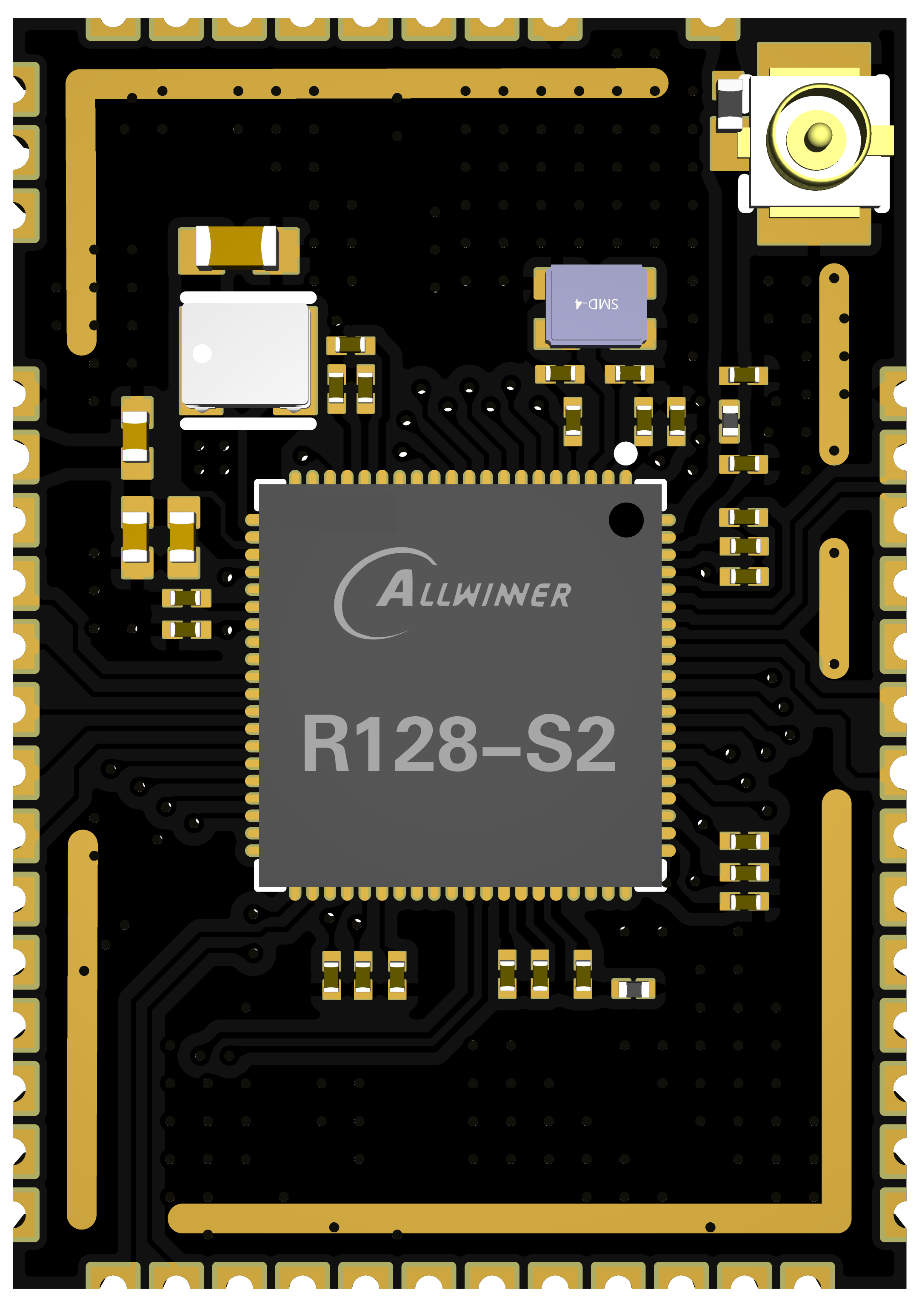
XuanTie 64Bit RISC-V [GCV] C906 CPU up to 600MHz, Support Vector 0.7
Arm Cortex-M33 Star MCU up to 240MHz
HiFi5 Audio DSP Xtensa LX7 up to 400MHz
1MB SRAM
8MB SiP OSPI HS_PSRAM@800MHz
8MB SiP OSPI LS_PSRAM@AHB Clock with DMA
16MB SiP QSPI NOR
RGB666, i8080, BT656, SPI Display up to 1024x768@60fps
G2D 2D graphics acceleration
DVP up to 1920*1088, JPEG encoding 1920*1088, 1024x768@40fps
3 Audio ADC, 24Bit, 8kHz-96kHz, Support 4 DMICs
2 Audio DAC, 24Bit, 8kHz-384kHZ
USB2.0 OTG
3 * UART, 2 * SPI, 2 * TWI, 8 * PWM, 1 * 12Bit 10 Channels ADC
IR TX/RX, LEDC up to 1024 * WS2812
ISO 7816 Card Reader
Wi-Fi Compatible with IEEE 802.11 b/g/n 2.4GHz
Bluetooth 5.0 Dual Mode complies with V2.1/4.0/4.2/5.0, Support BR/EDR
25.5*18mm, IPEX ANT, ESP32-S3 Compatible Pinout

