Slide 1





PROGRAMMING LANGUAGE
Teacher:JOVITA DEVERA

Slide 2
DETECT LOCATION OF THE USER RUNNING A WEB APPLICATION BY USING THE GEOLOCATION API

Slide 3
WHAT IS GEOLOCATION?
Definition: A method to determine the physical location of a user.
Uses: Maps, local services, weather apps.

Slide 4
WHAT IS THE GEOLOCATION API?
The Geolocation API is a browser API that provides a user's location and geographic information.
Purpose: Allows web apps to access user location.
How It Works: Utilizes GPS, Wi-Fi, or IP address.

Slide 5
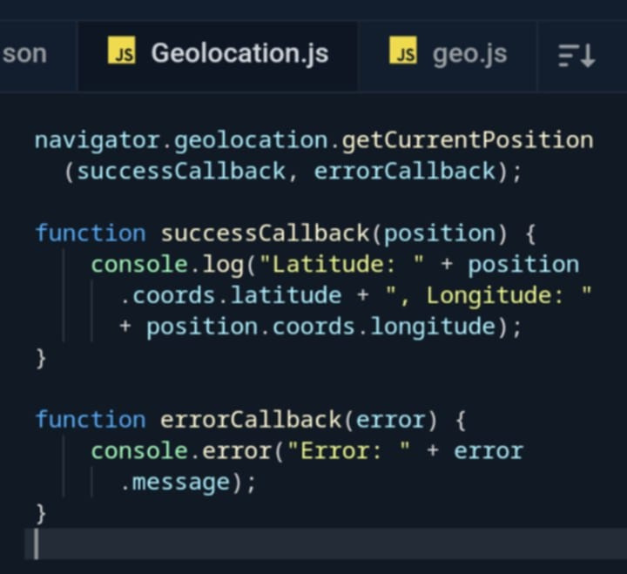
HOW TO USE THE GEOLOCATION API?
Notes:
SLIDE 5: HANDLING PERMISSIONS
ITS IMPORTANT TO NOTE THAT USERS MUST GIVES PERMISSIONS TOACCESS THEIR LOCATION. IF THEY DENIED ACCESS WE CAN HANDLE THAT WITH AN ERROR CALLBACK TO INFORM THEM.
SLIDE 6: PRACTICAL APPLICATION
THE GEOLOCATION API HAS MANY PRACTICAL APPLICATIONS SUCH AS FINDING NEARBY PLACES OR PROVIDING WEATHER UPDATE BASED ON THE USERS LOCATION
SLIDE 7: PRIVACY CONSIDERATION
PRIVACY IS CRUCIAL WHEN USING THE GEOLOCATION API ALWAYSS AASK FOR PERMISSION AND INFORM USERS WHY YOU NEED THEIR LOCATION REQUEST LOCATION ACCESS ONLY HWEN NECESSARY
SLIDE 8: CONCLUSION
IN CONCLUSION THE GEOLOCATION API ENHANCES WEB APPLICATIONS BY PROVIDING VALUABLE LOCATION DAT HOWEVER WE MUST HANDLE USER PRIVACY WITH CRE4R

Slide 6
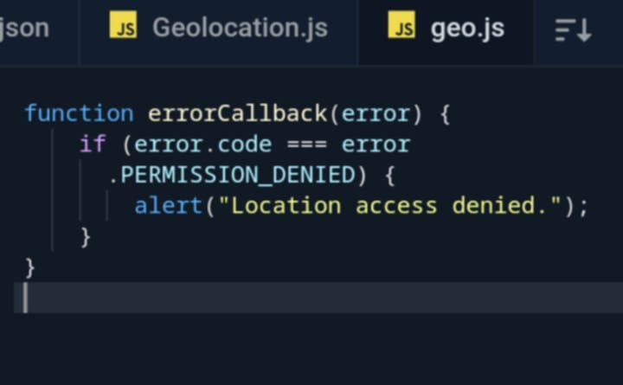
HANDLING PERMISSIONS
User Consent: Users must allow location access.
Example of Handling Denial:
Notes:
SLIDE 5: HANDLING PERMISSIONS
ITS IMPORTANT TO NOTE THAT USERS MUST GIVES PERMISSIONS TOACCESS THEIR LOCATION. IF THEY DENIED ACCESS WE CAN HANDLE THAT WITH AN ERROR CALLBACK TO INFORM THEM.

Slide 7
PRACTICAL APPLICATIONS
Examples:
Finding nearby places.
Weather updates based on location.
Notes:
SLIDE 6: PRACTICAL APPLICATION
THE GEOLOCATION API HAS MANY PRACTICAL APPLICATIONS SUCH AS FINDING NEARBY PLACES OR PROVIDING WEATHER UPDATE BASED ON THE USERS LOCATION

Slide 8
PRIVACY CONSIDERATIONS
Always Ask for Permission: Inform users why location is needed.
Use Location Responsibly: Request only when necessary.
Notes:
SLIDE 7: PRIVACY CONSIDERATION
PRIVACY IS CRUCIAL WHEN USING THE GEOLOCATION API ALWAYSS AASK FOR PERMISSION AND INFORM USERS WHY YOU NEED THEIR LOCATION REQUEST LOCATION ACCESS ONLY HWEN NECESSARY

Slide 9
CONCLUSION
The Geolocation API enhances web apps by providing location data, but it’s important to handle privacy carefully
Notes:
SLIDE 8: CONCLUSION
IN CONCLUSION THE GEOLOCATION API ENHANCES WEB APPLICATIONS BY PROVIDING VALUABLE LOCATION DAT HOWEVER WE MUST HANDLE USER PRIVACY WITH CARE

Slide 10
THANK YOU

