Slide 1
FRE 6883 Financial Computing
Team Project

Slide 2
Introduction
Content
Design and Implementation
Conclusion

Slide 3
01
Introduction

Slide 4
Work Assignment
Data Processing
Calculation
Visualization
Retrieve data from Yahoo Finance and Blomberg terminal
Implement Bootstrapping
Create menu of 5 options
Output graph

Slide 5
02
Design and
Implementation

Slide 6
Project Design
StockMap<string, struct>
StockMap<string, struct>

Slide 7
Data Processing
Download earnings data from Bloomberg terminal
Read it to C++
Retrieve historical data from yahoo finance
Data cleaning

Slide 8
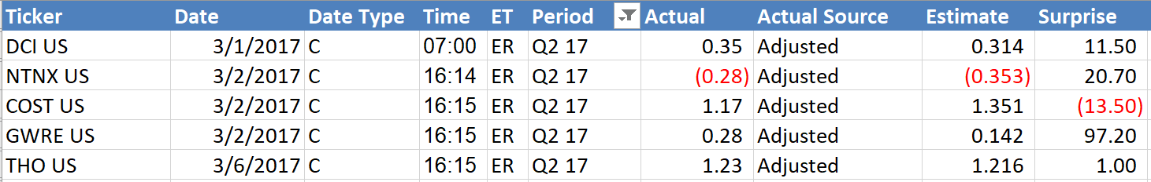
Process Bloomberg Query
Get rid of NULL values ( i.e., the stocks without actual EPS or Estimate EPS ) in Excel
Sort the stocks according to the Surprise ( given by Bloomberg terminal )
According to 1/3 and 2/3 percentile, we categorized the stocks ( 1% and 7% )
Calculated the StartTime and EndTime using workday function (holidays taken into account)

Slide 9
Download earnings data from Bloomberg terminal
Bloomberg
Data
StructData.csv
Read stock information in map in C++
class CSVReader

Slide 10
Read stock information in map
in C++
start date;
end date;
announcement date;
group;
actual EPS;
estimate EPS;
surprise;
Date vector;
Price vector;
Map Stock
Ticker | struct stock
… | …
… | …
… | …

Slide 11
Computing
Operator overloading
Calculate ARR and CAAR
Bootstrap

Slide 12
Retrieve Data from Yahoo Finance and Clean Data
Retrieve Data from Yahoo Finance —— GetStock()
Categorize and Clean Data —— categorize()
Note: outliers is stocks whose prices is zero or size is less than 241

Slide 13
Calculate AAR and CAAR
Calculate returns: matrix R(matrix &type)
Calculate abnormal returns: matrix AR(matrix RS, matrix RIWB)
Randomly select: matrix Randomselect(matrix AR)
Caculate AAR: vector<double> Calculation::AAR()
Caculate AAR: vector<double> Calculation::CAAR()

Slide 14
Bootstrap
Use a for loop and Randomselect function to do bootstrap
Each time randomly select 100 stocks from each group
Construct an object of class Calculation with this AR matrix
Call member function to calculate AAR and CAAR
Use moving average to calculate average AAR and CAAR
Notes:
In our project, after retrieving data from yahoo finance and populate them in to maps.
We designed to store stocks and corresponding iwb price data in matrix, and aligned them through stock trading day, because it’s effective for the calculation process.
// Since we want to know the general performance through bootstrapping, and don’t need to know the the specific information of stocks we select each time, so using matrix is suitable.
As for Bootstrap function, The parameter is the matrix of AR for each group.
We use a for loop to random select 100 AR vectors five times for each group.
Construct an object of calculation each time to calculate their AAR and CAAR.
And use moving average method to calculated the average AAR and CAAR for each group.
Then we save average AAR and CAAR in a matrix. The AAR is the first vector and CAAR is the second vector.
From this part we also get to know how to detect the source of error and fix it. We once had a problem that some times we got infinite values of CAAR, the we spent a whole day to modify the codes in calculation part. While finally we realized this is because we didn’t delete the 0 values in stock price and then go back to improve our code in data processing. The clean data is very important for the whole project, and know the whole process is very important. that is why all of our team members involved in every part and continuously meet together.

Slide 15
Visualization
Plot CAAR of three group and present the AAR and CAAR for 3 groups in a chart
Create a menu of 5 options

Slide 16
Plot and Chart
Change STL vector to Daniel Vector: Vector<double, long> DVector(vector<double> v)
Plot and Chart: TestPrintInExcel(aveCAAR_BEAT, aveCAAR_MEET, aveCAAR_MISS, aveAAR_BEAT, aveAAR_MEET, aveAAR_MISS);

Slide 17
Create Menu
1. Download data from Bloomberg and retrieve data from yahoo finance
2. Pull information for one stock from one group
3. Show AAR or CAAR for one group in CMD
4. Show the Excel graph with CAAR for all 3 groups and chart of AAR and CAAR
5. Exit our program

Slide 18
03
Conclusion

Slide 19
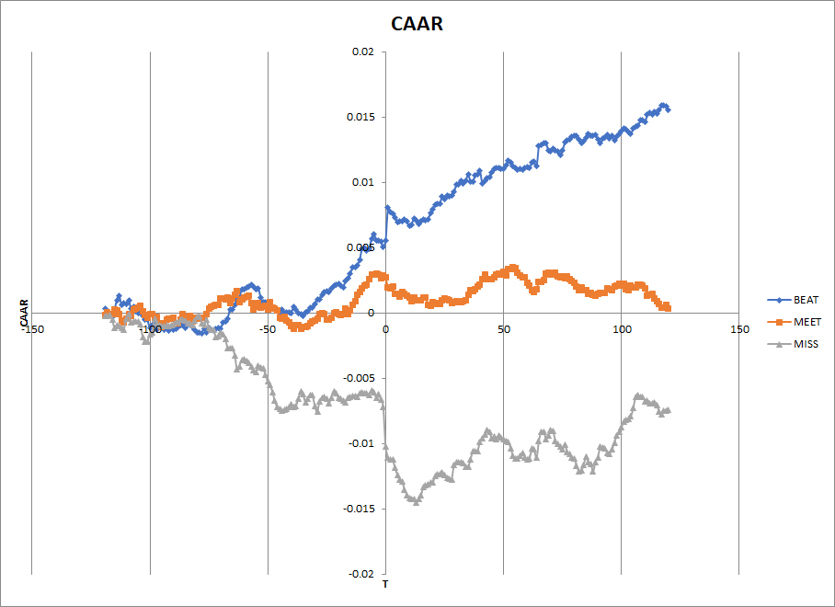
CAAR

Slide 20

Conclusion
The releasing of the earnings do has an impact on the stock price.
The difference of CAAR among the three groups has been widen greatly after the announcement.
The impact of Earnings Surprise on Beat is less than Miss.

Slide 21
Enhancement
Put the sCookies and sCrumb outside while loop ( cut the time for retrieving data )
Menu Design: Took care of the wrong input situation; user-friendly

Slide 22
Reference
Song Tang, FRE_GY 6883 Financial Computing Course Team Projects.
Bloomberg. Bloomberg Professional. (2017)[Online]. Available at: Subscription
Service (Accessed: 28 November 2017).
Prata, Stephen. C++ primer plus. Sams Publishing, 2002.

Slide 23
THANK
YOU

