Slide 1
Packet Scheduling Algorithm for Wireless Video Streaming
Yifang Cao (109330080)

Slide 2
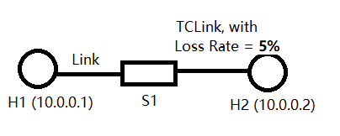
MiniNet Topology

Slide 3
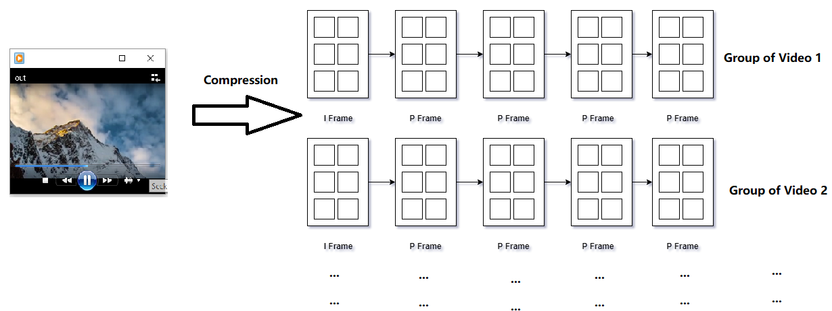
Video Compression
h.264

Slide 4
Earliest Deadline Scheduling Algorithm
1. Sent frames sequentially.
Frame 1 -> Frame 2 -> … -> … -> Frame N

Slide 5
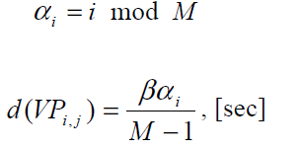

Frame Based Scheduling Algorithm
α: frame type
i: frame number
M: number of frames in a GOP
d(): deadline threshold
β: important coefficient
D(): the time difference in seconds between current time and the deadline of frame i.
Δ : denotes the latency between the time the sender emits a VP and the time the VP arrives at the receiver

Slide 6
Frame Based Scheduling Algorithm
Two pass algorithm
Pass One:
Pick the first unsent frame as candidate, subject to the constraint given by equation 3 in the previous slide.
Pass Two:
Pick

Slide 7
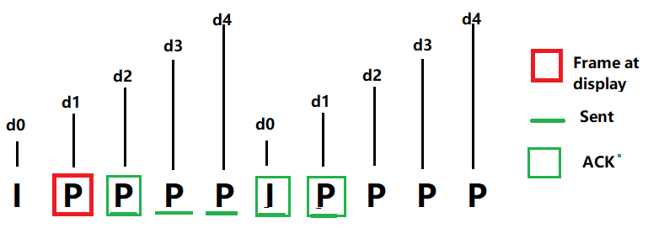
Frame Based Scheduling Example
Pass One: Pick unsent d2 as candidate
Pass Two: No other frame has smaller deadline threashold d, thus send d2

Slide 8
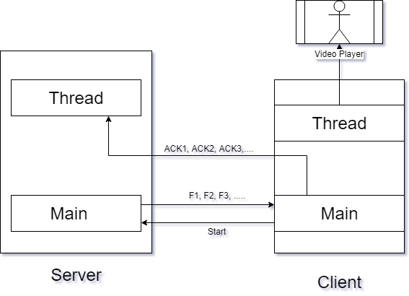
My Implementation

Slide 9
Video Demo
Video 1 – Streaming with no loss
Video 2 – Earliest Deadline Streaming with 5% loss rate.
Video 3 – Frame Based Scheduling Streaming with 5% loss rate.

Slide 10
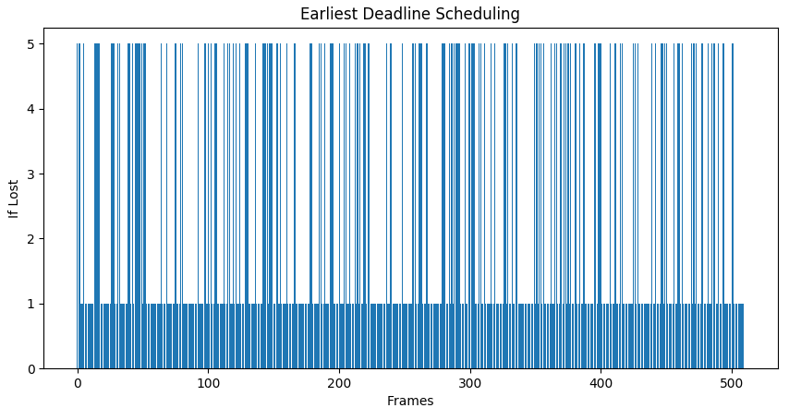
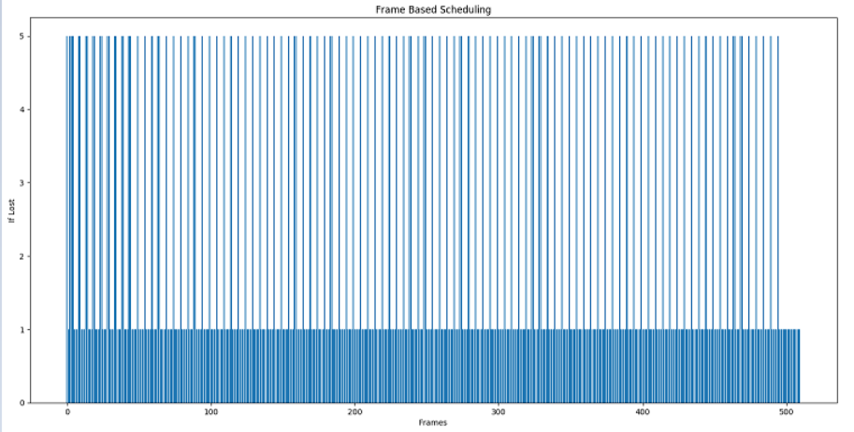
Frame Loss Distribution
Earliest Deadline Scheduling
Frame Based Scheduling

Slide 11
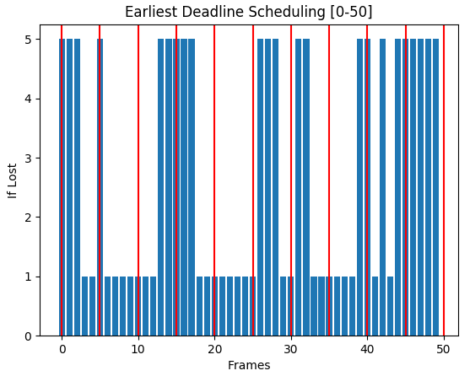
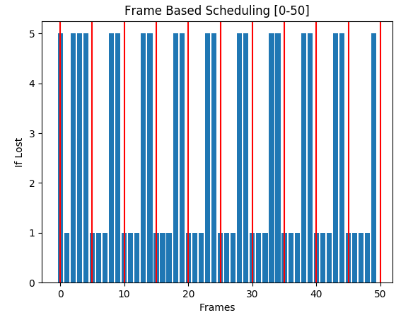
Loss Distribution (First 50 Frames)
Earliest Deadline Scheduling
Frame Based Scheduling

Slide 12
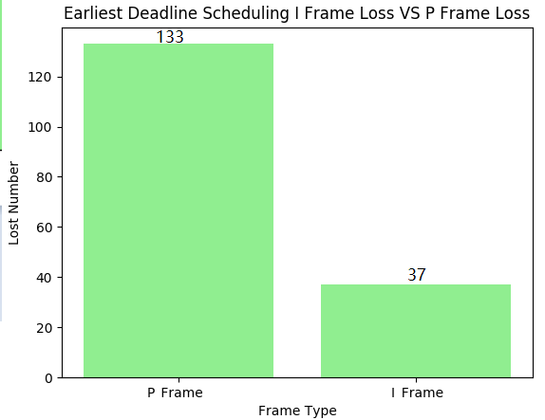
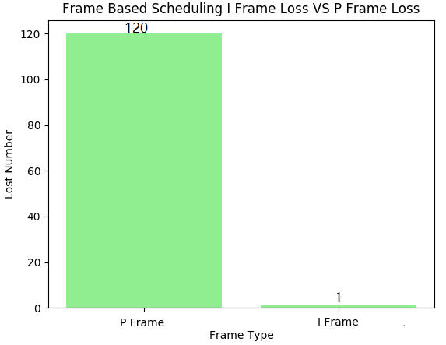
Frame Loss Comparison
EDS: 170 losses. 33.3% loss rate
EDS: 121 losses. 23.7% loss rate

Slide 13
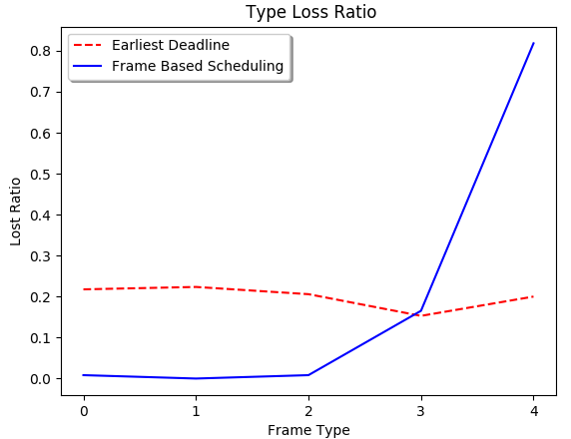
Frame Type Loss Ratio
EDS: Loss on each type is random .
FBS: More loss for Type 3 and Type 4

Slide 14
References
Kang, Sang H., and Avideh Zakhor. "Packet scheduling algorithm for wireless video streaming." International Packet Video Workshop. Vol. 2002. 2002.

