Slide 1
Final project : presentation - overview
Representation and description of the management of a database of an academic institution
Prepared by :
Yvan Nkondog
14/08/2026

Slide 2
Plan
1. Introduction
2. Motivation and Problem
3. Features and Functionality
4. Technical Details
5. Limitations and Proposed Solutions
6. Conclusion and Future Improvements
7. References

Slide 3
1. Introduction

Slide 4
1 – Introduction
  Database designed as end of course project of Harvard CS50 SQL course.
  Database designed to handle the management of academic institutions.
  The schema of the database is constituted of 6 tables.

Slide 5
2. Motivation and Problem

Slide 6
2.1 Motivation and Problem
    Managing data of small size poses no challenges.
    → However, when it comes to data of big size, using spreadsheets or
similar tools poses problems, regarding speed.
    Higher education academic institutions manipulate large quantities of data to handle their yearly activities.
    Many academic institutions have student enrollments of the order of 10 000.
    The database presented in this document has been designed to help academic institutions manage their yearly activities in an optimal manner, with respect to access of information and storage.

Slide 7
3. Features and Functionality

Slide 8
3.1 Features
Database includes six tables :
- Students
- Professors
- Courses
- Departements
- Enrollments
- Class schedules
The schema of the database is presented in section 4.

Slide 9
3.2 Functionality
The following general use cases are presented as basic functionality :
- Finding the list of students in a department.
- Finding the grades of students.
- Finding the list of professors in a department.
- Finding the list of students enrolled in a specific course.
- Finding the courses offered according to the situation of each student.
- Finding class schedules for a given semester and year.
- Etc.
  All the previous queries can be filtered by specifying some clauses.

Slide 10
3.2.1 Some lacking functions
  The current version of the database does not include the rank of professors and the level of students.
  The database does not distinguish former students from current students, and former professors from current professors.

Slide 11
4. Technical Details

Slide 12
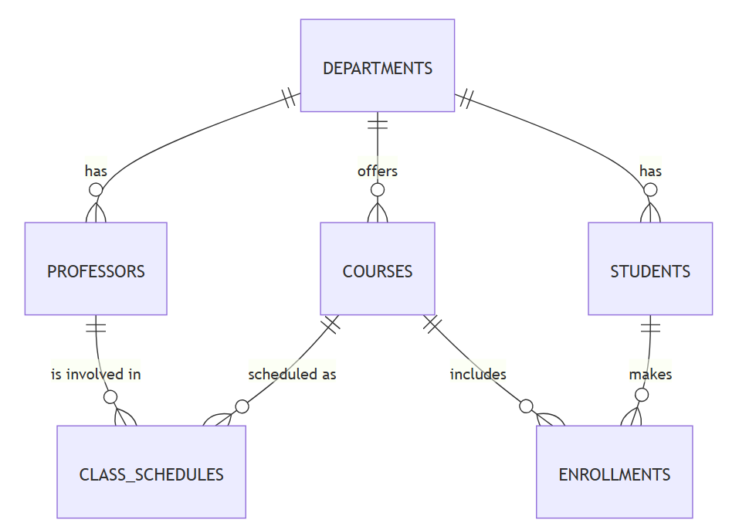
4.1 - Entity-relation diagram
1 Department → 0 or more Professor
1 Professor → 1 and only 1 Department
1 Department → 0 or more Course
1 Course → 1 and only 1 Department
1 Department → 0 or more Student
1 Student → 1 and only 1 Department
1 Professor → 0 or more Class schedule
1 Class schedule → 1 and only 1 Professor
1 Course → 0 or more Class schedule
1 Class schedule → 1 and only 1 Course
1 Course → 0 or more Enrollments
1 Enrollment → 1 and only 1 Course
1 Student → 0 or more Enrollment
1 Enrollment → 1 and only 1 Student
Fig1. Entity-relation diagram for an academic institution management
Source : Constructed using Mermaids.js live editor : https://mermaid.live/

Slide 13
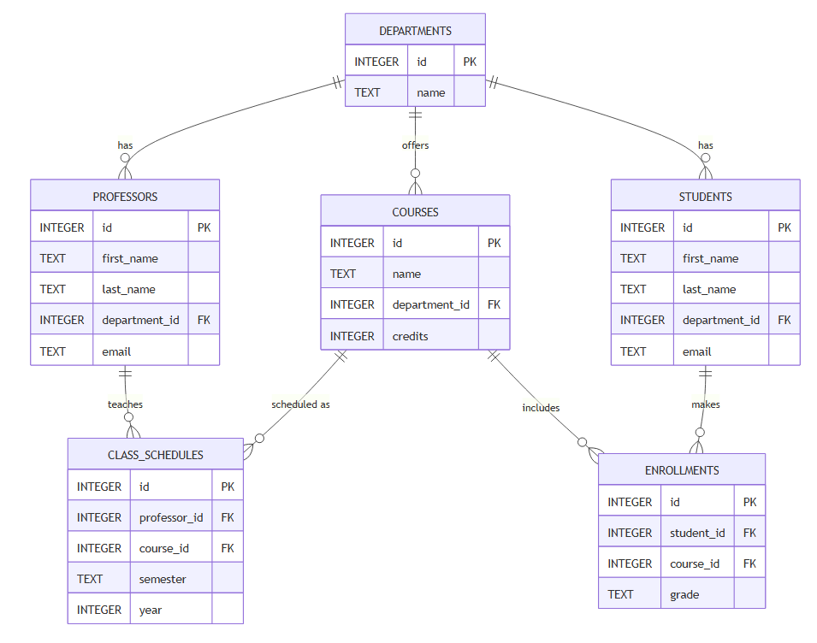
4.2 - Detailed entity-relation diagram
Represents the schema of each table
and the relation between each table
and the other tables.
Represented on each table :
=> Name of tables
=> Types of attributes
=> Names of attributes
=> Primary key and foreign key
Constraints.
Fig2. Detailed entity-relation diagram for an academic institution management
Source : Constructed using Mermaids.js live editore : https://mermaid.live/

Slide 14
4.3 Source of optimization
Source of optimization used : Indexing regularly used columns.
    INDEX "professor_name_search" ON "professors" ("first_name", "last_name") to handle common searches of professors by name.
    The INDEX "student_name_search" ON "students"("first_name", "last_name") added to handle common searches of students by name.
    The INDEX "course_credit_search" ON "courses"("credits") has been added to handle common searches which concern number of credits per course.
    The INDEX "class_schedule_year_semester_search" ON "class_schedules"("year", "semester") added to handle common searches which concern the professors that teach courses (semester).

Slide 15
5. Limitations and Proposed Solutions

Slide 16
5. Limitations And Proposed Solutions
Table enrollments currently linked to table class_schedules only through the attribute course_id (through the table courses).
  => Adding an attribute class_schedules_id to table enrollments should make it possible to track specific instances of table class_schedules (rather than just a course).
Many-to-many relations not taken into account, although they are possible.
  => Some universities permit students to enroll into different programs (at the same time), thus be part of many departments (at the same time).
  => Many-to-many relation between table students and table departments is possible.

Slide 17
6. Conclusion

Slide 18
6. Conclusion
  The current database handles all the use cases for which it has been designed.
  The database can however be extended and upgraded by adding new information into new tables. → For example, representing administrative staff.
  The database can also be upgraded by adding many-to-many relations where applicable, linking directly the tables enrollments and class_schedules, etc.

Slide 19
7. References
https://cs50.harvard.edu/sql/project/
https://mermaid.live/
https://cdn.cs50.net/sql/2024/x/project/sample-project.zip

