Slide 1



BIMDb

Slide 2

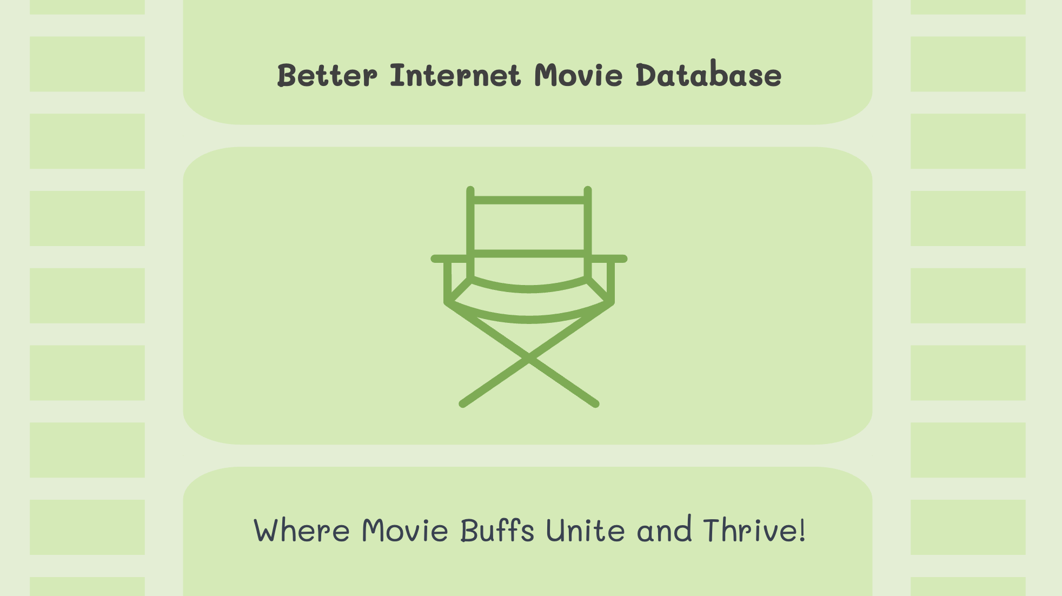

Better Internet Movie Database
Where Movie Buffs Unite and Thrive!

Slide 3
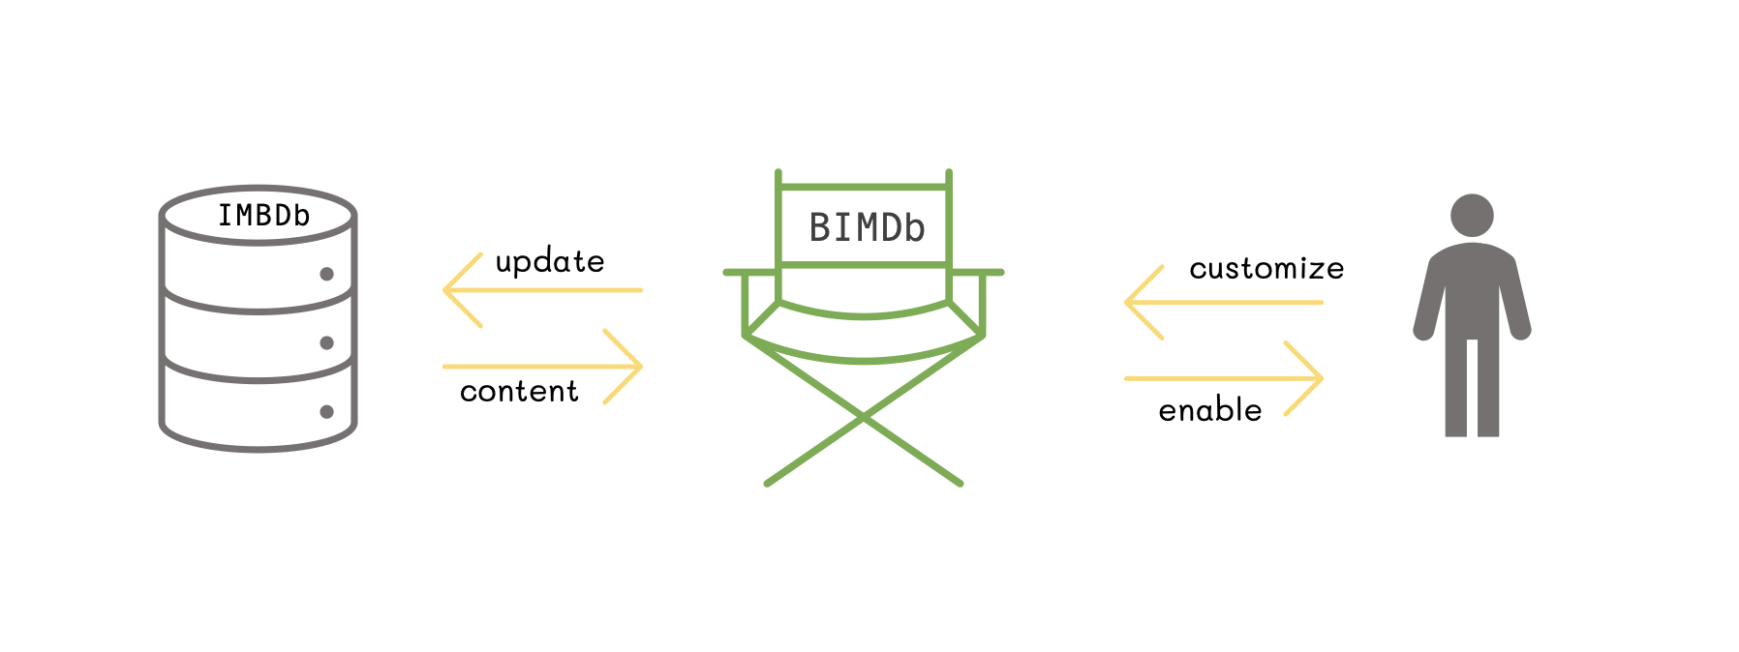



IMBDb
BIMDb
update
customize
content
enable

Slide 4

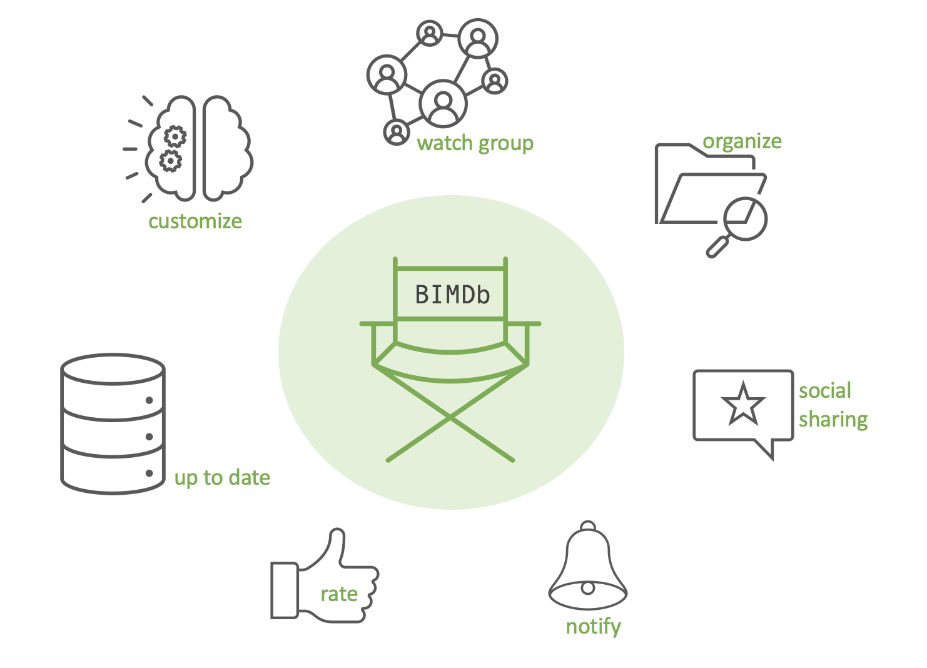






watch group
organize
customize
BIMDb
social sharing
up to date
rate
notify

