Slide 1



BIMDb

Slide 2

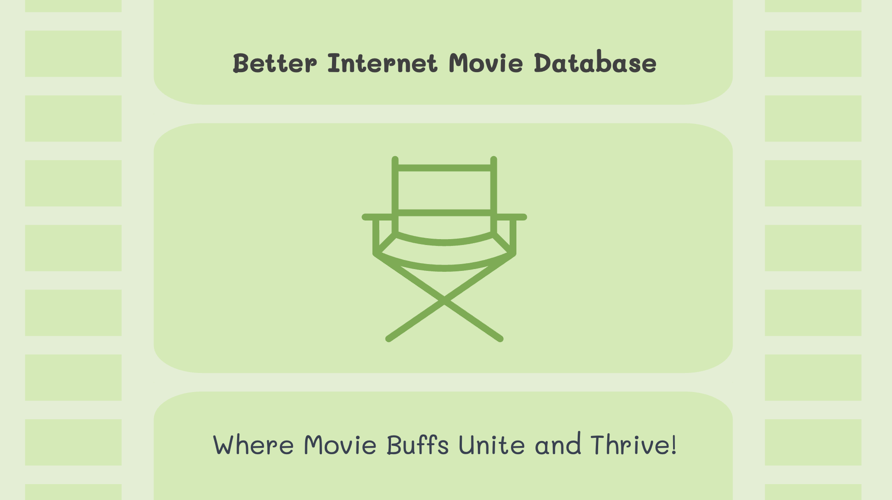

Better Internet Movie Database
Where Movie Buffs Unite and Thrive!

Slide 3
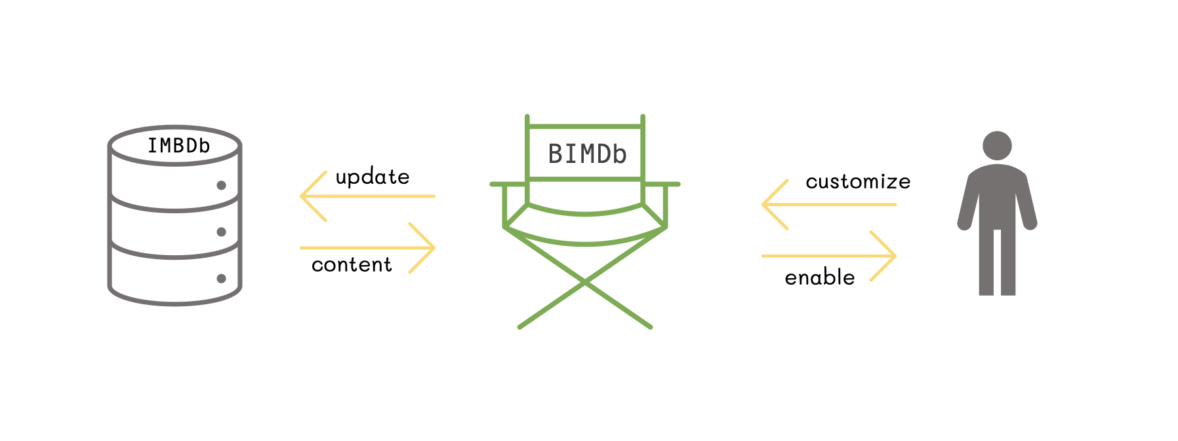



IMBDb
BIMDb
update
customize
content
enable

Slide 4
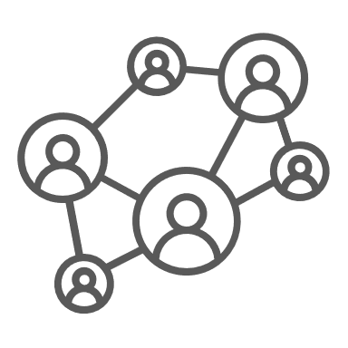
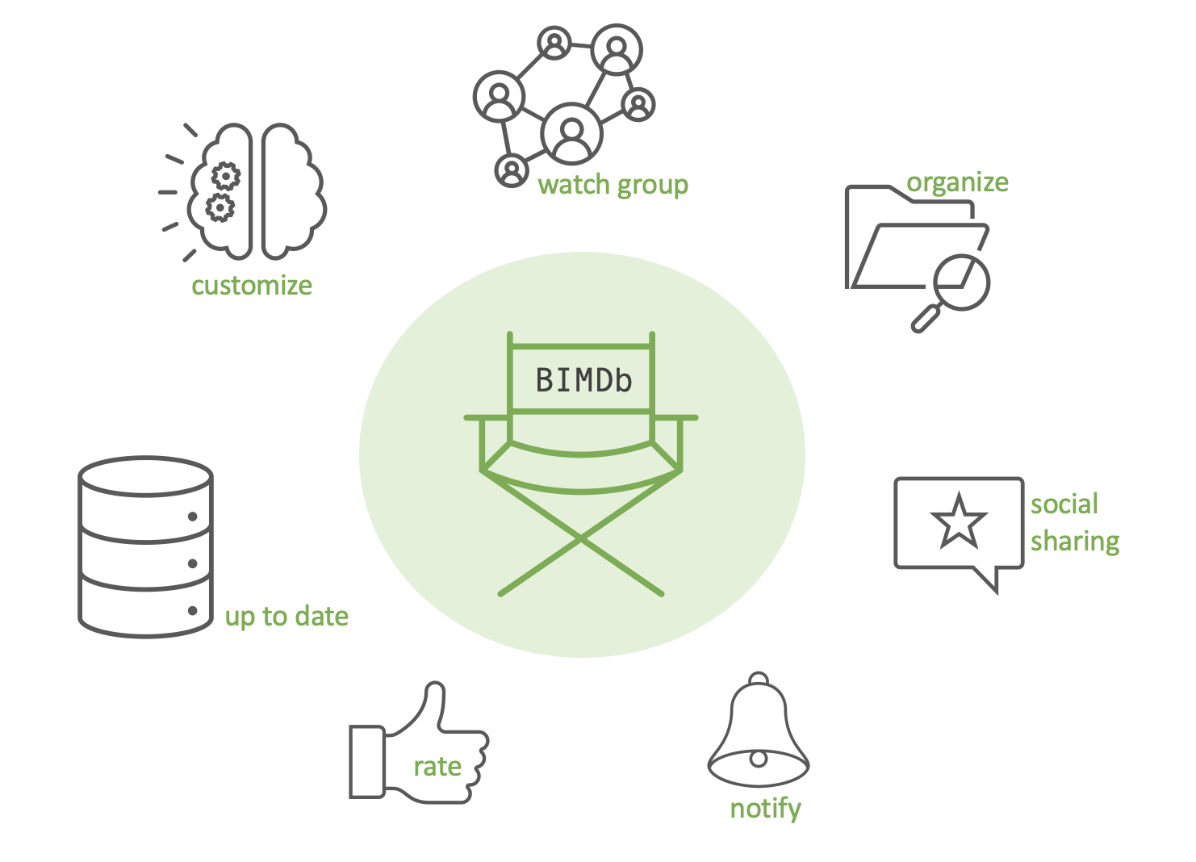






watch group
organize
customize
BIMDb
social sharing
up to date
rate
notify

Slide 5
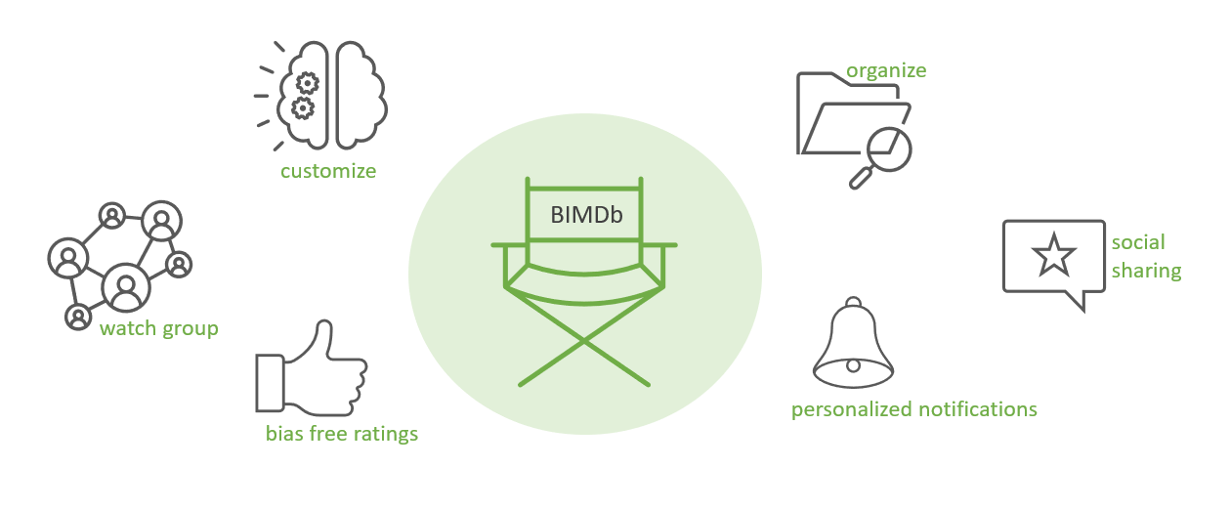
organize
customize
BIMDb
social sharing
watch group
personalized notifications
bias free ratings

Slide 6



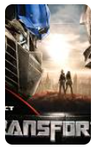

BIMDb
9/10
8/10
Your friends are talking about…
What’s new this week

Slide 7

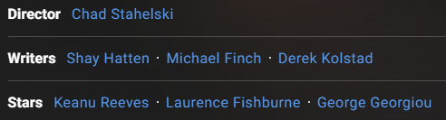
BIMDb
John Wick: Chapter 4
John Wick uncovers a path to defeating The High Table. But before he can earn his freedom, Wick must face off against a new enemy with powerful alliances across the globe and forces that turn old friends into foes.
Check bias

Slide 8

BIMDb
Social Media Browser
on
Peter
I liked the new movie blablablabl balbal blubl bliblbibulbilub bbibibbididid blub blabala
Anna
Especially the scene with ... Have to say, the check bias feature is amazingly accurate

