Slide 1
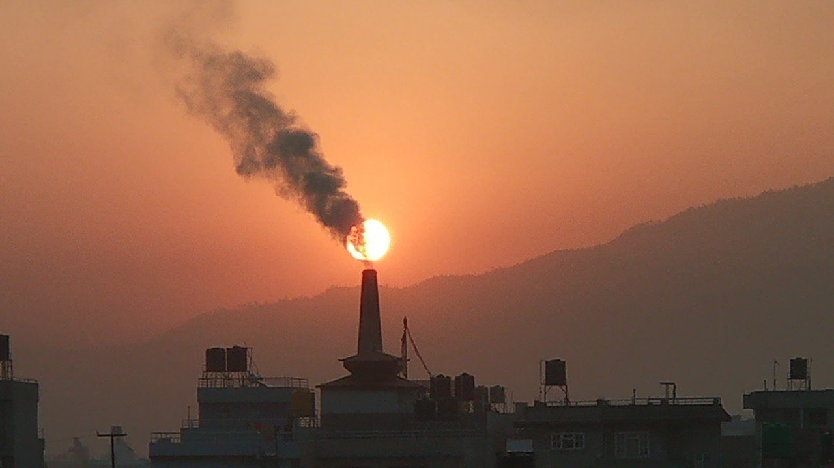
Particulate Pollution Monitoring
Air Pollution (source wikimedia)

Slide 2
Particulate Pollution – What is it?
PM is an environmental pollution that consists of particles suspended in some medium e.g.:
  Mud: Solid in water
  Dust: Solid in air
  Fog: Liquid in air
PM10: 10µm diameter (particles distinguishable by eye)
PM2.5: 2.5 µm (can be absorbed into bloodstream)
Aerosols: mixture of atmospheric particulate matter that are thoracic and respirable

Slide 3
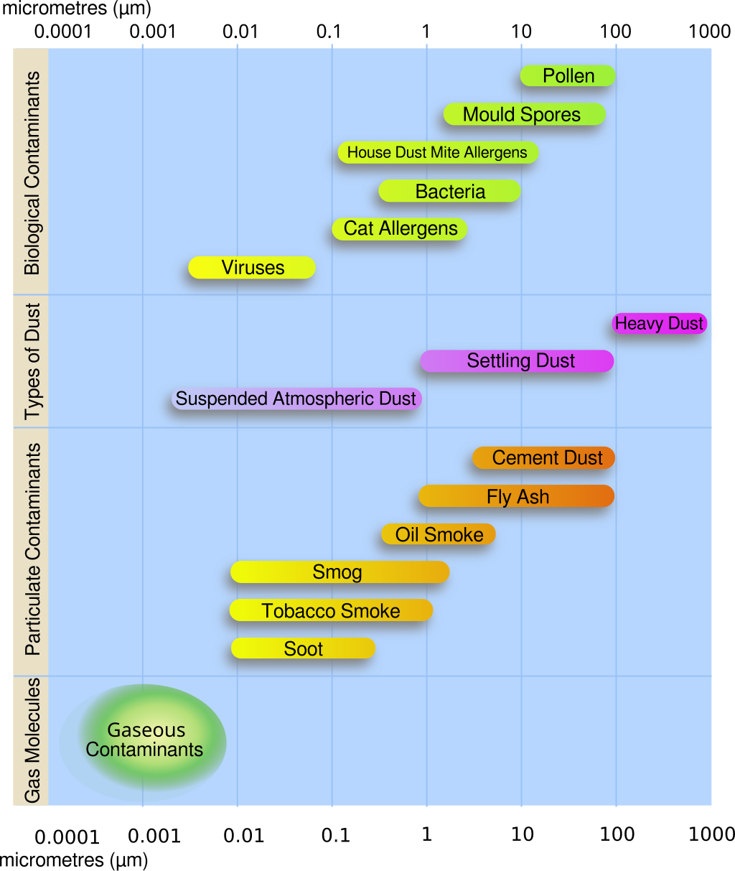
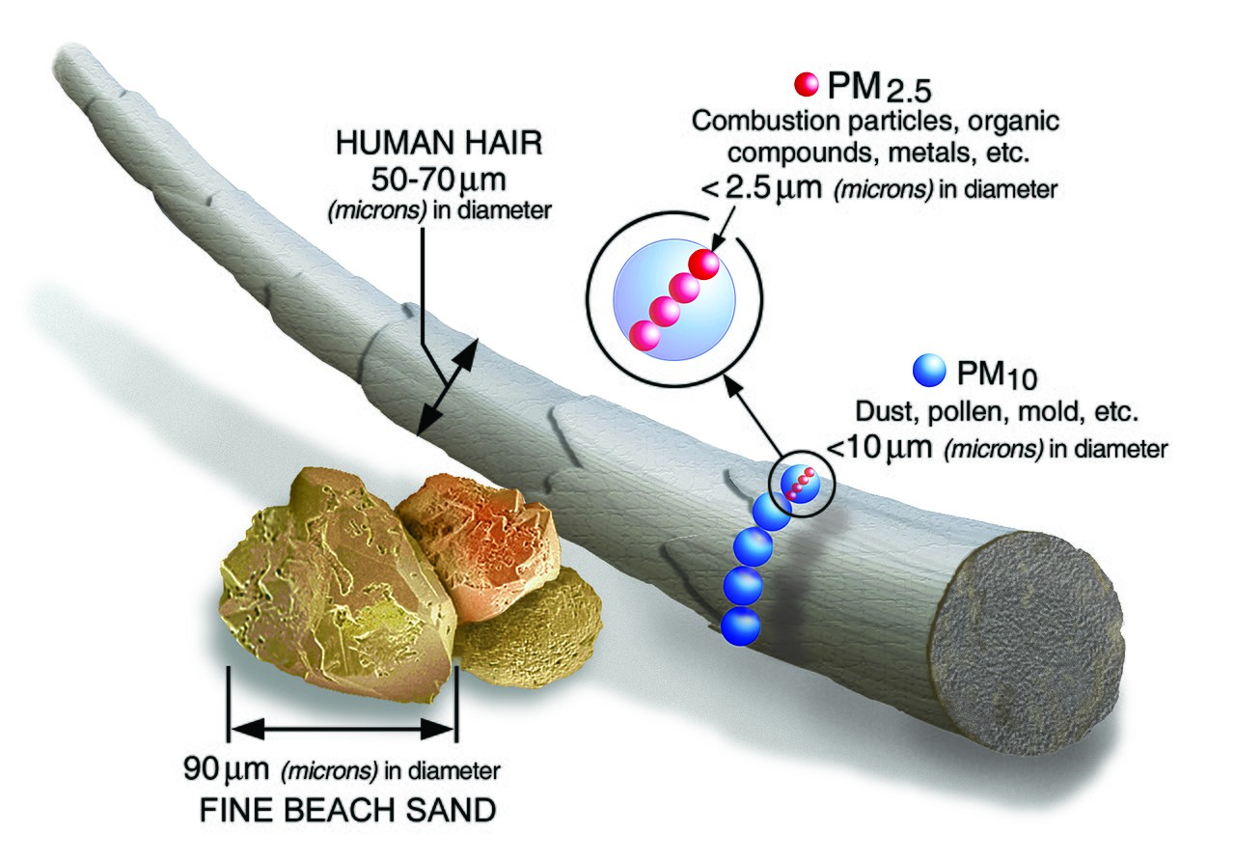
https://en.wikipedia.org/wiki/File:PM_and_a_human_hair.jpg
https://en.wikipedia.org/wiki/File:Airborne-particulate-size-chart.svg

Slide 4
Particulate Pollution – Why care?
There is no safe level of to PM exposure
Airborne particulate matter is a Group 1 carcinogen
PM2.5 is estimated to have contributed to 4.1 million deaths in 2016 worldwide

Slide 5
PM – Main sources
Combustion / Burning
Dusty (Construction) works
Industrial processes
Vulcano eruption

