Slide 1
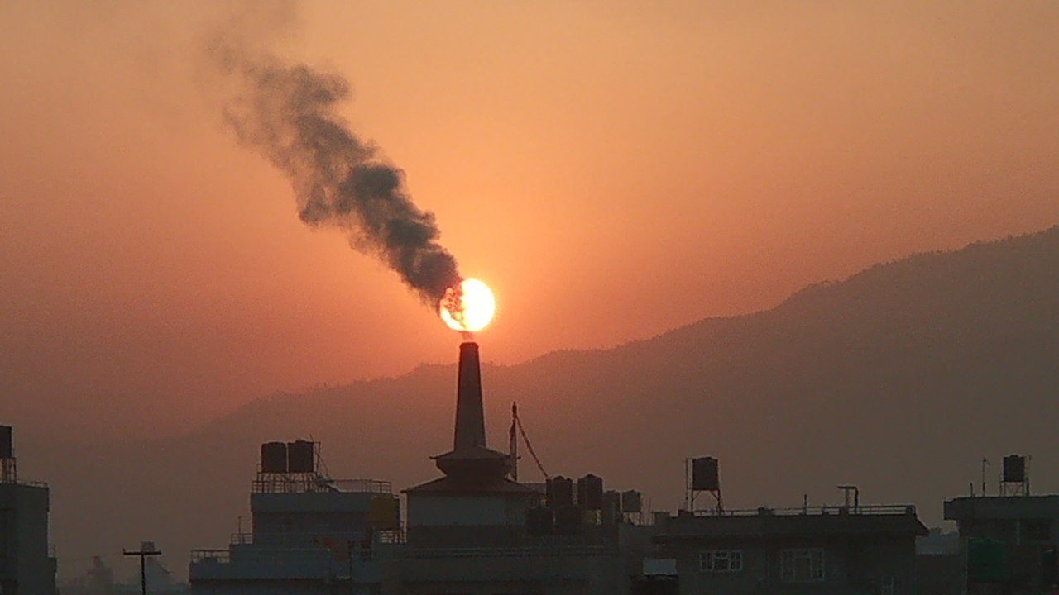
Particulate Pollution Monitoring
Air Pollution (source wikimedia)
Source: Air Pollution (source wikimedia)

Slide 2
Our mission
Easy accessible and understandable health risk management system for urban air pollution
Support decisions and actions to take for public and private health based on daily measurement
Provide insights into the most influential features contributing to PM2.5 levels

Slide 3
About AIRS and PPM
AIRS: Aerial Intelligence Remote Sensing
  Our team provides services based on satellite measurements for public and private use cases e.g.:
PPM: Particle Pollution Monitoring
  Application for public and personal health risk management related to air pollution and PM2.5 conenctration

Slide 4
Particulate Pollution – What is it?
PM is an environmental pollution that consists of particles suspended in some medium e.g.:
  Mud: Solid in water
  Dust: Solid in air
  Fog: Liquid in air
Distinguish between PM10 and PM2.5 particle size
Aerosols: mixture of atmospheric particulate matter that are thoracic and respirable

Slide 5
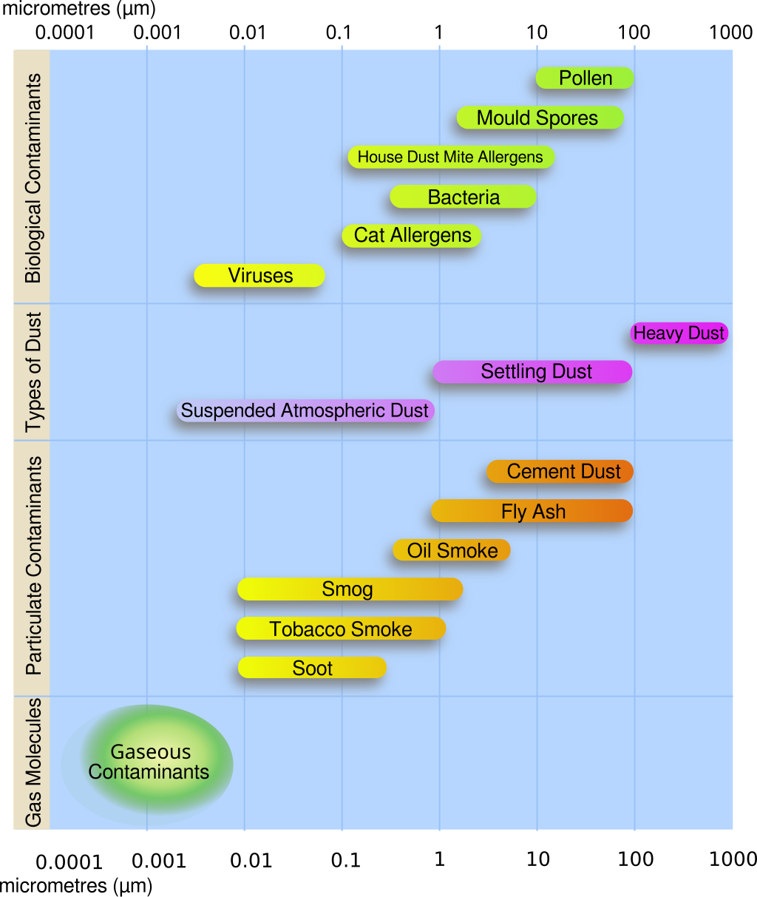
PM – Main sources
Combustion / Burning
Dusty (Construction) works
Industrial processes
Vulcano eruption
Source: https://en.wikipedia.org/wiki/File:Airborne-particulate-size-chart.svg

Slide 6
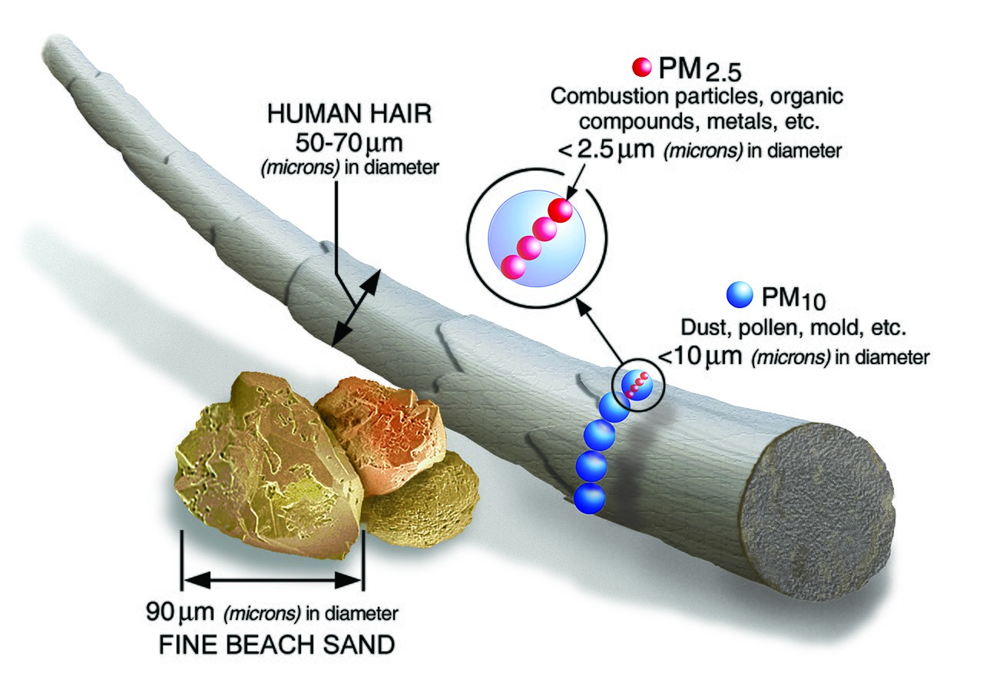
PM – Size matters
PM10: >= 10µm (particles still distinguishable by the naked eye)
PM2.5: >= 2.5 µm
(can be absorbed
into the bloodstream and
bypass blood-brain-barrier)
Source: https://en.wikipedia.org/wiki/File:PM_and_a_human_hair.jpg

Slide 7
Particulate Pollution – Why care?
There is no safe level of exposure to PM !
Airborne particulate matter is a
Group 1 carcinogen !
PM2.5 is estimated to have contributed to
4.1 million deaths in 2016 worldwide !

Slide 8
How it works – Main workflow
Processing of daily satellite measurements for
over 300 sites on more than 80 parameters
Evalute using a Random Forest Regression model with the depth of three as base model
Predict the daily concentration of PM2.5 with MSE and R²

Slide 9
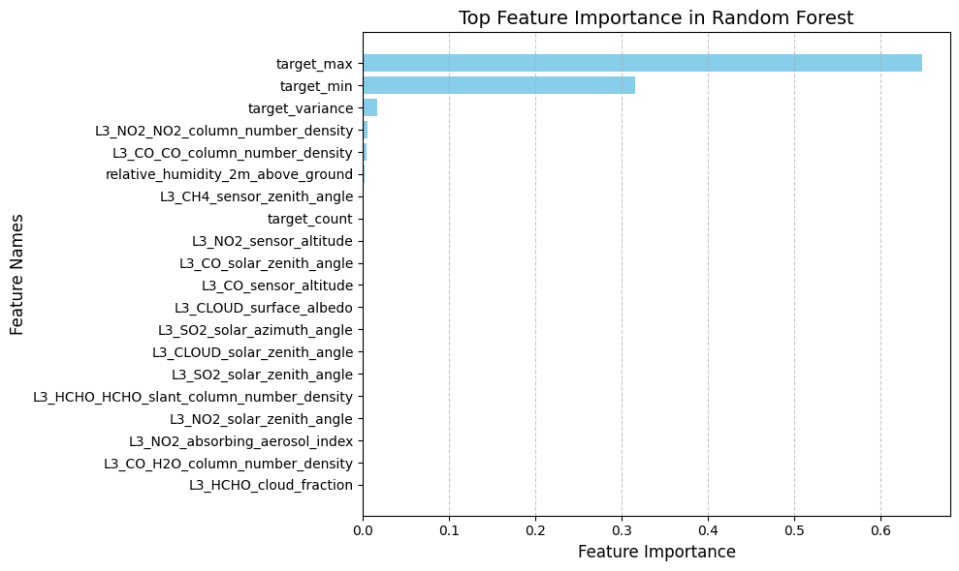
How it works – Main features ?
Correlation plot /
Heatmap did not
provide any
additional info for
correlation with
the target values

Slide 10
Exploratory Data Analysis

Slide 11
How it works – Error analysis
Random forests with depth of 3 to 7

Slide 12
Benefits
Robust model with explainable decisions
Light calculation load for user
Easy to interprete outcome

Slide 13
Future improvements and works
Add more data
Work with domain experts to
  reduce number of used features
  establish and test other models

Slide 14
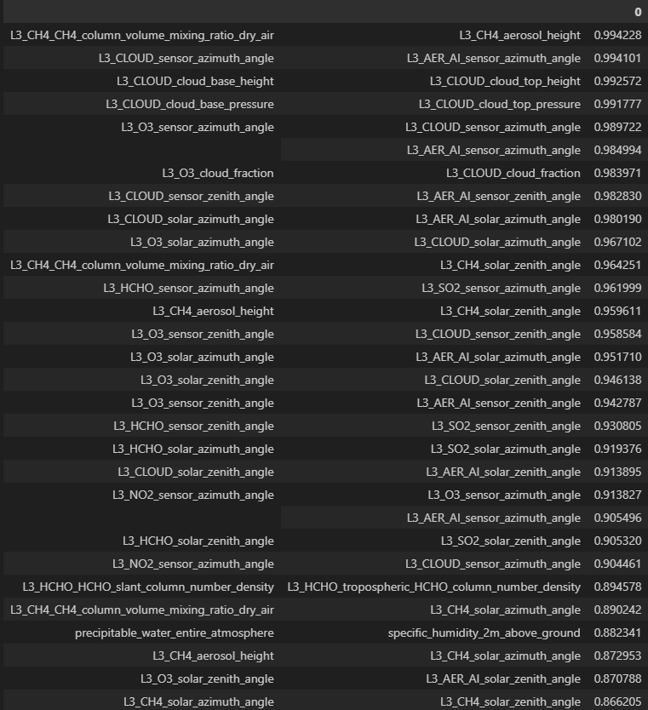
Future improvements and works
Review highly
correlated
features with
domain experts

Slide 15
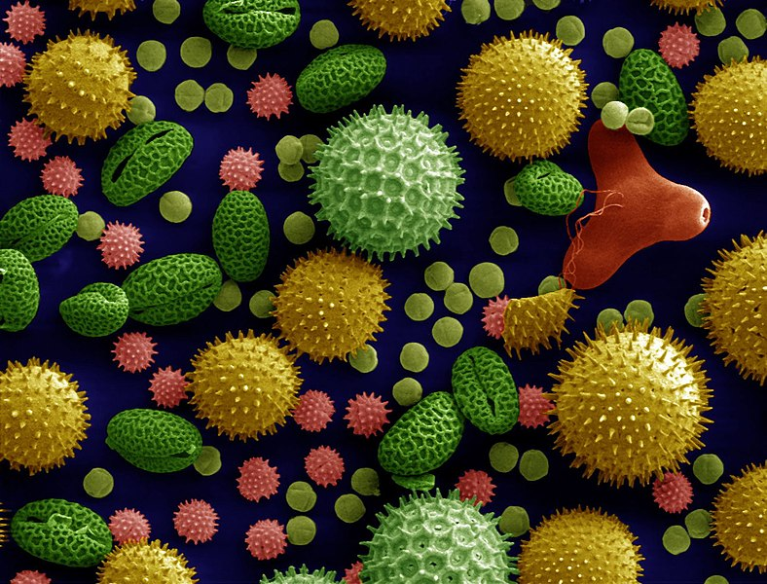
Thank you for your attention !
AIRS PPM team:
  Yassine Belloum
  Yves Engoulou
  Till Jung
Source: Misc pollen colorized (Dartmouth Electron Microscope Facility)

Slide 16
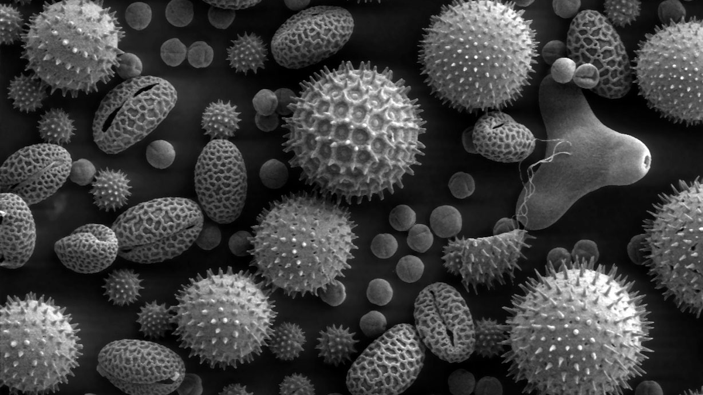
Particulate Pollution Monitoring
Source:: Scanning Electron Microscope Still Image of Pollen Particles (NASA)

