Slide 1
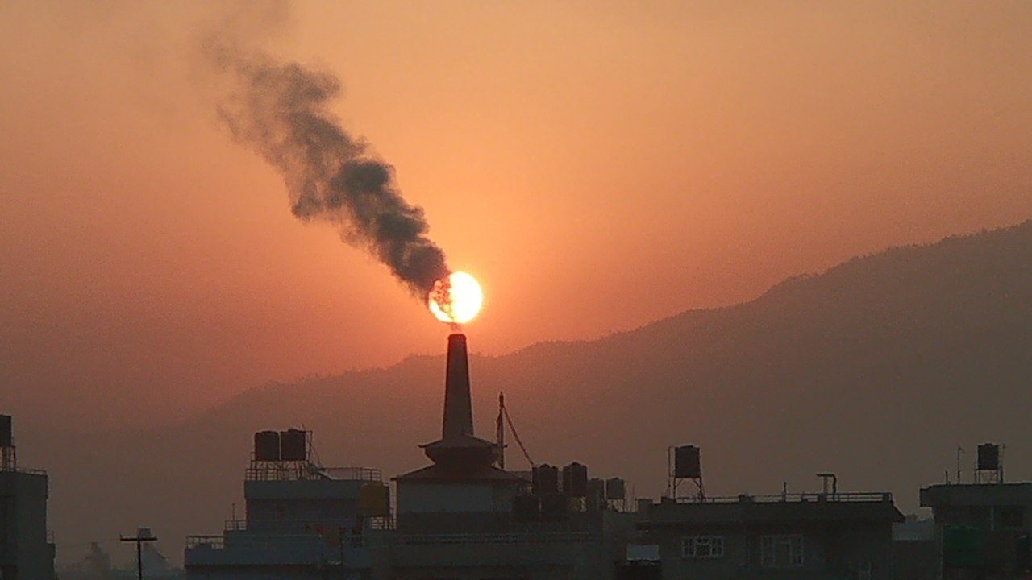
Particulate Pollution Monitoring
Air Pollution (source wikimedia)
Source: Air Pollution (source wikimedia)

Slide 2
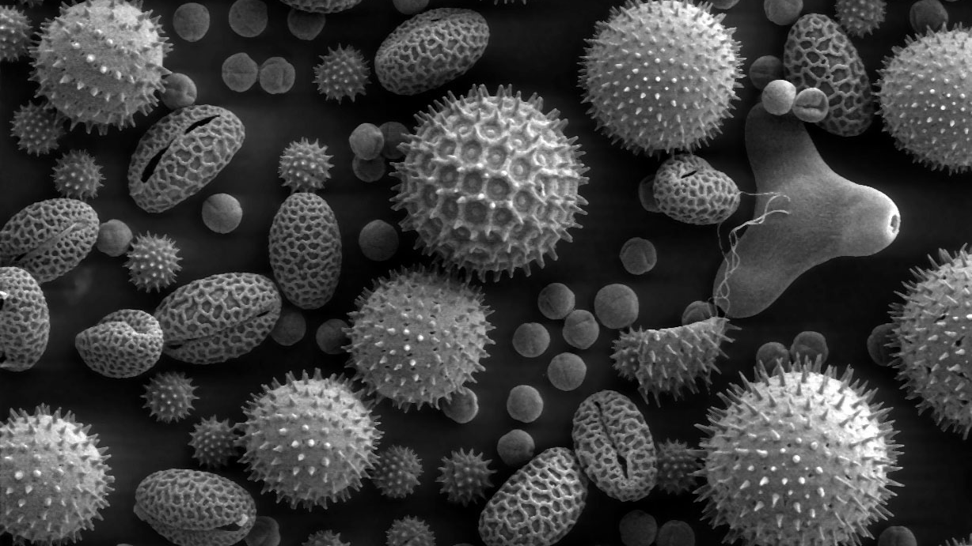
Particulate Pollution Monitoring
Source:: Scanning Electron Microscope Still Image of Pollen Particles (NASA)

Slide 3
Our mission
Easy accessible and understandable health risk management system for urban air pollution
Support decisions and actions to take for public and private health based on daily measurement
Provide insights into the most influential features contributing to PM2.5 levels

Slide 4
About AIRS and PPM
AIRS: Aerial Intelligence Remote Sensing
  Our team provides services based on satellite measurements for public and private use cases e.g.:
PPM: Particle Pollution Monitoring
  Application for public and personal health risk management related to air pollution and PM2.5 conenctration

Slide 5
Particulate Pollution – What is it?
PM is an environmental pollution that consists of particles suspended in some medium e.g.:
  Mud: Solid in water
  Dust: Solid in air
  Fog: Liquid in air
Distinguish between PM10 and PM2.5 particle size
Aerosols: mixture of atmospheric particulate matter that are thoracic and respirable

Slide 6
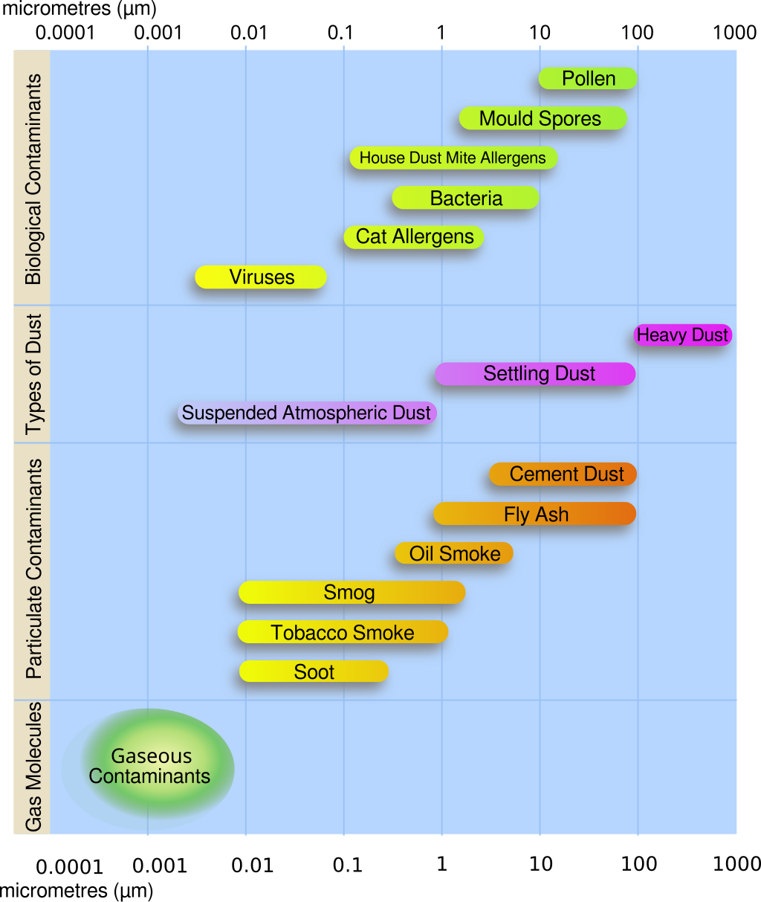
PM – Main sources
Combustion / Burning
Dusty (Construction) works
Industrial processes
Vulcano eruption
Source: https://en.wikipedia.org/wiki/File:Airborne-particulate-size-chart.svg

Slide 7
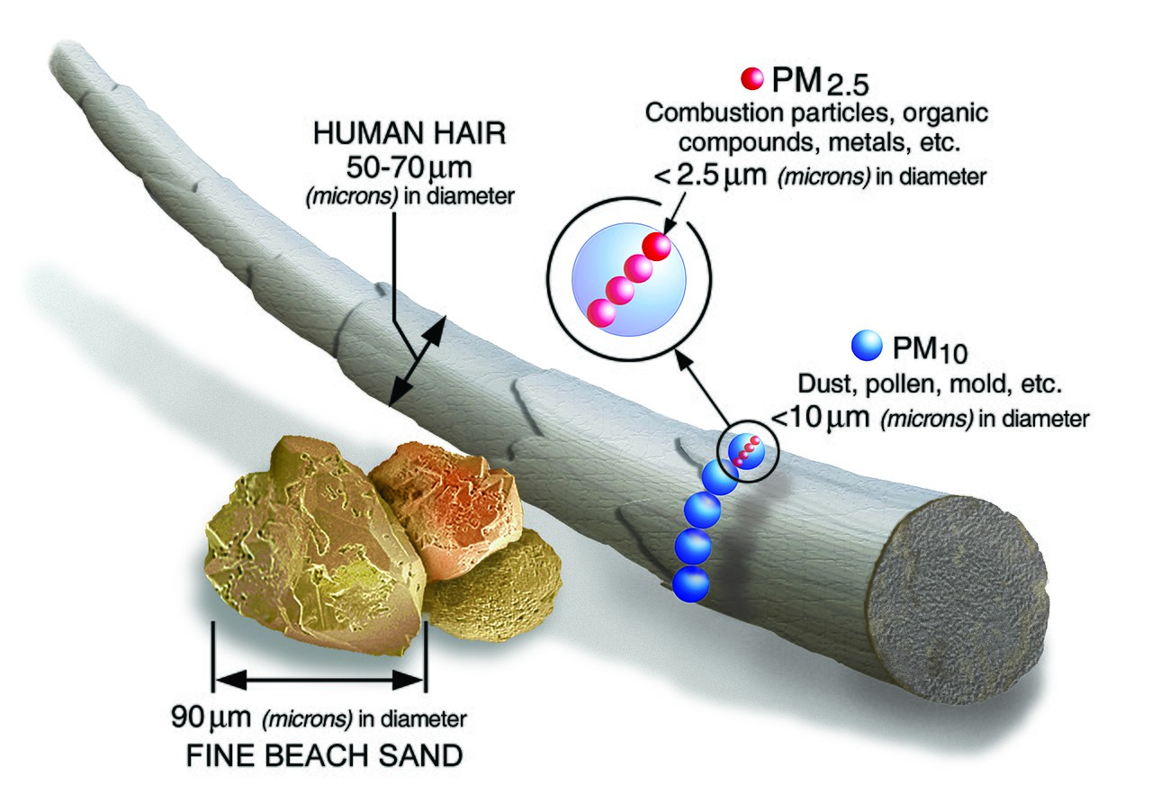
PM – Size matters
PM10: >= 10µm (particles still distinguishable by the naked eye)
PM2.5: >= 2.5 µm
(can be absorbed
into the bloodstream and
bypass blood-brain-barrier)
Source: https://en.wikipedia.org/wiki/File:PM_and_a_human_hair.jpg

Slide 8
Particulate Pollution – Why care?
There is no safe level of exposure to PM !
Airborne particulate matter is a
Group 1 carcinogen !
PM2.5 is estimated to have contributed to
4.1 million deaths in 2016 worldwide !

Slide 9
How it works – Main workflow
Processing of daily satellite measurements for
over 300 sites on more than 80 parameters
Evalute using a Random Forest Regression model with the depth of xxx
Predict the daily concentration of PM2.5 with RSME = xxx and R² xxx

Slide 10
How it works – Main features ?

Slide 11
How it works – Error analysis

Slide 13
Benefits
Robust model with explainable decisions
Light calculation load for user
Easy to interprete outcome

Slide 14
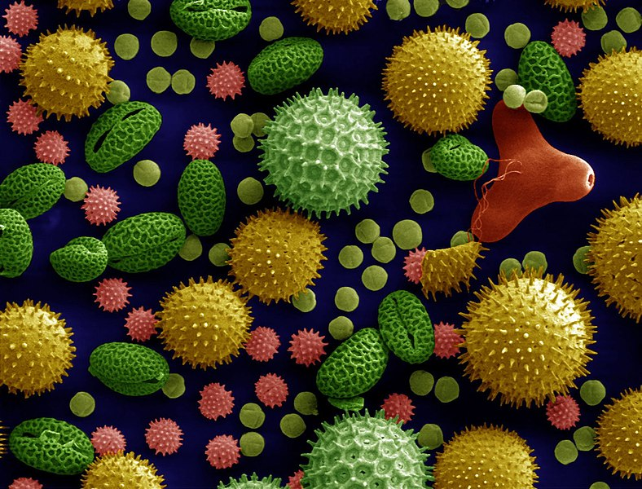
Thank you for your attention !
AIRS PPM team:
  Yassine Belloum
  Yves Engoulou
  Till Jung
Source: Misc pollen colorized (Dartmouth Electron Microscope Facility)

