Slide 1
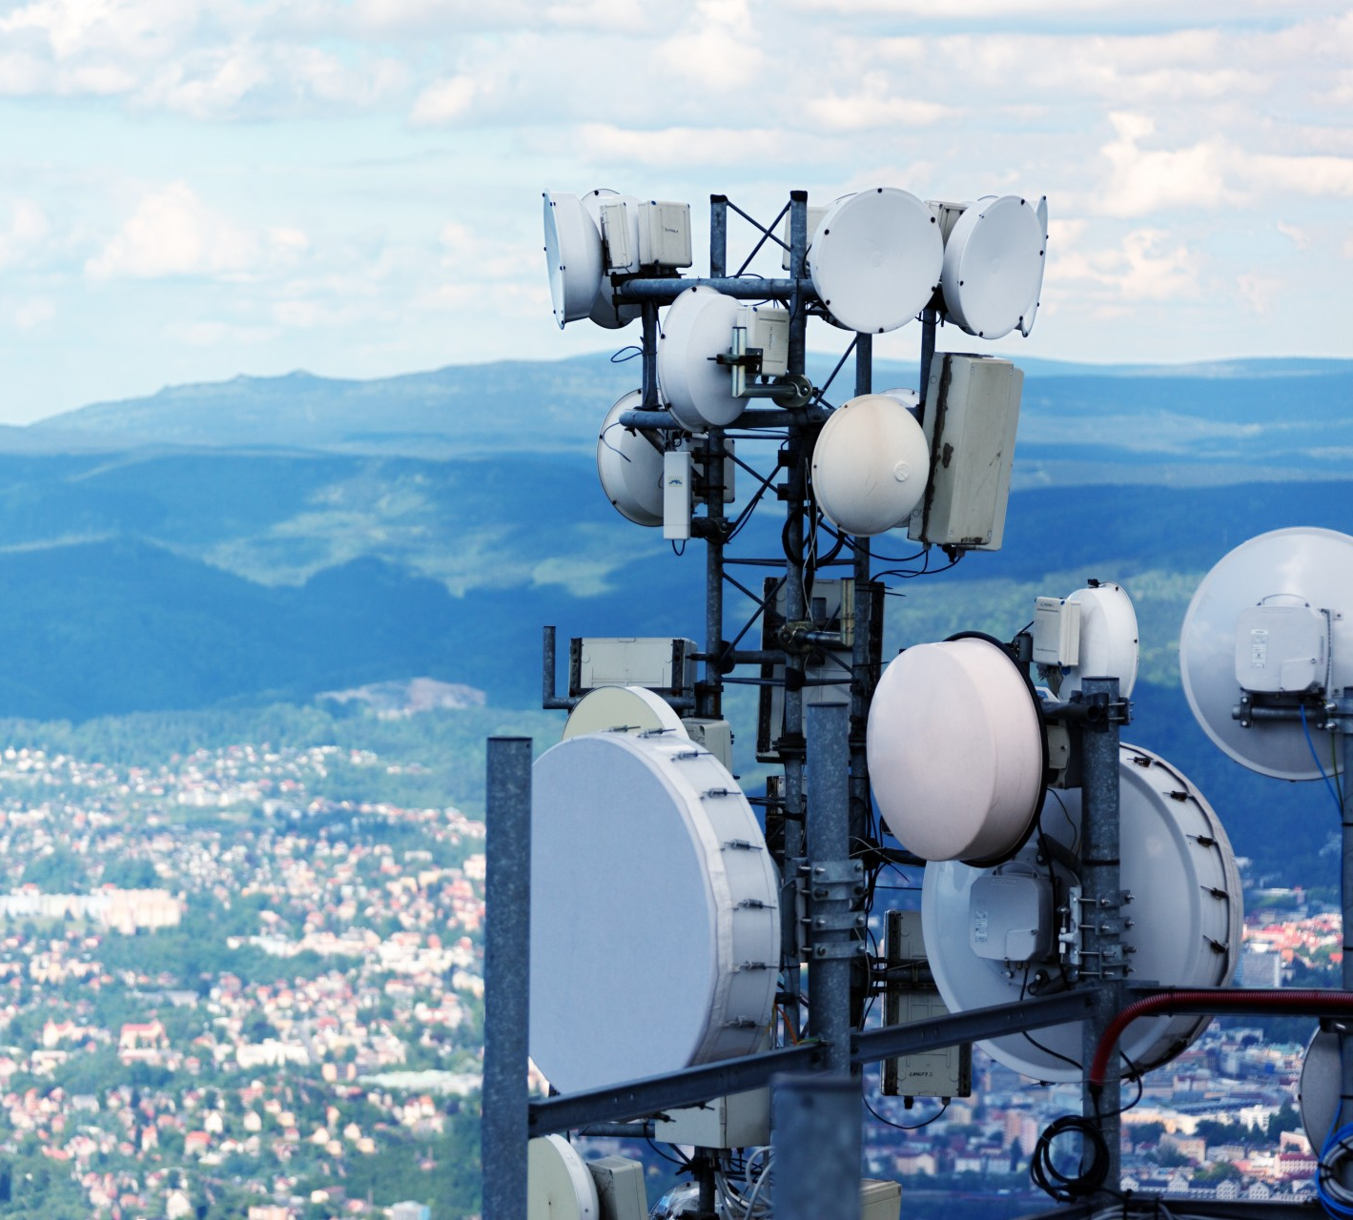
Telecom Customer Churn Analysis
Group II
David LOUIS
Kesnel Samuel JEAN PHILIPPE
Wedsanley JEAN PHILIPPE
Yvesna MARCELIN
27/08/2021

Slide 2
Introduction
CHURN ANALYSIS
Churn analysis is the process of using data to understand why customers have stopped using products or services of a company. It’s about figuring out why customers are churning at the rate they are, and how to fix the problem.
The customer churn analysis helps the company to retain its customers and ensure that the services offered satisfy the customers

Slide 3
Our Team
David Louis
davidlouis301@yahoo.fr
Kesnel Samuel Jean Philippe
kesnelsamuel@gmail.com
Wedsanley Jean-Philippe
wedsanleyjp97@gmail.com
Yvesna Marcelin
yvesnamarcelin48@gmail.com

Slide 4
Identifying the problem
Although the company is a leader in the telecommunications market, many of its customers are leaving it for its competitor, who is gaining ground, because there are no new customers to enter the market. The company is to find a way to keep all its customers. To do this, it must be able to identify the characteristics of the customers who have left and know what services are driving them away or what would have attracted them to the competitor.

Slide 5
Methodology
1
Data
2
Python/Pandas
3
Results
The company shared with us a dataset with 7,000 customers. Contains information about their demographics data , the services that they’re using and indicates whether a customer has been churned or not.
We use python libraries for:
Data Processing
Building helpful visualization
we use statistical test to better understand and find insight from the data
After all of these analyzes, informations on how to steer the marketing team to help them understanding the customers who churned. And how they can make better decision based on the insights with the aim to solve their churn rate

Slide 6
Stakeholders
1
The Company
2
The customers
3
The competitors
The company is the most affected by this problem because it is losing its reputation and its customers which considerably reduces their income.
And by losing both it is at risk by going bankrupt.
The only way that the problem affects customers is to the extent that they are confused in their choice and are not always satisfied.
Customer churn is the rate at which customers leave your company.
When the company keep losing their customers. Their competitors are going to have more advantages before the company

Slide 7
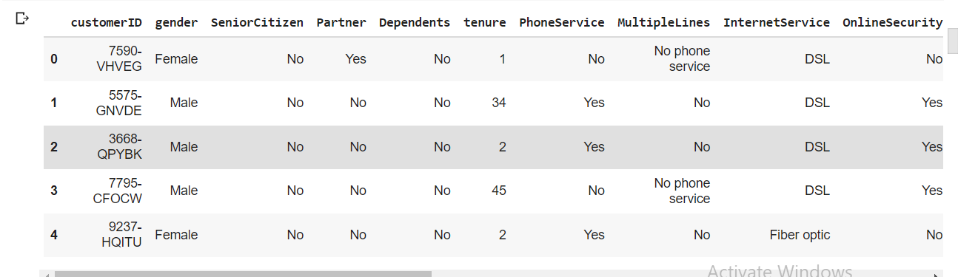
Dataset Overview

Slide 8
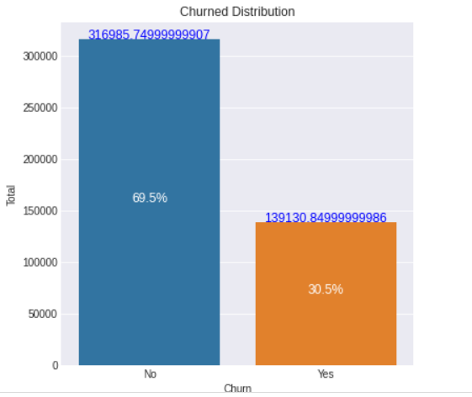
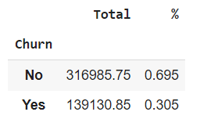
The impact of churn on the company

Slide 10
Relevant Analytics
The Dataset File has 7043 observations records with 21 variables.
“Senior Citizen” is a categorical column with only 2 values, such as 0 & 1. It indicates if the customer is an elderly person or a young person
The Average Monthly Charges is approximately $ 64.76, the min monthly charge is approximately 18.25, the max is approximately 118.75 and 75% of the customers have a monthly charge less than 90
The Average Total Charges is approximately 2279.80, the max is approximately 8684.80 and 75% of the customers have a Total charge less than 3787
The average tenure is around 32 months and, the max tenure is about 72 months and 75% of the customers have less 55 months with the company and there is group of new customers who have less than a month.

Slide 11
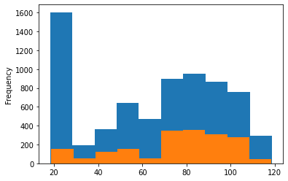
Monthly Charge
For the past month, customers who have churned have caused a total loss of $ 139,130.85, which represents 30% of the company's monthly income

Slide 12
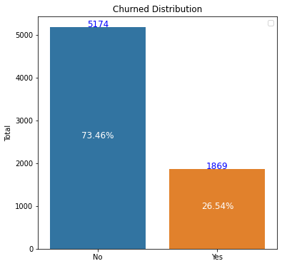
Rate of churned customers
Compared to the existing customer base the churned customer represent 26.54 % of the population
Total number of customers who churned is 1869 while the number of remaining customer 5174 which represent 73.5% of the population.

Slide 13
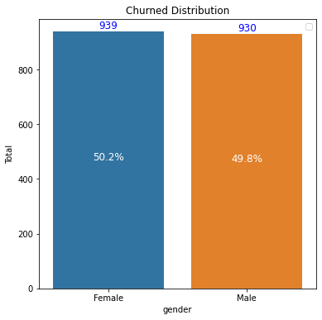
Churned customer by(gender)
The total number of Female customer who churn is 939, which represents 50.2% of the population.
The total number of Male customer who churn is 930, which represents 49.8% of the population.

Slide 14
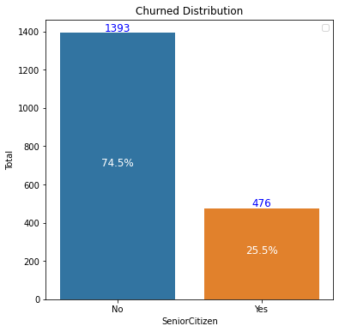
Churned customer by(Age Range, Senior Citizen)
The total number of Young customer who churned is 1393, which represents 74.5% of the churned population.
The total number of Senior customer who churned is 476, which represents 25.5% of the churned population.

Slide 15
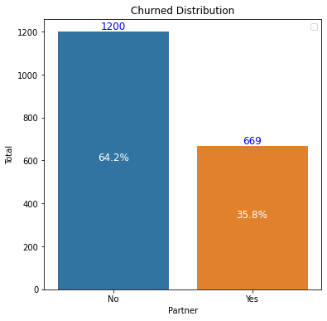
Churned customer by(Who do or not have a partner)
The total number of Customer who don't have a partner and churned are 1200, which represents 64.2% of the churned population.
The total number of Customer who do have a partner and churned are 669, which represents 35.8% of the churned population.

Slide 16
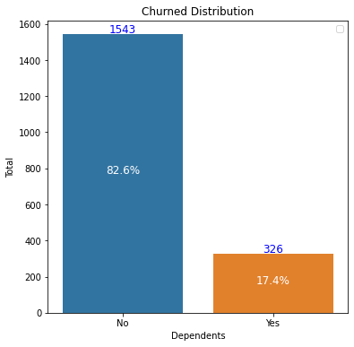
Churned customer by(Who do or not have a Dependents)
The total number of Customer who don't have Dependents and churned are 1543, which represents 82.6% of the population.
The total number of Customer who do have Dependents and churned are 326, which represents 17.4% of the population.

Slide 17
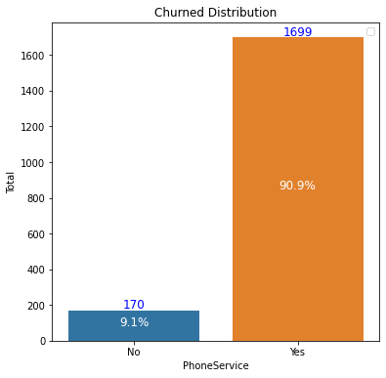
Customer analysis by(Services used)
The total number of Customer who don't use Phone services and churned are 170, which represents 9.1% of the churned population.
The total number of Customer who use Phone services and churned are 1699, which represents 90.9% of the churned population.

Slide 18
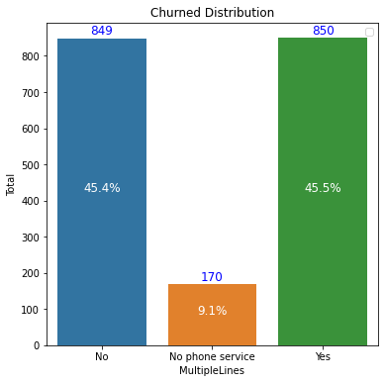
Customer analysis by(Multiple Lines)
The total number of Customer who don't use Multiple Lines and churned are 849, which represents 45.4% of the churned population.
The total number of Customer who use Multiple Lines and churned are 850, which represents 45.5% of the churned population.

Slide 19
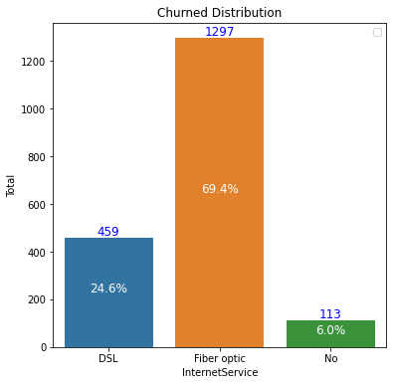
Churned customer analysis by(Internet Services)
The total number of Customer who don't use Internet services and churned are 113, which represents 6% of the churned population.
The total number of Customer who use Fiber Optic and churned are 1297, which represents 69.4% of the churned population.
The total number of Customer who use DSL(Digital Subscriber Line) and churned are 459, which represents 24.6% of the churned population.

Slide 20
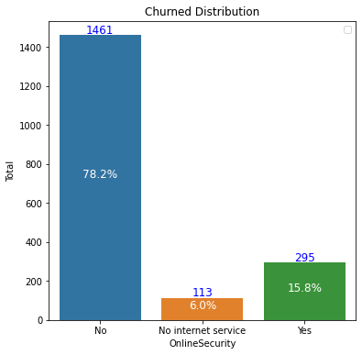
Churned customer analysis by(Online Security)
The total number of Customer who don't use Online security and churned are 1461, which represents 78.2% of the churned population.
The total number of Customer who use Online security and churned are 295, which represents 15.8% of the churned population.

Slide 21
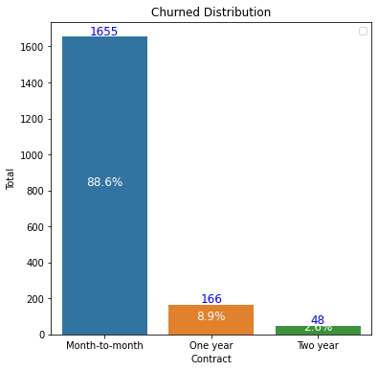
Customer analysis by(Billing Information)
The total number of Customer who use Month-to-month Contract and churned are 1655, which represents 23.5% of the population.
The total number of Customer who use One year Contract and churned are 166, which represents 2.4% of the population.
The total number of Customer who use Two year Contract and churned are 48, which represents 0.7% of the population.

Slide 22
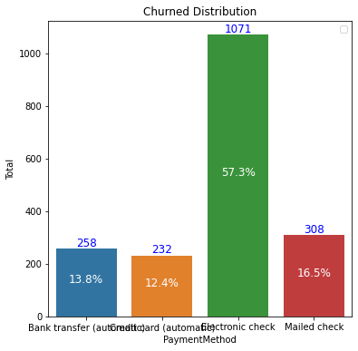
Customer analysis by(Payment method)
The total number of Customer who use Bank transfer as Payment Method and churned are 258, which represents 3.7% of the population.
The total number of Customer who use Credit card as Payment Method and churned are 232, which represents 3.3% of the population.
The total number of Customer who use Electronic check as Payment Method and churned are 1071, which represents 15.2% of the population.
The total number of Customer who use Mailed check as Payment Method and churned are 308, which represents 4.4% of the population.

Slide 23
Proposed
Solutions

Slide 24
Solutions
1
Marketing
2
Engage with customers
The Marketing staff should use a new marketing plan, to focus on promoting the services that their customers usually use
Define your most valuable customer.
Valuable customers have to be taken extra care of because they bring in the biggest revenue.

Slide 25
Recommendations
We recommend the staff marketing to focus on giving great customer experience, Use all social media platform and Mail Marketing to always stay connected to their customers. So whenever the management team see unexpected churn in the company, there are some simple ways they can use to find out why and to help them solve this.
Send a customer exit survey
Call the customer
Send some personalized messages to always keep their interest to the company

Slide 26
Reference & Appendices
Dataset
https://www.kaggle.com/blastchar/telco-customer-churn/data
Our Github Profiles
David Louis
Kesnel Samuel Jean Philippe
Wedsanley Jean Philippe
Yvesna Marcelin
Cover picture
https://www.publicdomainpictures.net/en/view-image.php?image=79382&picture=telecommunication-antennas

Slide 27
Thank you !

