Slide 1


Ayiti Analytics
Data Processing Bootcamp

Slide 2
Overview
Present Project
Methodology
Retrieve Dataset
Data Processing
Data Cleaning
Data Visualization

Slide 3
Project
Ayiti Analytics has an objective to know which three communes of the country will be the most likely to expand its training centers. Knowing that each cohort must have 30 students. Then to help him, we will answer theses questions below :
The most effective communication channels that will allow a student to be susceptible to selection.
The average number of university students who should participate in this program.
The average number of applications per week that we could have.
If we were to do all the bootcamp online, the best communes and how many applications would we need to select 30 student and the percentage of students would have a laptop, an internet connection, both at the same time.
The most effective communication channels that will allow a women to be susceptible to selection.

Slide 4

Methodology
To do this work we can use either Vs code or Google colab, we will recover the data by importing the files that we will use, this step is none other than the retrieve dataset.
After taking the files, we read them to see what we need to start our work, it’s step data processing.
The next step is to clean everything, remove the necessary steps those that are repeated several times and make all the data that we had previously become one for better handling.
The data visualization will allow us to make the necessary graph either with matplotlib seaborn etc. to see through our data and help our client.

Slide 5
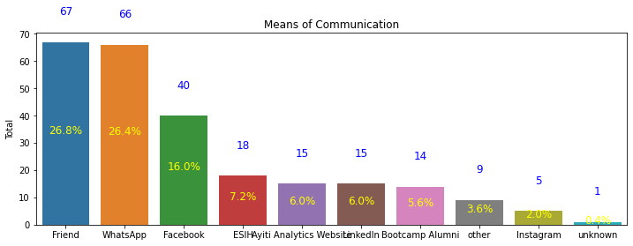
The most effective communication channels that will allow a student to be susceptible to selection.

Slide 6

The Total and Percent
In the previous graph we can see the quantity of people to select and by which channel we can also see the percentages
And here we can notice it but in another form.
 | Total | Percent
Friend | 67 | 0.268
WhatsApp | 66 | 0.264
Facebook | 40 | 0.160
ESIH | 18 | 0.072
Ayiti Analytics Website | 15 | 0.060
LinkedIn | 15 | 0.060
Bootcamp Alumni | 14 | 0.056
other | 9 | 0.036
Instagram | 5 | 0.020
unknown | 1 | 0.004

Slide 7
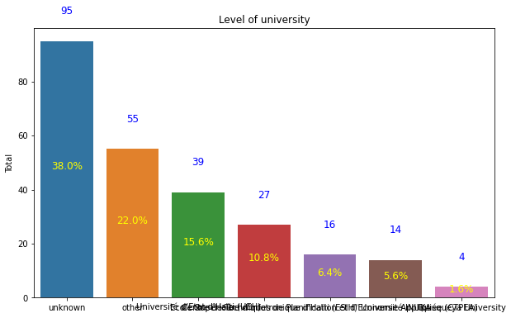
The average number of university students who should participate in this program.

Slide 8

Total and Percent
Now we can see the total and percent of the folowing universities they belong to.
 | Total | Percent
unknown | 95 | 0.380
other | 55 | 0.220
Université d'Etat d'Haïti (UEH) | 39 | 0.156
Ecole Supérieure d'Infotronique d'Haïti (ESIH) | 27 | 0.108
Centre de Techniques de Planification et d'Economie Appliquée (CTPEA) | 16 | 0.064
Université INUKA | 14 | 0.056
Quisqueya University | 4 | 0.016

Slide 9
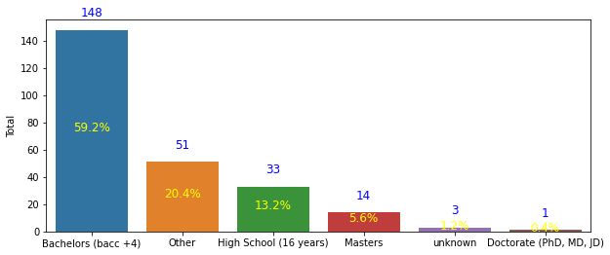
Education Level

Slide 10

Total and Percent
 | Total | Percent
Bachelors (bacc +4) | 148 | 0.592
Other | 51 | 0.204
High School (16 years) | 33 | 0.132
Masters | 14 | 0.056
unknown | 3 | 0.012
Doctorate (PhD, MD, JD) | 1 | 0.004
Here we see the total and the percentage of their level of study.

Slide 11

The average number of applications per week that we could have.
The total number of enrollments by gender and municipality per week.
 | male | female
Inscription_date
2021-02-14 | 108 | 28
2021-02-21 | 41 | 13
2021-02-28 | 26 | 3
2021-03-07 | 26 | 3
2021-03-14 | 2 | 0

Slide 12

Percents male and female
Here we have the total percentage by sex and by municipality of enrollment per week.
 | male | female
Inscription_date
2021-02-14 | 0.432 | 0.112
2021-02-21 | 0.164 | 0.052
2021-02-28 | 0.104 | 0.012
2021-03-07 | 0.104 | 0.012
2021-03-14 | 0.008 | 0.000

Slide 13

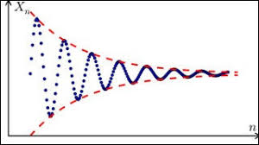
Totals male and female
 | female | male | sum | frequencies
Inscription_date
2021-02-14 | 28 | 108 | 136 | 0.544
2021-02-21 | 13 | 41 | 54 | 0.216
2021-02-28 | 3 | 26 | 29 | 0.116
2021-03-07 | 3 | 26 | 29 | 0.116
2021-03-14 | 0 | 2 | 2 | 0.008

Slide 14
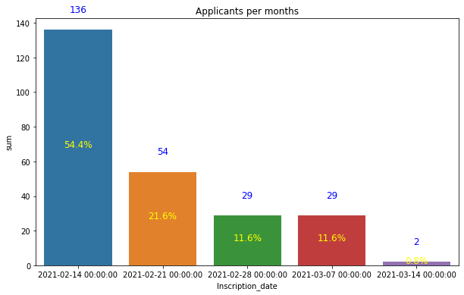

Slide 15

If were to do all the bootcamp online
Who would be the best communes and how many applications would we need to select 30 student and the percentage of students would have a laptop, an internet connection, both at the same time.
Here we have the total percentage by sex and by municipality of enrollment per week.
 | Total Internet | Total Percent Internet
Commune_FR
Delmas | 61 | 0.244
Port-au-Prince | 52 | 0.208
Pétion-Ville | 25 | 0.100
Carrefour | 18 | 0.072

Slide 16
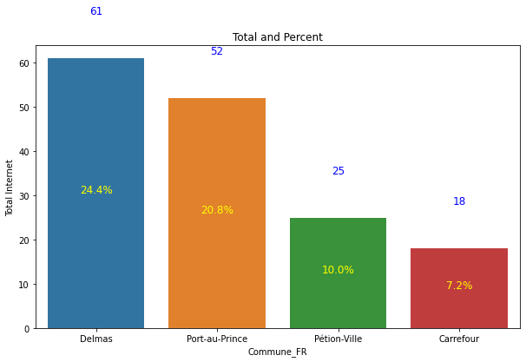

Slide 17

Total and Percent
 | Total Computer | Percent Computer
Delmas | 61 | 0.264
Port-au-Prince | 52 | 0.228
Pétion-Ville | 25 | 0.100
Carrefour | 18 | 0.084
Number of people per municipality with access to a computer and the total percentage.

Slide 18
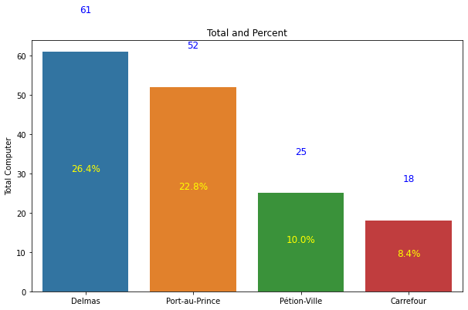

Slide 19
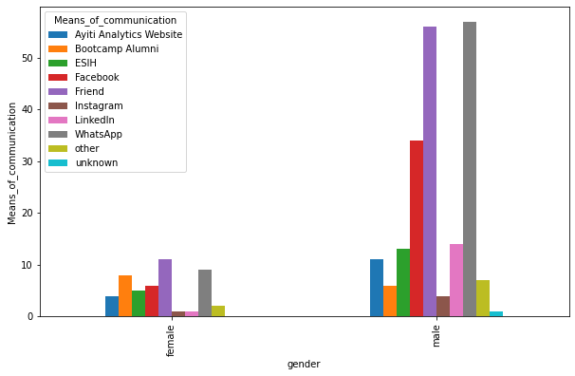
The most effective communication channels that will allow a women to be susceptible to selection

Slide 20


The graph below shows the communication channels for each sex, the male ones are not too different from the female ones.
The channel that attracts most girls is Friends then Whatsapp but for boys it's Whatsapp then Friends.

Slide 21
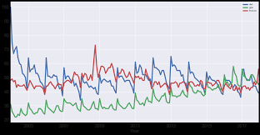
The three communes of the country will be the most likely to expand its training centers.
 | CommuneFR | Frequence
Delmas | 71 | 0.284
Pétion-Ville | 29 | 0.116
Carrefour | 23 | 0.092
We represent here the three communes the most likely to expand to training.

Slide 22
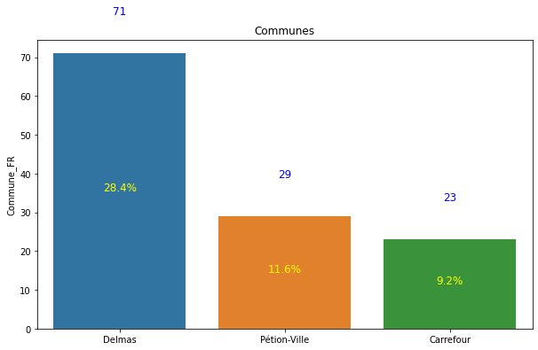

Slide 23
Result
First of all the channels that Ayiti Analytics should use to select more participants, to reach more people are the channel friends, Whatsapp and also Facebook, the others are necessary but the most likely are these three.
The average number of university students who should participate is not quite determined. however, those who have a bachelor's degree are the ones who participate the most.
Third, the average number of applications per week is 50%.
If the bootcamp were to be online, the first three communities to be selected for internet and computer access are.
The channel that should be used to have more girls in the training is the channel friend but also the channel Whatsapp.
Finally, the three communes apart from port au prince that Ayiti Analytics should choose for the training are Delmas, Petion-ville and Carrefour, these communes are much more interested, they have more access to internet and have a computer.

Slide 24
Reference
https://colab.research.google.com/drive/1Ch2DyocBlIU5pgdv1oFxB5_gJvvsWO0h?usp=sharing

Slide 25
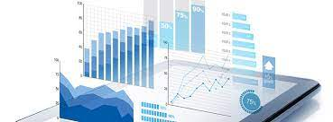
Prepared by Yvesna MARCELIN

