Slide 1
va
File created on: 23/10/2022 2:17:45 pm AEDT

Slide 2
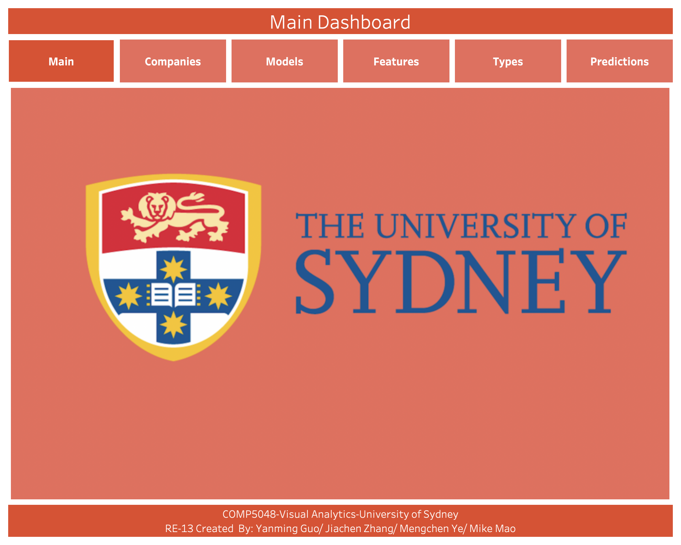

Slide 3
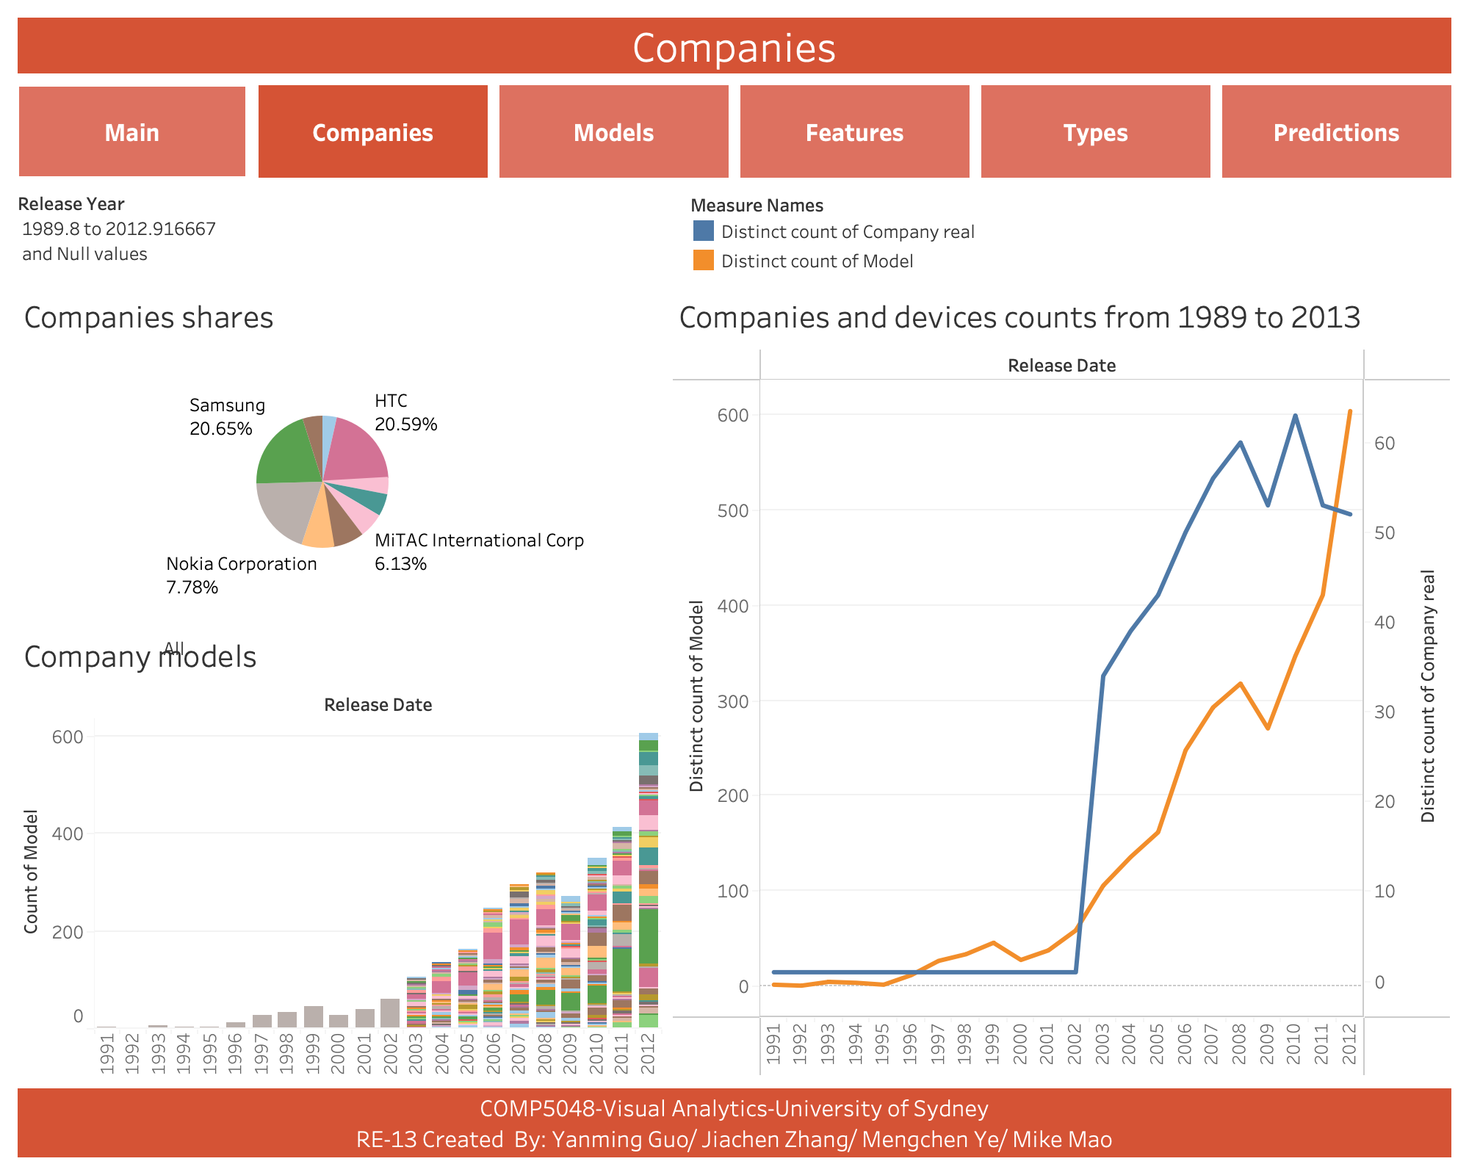

Slide 4
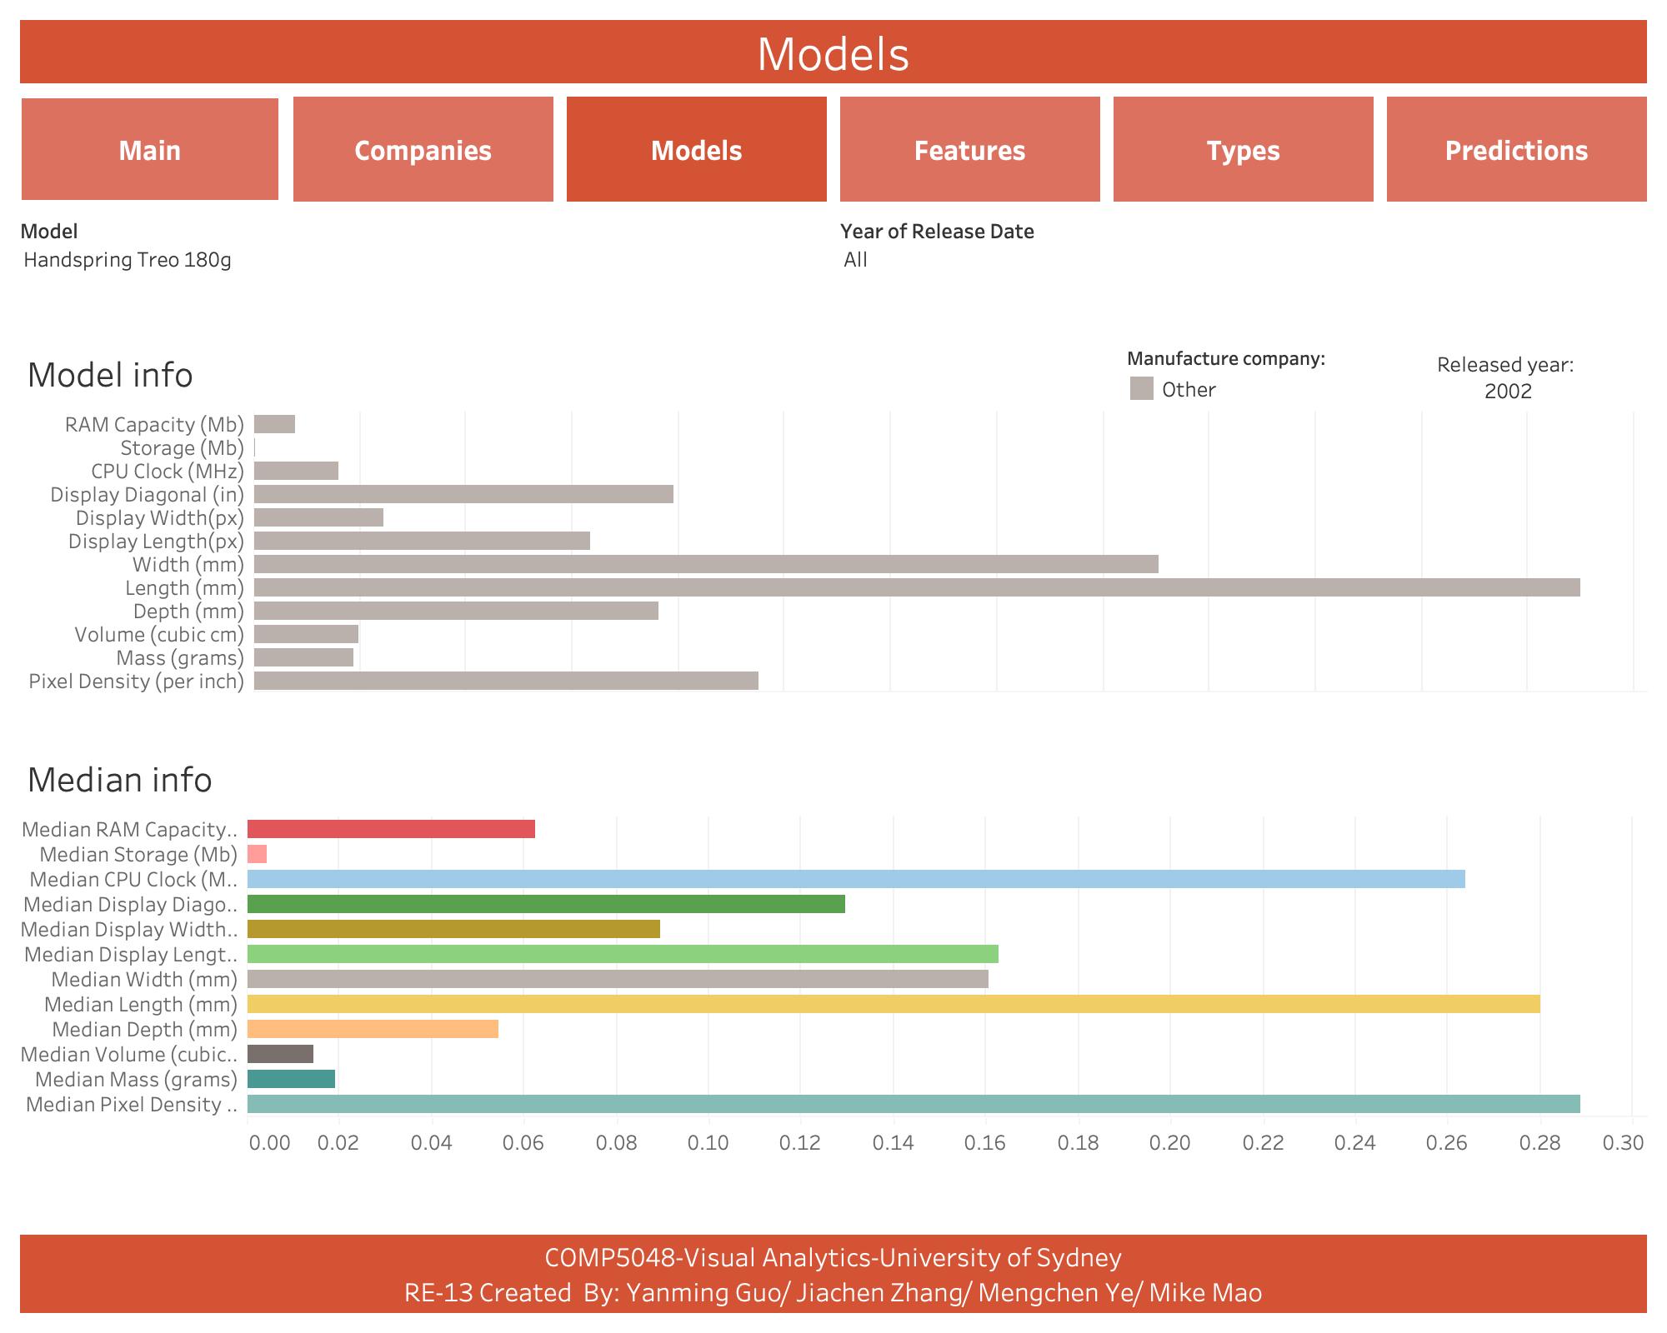

Slide 5
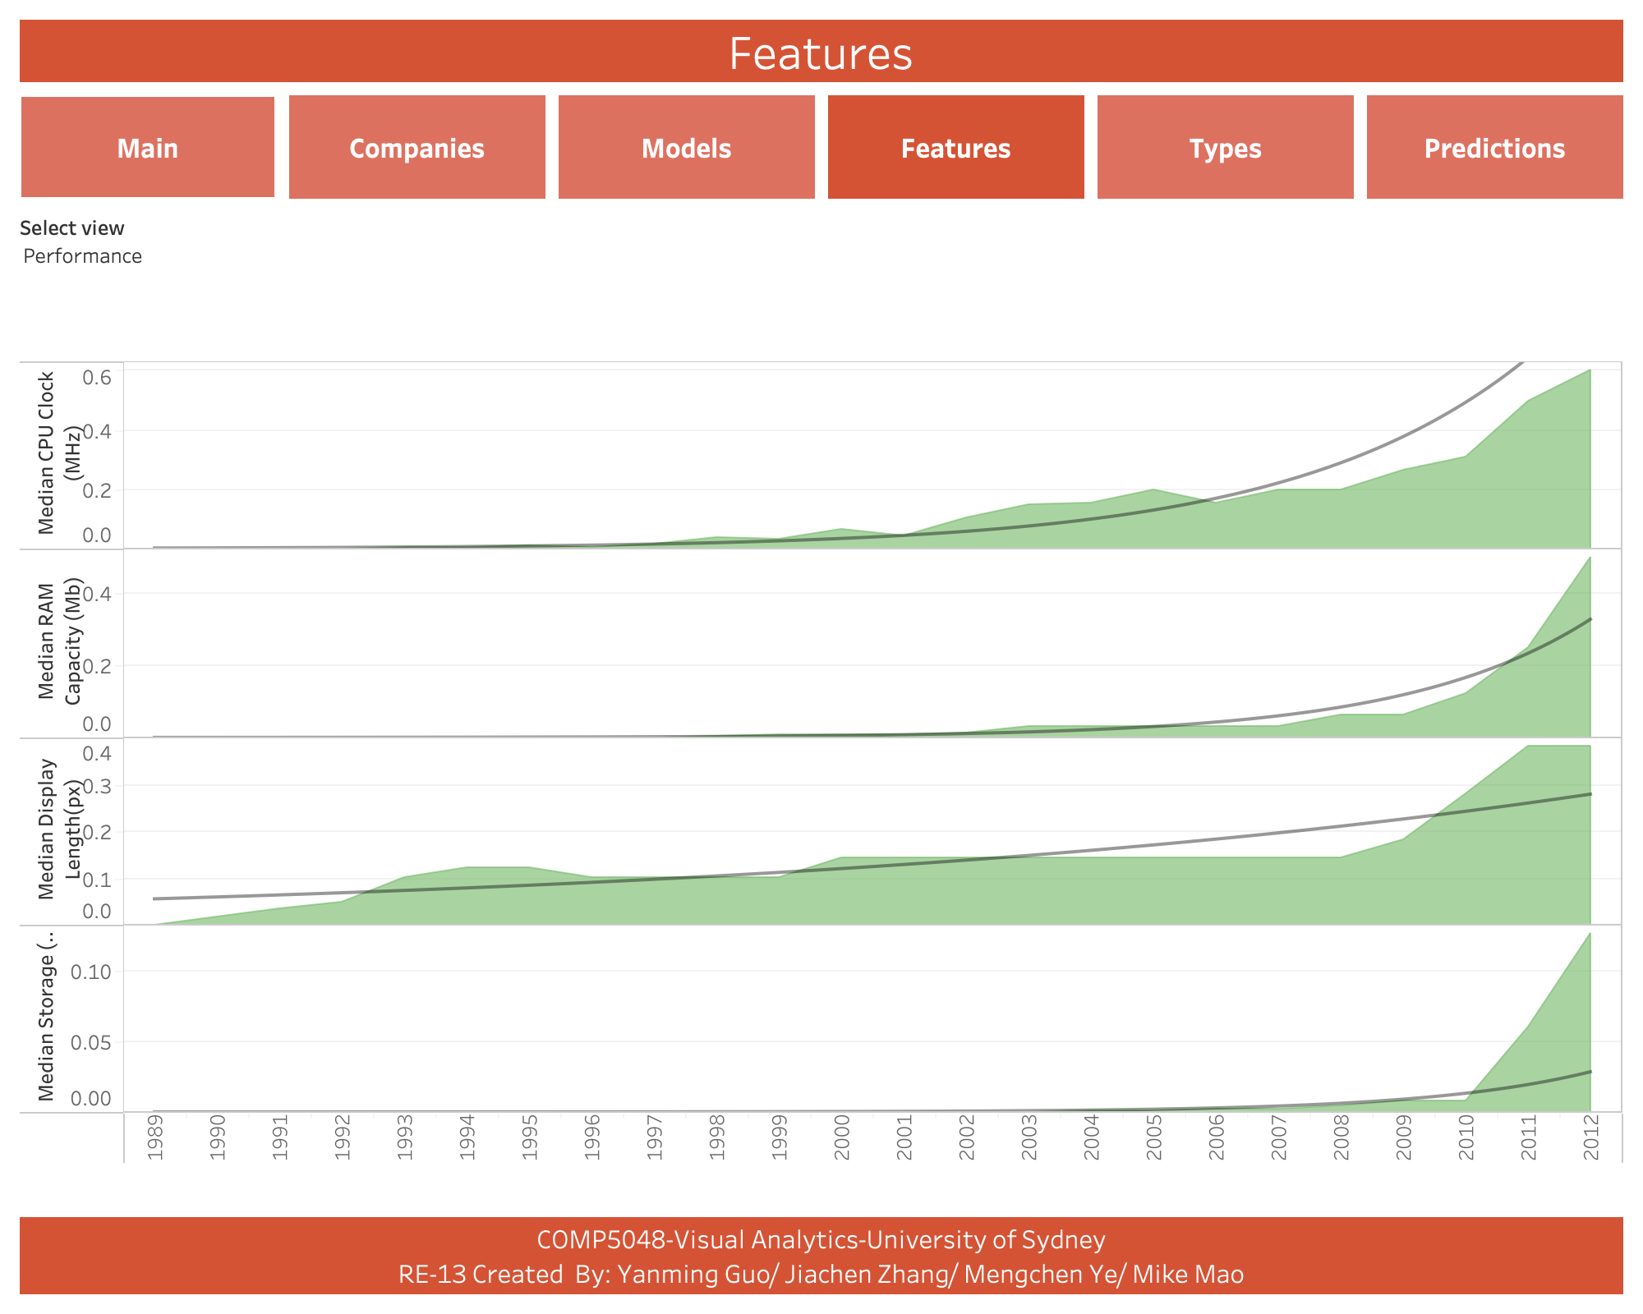

Slide 6
