Slide 1
KIDs & NTDB
Zhuoyi Huang, zhuoyih@stanford.edu
Stanford University School of Medicine
Division of Pediatric Surgery

Slide 2
KIDs Project
Updated General Linear Module Analysis
1. Change reference group
For Variable Zip code, use Zip code 4 as the reference group.
For Variable Age groups, use 12-17 as the reference group.
Finished.
2. Add ISS as a variable
For Cost and LOS, add ISS into the control for the Race;
For Mortality, add ISS into all of the other variables.
Already added as SEVGROUP
3. Obtained NTDB codes from Chaonan

Slide 3
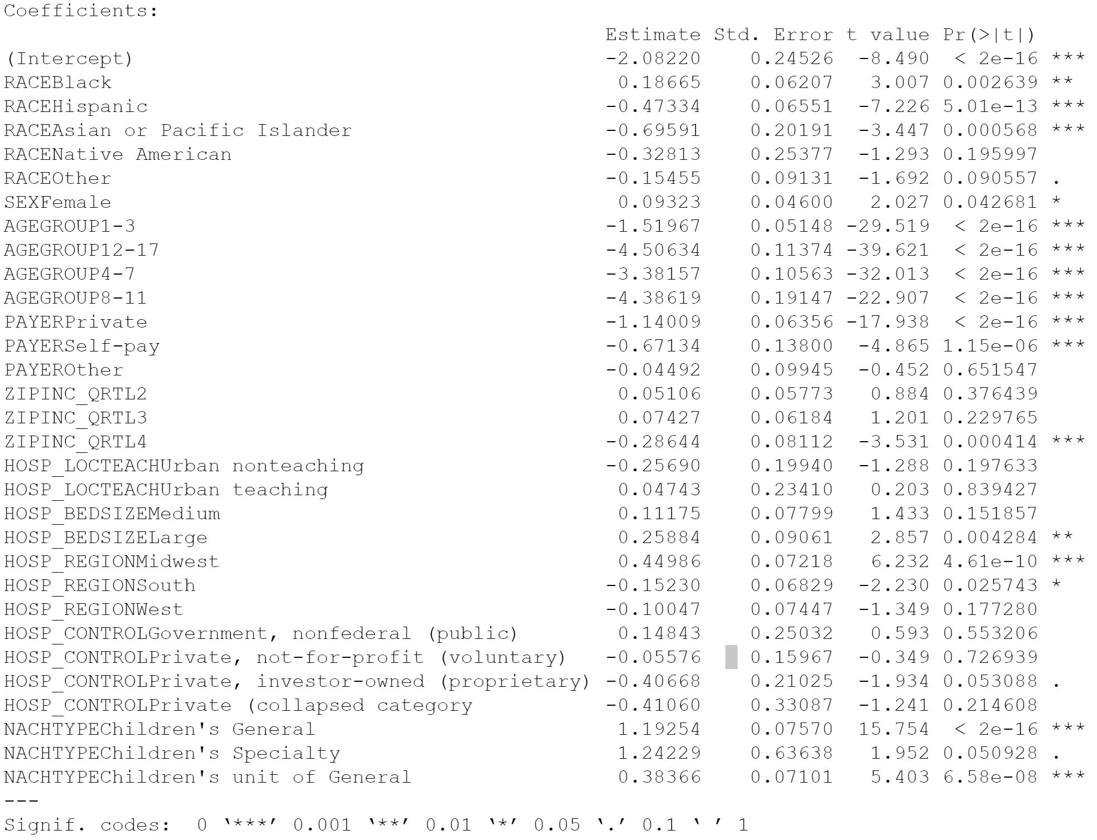
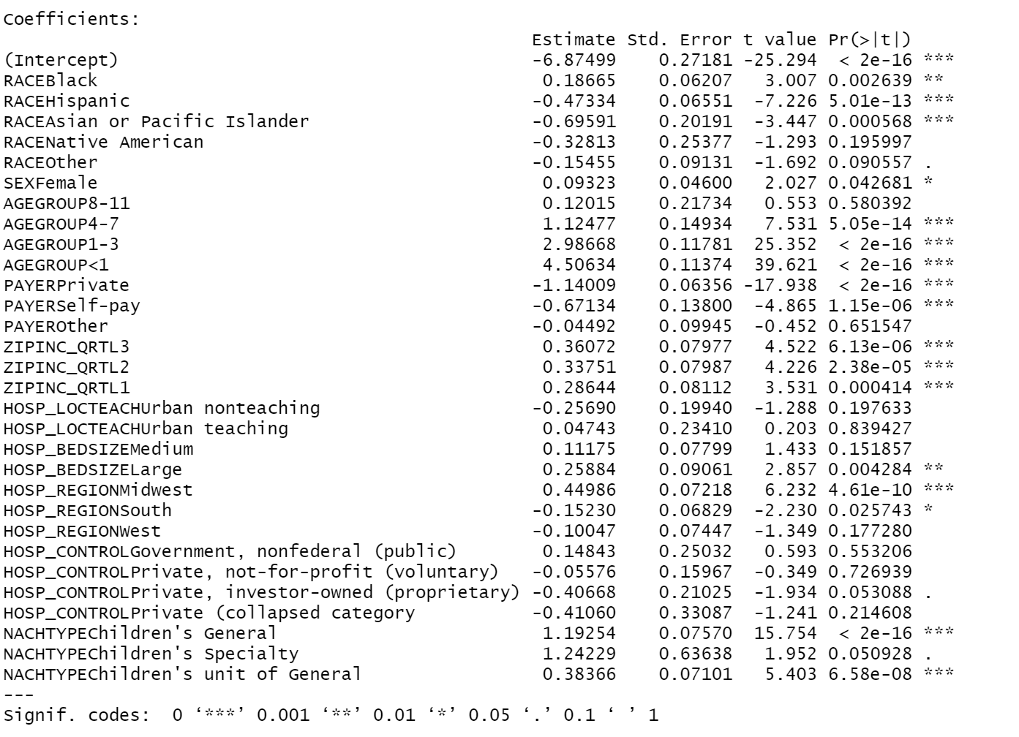
Comparison of Abuse-socio GLM coefficient results
Before
After

Slide 4
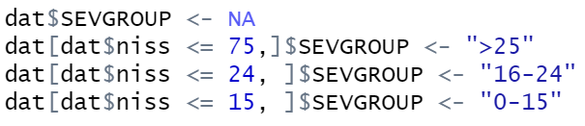
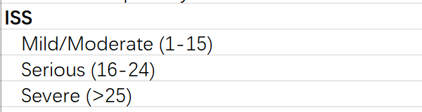
Add ISS as a variable
Renamed ISS as SEVGROUP, and classified into three groups, use > 25(Severe) as a the reference group.

Slide 5
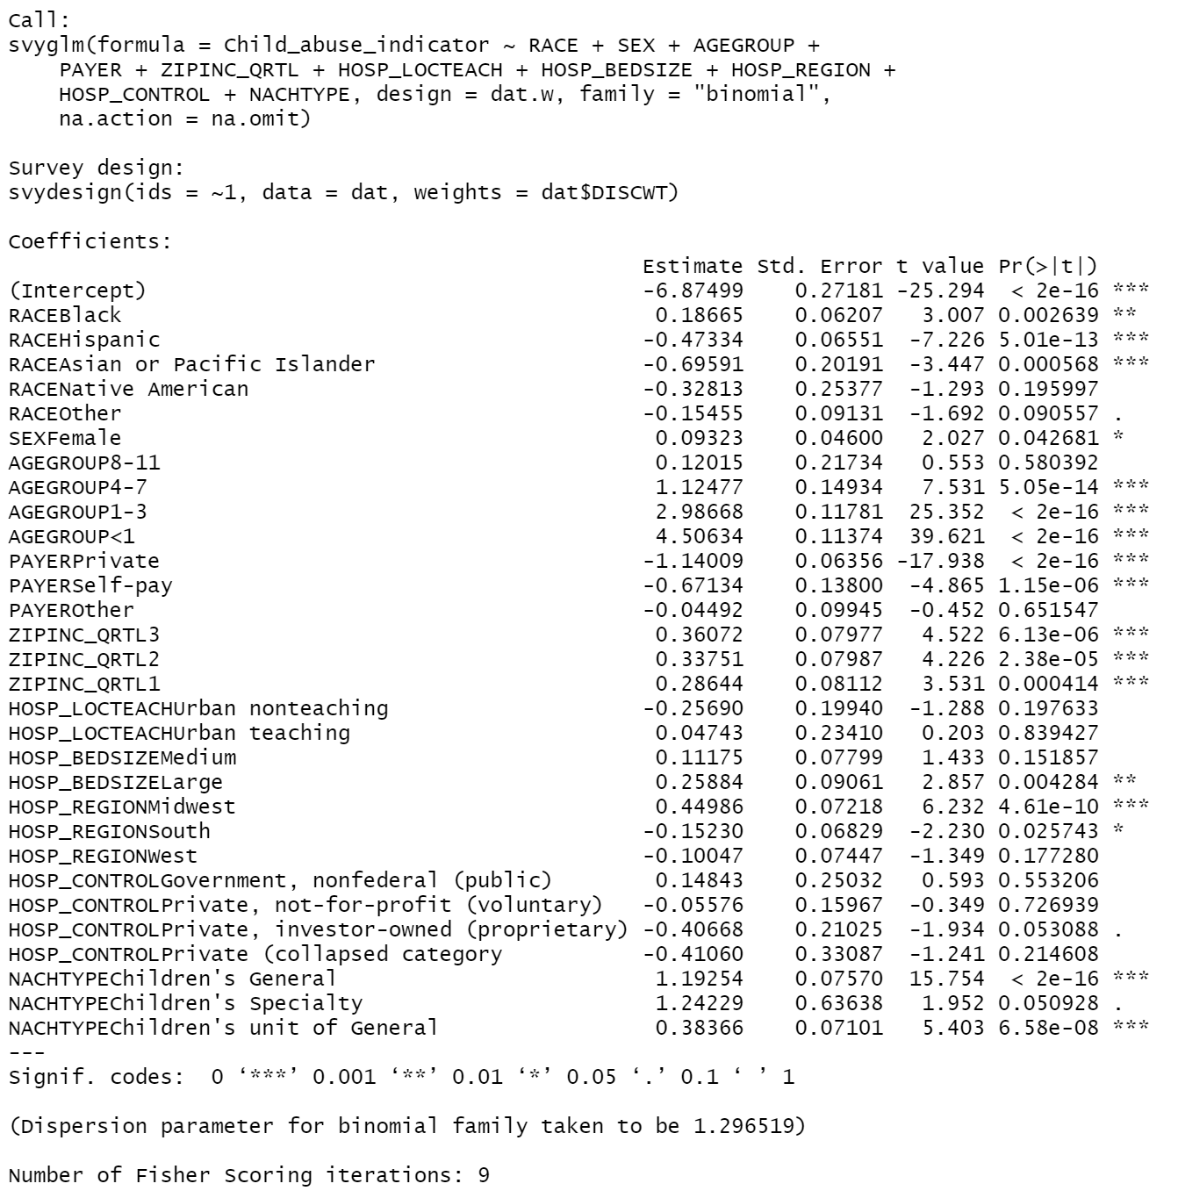
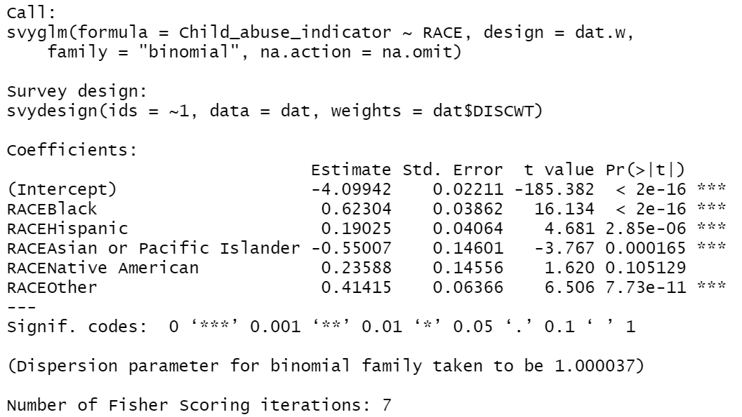
Abuse_race vs Abuse_socio

Slide 6
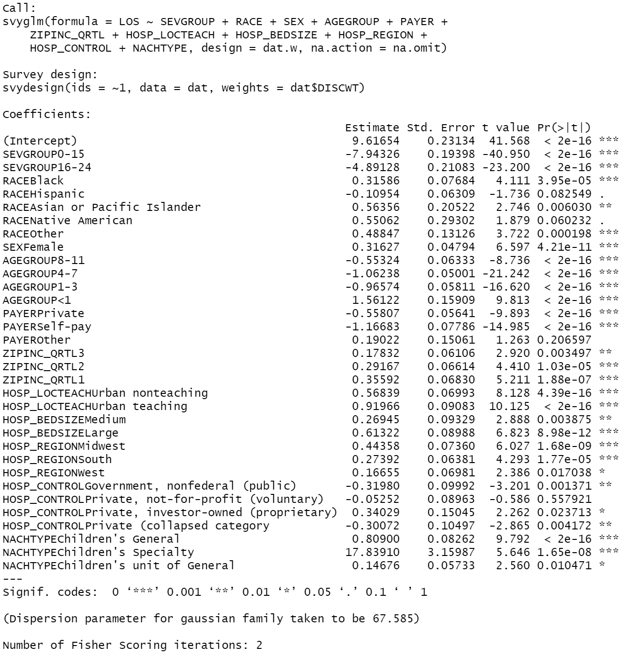
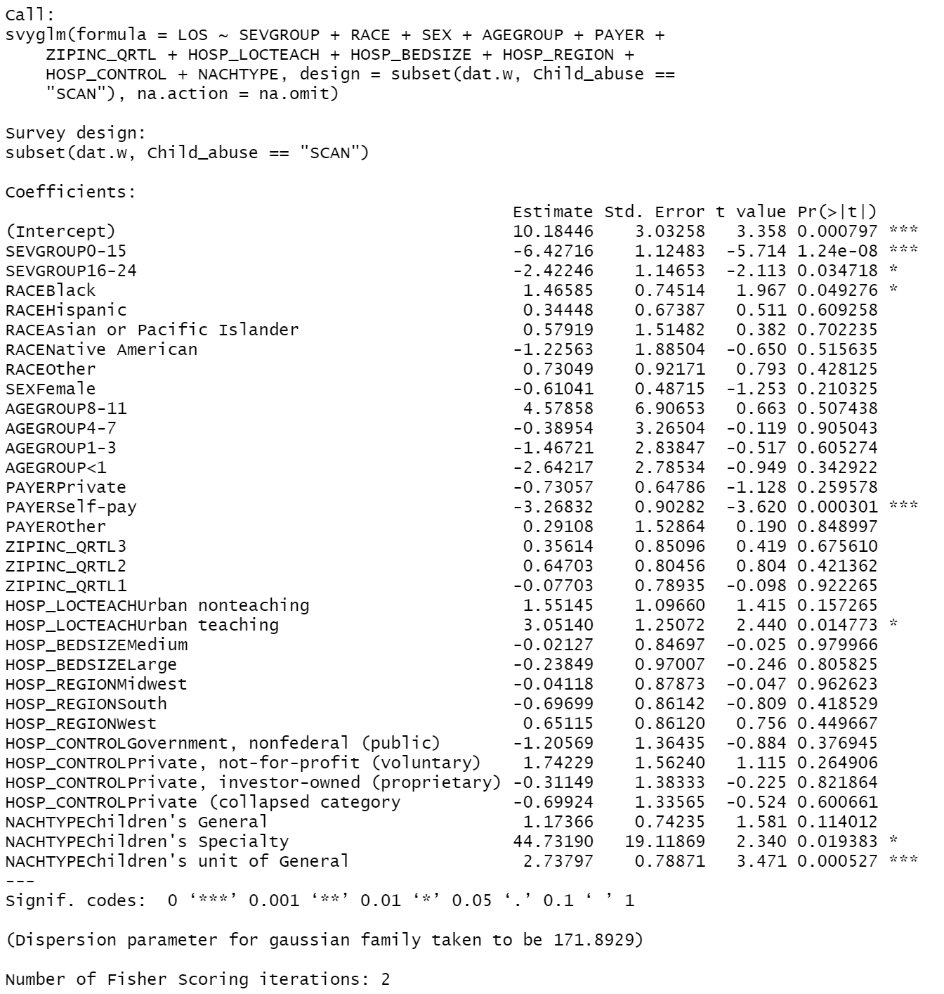
LOS_all vs LOS_scan

Slide 7
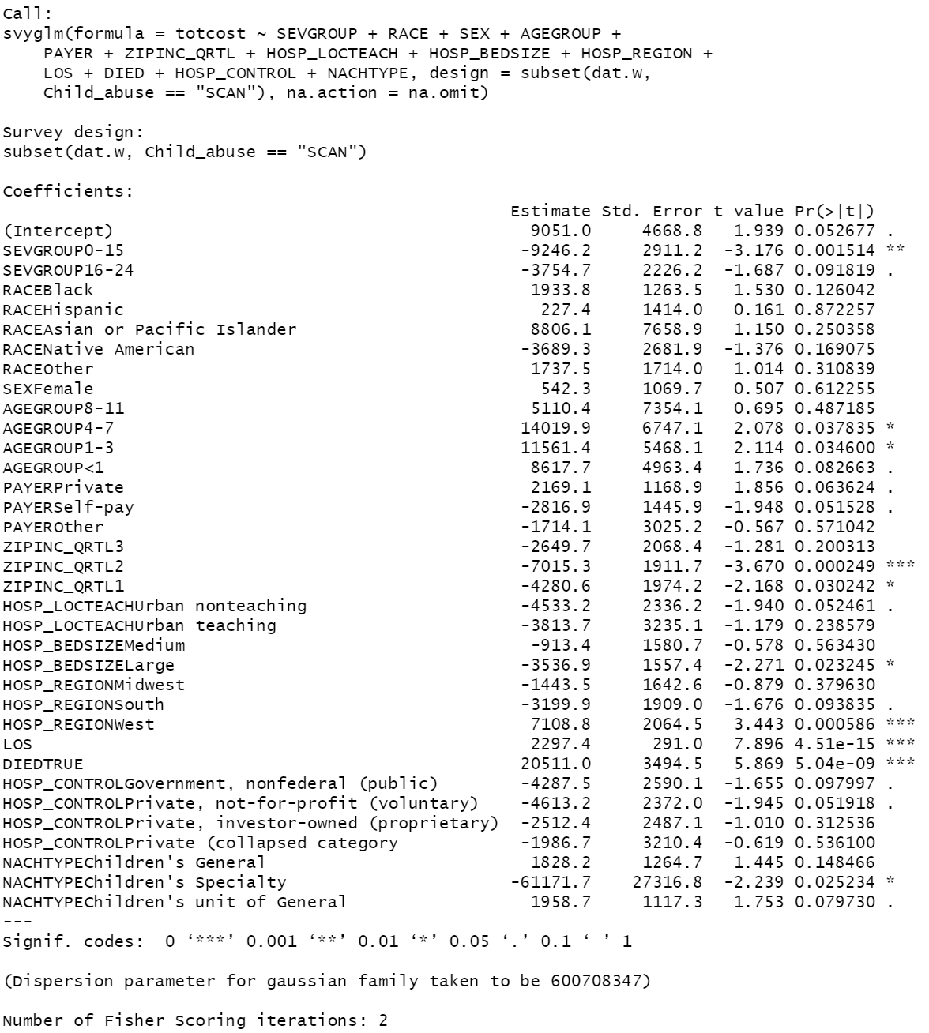
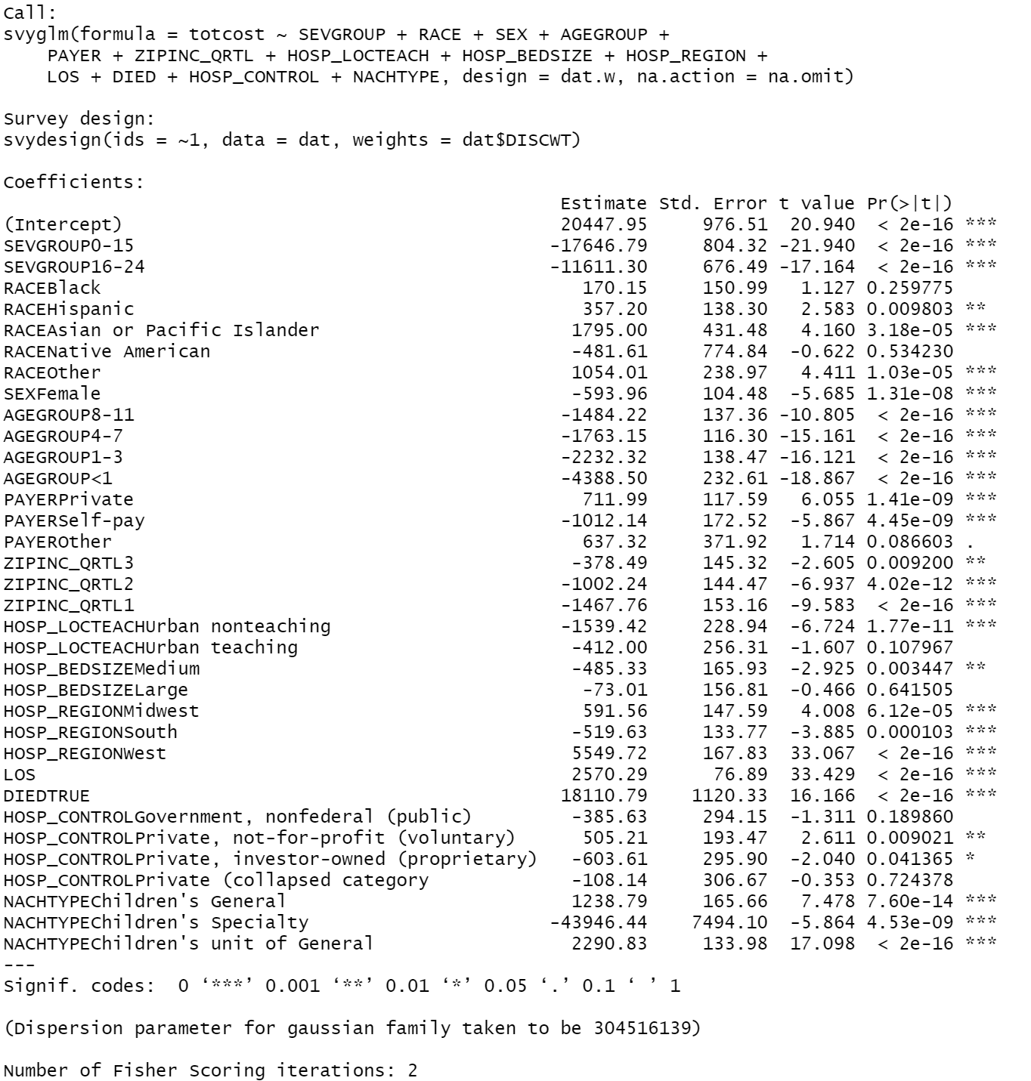
Cost_all vs Cost_scan

Slide 8
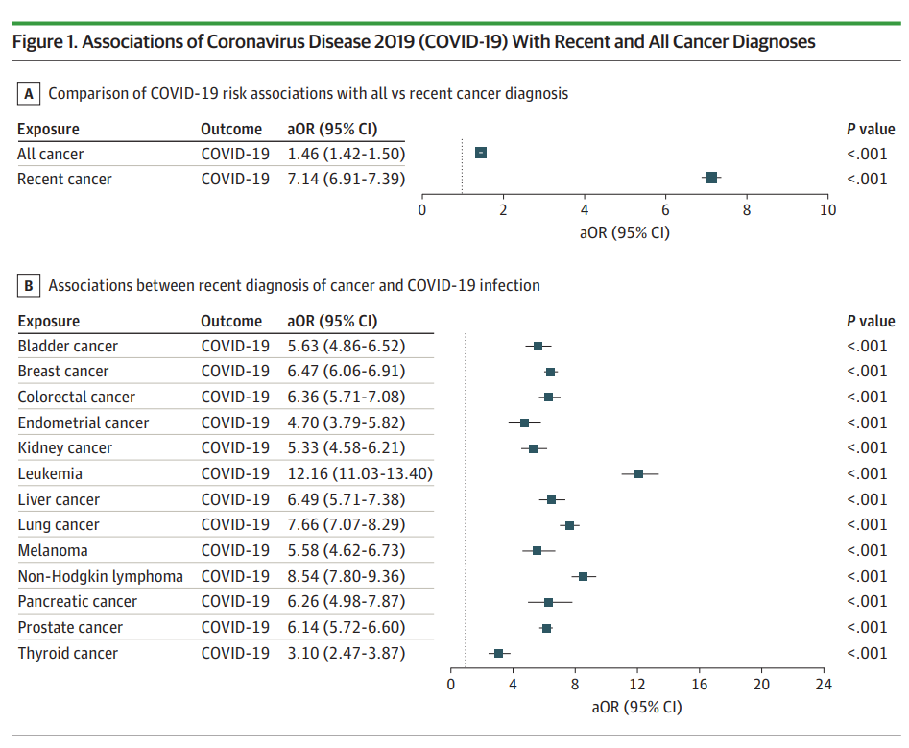
KIDs Odds Ratio
References
Racial Disparities in Incidence and Outcomes Among Patients With COVID-19
Odds Ratio:
Among those who Recently got diagnosed as cancer, the ratio of the number who get Covid-19 positive to the number who don’t get is higher than it is among who got all cancer.
People who got leukemia are more likely to get Covid-19 positive.

Slide 9
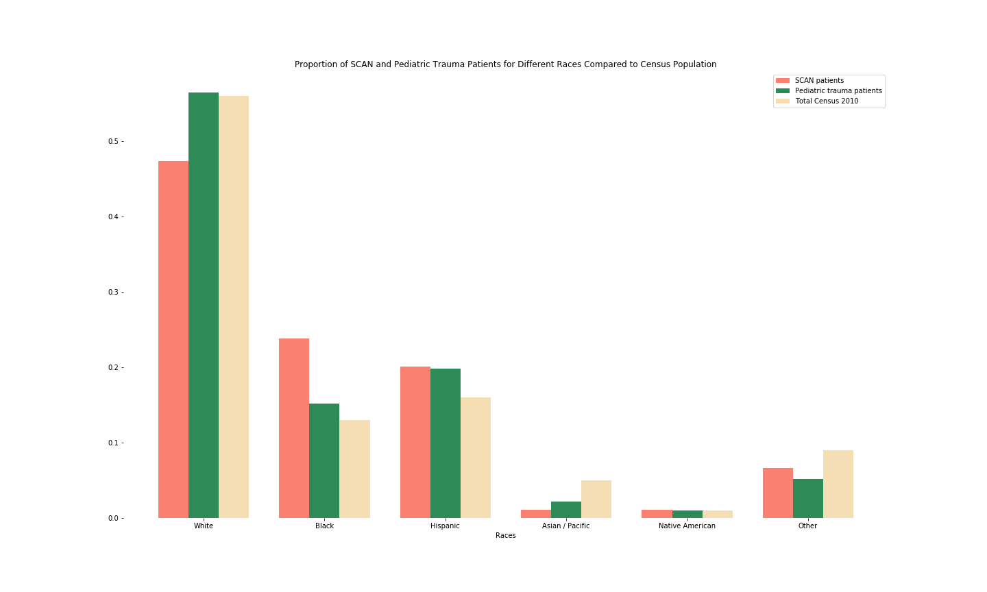
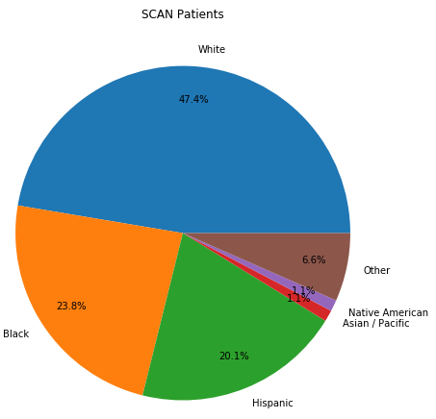
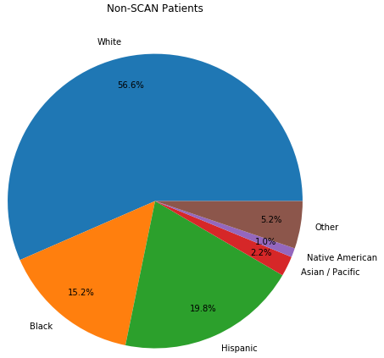
Association of SCAN and Race
Figure 1. Association of Suspected Child Abuse and Neglect(SCAN) with Races

Slide 10
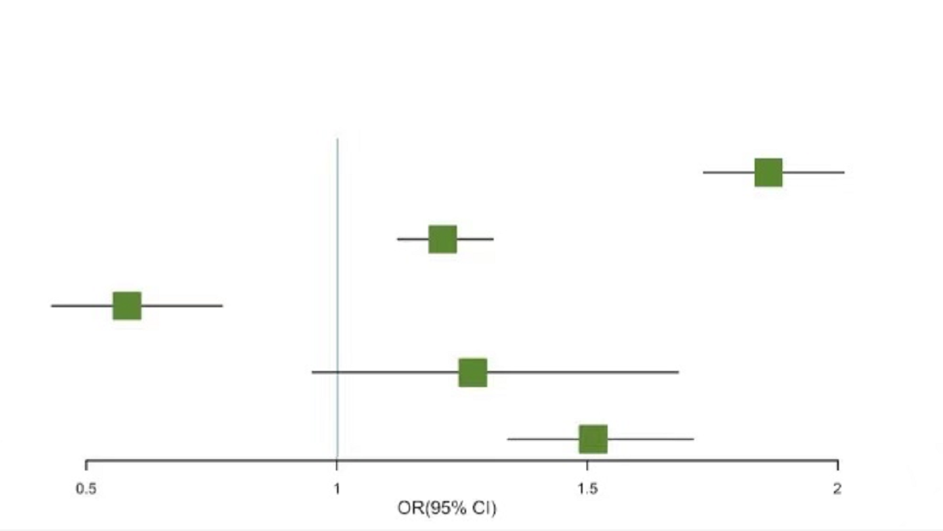
Association of SCAN and Race
Figure 1. Association of Suspected Child Abuse and Neglect(SCAN) with Races
Exposure | Outcome | OR(95% CI) | P Value
White Race | SCAN | - [Reference] | -
Black Race | SCAN | 1.86 (1.73-2.01) | <0.01
Hispanic Race | SCAN | 1.21 (1.12-1.31) | <0.01
Asian or Pacific Islander Race | SCAN | 0.58 (0.43-0.77) | <0.01
Native American Race | SCAN | 1.27 (0.95-1.68) | 0.1
Other Race | SCAN | 1.51 (1.34-1.71) | <0.01

Slide 11
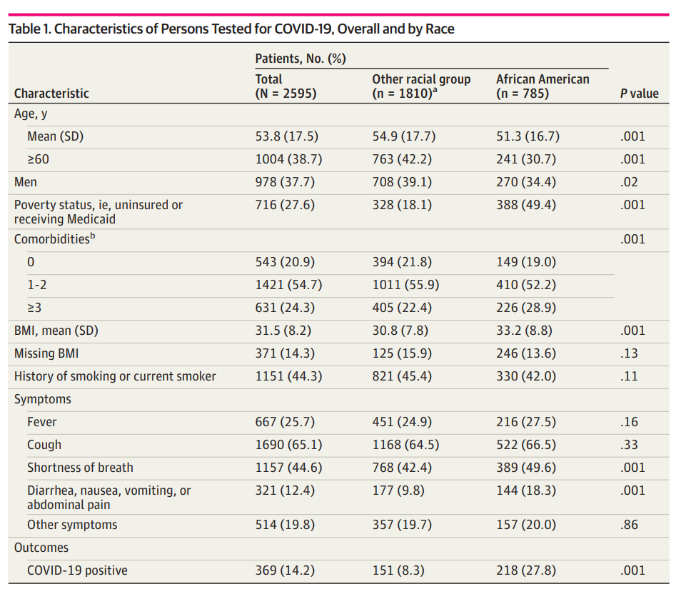
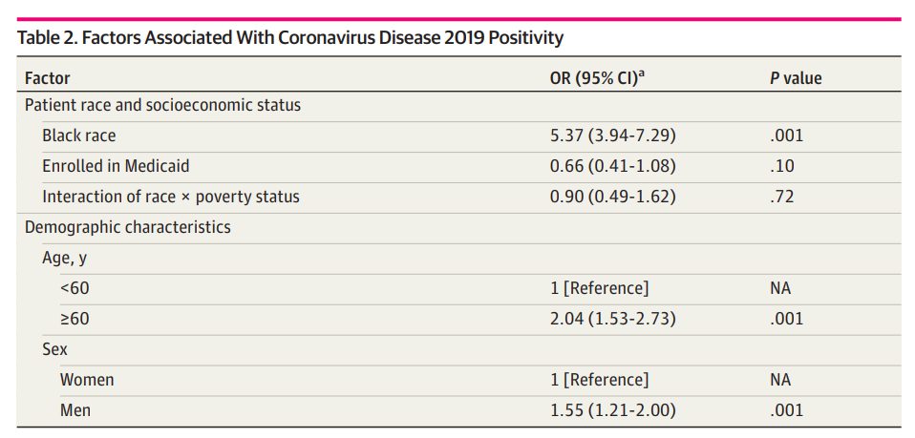
KIDs Odds Ratio
References
Analyses of Risk, Racial Disparity, and Outcomes Among US Patients With Cancer and COVID-19 Infection

Slide 12
Factors associated with SCAN
Factor | OR (95% CI) | P value
Demographic characteristics
Race
White | - [Reference] | -
Black | 1.21 (1.07-1.36) | <0.01
Hispanic | 0.62 (0.55-0.71) | <0.01
Asian or Pacific Islander | 0.50 (0.34-0.74) | <0.01
Native American | 0.72 (0.44-1.18) | 0.2
Other | 0.86 (7.16-1.02) | 0.1
Age
12-17 | - [Reference] | -
8-11 | 1.13 (0.74-1.73) | 0.6
4-7 | 3.08 (2.30-4.13) | <0.01
1-3 | 19.82 (15.7-25.0) | <0.01
<1 | 90.59 (72.5-113.2) | <0.01
Sex
Male | - [Reference] | -
Female | 1.10 (1.00-1.20) | 0.04
Factor | OR (95% CI) | P value
Socioeconomic status
Payer
Medicaid | - [Reference] | -
Private | 0.32 (0.28-0.36) | <0.01
Self-pay | 0.51 (0.39-0.67) | <0.01
Other | 0.96 (0.79-1.16) | 0.7
Zip code
4 | - [Reference] | -
3 | 1.43 (1.23-1.68) | <0.01
2 | 1.40 (1.20-1.64) | <0.01
1 | 1.33 (1.14-1.56) | <0.01
Hospital location
Rural | - [Reference] | -
Urban nonteaching | 0.77 (0.52-1.14) | 0.2
Urban teaching | 1.05 (0.66-1.66)) | 0.8
… …
Figure 2. Factors associated with SCAN

Slide 13
NTDB
To do:
Read codes provided by Chaonan.
Get familiar with the NTDB and PUF data files.
Reproduce the results of Chaonan.
Discuss about next steps.

Slide 14
KIDs & NTDB Thanks!
Zhuoyi Huang, zhuoyih@stanford.edu
Stanford University School of Medicine
Division of Pediatric Surgery

