Slide 1
Relative phase information for detecting human speech and spoofed speech
ID : 201501188
Name : Dhavalkumar Prajapati
Stage- 2

Slide 2
Algorithm Development
+
Implementation

Slide 3
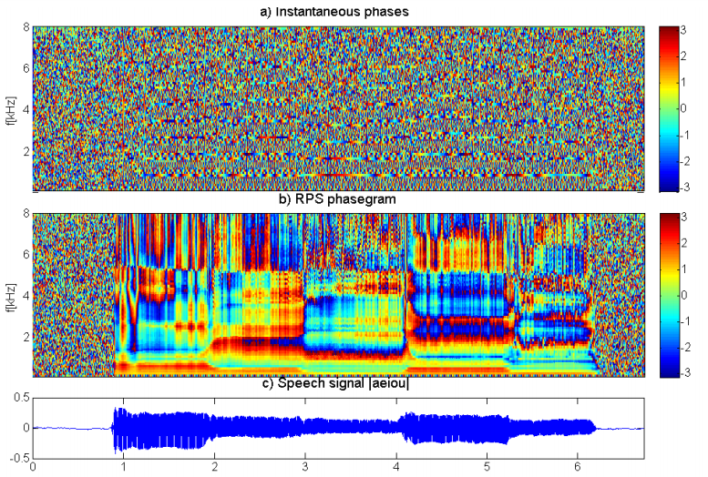
Source paper : Synthetic Speech Detection Using Phase Information

Slide 4
Pitch Tracking
[srh_f0,srh_time] = pitch_srh(x,fs,75,300,10);
Male Min frequency = 85 Hz
Female max frequency = 255 Hz
SRH: Summation of Residual Harmonics

Slide 5

sin_analysis()
Estimate sinusoid parameters using peak picking
For estimation :
frames = sin_analysis(x, fs, fos,option);
This function will estimate the value of amplitude,frequency and phase

Slide 6
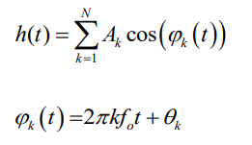


Harmonic analysis models each frame of a signal by means of a sum of sinusoids harmonically related to the pitch or fundamental frequency (f0)
Consider two signal as below
For simplicity we take θ1 = 0 so at time ta this two signal can be represented as

Slide 7
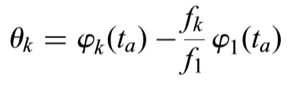

Eq. (1)
Eq.(2)
From Eq(1) and Eq(2) we get RPS :
In the case of harmonic analysis, f1 will be the fundamental frequency ( f0), the frequencies of the two sinusoids will be harmonically related, so f(k)=kf(1), and thus RPS:

Slide 8

RPS implementation
[RPS,option] = phase_rps(frames, fs, option);
Function phase_rps algorithm:
for n=1:size(f0s)
Ks = (0:size(frames(n).sins,2)-1)
pk = frames(n).sins(3,:); % 1.Amp , 2.fre, 3.The instantaneous phase
rps = pk - Ks.*pk(1);
dctsignal = dct2(rps);
static = dctsignal(1:60,:); % First 60 features
del = deltas(static);
deldel = deltas(del);
feature = [static;del;deldel];

Slide 9
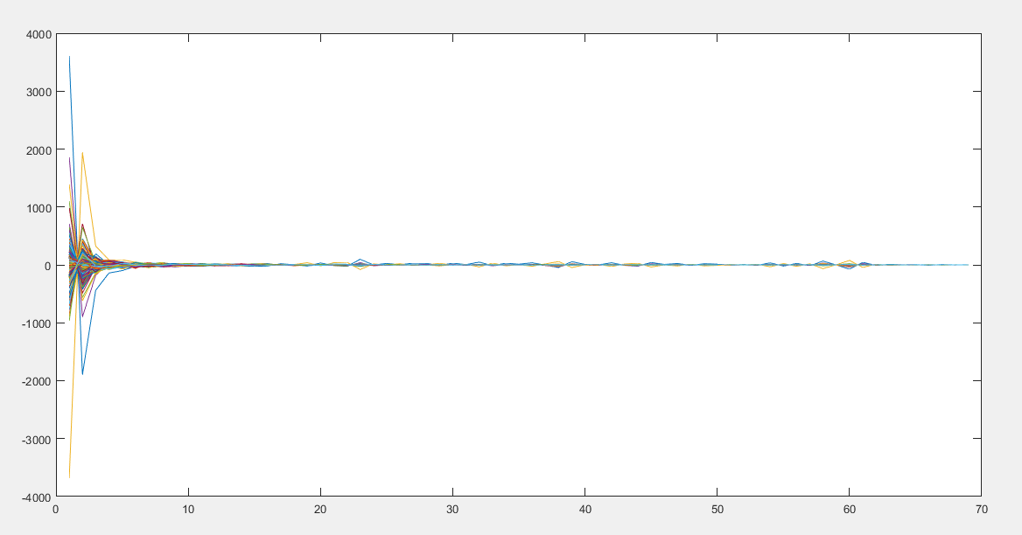
Features plot

Slide 10
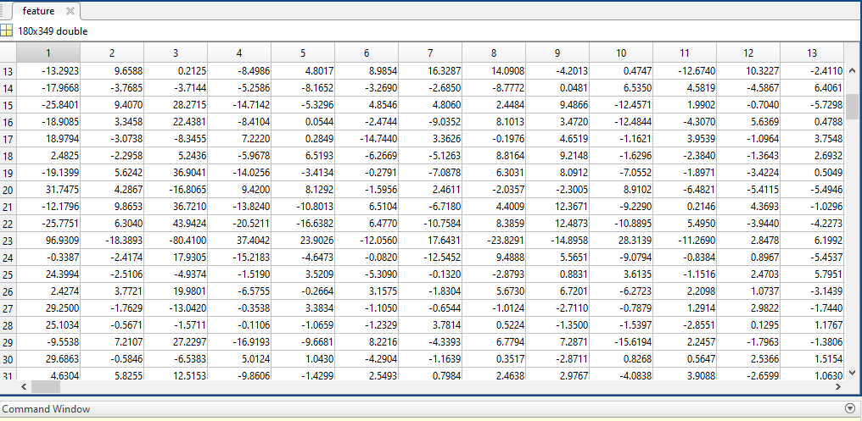
Features

Slide 11
Timeline for stage 3
Development of GMM (10-13 April)
Literature search on Replay attack (Database : “ASV spoof 2015” ) (14-15 April)
Implementation of Model (16-20 April)
Performance Analysis (01-04 May)

Slide 12
Literature Search
Simple representation of signal phase for harmonic speech models by I. Saratxaga, I. Herna´ez, D. Erro, E. Navas and J. Sa´nchez , ELECTRONICS LETTERS 26th March 2009 Vol. 45 No. 7
Features and Classifiers for Replay Spoofing Attack Detection by Cemal Hanilci
Speech Analysis/Synthesis Based on a Sinusoidal Representation by Robert J McAULY , THOMAS QUATIERI and IEEE Members,IEEE TRANSACTIONS ON ACOUSTICS, SPEECH, AND SIGNAL PROCESSING, VOL. ASSP-34, NO. 4, AUGUST 1986
Synthetic Speech Detection Using Phase Information by Ibon Saratxagaa , Jon Sanchez , Zhizheng Wub , Inma Hernaez

Slide 13
Thank You

