Slide 1
Topic : ​Relative phase information for detecting human speech and spoofed speech
ID : 201501188
Name : Dhavalkumar Prajapati

Slide 2
Motivation
Recently Speaker verification technology is used in many domain like banking system, security locks, unlock mobile, laptop etc.Voice conversion techniques present a threat to speaker verification systems.
In all domain security is very important, so this project’s aim is to prevent spoofed speech attack.

Slide 3
Applications
Speaker verification
To prevent bank scams
Mobile and Laptop unlock using speech
Security system

Slide 4
What is relative phase?
The phase of certain base frequency kept constant and the phase of other frequency estimate relative to this base frequency.

Slide 5
How it possible ?
Relative phase information extracted from a Fourier spectrum is used to detect spoofed speech.
Because natural phase information is entirely lost into spoofed speech.

Slide 6
Overview of spoofing detection system

Slide 7
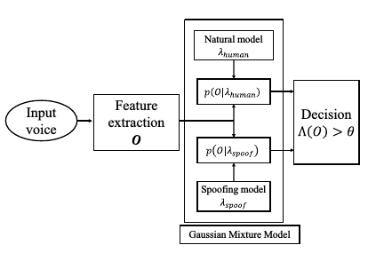

Slide 8


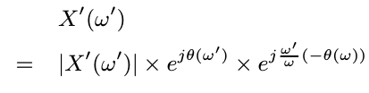
Relative Phase Information
Fourier transform of the signal 𝑥(n)
For calculate relative phase set base frequency ω to 0 we obtain
So other frequency ⍵’ spectrum become

Slide 9

The normalized phase information becomes

Slide 10
Time plan for Stage 2
time plan of work for stage 3
Gathering information about Relative phase feature
analysis of limitations in results and methods
20.03.2018
25.03.2018
31.03.2018
05.04.2018
06.04.2018
algorithm developments for calculation of RP
analysis of statistical significance of results

Slide 11
Literature search
Longbiao Wang , Yohei Yoshida, Yuta Kawakami1and Seiichi Nakagawa, “Relative phase information for detecting human speech and spoofed speech”,ASVspoof Challenge 2015
Longbiao Wang, Member, IEEE, Seiichi Nakagawa, Zhaofeng Zhang, Yohei Yoshida, and Yuta Kawakami, “Spoofing Speech Detection Using Modified Relative Phase Information”,IEEE JOURNAL OF SELECTED TOPICS IN SIGNAL PROCESSING, VOL. 11, NO. 4, JUNE 2017
Hema a Murthy and B Yegnanarayana “Group delay functions and its applications in speech technology”,Sadhana Vol. 36, Part 5, October 2011, pp. 745–782. c Indian Academy of Sciences

Slide 12
Future Implementation
Relative Phase model’s EER comparison with other models Like
MFCC + Relative Phase
MGDCC + Relative Phase
MFCC + MGDCC + Relative Phase

Slide 13
Thank You

