Slide 1
Relative phase information for detecting human speech and spoofed speech
ID : 201501188
Name : Dhavalkumar Prajapati
Stage- 3

Slide 2
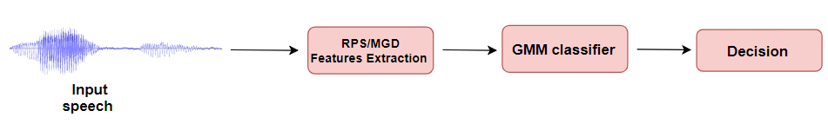
Flow chart of Spoofing detection system

Slide 3
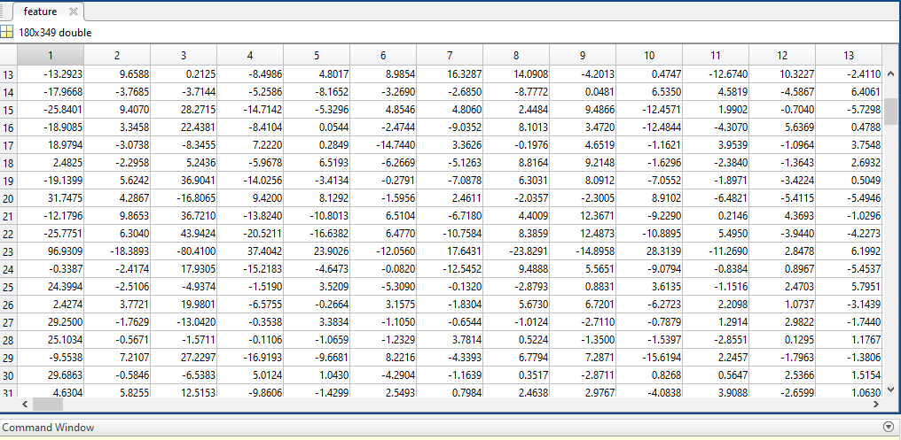
RPS features extracted in stage 2

Slide 4


MGDCC (Modified Group Delay Cepstral coefficient)
Group Delay is defined as the negative derivative of the Fourier Transform phase with respect to frequency
We can also calculate directly from the signal by using below equation
Where R is stands for real part and I for Imaginary part and Y(n) = nX(n).

Slide 5
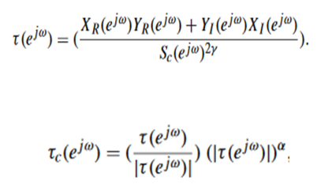
MGDCC cont.
For smoothing the curve we modify group delay function as below :

Slide 6
Implementation of MGDCC
modified_group_delay_feature(filePath, alpha, gamma, num_coeff)
Here alpha and gamma parameter are control the shape of spectrum and num_coeff is the value of dimension
By trial and error smoothing parameter,
alpha = 0.2
Gamma = 0.9

Slide 7
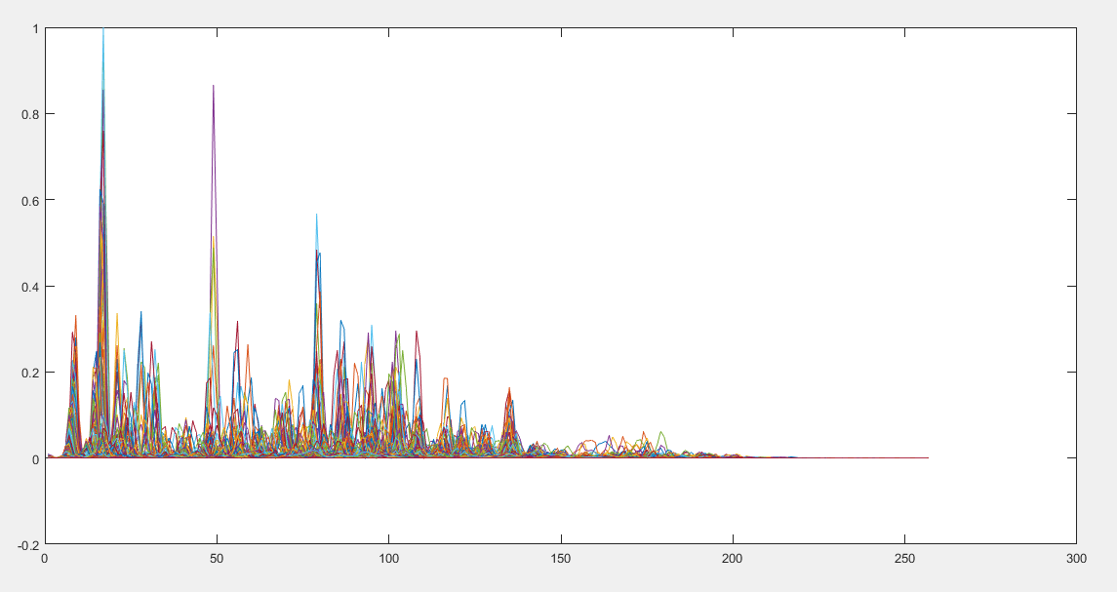
MGDCC

Slide 8
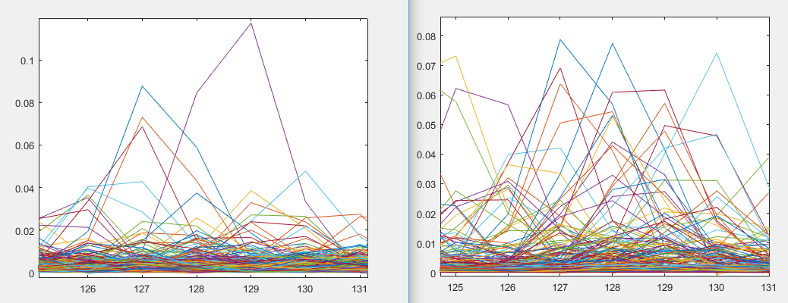
GD vs Modified GD
Group delay
Modified Group delay

Slide 9
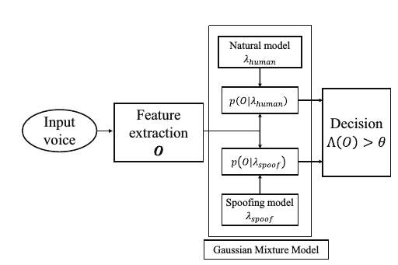
GMM
Features
Decision

Slide 10
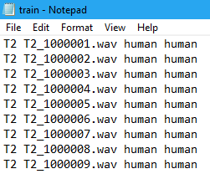
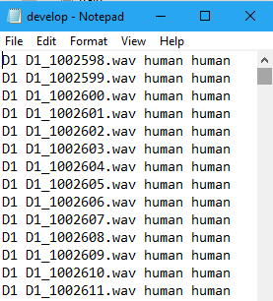
Dataset
“ASV Spoof 2017” dataset
Train using S1 to S5 known spoof attack

Slide 11
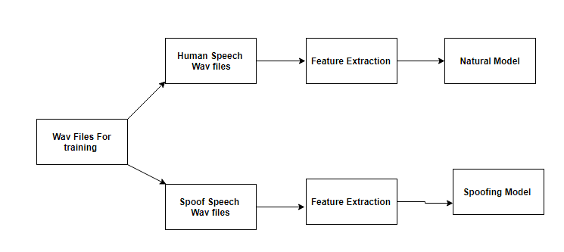
Train GMM

Slide 12
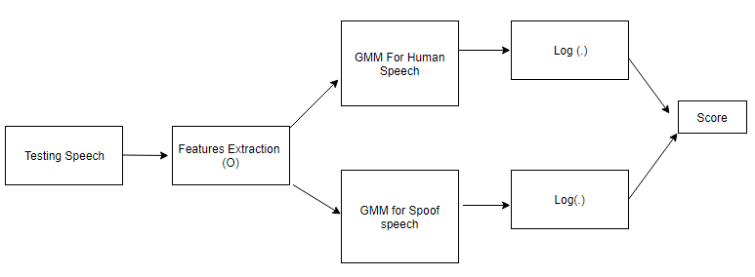
Development
P(O/λ_{hman})
P(O/λ_{human})
P(O/λ_{Spoof})
scores(i) = llk_human - llk_spoof;

Slide 13
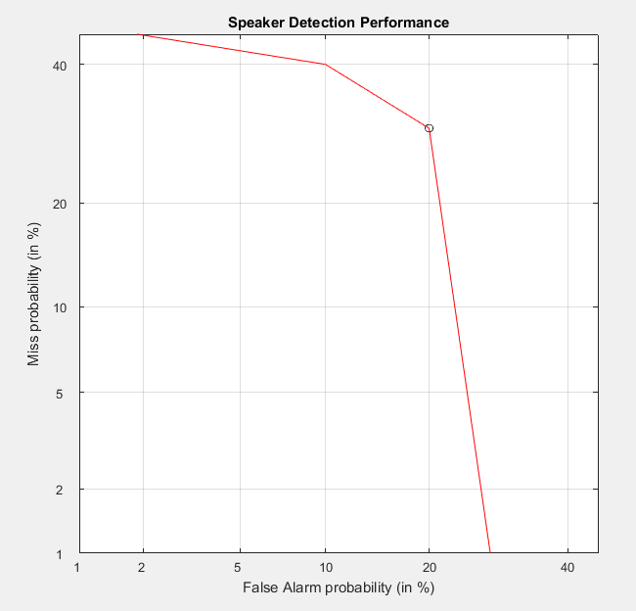
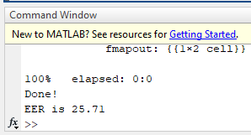
Analysis of results
For RPS DET Curve

Slide 14
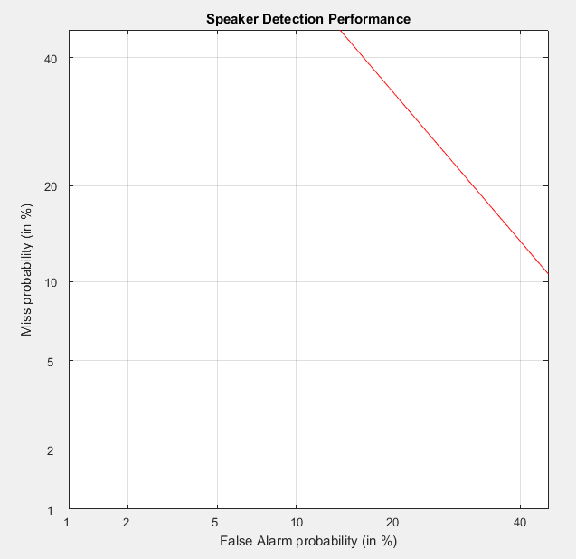
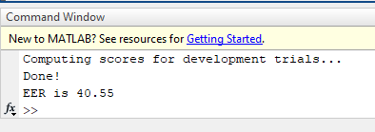
Analysis of results
DET curve For Group Delay

Slide 15
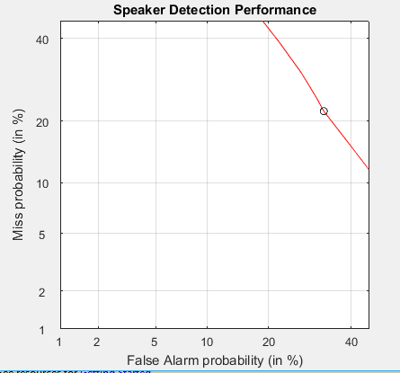
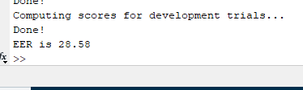
Analysis of results
DET curve For Modified Group Delay

Slide 16
Comparison of Result
Feature Extraction Method | EER(Error Equality Rate)
Relative Phase Shift | 25.71
Group Delay | 40.55
Modified Group Delay Function | 28.58

Slide 17
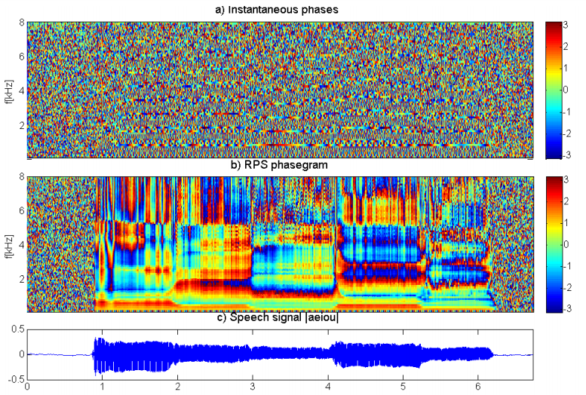
Limitation
RPS feature only obtain for voiced speech
Source paper : Synthetic Speech Detection Using Phase Information

Slide 18
Future work
Large Dataset would give very good results
Relative phase shift and Modified Group Delay cepstral coefficient combination would give better result
Combination of Relative Phase Shift and MFCC
RPS + MFCC + MGDCC

Slide 19
References
ASVspoof 2017: Automatic Speaker Verification Spoofing and Countermeasures Challenge Evaluation Plan by Tomi Kinnunen , Nicholas Evans , Junichi Yamagishi , Kong Aik Lee , Md Sahidullah , Massimiliano Todisco , H´ector Delgado
Longbiao Wang , Yohei Yoshida, Yuta Kawakami1and Seiichi Nakagawa, “Relative phase information for detecting human speech and spoofed speech”,ASVspoof Challenge 2015
DETware_v2.1 DET-Curve Plotting software for use with MATLAB https://www.nist.gov/file/65996

Slide 20
Thank You

