Slide 1
Data
Analyze & Interpret
Paper!
The
Dream:
Data
Processing
Data
Analysis
Results /
Figures
Writing
Results /
Figures
The
Reality:
Analyze
Data
Data
Paper!
Process
Data
Code
Writing

Slide 3
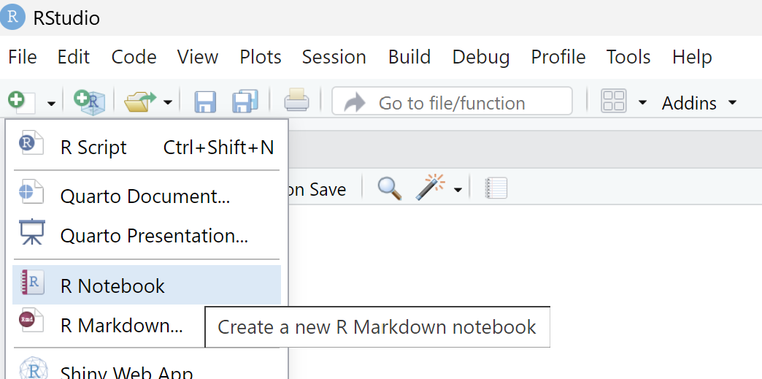


Slide 4
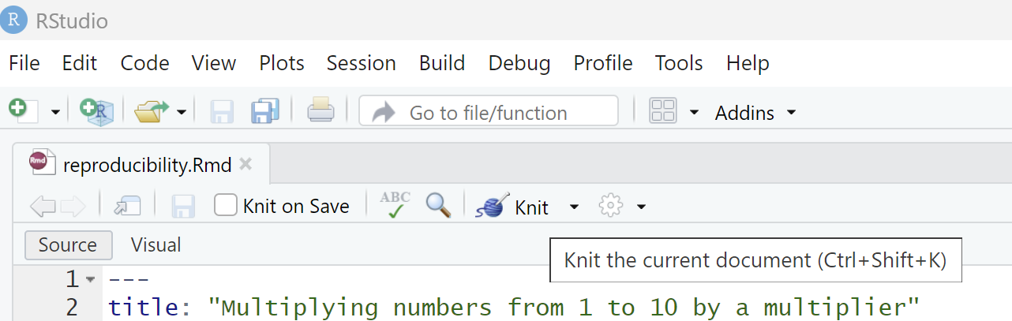

Slide 5
