Slide 1

NUS Course Materials: Ethical Behaviour and Respecting Copyright
All course participants (including permitted guest students) who have access to the course materials on LumiNUS or any approved platforms by NUS for delivery of NUS modules are not allowed to re-distribute the contents in any forms to third parties without the explicit consent from the module instructors or authorized NUS officials

Slide 2
Examples of Disallowed Things
No Posting on any websites (except for the materials explicitly allowed by your lecturer in the respective module)
No selling of material
No sharing of questions/answers which could lead to cheating/plagiarism

Slide 3
Java: Objects

Slide 4
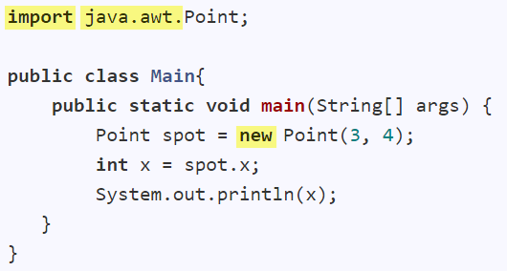

Package containing the Point class
Creates an object
Accesses an attribute of the object
Invokes method of the object
Java uses dot notation to access object members

Slide 5
What is the output?

Slide 8
Parameters
Arguments
Arguments are assigned to parameters.

Slide 9
Parameters
Arguments
Objects: passed by reference (i.e., the same object)
Primitives: passed by value (i.e., a copy)

Slide 10
x = 5
y = 0

Slide 11
x = 5
y = 5

Slide 12
x = 1
y = 1
x = 5
y = 5

Slide 13
x = 1
y = 1
7
x = 5
y = 5

Slide 14
x = 1
y = 1
7
x = 5
y = 5

Slide 15
x = 1
y = 1
7
x = 5
y = 5
What is the output?
(0, 0)
(1, 1)
(5, 5)

Slide 16
x = 1
y = 1
7
x = 5
y = 5
What is the output?
5
7

Slide 17
x = 1
y = 1
7
x = 5
y = 5
Objects: passed by reference (i.e., the same object)
Primitives: passed by value (i.e., a copy)

Slide 18

Garbage Collection
Java Garbage Collector will run periodically to remove unused objects.
This means the object is no longer used

Slide 19
x = 1
y = 1
7
x = 5
y = 5
p is ready to be garbage collected!

Slide 20
Java: Objects
Java uses dot notation to access object members
Objects: passed by reference (i.e., the same object)
Primitives: passed by value (i.e., a copy)
Java Garbage Collector will run periodically to remove unused objects.

Slide 21

Java: Classes

Slide 22
A constructor
Refers to the current object
Another constructor
Refers to the other constructor
A getter method
A setter method

Slide 24
Attributes

Slide 25
Attributes
A constructor

Slide 26
Attributes
A constructor
Refers to the current object

Slide 27
Attributes
A constructor
Refers to the current object
Another constructor
Refers to the other constructor

Slide 28
Attributes
A constructor
Refers to the current object
Another constructor
Refers to the other constructor
A getter method

Slide 29
Attributes
A constructor
Refers to the current object
Another constructor
Refers to the other constructor
A getter method
A setter method

Slide 30
Java: Class level members

Slide 31
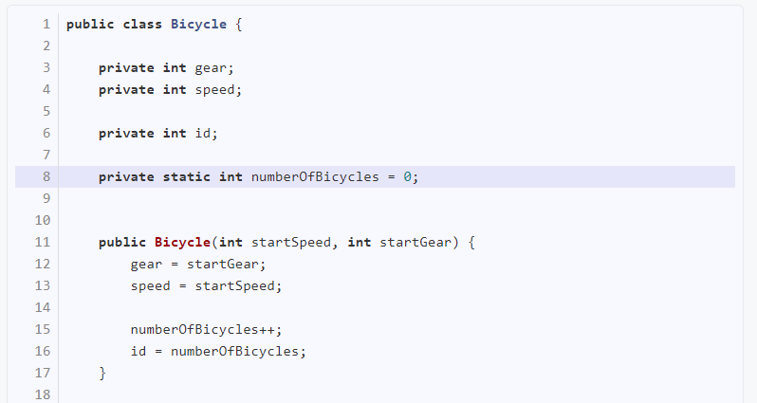

Slide 32
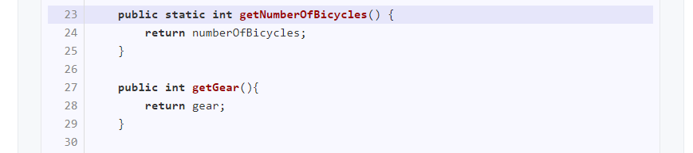

Slide 33
Bicycle b = new Bicycle(0, 1);
System.out.println(b.getNumberOfBicycles());
System.out.println(Bicycle.getNumberOfBicycles());

Slide 34
Java: Class level members
To make something class level use static keyword
To access a class level member, use the class name

