Slide 1
Speech analysis and contrast System
Defense for speech recognition course design
1953348 叶栩冰
1953066 刘昕宇
1953196 张铃沛
2021.12.30

Slide 2
CONTENTS
1
Speech to text (Chinese)
2
Emotion & gender analysis
3
Voice print contrast
4
Volume & else
5
Demonstration

Slide 3
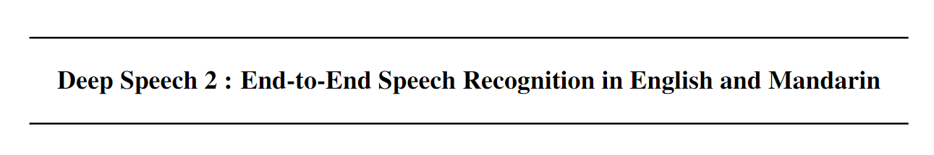
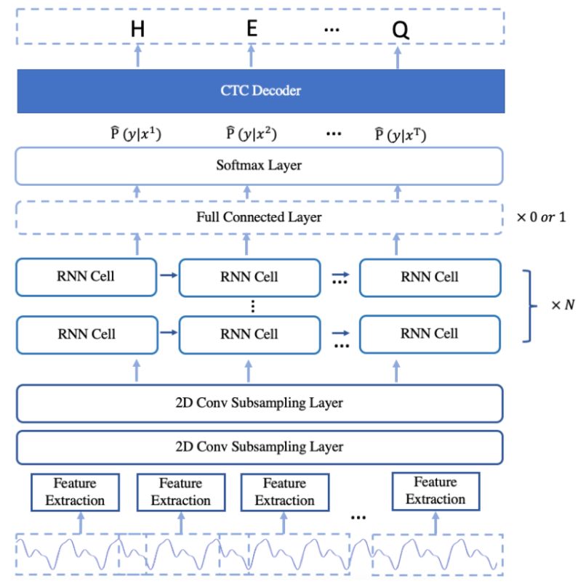
Speech to text (Chinese)
Paddle Deep Speech
•AIShell
•SpenAugment
•2 * Conv + 5 * LSTM
•CTC
•CER – 0.08452
•Score

Slide 4
Emotion & gender analysis
0 – female angry 1 – female calm 2 – female fearful 3 – female happy 4 – female sad 5 – male angry 6 – male calm 7 – male fearful 8 – male happy 9 – male sad
•RAVDESS
•Label
•mfcc 216*13 -> 216*1
•CNN1D
Notes:
为何讲情感和性别放一起 多分类 维度变化便于神经网络输入 普通NN CNN 效果好 adam优化器 多分类 说一嘴激活函数 relu softmax

Slide 5
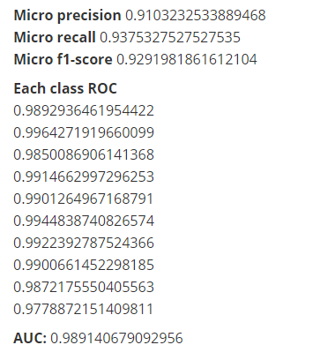
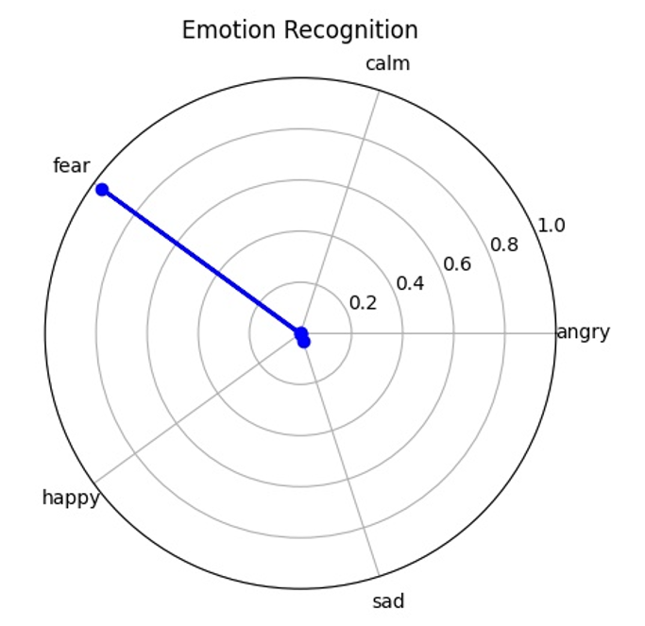
Emotion & gender analysis

Slide 6
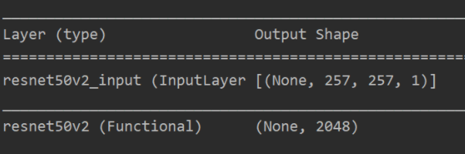
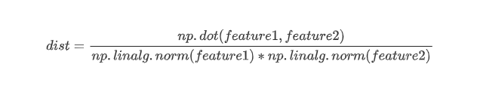
Voice print contrast
•zhvoice
•Short-Time Fourier Transform
•Resnet-50
•ArcFace
Notes:
不使用模型的预测值 而使用模型输出的一维矩阵 对其直接求对角余弦值 0-1 直接判断是否为一个人

Slide 7
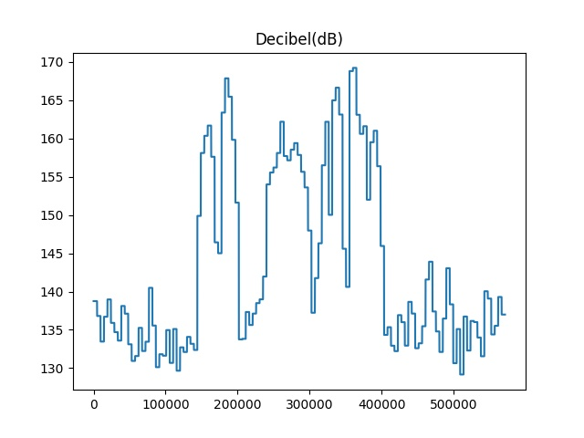
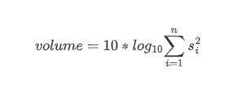
Volume & else
Notes:
每个帧幅值平方和的常数对数的10倍 =》分贝

Slide 8
Demonstration

Slide 9
Thanks a lot !
2021.12.30

