Slide 1
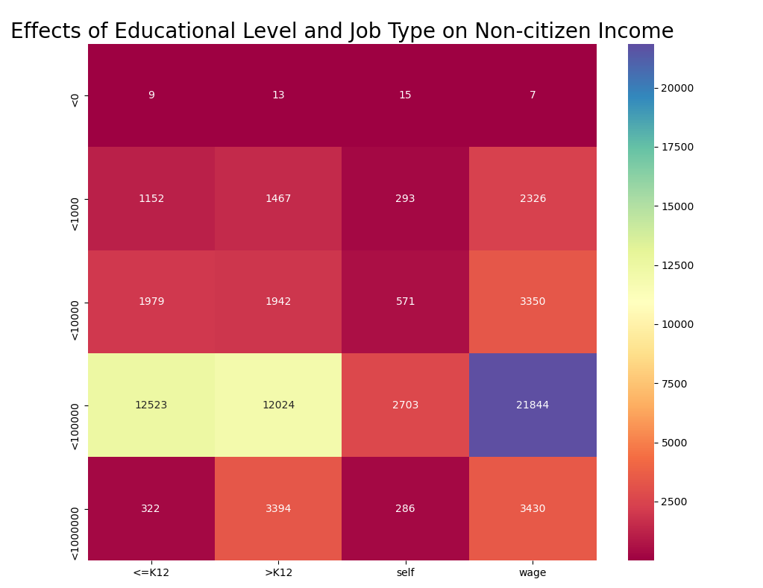
Effects of Educational Level and Job Type on Earnings Between Citizens and Noncitizens

Slide 2
