Slide 1
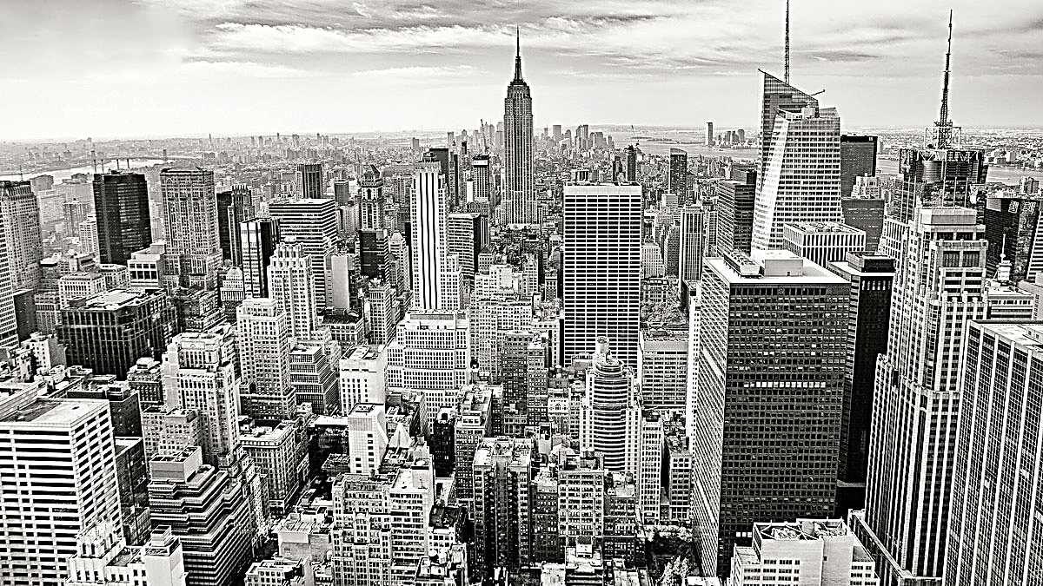
City of Regina Project
— Park Maintenance and Citizen Satisfaction
Shawn Lei, Yang Ye, Youqi Wu, Iris Zhang
Notes:
Hello everyone, I’m Youqi
Welcome to our presentation on the City of Regina Project,
focused on park maintenance and citizen satisfaction.

Slide 2
Regina City: Park Maintenance and Citizen Satisfaction
CONTENTS
1
Executive Overview
2
Critical Issues
3
Analysis
Data Description and Visualization
Location Mapping
Word Cloud
Sub Request Types
Topic Modeling
4
Possible Solutions
5
Implementation Plan
Notes:
On this slide, you can find the contents of our presentation, which include an executive overview, critical issues, analysis, possible solutions, and our implementation plan.

Slide 3
01
Regina City: Park Maintenance and Citizen Satisfaction
Executive Overview
Notes:
In the executive overview, we would like to highlight the challenges we are addressing.

Slide 4
Executive Overview
High volume of park maintenance requests
1
Clients’ need for efficient handling of visitor comments
handle the large number of visitor comments
prioritize critical issues.
2
Overview
3
Ultimate goal:
Improve citizen satisfaction and reduce complaints
Notes:
Due to the high volume of park maintenance requests,
manual review of all the requests has become impractical for the city of Regina.
Our clients: Sara and City of Regina
are seeking a process to efficiently handle
the large number of visitor comments
and prioritize critical issues
Thus, our goal is ultimately improve citizen satisfaction with the park maintenance service and reduce complaints.

Slide 5
02
Regina City: Park Maintenance and Citizen Satisfaction
Critical Issues
Notes:
Then, we will delve into our Critical Issues,

Slide 6
Critical Issues
1. Data Processing Challenge:
Large dataset size requiring automated processing
Inefficiencies in cleaning, understanding, and aggregating data
2. Unstructured Location Data:
Difficulty in accurately associating visitor comments with park locations
Unstructured and obfuscated location information
3. Issue Prioritization:
Need for prioritized list of issues based on frequency of complaints
Resource allocation for effective issue resolution
Notes:
I would like to highlight some key challenges we are facing in data processing,
particularly with large datasets that require automated processing.
These challenges include inefficiencies in data cleaning, understanding, and aggregation.
Additionally, we are struggling with unstructured location data,
accurately associating visitor comments with park locations,
and issue prioritization based on frequency of complaints.

Slide 7
Critical Issues
4. Urgent Issue Identification and Maintenance Constraints:
Strategies to identify urgent issues and consider maintenance constraints
Prompt and efficient resolution of significant problems
5. Citizen Satisfaction and Complaint Reduction:
Focus on critical issues and strategies to improve citizen satisfaction
Minimize number of complaints
Notes:
Urgent issue identification and maintenance constraints are also concerns.
Lastly, we need to focus on citizen satisfaction by minimizing complaints and improving issue resolution strategies.

Slide 8
03
Regina City: Park Maintenance and Citizen Satisfaction
Analysis

Slide 9
Analysis – Data Cleaning and Identifying Urgent Issues
1
Data Description and Visualization
2
Location Mapping
3
Word Cloud
4
Sub Request Types
5
Topic Modeling

Slide 10
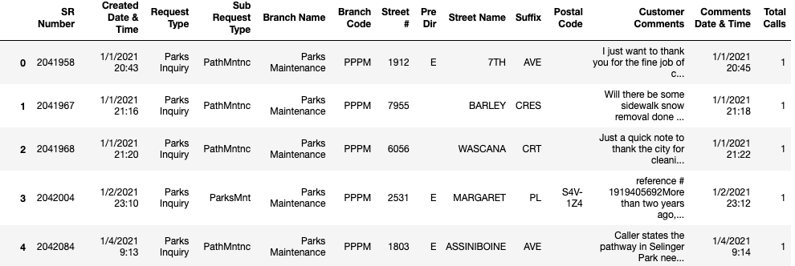
Data Description
Our original data contains 5043 rows of park visitor comments and 14 columns with information that categorizes and explains the comments from 2021-01-01 to 2022-10-21. However, the comments are not directly associated with the park location they are leaving a comment for.

Slide 11
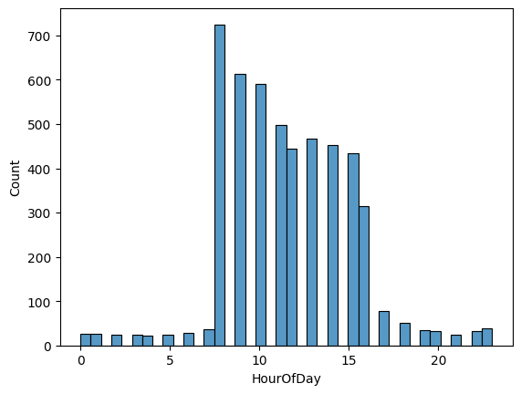
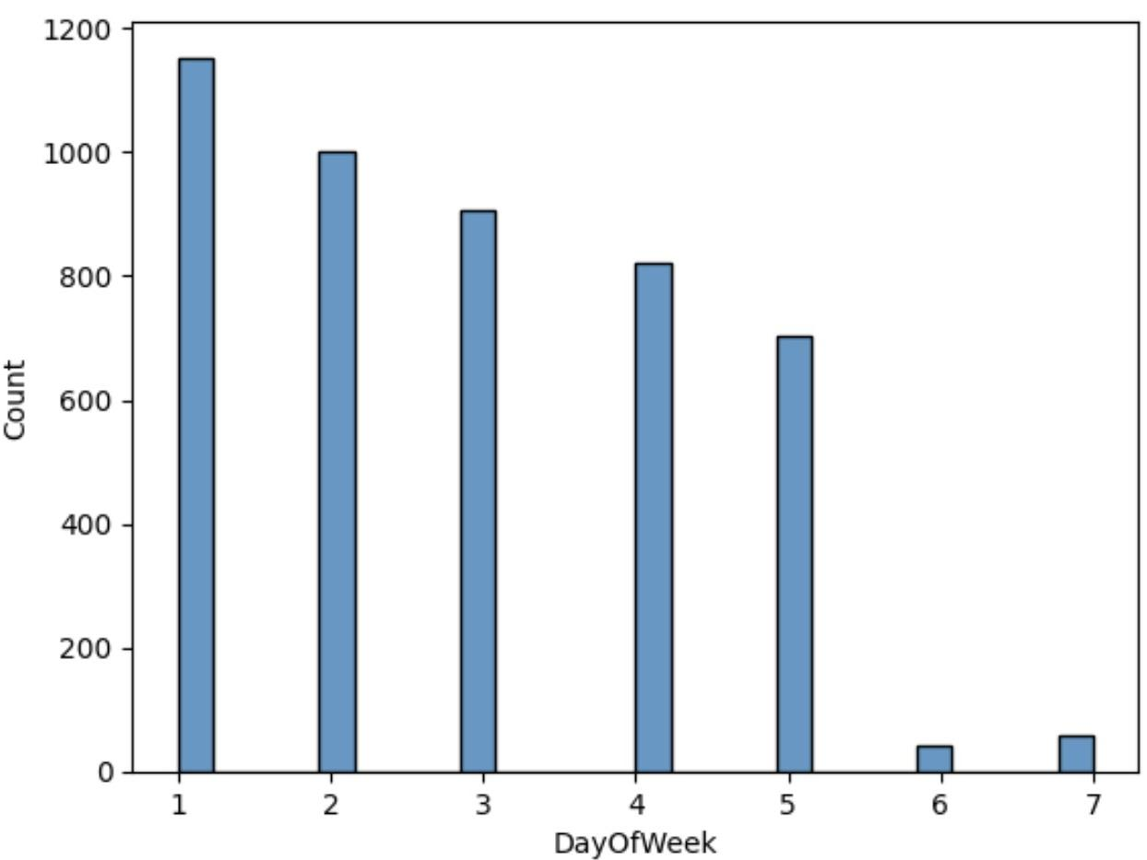
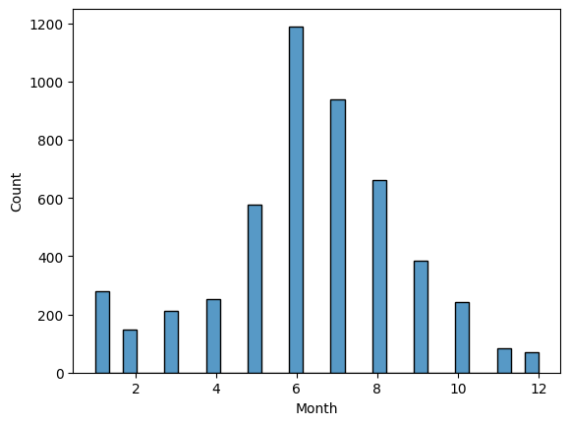
Data Visualization
Number of Complaints by Hour of Day
Number of Complaints by Day of the Week
Number of Complaints by Month

Slide 12
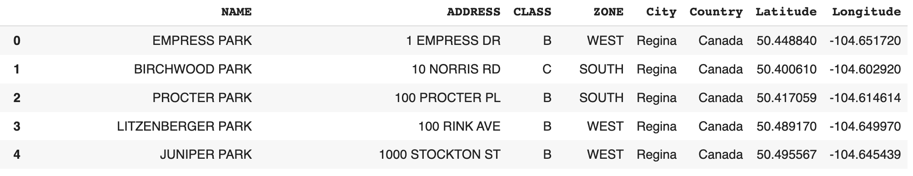
Location Description
The location data contains 306 parks and their address. By using Google geocoding API of park addresses, we get the latitude and longitude data columns.

Slide 13
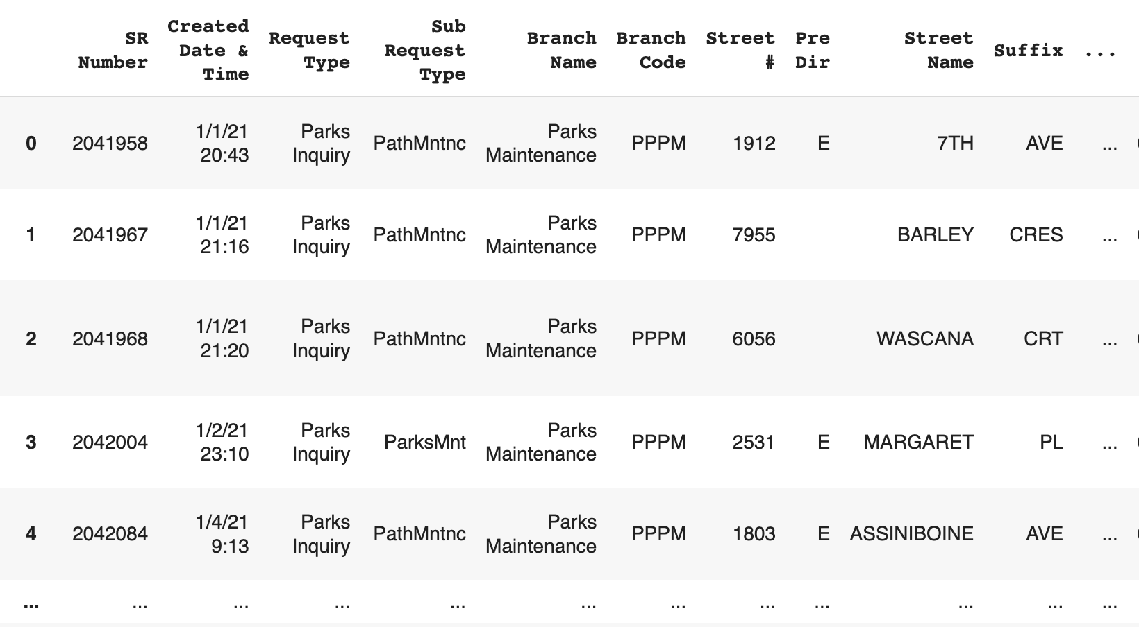
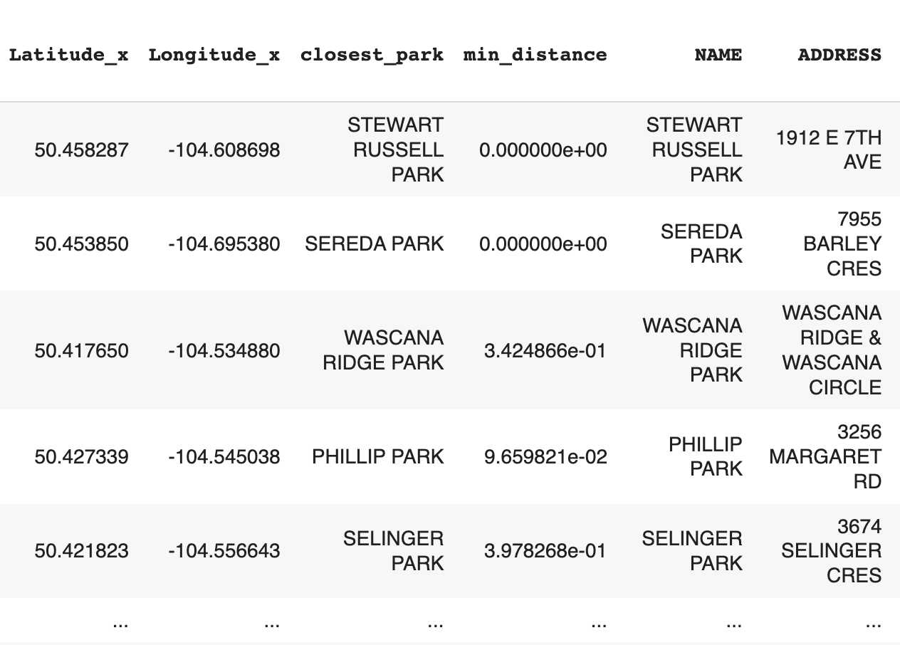
Location Mapping
We calculate the latitude and longitude coordinates for each park on the list. We identify the specific park location associated with each comment by assigning the nearest park to the corresponding comment coordinates.

Slide 14
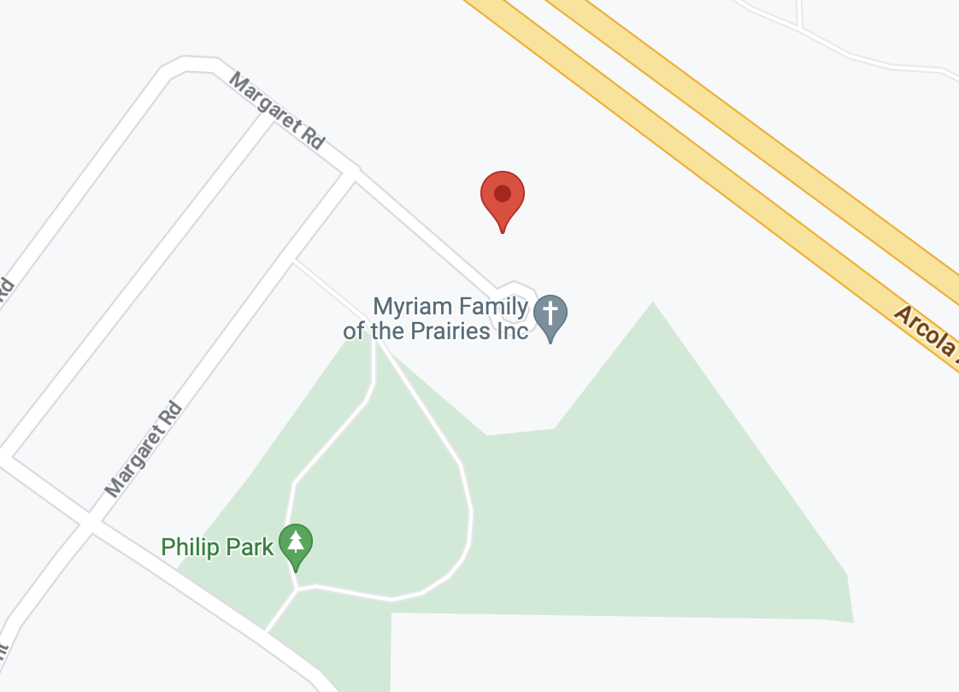
Location Mapping

Slide 15
Sub Request Types
ParksMnt | 1371 | ParksTrePr | 172 | CemetMntnc | 75 | BranchPick | 6 | PestsOther | 2
TurfMntnc | 558 | Ease&Blvd | 152 | ParksDrai | 53 | BrokenBran | 5 | TreePla | 1
IrrigMtnc | 526 | PrkGrbEmpt | 144 | DeadAnPU | 49 | TreeInsp | 4 | LightRep | 1
PathMntnc | 396 | LitPubProp | 132 | FoxtalWeed | 26 | PesNoxWd | 4 | DeadAnimal | 1
VehcleAcce | 248 | OutdrRink | 103 | TreePrunin | 11 | TreeObst | 2 | HortInq | 1
WeedsCity | 231 | PlayEquMnt | 94 | TreeRemova | 8 | RodContrl | 2 | BirdInquir | 1
No Subtype | 202 | WeedsDande | 91 | AdoptGree | 7 | TensCoMnt | 2 | MonInquiry | 1

Slide 16
Sub Request Types
Sub Request Type | Customer Comments | Keyword
PathMntnc | Lights at outdoor rink do not work. Please check and repair. | Lights
OutdrRink | I was awakened this fine morning to that most joyous sound of the back up "beep, beep, beep", flashing yellow beacons and truck lights shining into my bedroom window as the city worked on the skating rink at Mable Brown Park AT 6:45AM!!! Do I have to remind the city that there is a noise bylaw from 10pm to 7am (and 7am is a full hour too early in my opinion). Good Morning to you and Thanks guys. | Noise
OutdrRink | McNab Park Rink lights have not worked properly since the power went out in the storm 2 days ago - also asking to have the heat turned up some inside the shack | Broken lights, no heat
PathMntnc | RPS called - there was a vehicle accident that took down the post at the entrance of St Thomas Park on Tyvan Ave - Police File #RA21011380 | Car accident

Slide 17
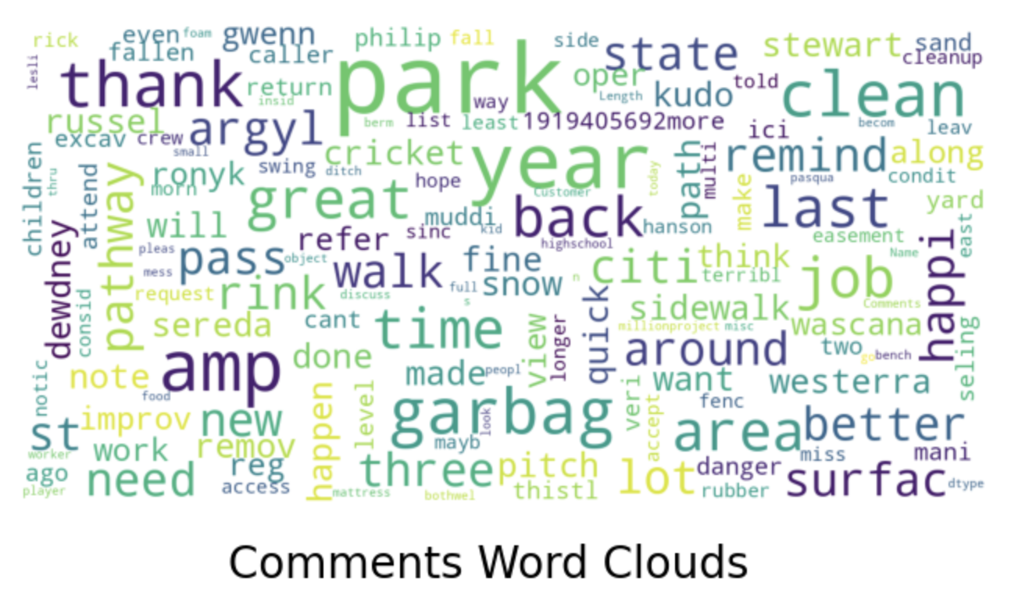
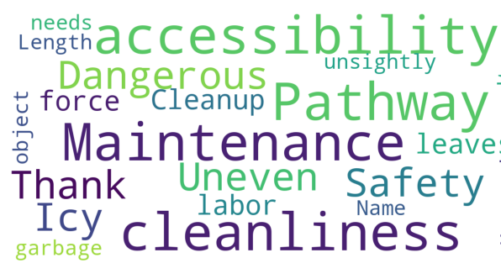
Word Cloud: Identify Urgent Issues
Before Keyword extraction
After Keyword extraction

Slide 18
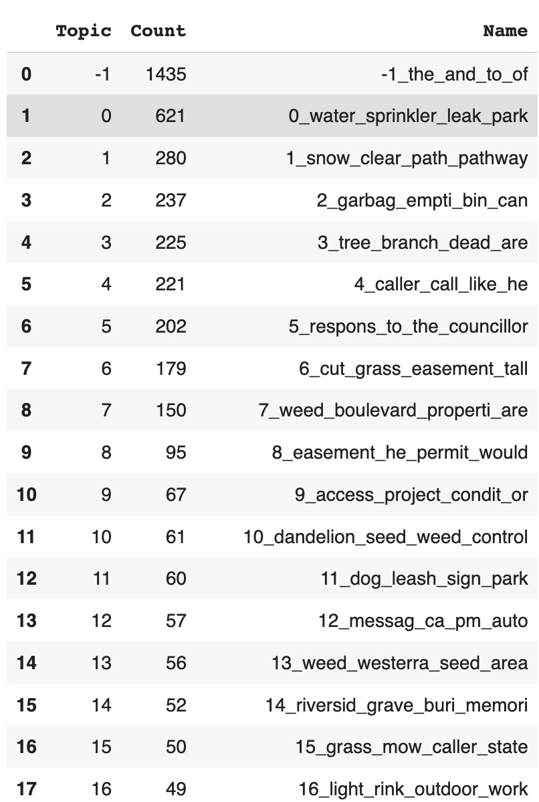
Topic Modeling: Identify Urgent Issues
Note that these topics are only a preliminary sample, not a well-established presentation of our urgent issue classification.
This provides some insight into potential issues that are often brought up in visitor comments, ranked from most frequent to less frequent.

Slide 19
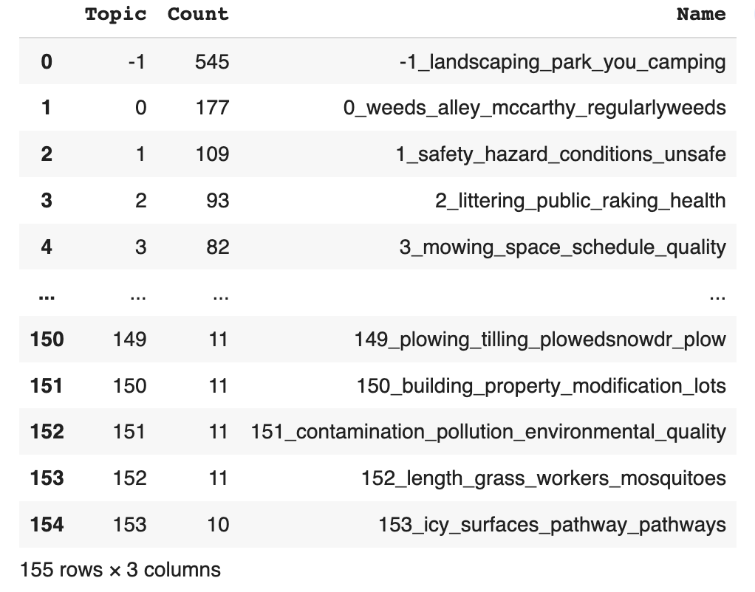
Topic Modeling: Identify Urgent Issues
After
process

Slide 20
04
Regina City: Park Maintenance and Citizen Satisfaction
Possible Solutions
Notes:
As previously mentioned, our goal is to provide our clients with several potential solutions for gathering and processing visitors’ complaints for parks in the city of Regina, and to optimize these solutions. However, we have encountered some difficulties during the progress of our project.

Slide 21
Possible Solutions
Solution: Design a web page for visitors to input comments and immediately reply comments with ChatGPT
Challenge: Some comments are inputted by park client manager after receiving visitors’ phone call. Visitors have no access to web comment system.
Notes:
Solution Step 1: Our first solution involves designing a web page where visitors can input comments and receive immediate replies via ChatGPT. We will provide a demonstration of this in the next section. During this step, the challenge we have encountered is that some comments are inputted by the park client manager after receiving visitors’ phone calls, which means that visitors do not have access to the web comment system. As a result, many park visitors prefer to give their complaints through phone calls, which reduces the efficiency of this solution. However, we believe that this solution has great potential in the future as it becomes more widely used.

Slide 22
Possible Solutions
Solution: Streamline the data processing and continuously output prioritized issue list
Challenge: Lack of communication with client, don’t know which tools (Tableau, Gsheet) are available to them and which input is available to us.
Notes:
Solution Step 2: The second solution we tried involves streamlining the data processing and continuously outputting a prioritized issue list. Howeever, we are currently facing a challenge in terms of communication with the client. Specifically, we are uncertain about which tools are available to them, and which input formats are available to us, and what are our client’s long-term preferences. For example, our tool may not be able to process data if the format changes from “complaints” to “customer reviews.”

Slide 23
Possible Solutions
Solution: Optimize the maintenance schedule based on urgency and serverness of comment
Challenge: Don’t know how each issue is ranked, so we simply rank issues based on the number of times they were mentioned.
Notes:
Solution Step 3: Furthermore, our solution also involves optimizing the maintenance schedule based on the urgency of each comment. One challenge is that we are uncertain about how each issue is ranked, and thus we could simply rank these issues based on the number of times they are mentioned. This approach may not be realistic, as our current rank is based on our own insights.

Slide 24
Possible Solutions
Solution: Cluster the parks into smaller zones by their location, and make maintenance issues more specific
Challenge: Don’t know the actual maintenance schedule (center of maintenance, responsible areas)
Notes:
Solution Step 4: Our fourth solution involves clustering parks into smaller zones by their location and making maintenance issues more specific, which would be more efficient in the future. But currently, we do not have detailed information about the maintenance schedule, such as the number of park maintenance centers in the city of Regina, their locations, or their responsible areas.
We may not have a complete solution to these issues at the moment, but no worries, we prepared some reasonable handling methods in this case. Next, we’ll have Eric to introduce you some solutions we recommended, and how we implement this procedure.

Slide 25
05
Regina City: Park Maintenance and Citizen Satisfaction
Implementation Plan/ Recommended Solution

Slide 26
Recommended Solutions
Critical Issues:
Data Processing Challenge
Unstructured Location Data
Issue Prioritization
Urgent Issue Identification and Maintenance Constraints
Citizen Satisfaction and Complaint Reduction

Slide 27
Recommended Solutions
Data Processing/Unstructured Location Challenge:
Solutions: Get location of comment, and match it to nearest park
Result: We know comment happens in which park

Slide 28
Recommended Solutions
Issue Prioritization and Maintenance Constraints
Solution:
Prioritized issue excel list based on Zone
Prioritized issue excel list based on Season
Park level issue list
Interactive map
Result:
Give client a straightforward look of the data

Slide 29
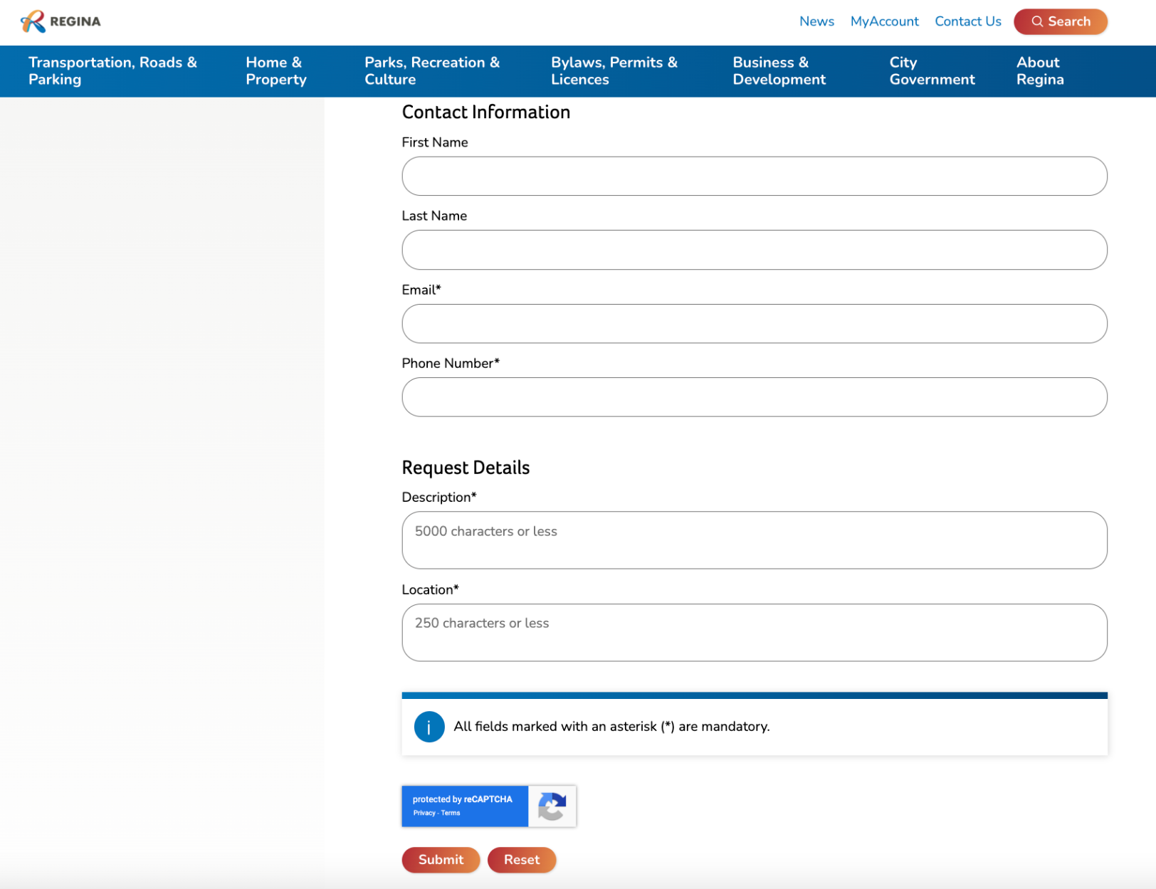
Recommended Solutions
Citizen Satisfaction & Complaint Reduction
Solution:
Chatbot

Slide 30


Demo
Visitor complaint:
More than two year ago the back of our yard in philip park was excavated and not return to an even surface for walk it's dangerous & muddy children have fallen there are many times. it just need a level. Can't this be attended to the pass of time is not make it better.
ChatGPT reply:
We apologize for the inconvenience caused by the uneven surface at Philip Park. We understand the safety concerns and will promptly address the issue. Thank you for your patience and valuable feedback.
Recommended Solutions
A Chatbot that auto replies visitor complaints based on GPT API, which aims to increase citizen satisfaction.
Chatbot
Analyze the patterns of complaints, we designed an maintenance map and list that keep track of urgent issues by client need
Schedule
Notes:
From the previous demo, you can see that we have accomplished several milestones on the path. We have identified the dataset that is graph-structured and contains a time-series component. We have received meaningful results with a couple of algorithms. In the next step,
We believe that using GNN and 1DCNN for data analysis is another powerful approach that can yield valuable insights. We plan to use GNN to learn the structural features of the graph and 1DCNN to analyze the time-series data. By combining these two approaches, we aim to gain a better understanding of the complex relationships between the graph nodes and the time-series data.

Slide 31
Implementation Plan
Map location of comment to nearest park
Extract more representative keywords of comments
Generate interactive Tableau map
Chatbot auto replies visitor comments based on GPT API
Analyze comment patterns, urgency, and priority
Output park issue list

Slide 32
THANK YOU

