Slide 1

CSC343 Presentation
Domain: Factors affecting medal winning in the Paralympic Games

Slide 2
Investigation Questions
1. Research on the effect of numbers of coaches and athletes on the medal winning of a National Paralympic Committee’s (NPCs). More specific, is one country more likely to win more medal if there are more people they send to the Paralympic?
2. Research on the effect of gender in medal winning, not just research on individual, but also on the total medal of a country. More specific, how the gender distribution of a National Paralympic Committee’s (NPCs) involves their medal winning.
3. Research on the effect of age in medal winning, not just research on individual, but also on the total medal of a country. More specific, how the age distribution of a National Paralympic Committee’s (NPCs) involves their medal winning.

Slide 3
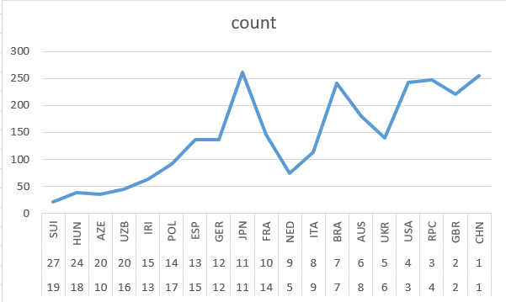
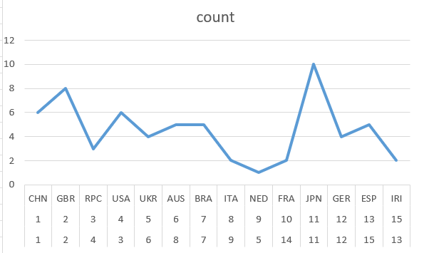
Discussion1
Positive relationship with number of athletes, no obvious pattern for number of coaches
Figure 1.1: Number of Athletes to Ranking of Medals
Figure 1.2: Number of Coaches to Ranking of Medals

Slide 4
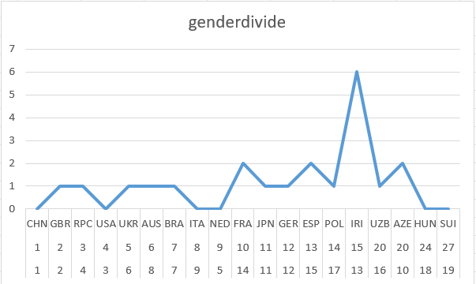
Discussion2
Balancing female and male participants gives a country better chance of more medal winning
Figure 2.1 Gender ratio to medal winning performance (x-axis is ranking)

Slide 5
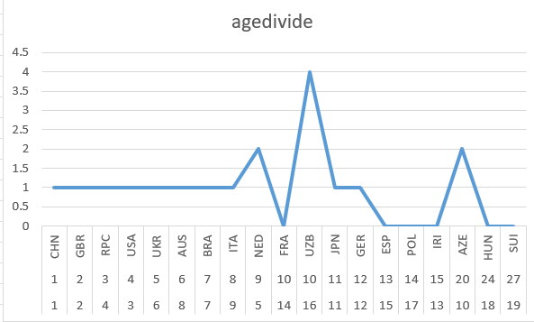
Discussion3
Combination of experience and peak body condition
Figure 3.1 Age Divide to Rankings of Total Medal

Slide 6
Challenges
Problems we faces and how we managed to overcome them
Large database ---- classify the data and divide them into parts
Need learning about domain

Slide 7
Lessons
Technical Issues and how we could improve our coding in the future
Divide-and-Conquer
Using Sample
Importance of Cleaning Data
Classify the elements and using rate as a factor

Slide 8
Questions

Slide 9
THANK YOU FOR LISTENING

