Slide 1




Recommend awaiting areas for FOOD DELIVERS
Problem Statement:
During dashers’ (delivers work for Doordash) daily work, they pick up items from the restaurant and deliver the items to the customers. However, dashers are not assigned to any rest or awaiting area during their idle time.
Data Source:
https://www.kaggle.com/datasets/polartech/doordash-restaurant-data
Team Members:
Yizhan Li, Tongyan Feng

Slide 2
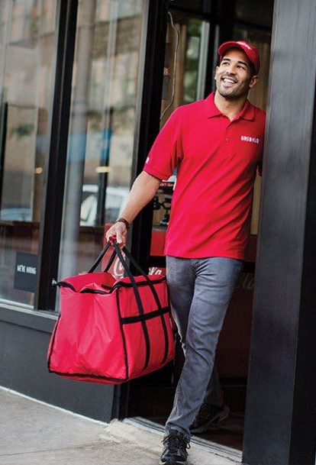
We are looking for:
In our project, we are planning to recommend awaiting/rest points for the dashers, the points radiate areas to ensure the dashers can react to new orders rapidly, in other word, pick joint orders within 2 minutes.
These stop areas may have a high level of closeness or betweenness centrality, they are important nodes to find the characters of the community and can even be used to build the shortest delivery paths.

Slide 3
content
Dimension reduction
Network formulation
Looking for candidate points
Analysis and evaluating the candidates
Conclusion & discussion
Insights

Slide 4
Dimension reduction
Pick 6 columns out of the original dataset.
Only loc_name, address, cuisines, latitude, longitude, review_count, these 6 factors will be used in the following steps.
From the original dataset, the team scoped on a region in Brooklyn, NY, whose ZIP code starts with 11221.
Downsize the number of restaurants to a handleable size and concentrate on a certain region.

Slide 5
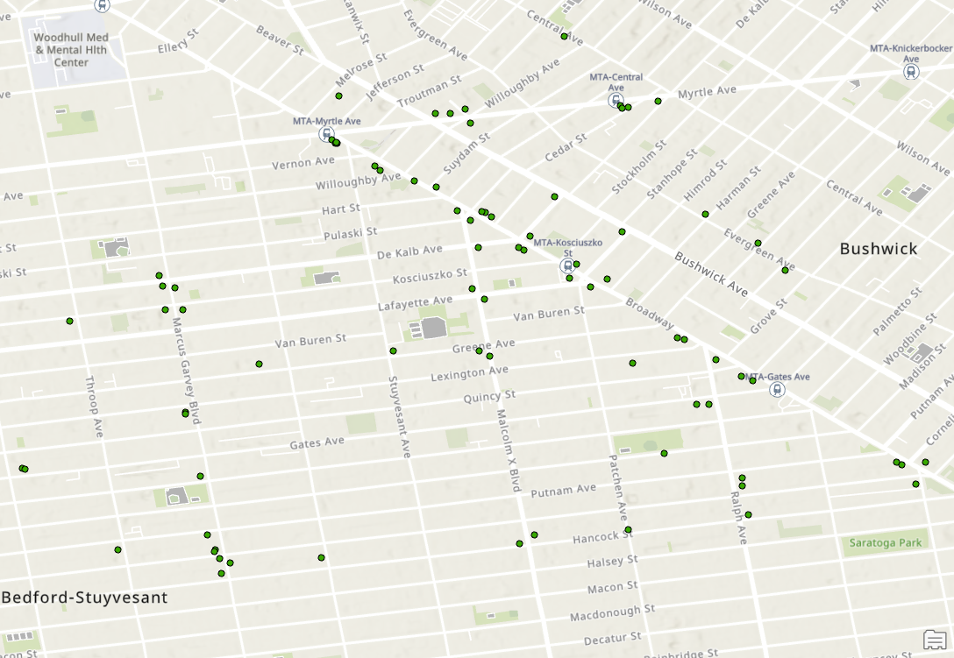
Network Formulation
Using ArcGIS to put the nodes on the map with their longitude and latitude data
Nodes (as green dots):
124 restaurants in this region;
Candidates points.
Edges (not noted):
Connecting restaurants to candidate points;
From candidates point to the service area edges. (later in service area analysis)

Slide 6
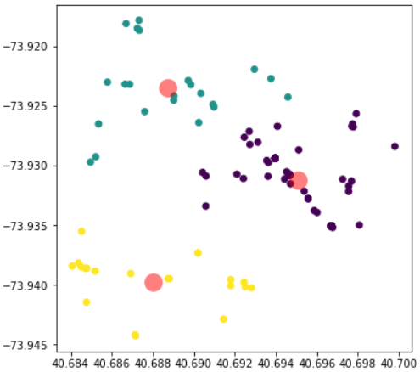
Selecting Potential Candidates
Applying Kmeans method to divide all the locations of restaurants in this region into 3 groups and find one central point for each group.
The locations of 3 candidate points (overall candidates):
40.695, -73.931
40.689, -73.924
40.688, -73.940

Slide 7
Maybe too naïve🤯?
For the restaurants are serving different types of products, we classified all the restaurants into to different categories.
For the restaurants(stores) serving groceries, desserts, and smoothies, we put them into “minor” group.
For the restaurants(stores) serving other kinds of food(like chicken, pizza, deli, sandwich and salad etc.) , we put them into “major” group.

Slide 8
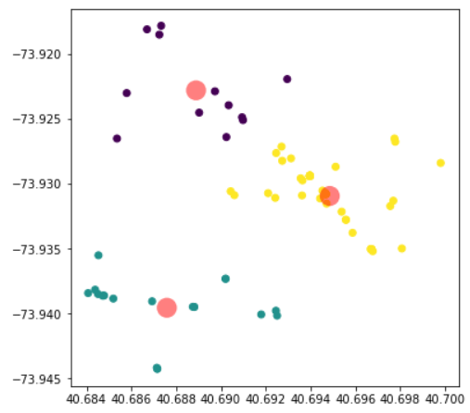
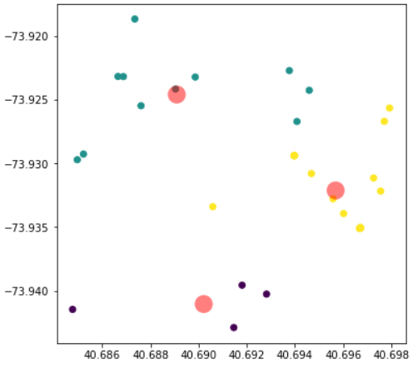
More Candidates
The locations of 3 candidate points for the major group:
40.689, -73.923
40.688, -73.940
40.695, -73.931
The locations of 3 candidate points for the minor group:
40.690, -73.941
40.689, -73.925
40.696, -73.932

Slide 9
Involving joint orders
As the 2 groups of restaurants(stores) have distinguished difference and the amount of stores of these two groups are different, we set up 2 Poisson distributions to simulate the occurrences of orders in each group and try to find the probability of joint orders(two orders from different groups are placed with 2 minutes, thus, the deliver needs to pick both of them up).
The probability can indicate a better position for the team as the location will be closer to the restaurants which are more likely to have orders.

Slide 10
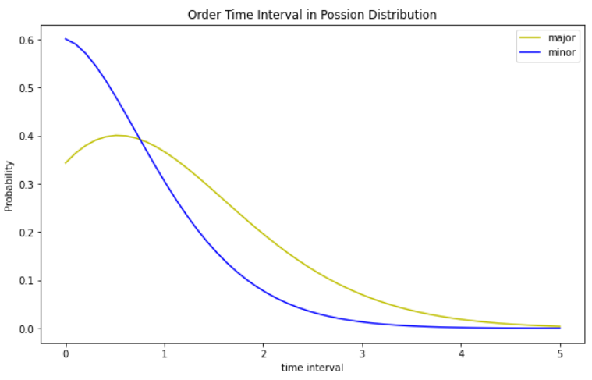
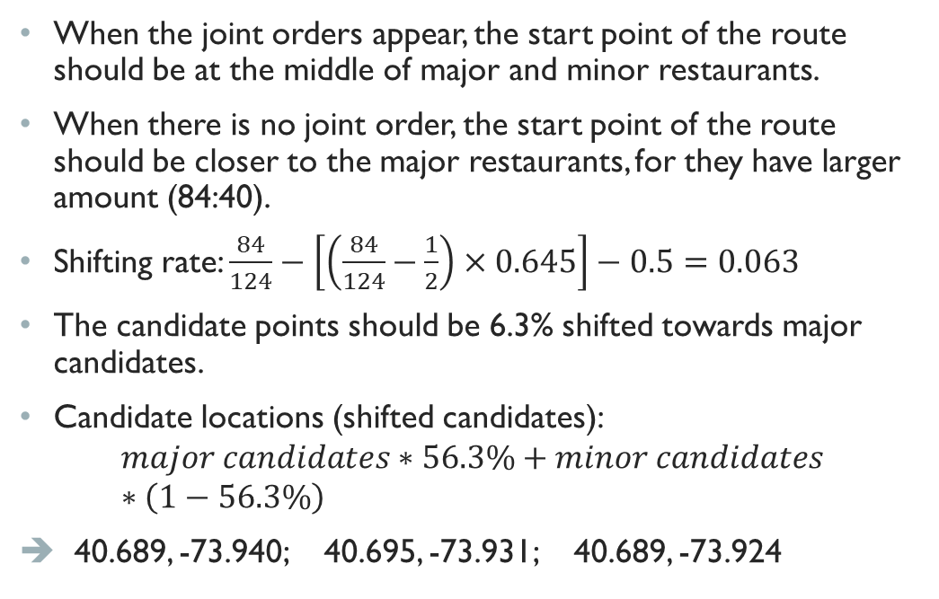
Candidates considering joint orders
When the joint orders appear, the start point of the route should be at the middle of major and minor restaurants.
When there is no joint order, the start point of the route should be closer to the major restaurants, for they have larger amount (84:40).
Shifting rate: $\frac{84}{124}−\left[\left(\frac{84}{124}−\frac{1}{2}\right)×0.645\right]−0.5=0.063$
The candidate points should be 6.3% shifted towards major candidates.
Candidate locations (shifted candidates):
$$major candidates∗56.3\%+minor candidates∗\left(1−56.3\%\right)$$
40.689, -73.940; 40.695, -73.931; 40.689, -73.924
Probability to have 2 orders from different groups within 2 minutes time interval:
0.645

Slide 11
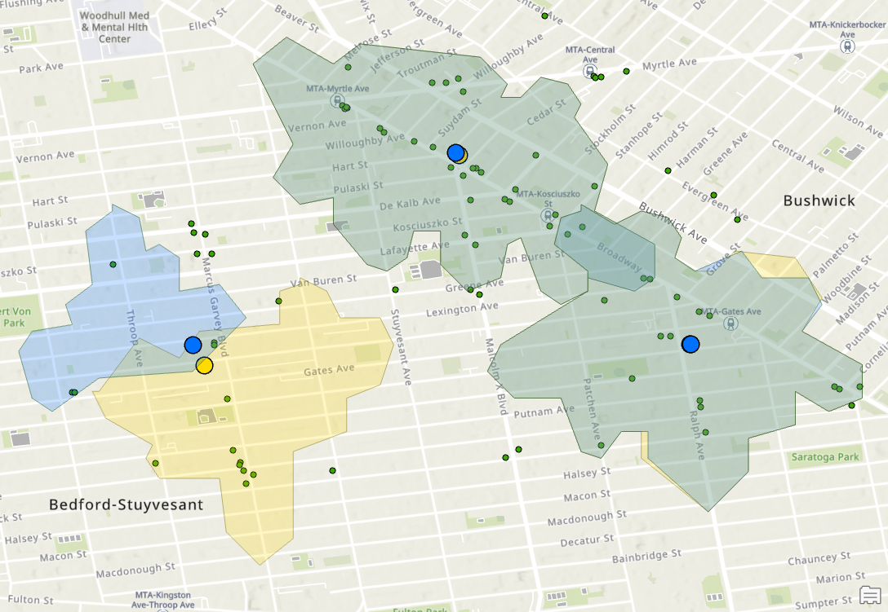
Service area analysis
As the candidates for major and minor are too biased, we only conduct service area analysis for the overall candidates and the shifted candidates.
Yellow points and area: overall candidates and its service area.
Blue points and area: shifted candidates and its service area.
Green points: the restaurants

Slide 12
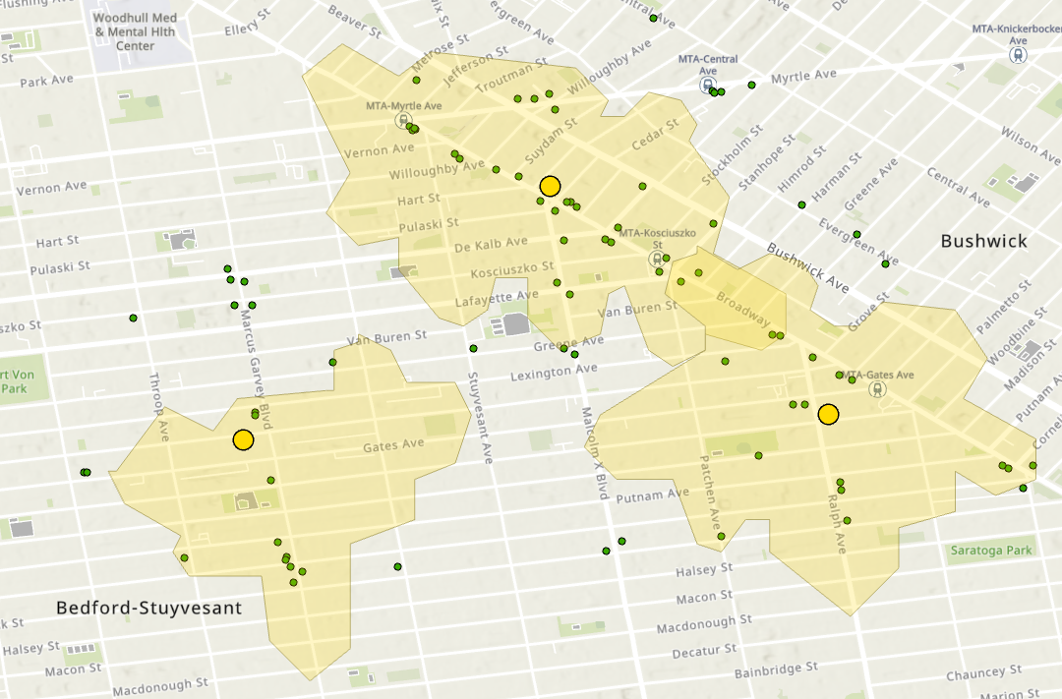
Final decisions
To make the final decision: whether using the overall candidates or the shifted candidates, the team counted the number of restaurants outside the 2-minutes service are for each case.
For overall candidates, there are 23 restaurants outside its 2-minutes service area.
For shifted candidates, there are 28 restaurants outside its 2-minutes service area.
Overall candidates WIN! 🥳
Our winners are :
40.695, -73.931
40.689, -73.924
40.688, -73.940

Slide 13
Discussion & potential improvement
The significant difference of service area might be the existence of one ways.
Kmeans method cannot consider the influence of one ways, basically, this method in this case detects the community by the direct distances between the locations.
In further research, the team can figure out the algorithm using the actual transportation distance to have do a better community detection.
The team used Poisson distribution to simulate the occurrence of orders. However, in reality, the occurrence of orders can be influenced by many factors, to simulate it better, the team may need data of orders, which was unavailable for the team yet.

Slide 14
Insights from 653
Community Detection
Kmeans
major/minor group by the kind of food serving.
Centrality
Degree centrality (more nodes inside the service area)
Closeness centrality (the winner points have higher closeness centralities)
Shortest Path
From the winner points to the edge of the service area.

Slide 15
Q&A
🤔

