Slide 1


Amazon
Review Analysis
CIND820:
Big Data Analysis Project
Project by: Leo Yang Zhang
Yang2.Zhang@torontomu.ca
Student #500424276
Supervisor: Dr. Tamer Abdou
Fall-Winter 2023

Slide 2

Abstract
In an era dominated by e-commerce, the importance of customer reviews cannot
be overstated. Amazon, as a global retail giant, thrives on these reviews which in turn
Influencing millions of purchase decisions everyday.
This project's goal is to explore the distribution of consumer sentiment, compare star ratings in relation to the topics and base on the accuracy of models, identify actionable Improvements for businesses

Slide 3
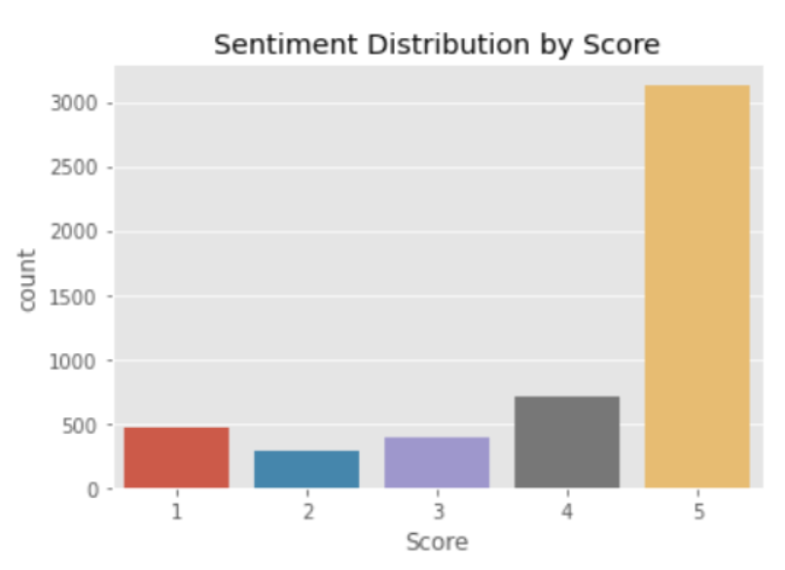
The Dataset
500,000+ Reviews
250,000+ Users
9
Parameters
70,000+ Products
Score from 1 to 5 which 5 being most positive, 1 being most negative.
Smaller sample size (5000) was used for this analysis

Slide 4
The Approach
Dataset: https://www.kaggle.com/datasets/snap/amazon-fine-food-reviews/
Data Processing
Data Cleaning
Tokenization
Stop Words
EDA
Conclusion
Model
Training
Logistic Regression
LDA
Random Forest Classifier
XGBoost
VADER Score
Model Evaluation

Slide 5
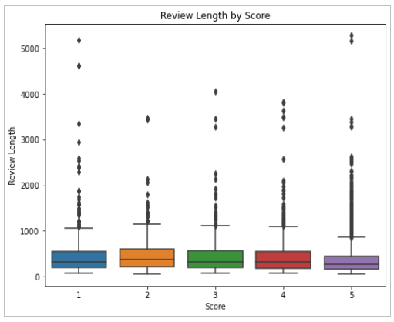
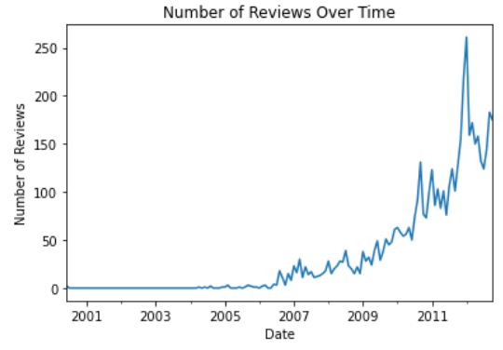
Data Processing
Attribute
Classification
Review Text; Rating; Product ID;
Date; Review Length;
Helpfulness Numerator & Denominator;
Summary
Statistics
Tokenization, Stop Words & Labelling reviews
10 Most Common Words
br: 4301
like: 2027
good: 1761
great: 1468
taste: 1402
one: 1334
product: 1276
flavor: 1201
coffee: 1116
chips: 1070
Labels for reviews
Based on star scores:
1-2 Stars – Negative
3 Stars – Neutral
4-5 Stars – Positive

Slide 6
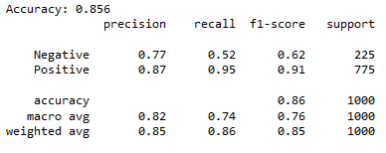
Model Training
Logistic
Regression & Feature
Importance
Prepares the data for sentiment classification.
Uses CountVectorizer to convert text data into numerical features.
Print the most important words for positive and negative sentiment.
The model performs well in identifying positive sentiment,
with a high precision and recall for positive reviews (0.87 and 0.95, respectively).
However, the model is less effective at identifying negative sentiment,
as indicated by the lower precision (0.77) and recall (0.52) for negative reviews.

Slide 7
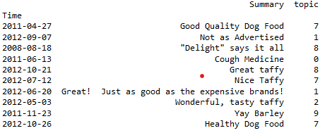
Model Training
LDA &
Topic Extraction
Tea
Favorite
Cookie
Green
Tasty
Easy
Smooth
Fresh
Great
Hot
Like
Chocolate
The topics extracted by LDA appear to represent various aspects of product
reviews, including positive sentiments about taste, quality, and value for money.

Slide 8
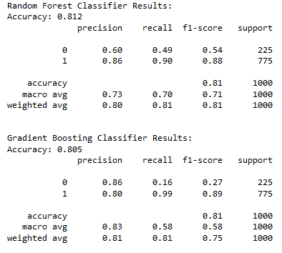
Model Training
Random Forest & XG Boost
Utilizes Random Forest and Gradient Boosting classifiers for sentiment classification.
Evaluates and prints the accuracy and classification report for both models.
Both models have a similar overall accuracy, but their strengths and
weaknesses differ.
The Random Forest Classifier performs better in identifying negative
sentiment (higher recall) but sacrifices precision, resulting in a lower F1-Score
for negative sentiment.
The Gradient Boosting Classifier excels in precision for negative
sentiment but has low recall, leading to a lower F1-Score for negative sentiment.
Depending on the specific business context and priorities, one might choose
one model over the other. For example, if minimizing false negatives
(missing negative reviews) is critical, Random Forest model is preferrable

Slide 9
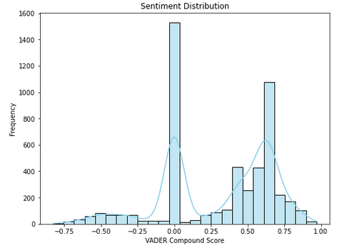
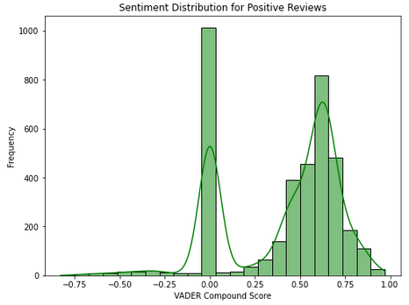
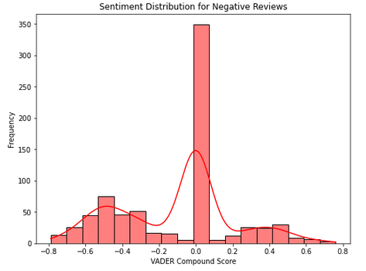
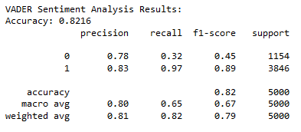
Model Training
VADER
Sentiment Score
Applying VADER sentiment intensity analyzer to assess the polarization of sentiment.
Incorporated sentiment labels for distribution calculation.
The VADER sentiment analysis model is relatively better at identifying positive sentiment,
with high precision and recall, suggesting that it is effective at capturing positive expressions in the text.
The model struggles with negative sentiment, as indicated by the lower recall for
the negative class. It tends to miss negative instances, leading to a lower F1-Score for
negative sentiment.

Slide 10

Conclusion
Each model exhibited strengths and weaknesses in sentiment analysis, emphasizing the importance of understanding specific business requirements and priorities.
Logistic regression and random forest excelled in positive sentiment identification, while gradient boosting showed high precision for negative sentiment.
VADER, designed for sentiment analysis, performed well for identifying positive sentiment intensity.
LDA and feature importance analysis provided insights into topics and influential words associated with sentiment in the dataset.
In practical terms, actionable recommendations for businesses are:
Optimize Customer feedback loop to capture negative feedback
Enhance product features according to topic groups
Refine marketing strategies by leveraging positive sentiment words
Capture Trends & emerging markets by diversifying product offerings

Slide 11

THE END

