Slide 1
JumpStart Retail AI Customer Support System
How the AI Agent Chatbot Is Implemented
Sales Pitch Presentation · 20 July 2026
Zaw Myo Tun · HDSE Capstone Project (INTL-HDSE-CPL-0725)
Notes:
Good morning everyone. I'm Zaw Myo Tun, and this presentation is a technical walkthrough of my capstone project: an agentic AI customer-support system for JumpStart Retail. Unlike a feature overview, today I'll open the hood — I'll follow one customer message through every processing stage of the AI agent: input validation, history loading, intent detection, clarification, planning, tool execution, confidence verification, response generation, safety checking, and human handover. By the end you'll understand not just what the system does, but exactly how each decision is made and why each guardrail exists. Everything I show is implemented and running locally today.

Slide 2
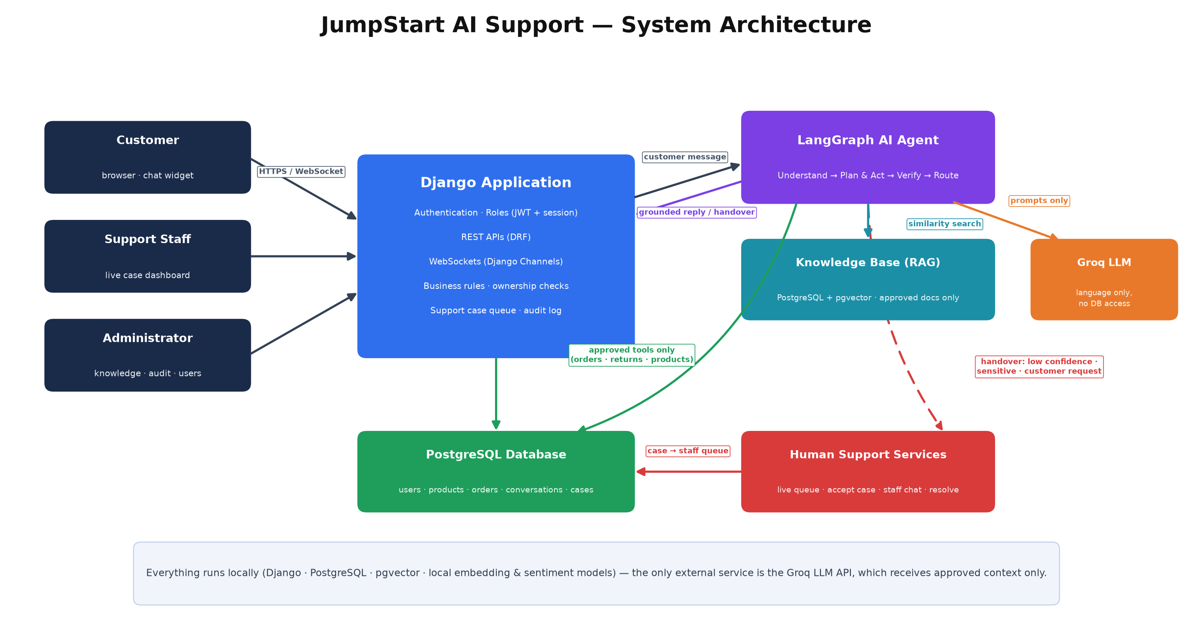
High-Level AI Agent Architecture
Notes:
This is the complete architecture. On the left, three user roles — customer, support staff, administrator — all connect through the Django application, which owns authentication, role-based permissions, REST APIs, and WebSockets for real-time chat. When a customer message arrives, Django passes it to the LangGraph agent — the purple box — which runs the four-stage workflow: understand, plan and act, verify, route. The agent can consult two evidence sources: the RAG knowledge base (approved documents embedded in PostgreSQL with pgvector) and the business database through approved tools only. The Groq LLM on the far right receives prompts and returns text — it has no direct access to the database and cannot execute anything. When the agent decides to escalate, a support case is created and pushed over WebSocket to the staff dashboard in real time. The one design principle to remember: the AI drafts language; Django enforces the rules.

Slide 3
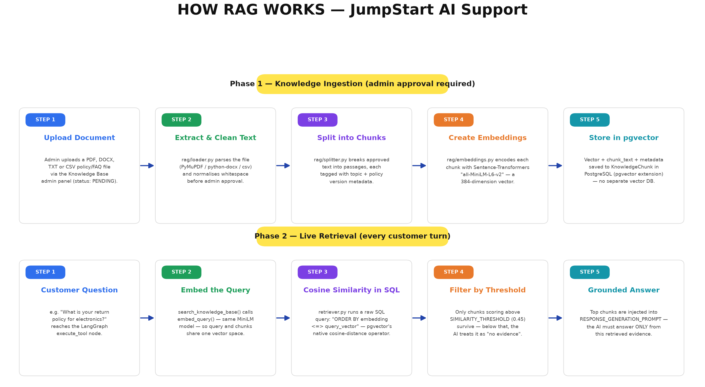
How RAG Works in JumpStart
Notes:
This is the Retrieval-Augmented Generation pipeline — the reason the AI can't invent policies. Phase 1 is ingestion: an administrator uploads a policy document — PDF, Word, text or CSV — it's text-extracted, split into chunks, each chunk embedded into a 384-dimensional vector using the all-MiniLM-L6-v2 model running locally, and stored in PostgreSQL via pgvector. Nothing becomes searchable until an admin explicitly approves it. Phase 2 runs on every customer question: the query is embedded with the same model, pgvector's native cosine-distance operator finds the most similar chunks directly in SQL, and only chunks above a 0.45 similarity threshold count as evidence. If nothing clears the threshold, the AI doesn't guess — it treats it as 'no evidence found' and escalates to a human. The retrieved text is injected into the response prompt with a strict instruction: answer ONLY from this evidence.

Slide 4
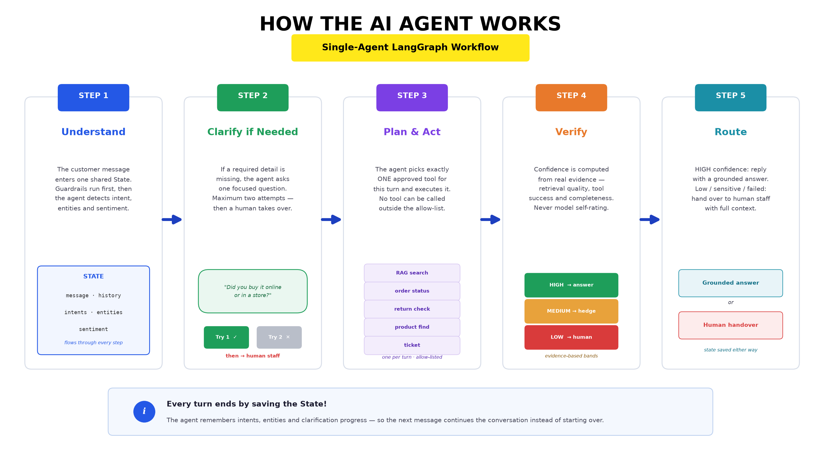
The Agentic Workflow (LangGraph)
Notes:
This is the actual compiled LangGraph workflow from my code — every box is a real node in agents/graph.py. The blue column is understanding: validate the input (with prompt-injection and small-talk guardrails that never even reach the LLM), load recent history, detect intent and entities, and check whether required details are missing. Orange is planning and acting: choose one tool category and execute it. Purple is verification: an evidence-based confidence formula, then a two-layer safety check on the generated response — a keyword filter plus an LLM groundedness check. The red node on the right is handover — notice how many dashed red arrows lead there: an explicit request, a frustrated customer, failed clarification, low confidence, a sensitive topic with insufficient certainty, or an unsafe response. Every path — every single one — converges on save_state, so no conversation turn ever ends without persisting its state and audit log.

Slide 5
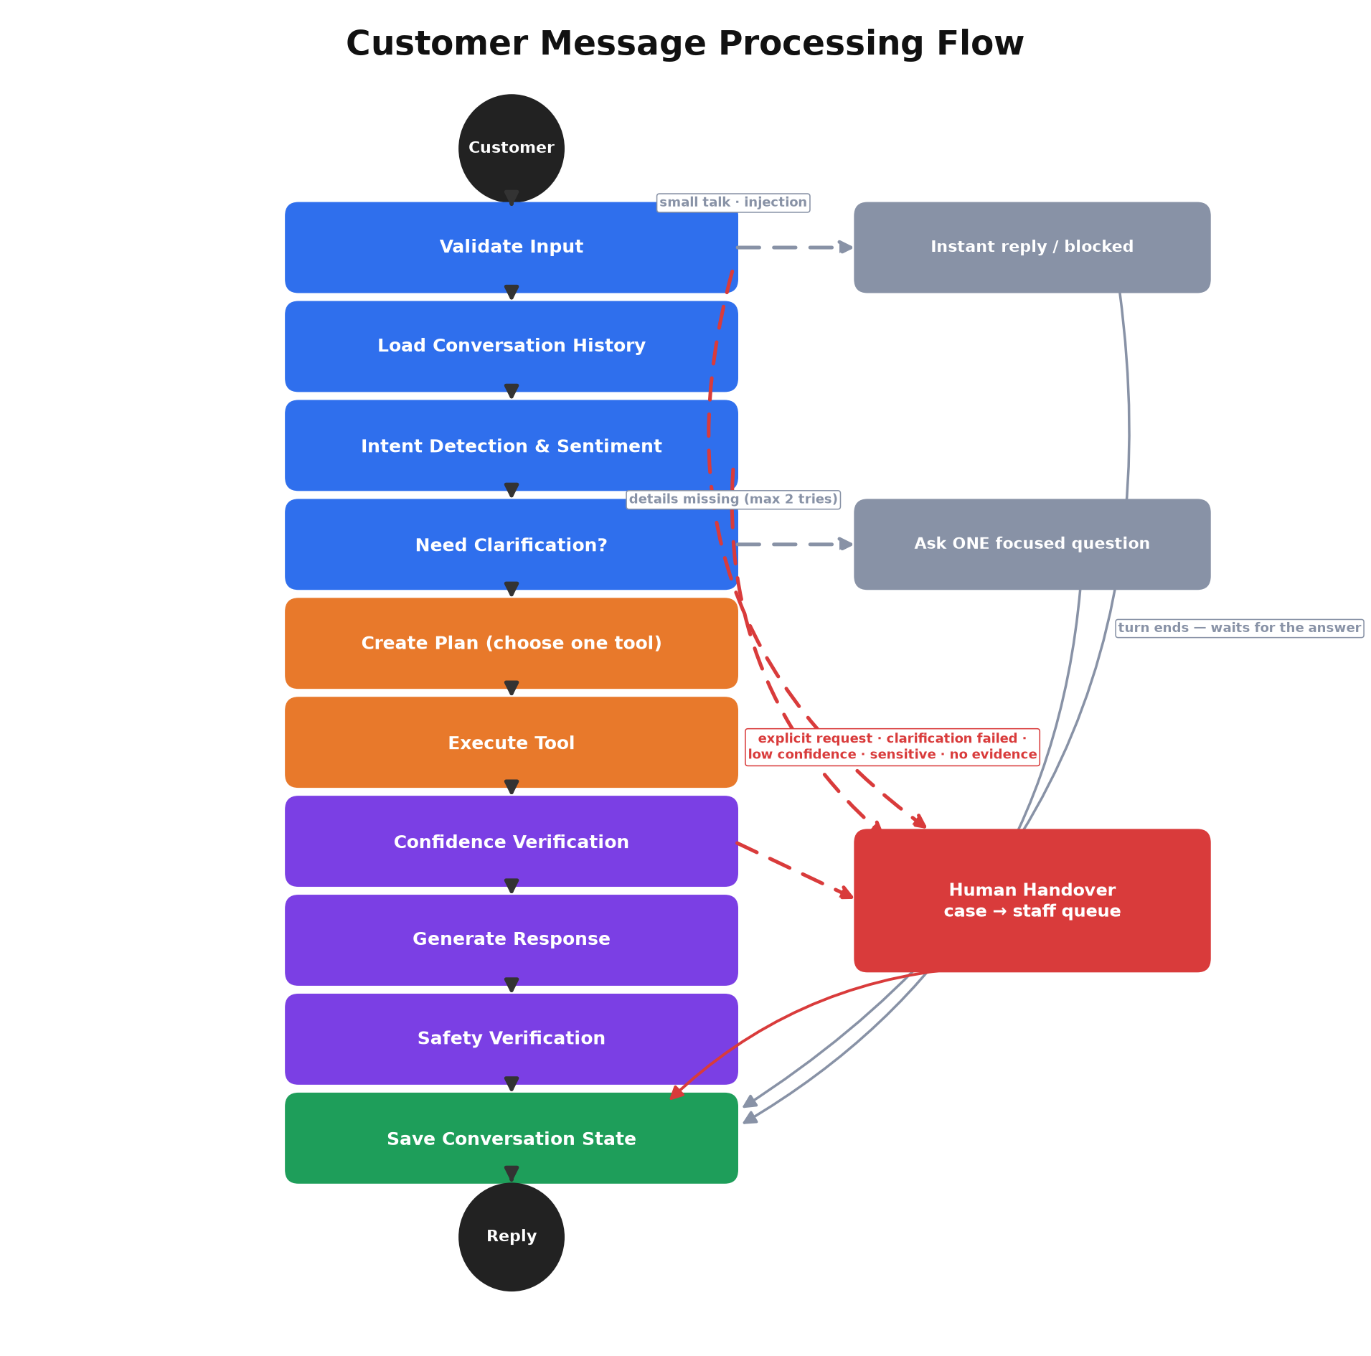
Customer Message Processing Flow
The path every single message travels
Notes:
This flowchart is the map for the rest of the presentation — every following slide zooms into one box. A customer message enters at the top. Validate Input runs guardrails before any AI is involved — small talk and injection attempts exit immediately to the right. Then the agent loads conversation history, detects intent and sentiment, and asks: do I have enough details to act? If not, it asks one focused question and the turn ends. Otherwise it plans, executes exactly one approved tool, and verifies its own confidence using measurable evidence. Low confidence — or any of the red-dashed conditions — routes to human handover instead of an answer. Only responses that pass generation and safety verification reach the customer. Notice that every path, including handover and clarification, converges on Save Conversation State — the agent never ends a turn without persisting its memory.

Slide 6
Node 1 — Validate Input
Deterministic guardrails before any AI runs
Empty-message check and 2,000-character length limit.
Prompt-injection detection — a blocklist of known attack phrasings ("ignore previous instructions",
"reveal your system prompt", "developer mode"…) → polite canned refusal, message never reaches the LLM.
Small-talk detection — "hi", "thanks", "bye" matched exactly against phrase lists → instant friendly reply.
Why: a greeting sent through RAG would find no evidence and wrongly escalate to a human.
Explicit human-request detection — "talk to a human" → immediate handover, no AI reasoning needed.
Benefit: pure string matching — fast, free, and impossible to trick with clever wording.
Notes:
The first node runs before any AI is involved, and that's the point. These guardrails are deterministic string checks — no model call, no cost, no latency, and critically, no way to be talked around. Prompt-injection attempts like 'ignore your previous instructions' are matched against a blocklist and receive a canned redirect; the malicious text never reaches the language model at all. Small talk gets special handling for a subtle reason: if 'hi' went through the normal pipeline, the knowledge search would find nothing relevant, confidence would collapse, and the system would absurdly escalate a greeting to a human agent. And when a customer explicitly asks for a person, there's nothing to reason about — the request routes straight to handover. Every unnecessary LLM call avoided here also saves real money and seconds of response time.

Slide 7
Node 2 — Load Conversation History
Context that makes multi-turn conversation possible
Retrieves the last 10 messages of the session, formatted as a labelled transcript.
Gives the LLM the context to understand follow-ups: "and how long does THAT take?"
Bounded window — deliberately not the full history:
keeps token cost and latency predictable regardless of conversation length
Separately, details remembered from earlier turns are re-loaded from the saved conversation state:
entities already provided (order number, product…) are never asked for twice
the clarification-attempt counter survives across turns — so limits actually work
Notes:
The agent itself is stateless — each message starts a fresh run of the workflow. This node is what makes the conversation feel continuous anyway. It loads the last ten messages as a labelled transcript so the language model can resolve references like 'that order' or 'how long does it take' — questions that are meaningless without context. The window is deliberately capped at ten: a bounded context keeps cost and response time predictable no matter how long the chat gets. Alongside the transcript, the agent reloads its own saved memory from the previous turn — the details the customer already provided and how many clarification questions have been asked. That last part matters: if the attempt counter reset every turn, the 'maximum two clarifications' rule could never actually trigger, and the bot could interrogate a customer forever.

Slide 8
Node 3 — Intent Detection
One LLM call extracts everything the agent needs to know
Groq LLM + engineered prompt classify the message into 13 defined intents.
Extracts entities with exact allowed keys & values (order number, product, category…).
States the customer goal in one sentence.
Lists missing fields still needed before a tool can act.
Flags explicit human requests the guardrails missed.
Sentiment analysed separately by a LOCAL model (cardiffnlp/twitter-roberta-base-sentiment-latest) — customer emotion never leaves the machine.
// example output for:
// "Can I return my headphones?"
{
"intents": ["return_policy"],
"customer_goal":
"Return the headphones",
"entities": {
"product_name": "headphones",
"product_category": "electronics"
},
"missing_fields":
["days_since_purchase"],
"explicit_human_request": false
}
Notes:
This is the first real AI step. A single structured LLM call does four jobs at once: classify the message into one or more of thirteen defined intents — order tracking, return policy, refund, complaint and so on; extract entities using an exact allowed vocabulary that matches the database — so 'category' can only be one of the real store categories; summarise the customer's goal in one sentence; and list which required details are still missing. The example on the right shows real output: the customer wants to return headphones, the category was correctly inferred as electronics, and the system knows it still needs to ask when the item was purchased. Sentiment is deliberately NOT asked of the cloud LLM — a local RoBERTa model classifies it on my machine, so the customer's emotional state never leaves the premises. The JSON contract matters: every downstream node relies on these exact fields.

Slide 9
Node 4 — Clarification
Ask, don’t guess — but never interrogate
If required details are missing, the agent asks ONE focused question — never a list.
Quick-reply buttons offered when the answer is a short choice ("Online" / "In-store").
Details remembered across turns — an order number given earlier is never asked again.
Progress-aware limit: a turn only counts against the cap if NO progress was made.
a request needing 3 details can legitimately take 3 polite questions
a customer who answers "I don’t remember" twice in a row → automatic escalation to a human
Why: research shows badly-timed probing questions are the fastest way to frustrate customers.
Notes:
When information is missing, the agent has two options: guess or ask. Guessing produces confident nonsense, so it asks — but asking has its own failure mode: interrogation. The design here follows a principle from the customer-service research in my proposal — probe at the right time, one thing at a time, and stop when probing becomes intrusive. So the agent asks exactly one focused question per turn, with quick-reply buttons when the answer is a simple choice. Everything the customer provides is remembered across turns. The escalation limit is progress-aware: a turn only counts against the two-attempt cap when no new information was gained. That distinction matters — a return question genuinely needing three details can take three polite questions, but a customer who answers 'not sure' twice in a row is clearly stuck, and the system stops asking and brings in a human instead.

Slide 10
Node 5 — Planning
A decision table chooses exactly ONE tool per turn
The planner follows an explicit, ordered decision table (first matching row wins):
human request / frustrated complaint → Human Handover
order tracking → Order Tool
return or cancellation with a specific item → Return Tool
a specific product or store question → Product Tool
general policy / FAQ / “what do you sell” questions → Knowledge Tool (RAG)
issue to log for later, no live agent needed → Support Ticket
pure conversation, nothing to look up → No Tool
It also drafts a suggested action for staff — attached to the case if this turn ends in handover.
Notes:
The planning node answers one question: which single capability serves this turn? It follows an explicit ordered decision table rather than free-form model judgement — the first matching row wins, which makes routing predictable and testable. Human requests and visibly frustrated complaints route to handover before anything else. Order tracking goes to the order tool. A return question about a specific named item goes to the return-eligibility engine, while a general 'what's your return policy' question goes to knowledge search instead — same topic, different tool, because one computes an answer and the other quotes policy. One subtle detail: general questions like 'what do you sell' deliberately route to knowledge rather than product search, because keyword-matching a vague sentence against the catalog surfaces random items. The planner also drafts a one-line suggested action for staff, so if this turn escalates, the human picks up a recommendation, not a blank case.

Slide 11
Node 6 — Tool Execution
The only hands the AI has — all allow-listed, all validated
Knowledge Tool — RAG similarity search over approved documents, topic-filtered by intent.
Order Tool — real database lookup by order number, always scoped to the logged-in customer.
the same "not found" answer whether an order doesn’t exist or belongs to someone else
Return Tool — a rules engine: purchase channel + category + days elapsed → eligible / not / needs staff.
Product Tool — keyword search over the catalog; generic queries return a real category overview instead.
Ticket Tool — logs a support case for follow-up without a live agent.
Handover Tool — creates the case, notifies the staff queue, pauses the AI (next slide covers it fully).
The LLM never touches the database — it can only request these functions with validated parameters.
Notes:
Tools are the only way the AI can act on the world, and every one of them is a normal, testable function I wrote — the language model can only request them, never bypass them. The knowledge tool runs the RAG search. The order tool queries the real database, always filtered by the logged-in customer's identity — and deliberately gives the same 'not found' response whether an order doesn't exist or belongs to someone else, so the chatbot can never be used to probe other customers' orders. The return tool is pure business rules — channel, category and days elapsed decide eligibility, with in-transit orders flagged for staff review rather than guessed at. The product tool handles catalog search, with a safeguard: a vague 'what do you sell' returns an honest category overview from the database instead of arbitrary keyword matches. Each tool returns structured data that becomes evidence for the confidence check two nodes later.

Slide 12
RAG Knowledge Base
What the AI is allowed to know
10 approved documents currently embedded:
Return & Refund Policy · Delivery & Shipping
Warranty & Repairs · Payment Methods
Promotions & Discount Codes · Product Range Guide
Store Information & Hours · Order Status Guide
Support & Escalation Guide · General FAQ
Real files (PDF, DOCX, TXT, CSV) — parsed by the same pipeline an admin upload uses.
Only ADMIN-APPROVED documents are ever searchable; disabled docs vanish from results instantly.
Document (PDF / DOCX / TXT / CSV)
↓ extract & clean text
↓ split into chunks
↓ embed locally (384-dim vectors)
↓ store in PostgreSQL + pgvector
↓ cosine similarity search per question
↓ relevant passages = EVIDENCE
Notes:
RAG — retrieval-augmented generation — is how the AI knows company policy without hallucinating it. The knowledge base currently holds ten approved documents covering every support topic: returns, delivery, warranty, payments, promotions, products, stores, order statuses, the escalation guide and a general FAQ. These are real files in four formats, parsed by the same extraction pipeline an administrator upload goes through. The pipeline on the right runs at approval time: text is extracted, cleaned, split into chunks, embedded into 384-dimensional vectors by a local Sentence Transformers model, and stored in PostgreSQL using the pgvector extension — no separate vector database needed. At question time, the customer's query is embedded with the same model and compared by cosine similarity; only passages above a relevance threshold count as evidence. Governance is the key: only admin-approved documents are searchable, and disabling a document removes its chunks from results immediately.

Slide 13
Node 7 — Confidence Evaluation
Measured from evidence — never the model’s own opinion
Confidence is computed from measurable signals:
RAG relevance — best similarity score of retrieved passages
approved evidence present — did anything credible come back?
tool success — did the database lookup actually work?
entity completeness — were all required details collected?
Penalties: sensitive intents (refund / cancel / complaint) ×0.80;
a frustrated customer on top of that ×0.70 — a stricter bar when it matters most
Hard rule: no evidence at all → human, regardless of the score.
HIGH (≥ 0.80)
answer confidently
MEDIUM (≥ 0.65)
answer + offer a human
LOW (< 0.65)
do not answer — hand over
Notes:
This node is the heart of the system's trustworthiness. Language models are notoriously overconfident about their own answers, so I never ask the model how sure it is. Instead, confidence is computed from things I can measure: how similar the best retrieved passage actually is to the question; whether any approved evidence came back at all; whether the tool call succeeded; and whether all the required details were collected. Sensitive intents — refunds, cancellations, complaints — carry a flat penalty so they need visibly stronger evidence before the AI acts alone, and a frustrated customer adds a second penalty on top: the angrier the situation, the higher the bar for automation. The score maps to three bands with fixed thresholds — high answers confidently, medium answers but offers a human, low doesn't answer at all. And one hard rule overrides everything: if there is no evidence whatsoever, the conversation goes to a person, whatever the formula says.

Slide 14
Node 8 — Response Generation
The reply is drafted from evidence — nothing else
Inputs assembled into one grounded prompt:
the customer’s message and goal · retrieved knowledge passages (with sources)
the structured tool result (treated as ground truth) · the confidence band
Groq drafts the reply under strict rules:
use ONLY the evidence provided — never invent policies, prices, or dates
never promise refunds or cancellations — those require staff approval
at MEDIUM confidence, naturally offer to connect the customer with a person
2–4 warm, professional sentences — no internal details, no jargon
Also returns 2–3 quick-reply suggestions the customer might tap next.
Notes:
Only now — after evidence has been gathered and confidence computed — does the system draft the actual reply. The prompt hands Groq everything it's allowed to use: the customer's message and goal, the retrieved knowledge passages with their source titles, the structured tool result which it must treat as ground truth, and the confidence band. The rules inside the prompt are strict: use only this evidence, never invent a policy or a price, and never promise a refund or cancellation — those are decisions for staff. The confidence band even shapes the tone: at medium confidence the reply naturally offers to bring in a human for certainty, which is honest without being alarming. The model also proposes two or three quick-reply buttons — 'Track another order', 'Talk to a human' — that make the next turn one tap instead of typing. The output is structured, so the reply text and the buttons arrive as separate fields.

Slide 15
Node 9 — Safety Verification
Two layers between the draft and the customer
Layer 1 — keyword filter (instant, deterministic):
catches explicit over-promises: "I will refund", "I can cancel", "guaranteed"…
Layer 2 — LLM groundedness check (semantic):
a second model call compares the draft against the evidence:
"does this response claim anything the evidence doesn’t support?"
catches subtle hallucinations layer 1 can’t — e.g. an invented "60-day window"
A failed check triggers ONE regeneration with the violation flagged; a second failure → handover.
Result: the customer only ever sees a grounded response.
Notes:
Even a well-instructed model occasionally drifts, so the drafted reply passes through two independent safety layers before the customer sees it. Layer one is a deterministic keyword filter — it instantly catches explicit over-promises like 'I will refund you' or 'guaranteed', phrases the AI has no authority to say. Layer two is semantic: a second model call receives the draft and the evidence side by side and answers one question — does this response claim anything the evidence doesn't support? That catches the subtle failures a keyword list structurally cannot, like a fabricated sixty-day return window stated in perfectly innocent words. When either layer fails, the response is regenerated once with the violation flagged; if it fails again, the system stops trying and hands the conversation to a human. The design philosophy: it is always better to escalate than to send a confident falsehood.

Slide 16
Node 10 — Human Handover
Not a failure state — a designed first-class feature
8 defined triggers:
explicit customer request
frustrated complaint (negative sentiment + complaint)
clarification failed (2 attempts, no progress)
low confidence · sensitive issue
no evidence found · tool failure
planner judgement
Every reason produces a different customer-facing explanation — the handover is never silent.
Support case created
↓ with the AI’s full context: intents, details,
tools used, sources, confidence, suggested action
↓ session paused for AI — customer told why
↓ WebSocket alert → live staff queue
↓ staff accepts → real-time chat with customer
↓ resolve, or return the session to the AI
Notes:
Handover is the feature that makes everything else safe to deploy, so it's engineered as a first-class workflow, not an error page. Eight defined triggers can start it — from the obvious, like the customer asking for a person, to the subtle, like a complaint delivered with negative sentiment, or two clarification attempts that made no progress. Each reason produces a different explanation to the customer, so the transfer never feels silent or abrupt. Mechanically: a support case is created carrying the AI's entire understanding — detected intents, extracted details, which tools ran, which knowledge sources were consulted, the confidence score, and a suggested action — so the staff member starts informed, not from zero. The AI pauses for that session. A WebSocket alert pushes the case to the live staff queue instantly; the first staff member to accept it chats with the customer in real time, and can either resolve the case or hand the session back to the AI.

Slide 17
Node 11 — Conversation State
The memory that survives between turns
Saved to the database at the end of EVERY turn — no path skips it:
detected intents · customer goal · extracted entities
missing fields · clarification attempts · planned steps
tool call count · confidence · sentiment
Benefits:
true multi-turn conversation — details given once are known forever
limits that actually work — attempt counters survive across messages
full transparency — the admin audit log can replay exactly what the AI knew and decided, per message
Notes:
The final node closes the loop. Whatever path a message took — answered, clarified, blocked, or handed over — the turn always ends by saving the agent's working memory to the database: the intents it detected, the goal it understood, every entity the customer has provided, what's still missing, how many clarification attempts have been used, which tools ran, the confidence it computed, and the sentiment it read. This is what the next turn reloads in node two — it's the mechanism behind everything 'multi-turn' in this system. It also powers governance: because every turn's state and every node's action is persisted, the administrator's audit log can replay any conversation message by message and see exactly what the AI knew, what it did, and why it decided what it decided. Nothing the agent does is invisible.

Slide 18
The Complete Tool Belt
Tool | What it does | Data source
Knowledge Tool | RAG similarity search over approved policy documents | pgvector knowledge base
Order Tool | Order status, tracking & delivery estimate lookup | PostgreSQL (customer-scoped)
Return Tool | Return / cancellation eligibility rules engine | business rules + order data
Product Tool | Product & store search; category overview for generic asks | PostgreSQL catalog
Ticket Tool | Logs a support case for later follow-up | support case table
Handover Tool | Escalates to live staff with full AI context | case + WebSocket queue
Feedback Tool | Records 👍/👎 after resolution (via form, not the agent) | feedback table
Notes:
Here is the complete tool belt in one view — seven capabilities, each a plain, testable function. The first six are what the planner can choose between during a conversation: knowledge search over the approved documents, order lookup scoped to the logged-in customer, the return-eligibility rules engine, product and store search, ticket logging, and the handover escalation. The seventh — feedback — is deliberately different: it records the customer's thumbs-up or thumbs-down after a conversation ends, but it's triggered by the feedback form in the interface, not by the agent's own planning; there's no reason an AI should ever decide to submit satisfaction ratings on the customer's behalf. What the table really shows is the security model: every row is an allow-listed function with validated parameters. The language model cannot query the database, cannot write to it, and cannot invent a tool that isn't on this list.

Slide 19
Technologies Used
Django + Django REST Framework — application core, auth (JWT + session), role-based APIs.
Django Channels + WebSockets (Daphne) — live chat, staff queue alerts, live audit log; HTTP-polling fallback.
LangGraph — the agent workflow engine: nodes, conditional edges, shared state.
Groq API (openai/gpt-oss-20b) — fast LLM inference for language tasks only.
PostgreSQL + pgvector — one database for business data AND vector search.
Sentence Transformers (all-MiniLM-L6-v2) — local 384-dim embeddings.
HF Transformers (cardiffnlp/twitter-roberta-base-sentiment-latest) — local sentiment analysis.
Tailwind CSS + HTMX + Alpine.js — responsive frontend without a SPA framework.
Notes:
A quick tour of the stack and, more importantly, why each piece was chosen. Django gives me batteries-included auth, ORM and admin tooling; DRF adds clean role-based APIs. Django Channels provides WebSockets for everything real-time — customer chat, staff queue alerts, the live audit view — with an HTTP polling fallback when a socket can't connect. LangGraph structures the agent as explicit nodes and conditional edges over one shared state, which is exactly what makes the workflow you've seen today auditable and testable. Groq serves the language model — chosen for very low latency, which matters in live chat. PostgreSQL with pgvector was a deliberate simplification: one database holds both business data and vector search, so there's no separate vector store to run and keep consistent. The embedding and sentiment models are small enough to run locally — customer text for those steps never leaves the machine. The frontend is server-rendered Django with Tailwind, HTMX and Alpine — responsive without the weight of a single-page app.

Slide 20
Current Progress
Development complete — evidence phase next
COMPLETED ✓
AI agent — full LangGraph workflow
RAG knowledge base (10 approved docs)
All 7 tools · confidence & safety layers
Human handover + live staff dashboard
WebSocket real-time chat & queue
Admin panel: knowledge, users, audit log, feedback
Retail storefront, auth, roles
REMAINING ○
Testing — functional, integration, security
Debugging from test findings
Evaluation — RAG answer quality,
handover correctness, questionnaire,
3-participant usability test
Final optimisation & documentation
Target: complete before EOC — 30 July
Notes:
Where the project stands today, stated plainly. The development phase is complete: everything you've seen in this presentation — the full agent workflow, the knowledge base with its ten approved documents, all seven tools, the confidence and safety layers, human handover with the live staff dashboard, real-time WebSockets, and the admin panel — is implemented and running locally, and I can demonstrate any of it right now. What remains is the evidence phase from my project plan: formal testing — functional, integration and security; debugging whatever that testing surfaces; then the evaluation work — measuring RAG answer quality, verifying handover triggers fire correctly and don't over-fire, running the anonymous questionnaire with twenty to thirty participants, and the three-person usability test. All of it is scheduled to finish before the end of course on 30 July.

Slide 21
Conclusion
Achieved: a working agentic AI support system where every answer is grounded, every decision is
measured, every action is auditable — and a human is always one step away.
Status: development complete and demonstrable; testing, evaluation and final report on track for 30 July.
Future work: cloud deployment, multilingual support, automatic staff assignment, retrieval re-ranking.
Thank you — questions welcome.
Notes:
To conclude: the project set out to prove that an AI support agent can be genuinely useful without being trusted blindly — and the implementation demonstrates exactly that. Every answer traces to approved knowledge or real data; confidence is measured from evidence rather than model self-belief; two safety layers stand between a drafted reply and the customer; and when any of it falls short, a human takes over with the AI's full context in hand. Development is complete and demonstrable today; the testing and evaluation phase runs from now until the end of course on 30 July, and the final report will present those results honestly, including where the system fails. Beyond the capstone, natural next steps are cloud deployment, multilingual support, automatic staff assignment and smarter retrieval re-ranking. Thank you for your attention — I'm happy to take questions, or to demonstrate any part of the system live.

