Slide 1
JumpStart AI Support
An Agentic AI Customer-Support Chatbot with Human Handover
Sales Pitch Presentation · 20 July 2026
Zaw Myo Tun · HDSE Capstone Project (INTL-HDSE-CPL-0725)
Notes:
Good morning/afternoon everyone. I'm Zaw Myo Tun, and today I'm presenting my capstone project: JumpStart AI Support — an agentic AI customer-support chatbot with human handover, built for a fictional retailer called JumpStart Retail. In the next 15 minutes I'll show you what the system does, demonstrate what I've completed so far, and explain what remains before the end of course on 30 July. The key idea in one sentence: an AI assistant that answers routine retail support questions from approved evidence only — and knows when to hand the conversation to a real human instead of guessing.

Slide 2
The Problem
Why retail customer support is hard to automate safely
Customers expect instant answers — order status, returns, delivery, payments — at any hour.
A plain FAQ page cannot hold a multi-turn conversation or use the customer’s account context.
But a raw LLM chatbot is dangerous for a business:
It can invent policies that don’t exist ("hallucination")
It can promise refunds or cancellations it has no authority to give
It keeps talking even when the customer is frustrated and needs a person
The real question: not "can AI answer?" but "can AI know when NOT to answer?"
Notes:
The business problem is a trust problem, not a technology problem. Retail customers ask questions that range from trivial (what's your return window?) to sensitive (I want my money back). A plain FAQ page can't hold a conversation. But an unconstrained LLM is worse — it will confidently invent a 60-day return policy that doesn't exist, or promise a refund it can't authorise. So the core question my project answers is: how do you build an AI assistant that is useful for routine questions but reliably steps aside — to a real human — the moment it's out of its depth?

Slide 3
The Solution: A Governed Hybrid AI + Human Service
One AI agent, four disciplines — every customer message goes through:
UNDERSTAND — detect intent, extract details, read sentiment
PLAN & ACT — choose ONE approved tool (policy search, order lookup, return check…)
VERIFY — compute evidence-based confidence; never trust the model’s own certainty
ROUTE — answer, ask a follow-up question, or hand over to human staff
Answers are grounded ONLY in admin-approved knowledge + real database lookups.
Human handover is a first-class feature: a live staff dashboard with a real-time queue.
Full audit trail: every AI decision is logged and visible to the administrator.
Notes:
My solution is a single AI agent with strict governance. Every message passes through four stages: understand, plan-and-act, verify, route. The critical design decision is the VERIFY stage — the system computes its own confidence score from measurable evidence: did retrieval find relevant approved documents? did the database lookup succeed? were all required details collected? It never trusts the language model's self-reported certainty. If confidence is low, the intent is sensitive, or the customer is frustrated — the conversation routes to a human staff member through a live dashboard, with the AI's full reasoning attached so staff don't start from zero.

Slide 4
System Architecture
Everything runs locally except one external LLM API
Frontend
Django templates + Tailwind CSS + HTMX + Alpine.js — customer store, chat panel, staff & admin dashboards
Backend
Django 5 + Django REST Framework — auth (JWT + session), REST APIs, role-based access (customer / staff / admin)
Real-time
Django Channels + WebSockets — live chat, staff queue alerts, live admin audit log (HTTP polling fallback)
AI Agent
LangGraph single-agent workflow — 14 nodes, deterministic routing, Groq API (openai/gpt-oss-20b) for language only
Knowledge / RAG
PostgreSQL + pgvector — approved documents, 384-dim MiniLM embeddings, cosine similarity search
Local ML
Sentence-Transformers embeddings + Hugging Face RoBERTa sentiment — both run on my own laptop, no API cost
Notes:
The architecture is deliberately cost-effective and local-first. The whole stack — Django, PostgreSQL with the pgvector extension, the embedding model, and the sentiment model — runs on my own Windows laptop. The only external dependency is the Groq API, which provides the language model for understanding and drafting responses. Importantly, the LLM has NO direct access to my database, no ability to execute code, and no authority over handover decisions — those are all deterministic Django/LangGraph logic. One notable choice: I don't need a separate vector database like Pinecone or ChromaDB — pgvector lets PostgreSQL store the embeddings right next to the relational data.

Slide 5
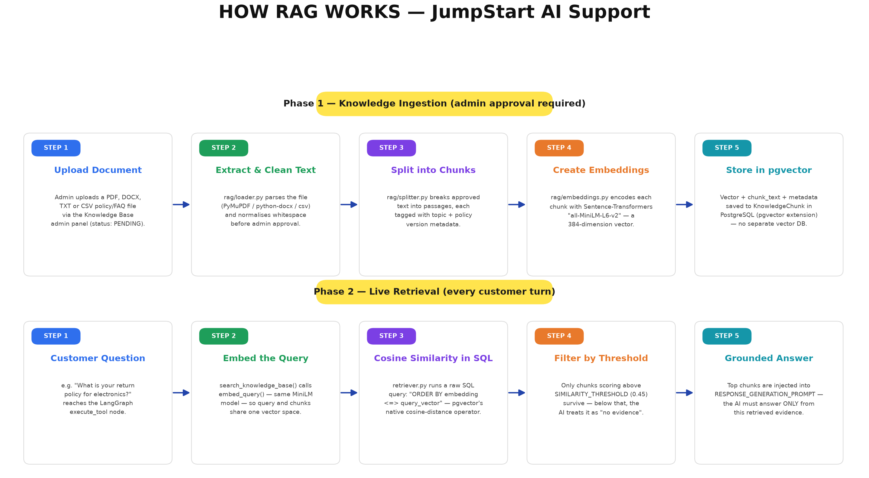
How RAG Works in JumpStart
Notes:
This is the Retrieval-Augmented Generation pipeline — the reason the AI can't invent policies. Phase 1 is ingestion: an administrator uploads a policy document — PDF, Word, text or CSV — it's text-extracted, split into chunks, each chunk embedded into a 384-dimensional vector using the all-MiniLM-L6-v2 model running locally, and stored in PostgreSQL via pgvector. Nothing becomes searchable until an admin explicitly approves it. Phase 2 runs on every customer question: the query is embedded with the same model, pgvector's native cosine-distance operator finds the most similar chunks directly in SQL, and only chunks above a 0.45 similarity threshold count as evidence. If nothing clears the threshold, the AI doesn't guess — it treats it as 'no evidence found' and escalates to a human. The retrieved text is injected into the response prompt with a strict instruction: answer ONLY from this evidence.

Slide 6
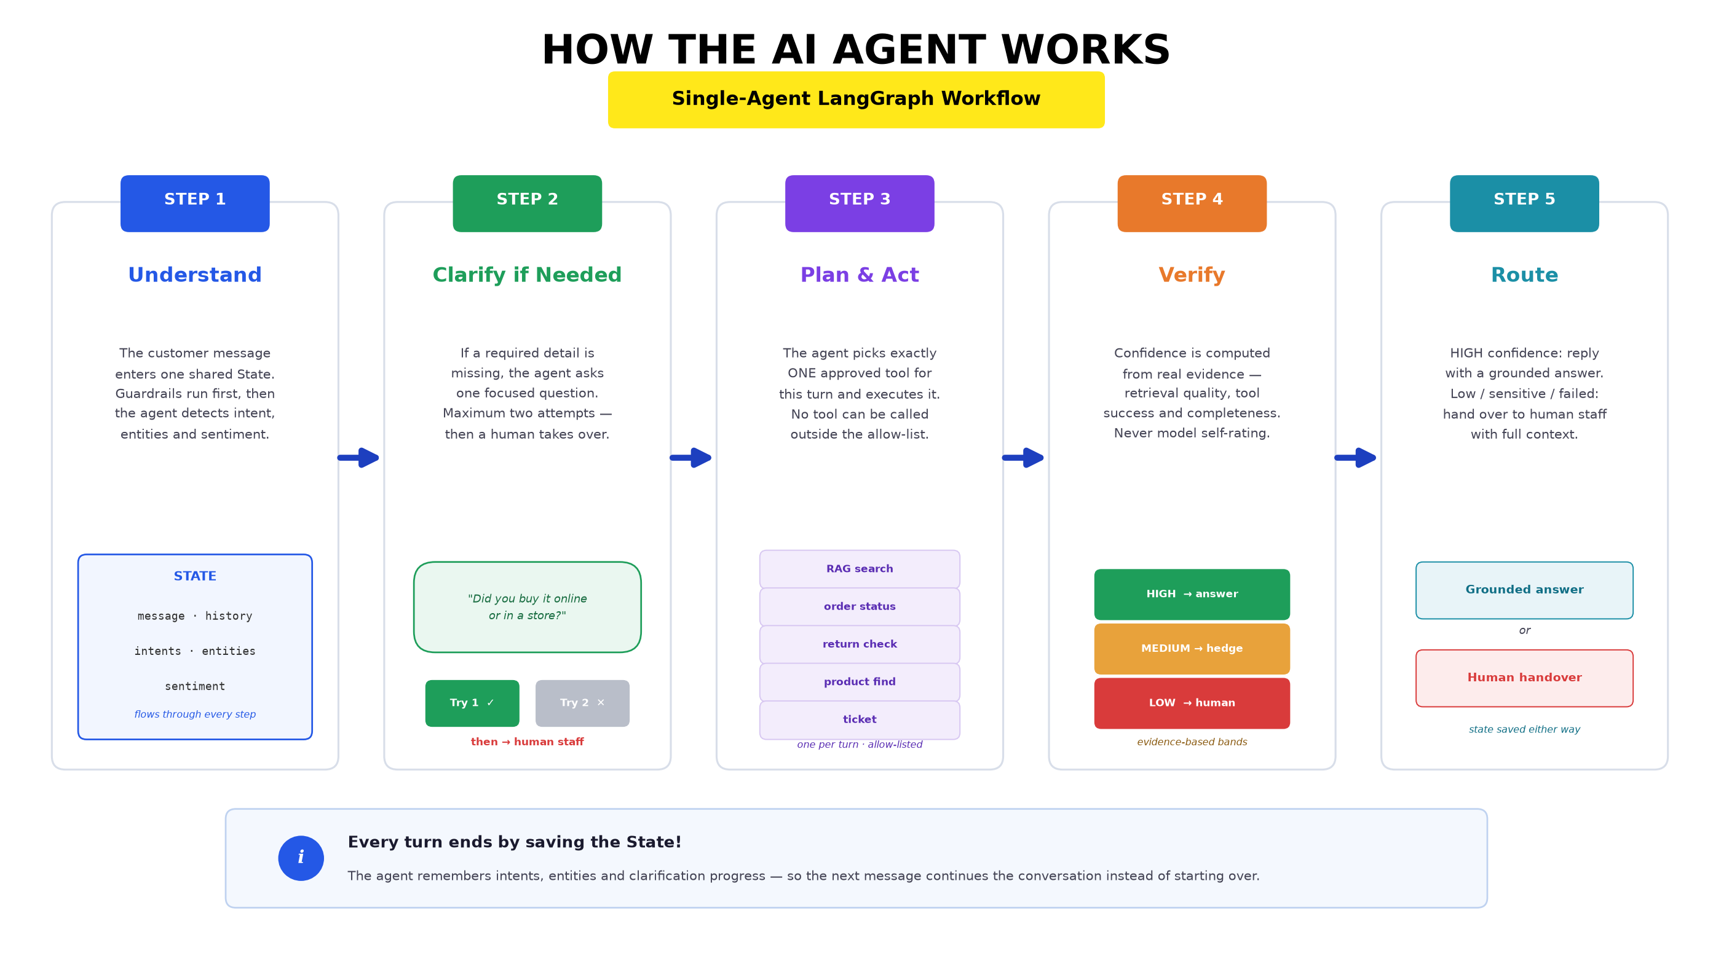
The Agentic Workflow (LangGraph)
Notes:
This is the actual compiled LangGraph workflow from my code — every box is a real node in agents/graph.py. The blue column is understanding: validate the input (with prompt-injection and small-talk guardrails that never even reach the LLM), load recent history, detect intent and entities, and check whether required details are missing. Orange is planning and acting: choose one tool category and execute it. Purple is verification: an evidence-based confidence formula, then a two-layer safety check on the generated response — a keyword filter plus an LLM groundedness check. The red node on the right is handover — notice how many dashed red arrows lead there: an explicit request, a frustrated customer, failed clarification, low confidence, a sensitive topic with insufficient certainty, or an unsafe response. Every path — every single one — converges on save_state, so no conversation turn ever ends without persisting its state and audit log.

Slide 7
Completed — Customer Experience
Ready to demonstrate live
Full retail storefront: 6 categories, 18 products, cart-ready product pages, demo accounts.
Authenticated real-time chat widget (WebSocket, with HTTP polling fallback):
Typing indicators, read receipts, quick-reply buttons, session history
The AI answers grounded questions: policies, order tracking, return eligibility, product search.
Multi-turn clarification — asks ONE focused question when details are missing (max 2 attempts).
Sentiment-aware: a frustrated complaint is held to a stricter confidence bar.
"Talk to a human" works at any time — instantly, without AI involvement.
Post-resolution thumbs up/down feedback with optional reason.
Notes:
Now, what's actually completed. The full customer experience is working end-to-end, and I'll demonstrate it live. A customer logs in — demo accounts are seeded — browses the store, and opens the chat widget. The conversation happens over WebSockets: typing indicators, read receipts, quick-reply suggestions. The AI can quote the return policy with the real day windows, track a mock order including carrier detail, compute return eligibility for a specific item, and search products. When details are missing — say a return question without knowing when the item was bought — it asks exactly one focused follow-up question, and gives up gracefully to a human after two failed attempts rather than interrogating the customer forever. And at any moment the customer can just type 'talk to a human' — that's caught deterministically in Django, no LLM involved, and escalates immediately.

Slide 8
Completed — Staff & Admin Dashboards
Ready to demonstrate live
Staff dashboard: live queue (WebSocket alerts), atomic first-accept, 3-case limit per staff.
Staff chat with full AI context handed over: reason, customer goal, intents, entities,
tools already tried, knowledge sources consulted, AI confidence, suggested action
Internal staff notes + resolve / return-to-AI controls.
Admin panel: knowledge base upload → preview → approve/reject workflow (PDF/DOCX/TXT/CSV).
Admin audit log: per-conversation, per-message AI reasoning trace — live-updating via WebSocket.
RAG metrics dashboard, user management, feedback review — all role-gated.
Notes:
The human side is equally complete. When the AI hands over, every staff member's dashboard gets a real-time alert. Case acceptance is atomic — an SQL-level guarantee that only the first staff member to click Accept gets the case. The staff member sees everything the AI already worked out: why it escalated, what the customer wants, which tools it tried, which knowledge sources it consulted, its confidence score, and a suggested next action — so the customer never has to repeat themselves. On the admin side: the knowledge-approval workflow controls exactly what the AI is allowed to know, and the audit log shows the AI's complete reasoning for every single message — intent detected, tool called, confidence computed, escalation decision — updating live while a conversation is happening. I recently added that live-streaming feature over WebSockets.

Slide 9
Completed — Safety & Governance
The part that makes it trustworthy
Prompt-injection guard: "ignore your instructions…" never reaches the LLM or tools.
The LLM has NO database access, NO code execution, NO handover authority.
Tool allow-list: exactly 6 approved functions with validated parameters.
Evidence-based confidence (HIGH / MEDIUM / LOW) — from retrieval scores, tool success,
and data completeness. Sensitive intents (refund / cancellation / complaint) penalised.
Two-layer response safety: forbidden-promise keyword filter + LLM groundedness check.
Ownership checks everywhere: customers can only ever see their own data.
All of the above is implemented — formal testing of it is the next phase.
Notes:
This slide is the heart of the pitch — governance is what separates this from a toy chatbot. Injection attempts are string-matched and blocked before any AI involvement. The language model can only ever act through six allow-listed tools with validated parameters — it cannot touch the database, run code, or decide by itself to hand over. Confidence is computed from measurable evidence, never from the model's self-assessment. Generated responses pass through two safety layers: a keyword filter catching explicit overpromises like 'I will refund you', and a second LLM pass that checks the response is actually grounded in the retrieved evidence — catching subtler hallucinations. To be clear about status: all of these mechanisms are implemented and working in the prototype — the formal, documented testing of them belongs to the next phase, which I'll cover in the remaining-work slide.

Slide 10
Live Demonstration
Three roles, one conversation
1. CUSTOMER — asks a policy question → grounded AI answer with sources.
2. CUSTOMER — asks about an order → real database lookup, carrier tracking detail.
3. CUSTOMER — vague return request → AI asks a focused clarification question.
4. CUSTOMER — "talk to a human" → instant escalation, waiting state shown.
5. STAFF — live queue alert → accept case → chat directly with the customer.
6. ADMIN — open the audit log → watch the AI’s reasoning for each message, live.
Demo accounts: customer_demo / staff_demo / admin_demo · all seeded via manage.py seed_data + seed_knowledge
Notes:
Here's the demo flow I'll run now — three browser profiles, three roles, one conversation travelling between them. First as the customer: a policy question that gets a grounded answer, an order lookup that hits the real mock-order database, and a deliberately vague return request so you can see the clarification behaviour. Then I'll ask for a human. Watch the staff dashboard in the second window — the case appears in the queue in real time with a sound alert. I'll accept it as staff and reply directly. Finally, in the admin panel, I'll open this same conversation's audit log and you can see every decision the AI made along the way — live. [Run demo — approx 5 minutes. Fallback if live demo fails: screen recording is prepared.]

Slide 11
Remaining Work
Development is complete — testing, evaluation and documentation are next
TESTING & DEBUGGING (next phase)
Functional, integration & security testing: permissions, injection attempts, edge cases
Structured RAG answer-quality evaluation across representative retail questions
Handover-correctness test matrix: right cases escalate, no unnecessary escalations
EVALUATION
Anonymous questionnaire (~20–30 participants) — expectations & concerns
Exploratory usability test with 3 participants on realistic support tasks
Analysis of feedback, confidence bands and handover reasons from real usage
DOCUMENTATION — final report, evaluation write-up, evidence packaging.
Notes:
Being transparent about what remains, exactly as the email asked. The development phase is complete — every feature I showed today is implemented and working. What remains is everything after development: the full testing phase, evaluation, and documentation. Testing: functional, integration and security testing — especially permission boundaries and injection resistance — plus a structured answer-quality evaluation across a representative set of retail questions and a handover-correctness matrix. Evaluation: the anonymous questionnaire targeting 20 to 30 participants, and the three-person usability test on realistic tasks — asking a policy question, tracking an order, going through a handover. And finally the report: writing up the evaluation, packaging screenshots, logs and test results as evidence.

Slide 12
Plan to End of Course — 30 July 2026
20–22 July
Incorporate today’s feedback · functional, security & integration testing
22–24 July
Debugging · RAG answer-quality evaluation · handover-correctness test matrix
23–26 July
Questionnaire distribution & collection · 3-participant usability sessions
26–28 July
Analyse results · charts & thematic analysis · evaluation chapter
28–30 July
Final report assembly · evidence packaging · recorded demo · submission
Notes:
Here's my concrete day-by-day plan for the final ten days. The first two blocks finish the technical evidence: security and integration testing, then the structured RAG-quality and handover-correctness evaluations. In parallel from the 23rd, the questionnaire goes out and I run the usability sessions — these overlap deliberately since questionnaire collection is mostly waiting time. The 26th to 28th is analysis: turning raw responses into charts and themes and writing the evaluation chapter. The final two days are assembly and submission — final report, evidence package, and a recorded demonstration as a safety net. The implementation being already complete is what makes this timeline realistic: nothing on this slide depends on writing new features.

Slide 13
The Pitch, in One Slide
An AI assistant that answers from approved evidence only,
knows its own confidence,
and hands difficult conversations to a human — with full context.
Development: complete and demonstrable today.
Testing, evaluation & final report: on track for 30 July.
Thank you — questions welcome.
Notes:
To close: JumpStart AI Support is an AI assistant that answers only from approved evidence, computes its own confidence honestly, and hands difficult conversations to a human with full context attached — so automation helps where it's safe and defers where it isn't. The implementation is complete and everything you saw today runs live on my laptop. The remaining work — testing evidence, user evaluation, and the final report — is scheduled day-by-day through to submission on the 30th. Thank you — I'm happy to take questions, and if there's time I can show any part of the system in more depth.

