Slide 1
Melbourne House Sales Market
Data Visualization
Presenting by Zahra Sokoot

Slide 2
Business Case Overview
Finding the best opportunity for selling more house to people. To do so, We need to find the factors that affect the price and find the people's interest of houses. So, the benefits of this action is to building new house based on these factors and sell more the houses that already built. To show which factors are more important for buyers and in which time they are willing to buy a house more. In this case, we can focus to sell more in these factors ( for example increase the store manager in some special time of the year and in specific suburb that are more interested by people.)
As a future work, Find the best agents and research more about their method of sell and add relevant data to this part.

Slide 3
The history of data
Dataset contain 28 columns with 27247 entries.
The data belongs to year between 2016 to 2018.

Slide 4
1- Business Case Scope Description for CEO
Finding the factors that affect on price and for the company it is very important to improve this factor to absorb more buyers.

Slide 5
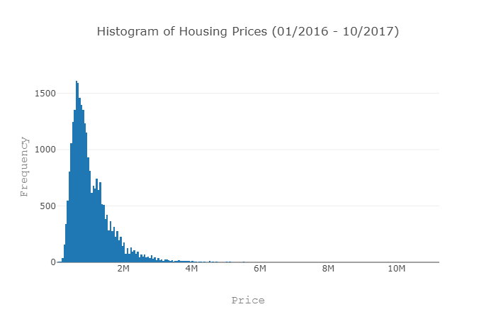
1-1 Histogram of Price
1) This figure shows that the house with price between 600k-650k has the highest frequency in our dataset. It means people prefer to buy house in this range
2) Other thing we can understand by this figure is the houses with range upper than 2M have less interest from people.

Slide 6
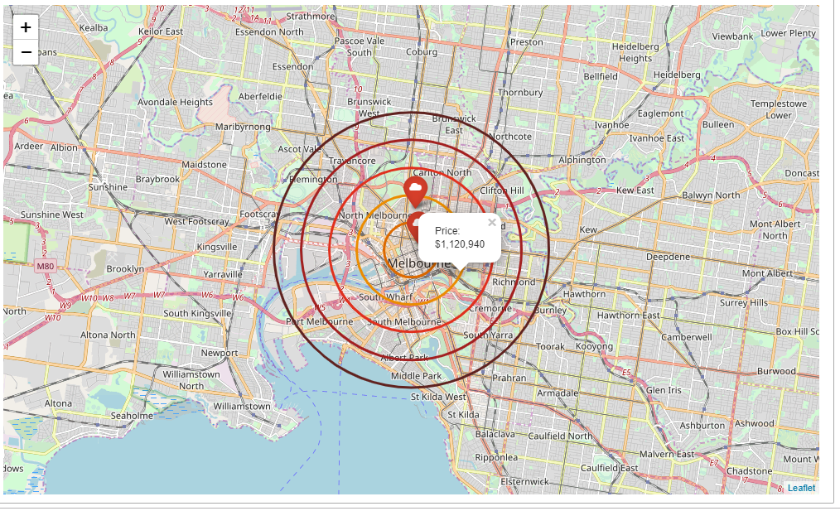
1-2 Make a map to recognize the Price vs Distance behavior of buyer
The distance has a negative correlation with price which means, the house with long distance has the lowest price to compare the houses in the Melbourne city center.

Slide 7
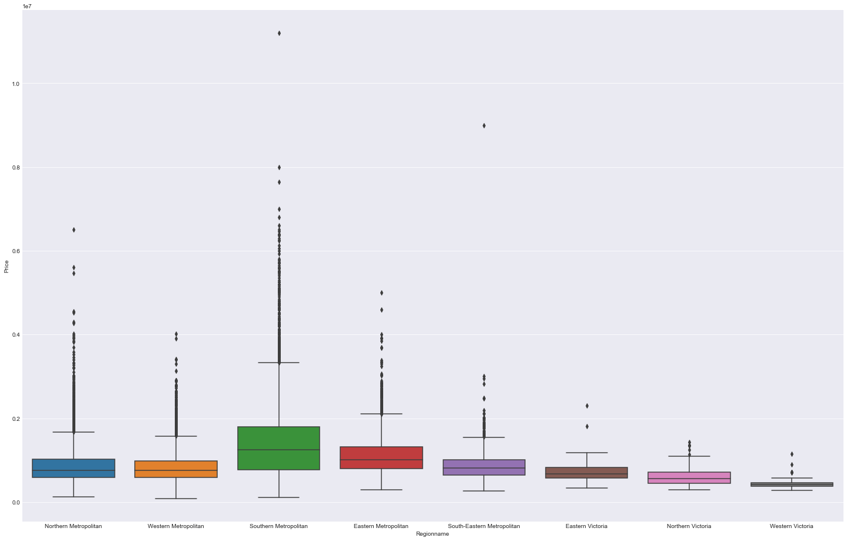
1-3 Which Suburb has highest attention from buyers
In this figure we can recognize that the Southern Metropolitan has the highest interest for buyers as well as the price have been change more in this suburb

Slide 8
2- Business Case Scope Description for Sales Manager
1) Finding the behavior of selling during time.
2) The correlation between variables and find the most relevant data that affect on price.
3) Finding the best agents.
4) Finding that the type of the house that has the highest sell.

Slide 9
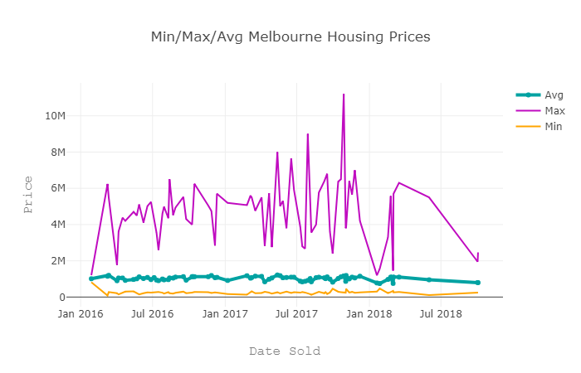
2-1 Line graph for price during the time
This plot shows that the average price for houses is mainly constant during the 2016-2018. The Max price is more fluctuated that Min price.

Slide 10
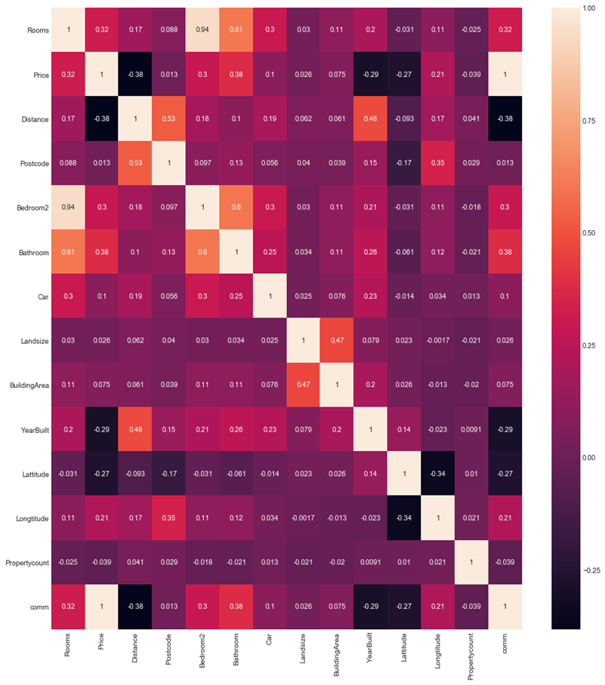
2-2 Heatmap for Finding the Correlation between variable
The correlation between all variables in datasets.
The price has the negative relation with distance with -0.38 as well as year built with -0.29.

Slide 11
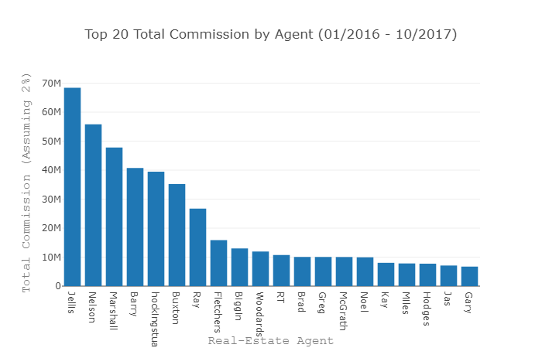
2-3 Bar Chart to Find the 20 Top Commissions by Agent.
The top 20 commission by agent between 2016 and 2018 which shows the Jellis’s agent has the highest total commissions among all agents.

Slide 12
3- Business Case Scope Description for Store Manager
Finding the buyer behavior more in details and focus on these factor to increase the selling trend.
1) when buyers are more interested to but a house.
2) which time of the year buyers are more willing to buy.
3) which method of selling has better impact on selling more.

Slide 13
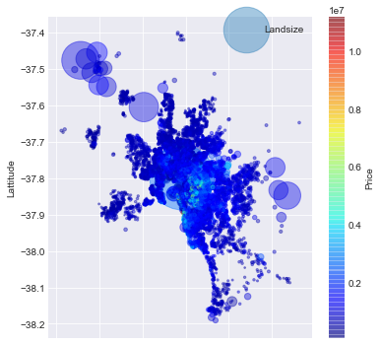
3-1 Finding the place and size of the houses
This graph can show , where people are interested to buy a house and the size of bubble recognize as a landsize.
The houses by the biggest landsize exist in the area that has long distance from the Melbourne center area.
The price of the house is much greater than in the city center of Melbourne

Slide 14
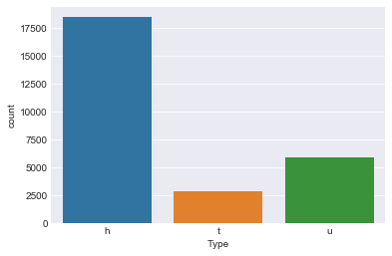
3-2 Finding the Best Type of the House for Sell
H=House, t=Townhouse, u=Unit
The house has the highest rate which shows people are more interested to buying the house rather than a unit or a townhouse.

Slide 15
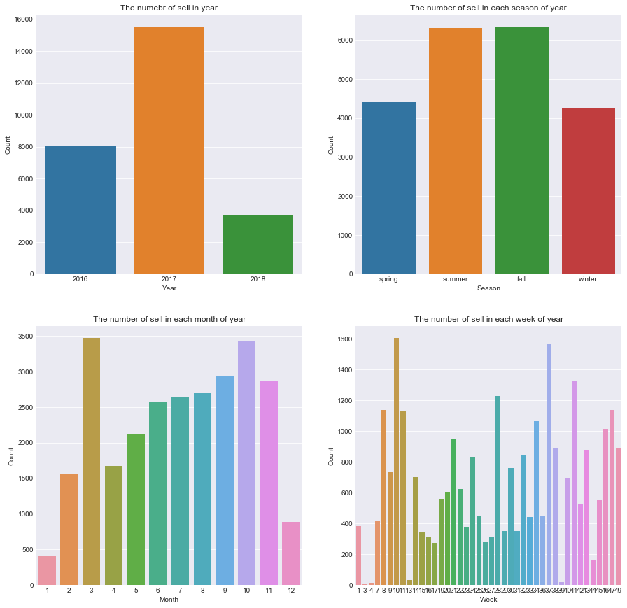
3-3 Find the Best Time of the Sell During the Year
1) 2017 has the highes number of sells.
2) Summer and fall people are more interested to buy the houses.
3) May and October have the highest number of sells and January has the lowest one in a whole year.
4) Week 3,4 and 39 almost zero and the highest ones are week 10 and 37.

