Slide 1
The Smart Home User Experience Dilemma
Prof. Dr.-Ing. Christian Paetz
Chemnitz University
Munich, Nov 2014

Slide 2
Problem statement
There is no commonly accepted best practise in managing a Smart Home (like the X of closing a window on a PC)
There is no standard apartment or home (every home has different style, naming and position of windows, doors, light, ...)
There is no standard set of use cases for the Smart Home but complexity

Slide 3
How to solve this
Learn from the young ones - Elementary School
Keep it simple in the beginning
Allow early success on little things
Repeat, repeat and again repeat
Learn from the old ones - Modeling science theory (*)
Readable yet formal
Information hiding
Separation of concerns
Establish basic set of rules and stick to it.
Ramesh Bharadwaj, C: Heitmeyer: Applying the SCR Requirements Specification Method to Practial Systems: A Case Study, 21st Software Engineering Workshop, NASA Goddard Space Flight Center, Greenbelt, Dec. 1996

Slide 4
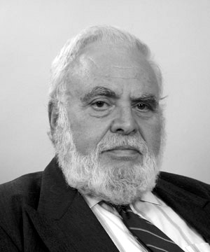
Solomon Golomb: Models (1968)
Don’t apply a model until you understand the simplifying assumptions on which it is based and can test their applicability.
Distinguish at all times between the model and the real world.
The purpose of notation and terminology should be to enhance insight and facilitate computation – not to impress or confuse the uninitiated

Slide 5
What does this mean to us
Elements
Events
Apps

Slide 6
Elements
All functions in a smart home, regardless of action or information are displays in one element each
“All elements are created equal”
Elements have same size, same color, same extensions, same configuration
Whether the function is performed by a physical device or a virtual device or a special function or or or , its always one single element

Slide 7
How to manage Elements
Sea of elements
Small number of managed elements call for hierarchy, large numbers of elements call for search (see yahoo in the first days versus google today)
There are only two groupings
Dashboard – the important elements
Rooms – all elements assigned by room

Slide 8
Events
Every change of a status (actor) or a value (sensor) is an event
„All events are created equal“
Events can be filtered by device, root cause, etc.
All Events have same size, same color, same information
Whether the event is generated by a physical device or a virtual device or a special function or or or …, its always one single event

Slide 9
Apps
Every function above and beyond accessing information or controlling devices is an application, short app
Apps can do
Aggregation of information based on other information
Information from outside the home ( e.g. weather)
Aggregated action (scenes)
Automation (e.g. if -> then)
Complex usage of the devices (e.g. alarm system)

Slide 10
Apps Display
All apps are displayed equal
In app store
In local app repository
In list of active apps
Apps can be added by users, installers,...
Apps can be created by users, developers, ...

Slide 11
Consoles
The Smart Home is used (controlled, configured and monitored) in multiple way, parallel and simultaneously
Web browser
iPAD
Phone
Wall Panel
Local control on device

Slide 12
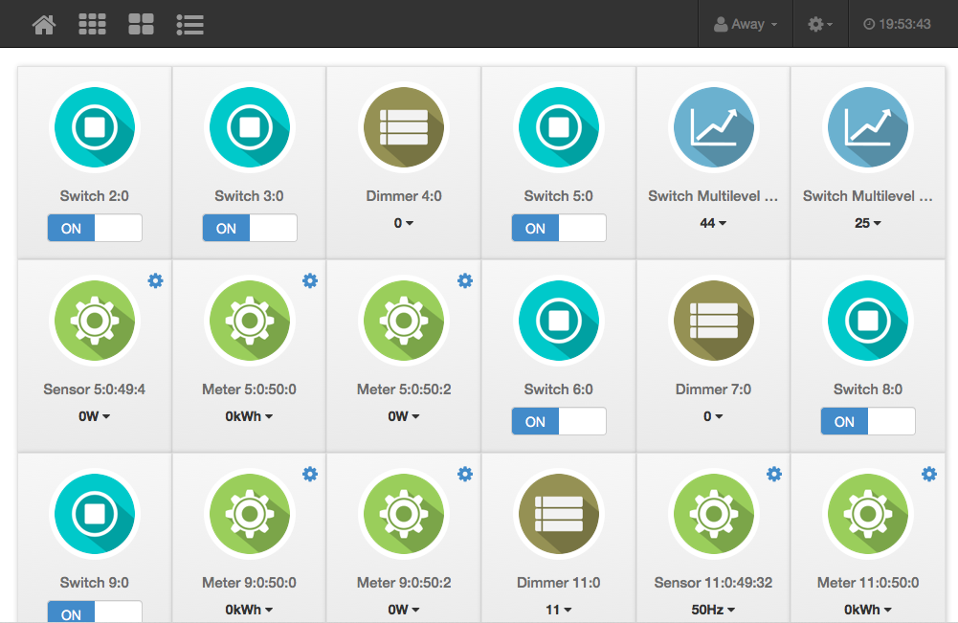
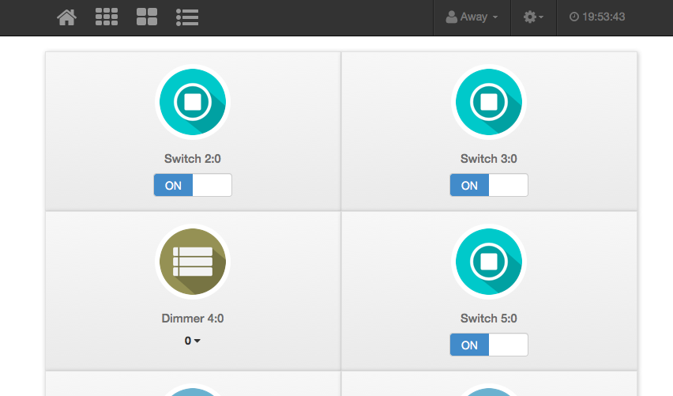
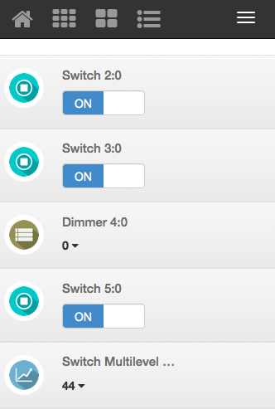
All displays are created equal
Web,
Pad,
Phone

