Slide 1
网络设备基本调试
ISSUE 1.0
日期：
杭州华三通信技术有限公司 版权所有，未经授权不得使用与传播

Slide 2
引入
按照初始目标组建配置完互联网络后，首要的任务是检查网络的连通性
为定位网络设备协议或控制参数的配置错误或运行故障，需要使用调试信息

Slide 3

课程目标
学习完本课程，您应该能够：
掌握用ping、tracert命令检查系统连通性
掌握使用debug等命令进行网络系统基本调试的方法

Slide 4
目录
网络连通性测试
系统调试

Slide 5
ping的实现原理
RTA
RTB
RTC
192.168.1.1
192.168.1.2
192.168.2.1
192.168.2.2
192.168.3.1
ping 192.168.3.1
echo-request
echo-reply

Slide 6
ping命令的输出
[RTA]ping 192.168.3.1
PING 192.168.3.1: 56 data bytes, press CTRL_C to break
Reply from 192.168.3.1: bytes=56 Sequence=1 ttl=254 time=28 ms
Reply from 192.168.3.1: bytes=56 Sequence=2 ttl=254 time=28 ms
Reply from 192.168.3.1: bytes=56 Sequence=3 ttl=254 time=28 ms
Reply from 192.168.3.1: bytes=56 Sequence=4 ttl=254 time=27 ms
Reply from 192.168.3.1: bytes=56 Sequence=5 ttl=254 time=28 ms
--- 192.168.3.1 ping statistics ---
5 packet(s) transmitted
5 packet(s) received
0.00% packet loss
round-trip min/avg/max = 27/27/28 ms

Slide 7
使用ping命令
<H3C>ping ?
-a Select source IP address
-c Specify the number of echo requests to be sent
-f Specify packets not to be fragmented
-h Specify TTL value for echo requests to be sent
-i Select the interface to send the packets
-m Specify the interval in milliseconds to send packets
-n Numeric output only. No attempt will be made to lookup host
addresses for symbolic names
-p No more than 8 "pad" hexadecimal characters to fill out the
sent packet. For example, -p f2 will fill the sent packet
with f and 2 repeatedly
-q Quiet output. Nothing will be displayed except for the summary
lines.
-r Record route. Include the RECORD_ROUTE option in the
ECHO_REQUEST packets and display the route
-s Specify the number of data bytes to be sent
-t Specify the time in milliseconds to wait for each reply
-tos Specify TOS value for echo requests to be sent
-v Display the received ICMP packets other than ECHO-RESPONSE
packets.
STRING<1-20> IP address or hostname of a remote system
ip IP Protocol
ipv6 IPv6 Protocol

Slide 8
tracert的实现原理
RTA
RTB
RTC
192.168.1.1
192.168.1.2
192.168.2.1
192.168.2.2
192.168.3.1
echo-request ttl=1
(1)
ttl-exceeded
echo-request ttl=2
(2)
port-unreachable
tracert 192.168.3.1

Slide 9
tracert命令的输出
[RTA]tracert 192.168.3.1
traceroute to 192.168.3.1(192.168.3.1) 30 hops max,40 bytes packet, press CTRL
_C to break
1 192.168.1.2 17 ms 17 ms 17 ms
2 192.168.2.2 18 ms 19 ms 19 ms
*Oct 1 17:11:02:973 2008 RTA IPFWD/7/debug_case:
Sending, interface = Serial6/0, version = 4, headlen = 20, tos = 0,
pktlen = 40, pktid = 30003, offset = 0, ttl = 1, protocol = 17,
checksum = 48959, s = 192.168.1.1, d = 192.168.3.1
*Oct 1 17:11:03:407 2008 RTA IPFWD/7/debug_case:
Sending, interface = Serial6/0, version = 4, headlen = 20, tos = 0,
pktlen = 40, pktid = 30006, offset = 0, ttl = 2, protocol = 17,
checksum = 48700, s = 192.168.1.1, d = 192.168.3.1
*Oct 1 16:59:43:773 2008 RTA IPDBG/7/debug_icmp:
ICMP Receive: ttl-exceeded(Type=11, Code=0), Src = 192.168.1.2, Dst = 192.168.1.
1; Original IP header: Pro = 17, Src = 192.168.1.1, Dst = 192.168.3.1, First 8 b
ytes = 7533829A 00140000
*Oct 1 16:59:43:920 2008 RTA IPDBG/7/debug_icmp:
ICMP Receive: port-unreachable(Type=3, Code=3), Src = 192.168.2.2, Dst = 192.1
.1.1; Original IP header: Pro = 17, Src = 192.168.1.1, Dst = 192.168.3.1, First
8 bytes = 7533829D 00140000

Slide 10
使用tracert命令
<H3C>tracert ?
-a Select source IP address
-f First time to live
-m Maximum time to live
-p UDP port number
-q Number of probe packets
-w Timeout in milliseconds to wait for each reply
STRING<1-20> IP address or hostname of a remote system
ipv6 IPv6 Protocol

Slide 11
目录
网络连通性测试
系统调试

Slide 12
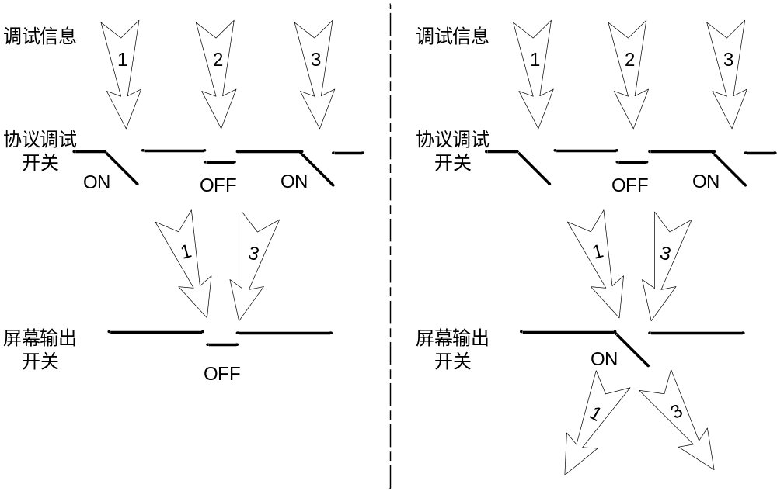
系统调试介绍
对网络设备所支持的绝大部分协议和功能，系统都提供了相应的调试功能，帮助用户对错误进行诊断和定位
调试信息的输出由两个开关控制

Slide 13
系统调试的操作
开启控制台对系统信息的监视功能
打开调试信息的屏幕输出开关
打开模块调试开关
显示调试开关
<H3C>terminal monitor
<H3C>terminal debugging
<H3C>debugging module-name
<H3C>display debugging

Slide 14
调试信息输出的例子
<RTA>ping -c 1 192.168.1.2
PING 192.168.1.2: 56 data bytes, press CTRL_C to break
*Oct 1 17:16:21:648 2008 RTA IPFWD/7/debug_case:
Sending, interface = Serial6/0, version = 4, headlen = 20, tos = 0,
pktlen = 84, pktid = 2775, offset = 0, ttl = 255, protocol = 1,
checksum = 11646, s = 192.168.1.1, d = 192.168.1.2
prompt: Sending the packet from local at Serial6/0
*Oct 1 17:16:21:673 2008 RTA IPFWD/7/debug_case:
Receiving, interface = Serial6/0, version = 4, headlen = 20, tos = 0,
pktlen = 84, pktid = 1515, offset = 0, ttl = 255, protocol = 1,
checksum = 12906, s = 192.168.1.2, d = 192.168.1.1
prompt: Receiving IP packet from Serial6/0
*Oct 1 17:16:21:674 2008 RTA IPDBG/7/debug_case:
Delivering, interface = Serial6/0, version = 4, headlen = 20, tos = 0,
pktlen = 84, pktid = 1515, offset = 0, ttl = 255, protocol = 1,
checksum = 12906, s = 192.168.1.2, d = 192.168.1.1
prompt: IP packet is delivering up!
Reply from 192.168.1.2: bytes=56 Sequence=1 ttl=255 time=26 ms
--- 192.168.1.2 ping statistics ---
1 packet(s) transmitted
1 packet(s) received
0.00% packet loss
round-trip min/avg/max = 26/26/26 ms

Slide 15
本章总结
ping使用ICMP回显请求与应答检测网络连通性
tracert使用TTL超时机制检测网络连通性
调试信息的输出由协议开关和屏幕开关两个开关控制

