Slide 1
Afeka Face 2020
Designed and implemented by
Marat Lis; Maxim Chanturiay

Slide 2
Project overview
Afeka face simulates parts of a social network website.
Technologies and concepts used:
Ubuntu 18.04
Php v7.x
MySQL v14.14
Apache 2.x
ECMA Script 2015 (JS)
AJAX with the “vanilla” XMLHttpRequest object.
MVC design pattern
Rc4 encryption

Slide 3
Project overview
The following features have been implemented:
Signup / Login.
User credentials encryption.
Upload posts with thumbnail, private / public configuration, images, text message.
Search for friends by string keyword with the filtering.
View friend’s page.
View friend’s posts.

Slide 4
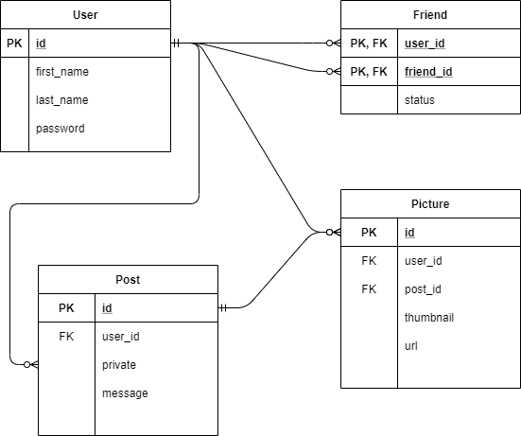
Project details
The following diagram summarizes the relationships between the persisted data.

Slide 5
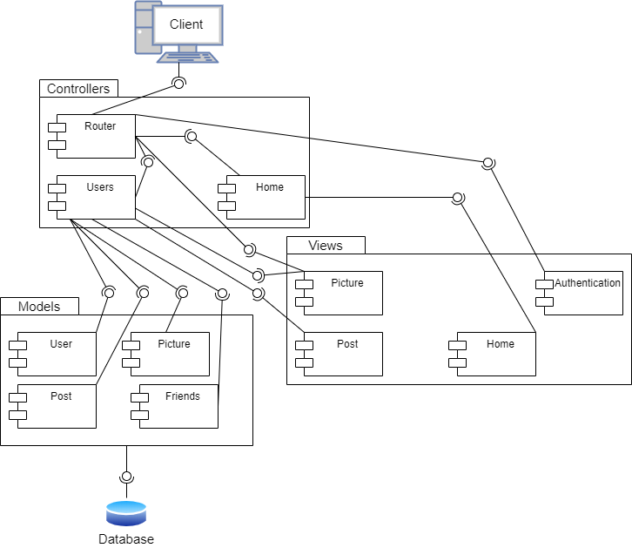
Project details
The following diagram summarizes
the relationships between the MVC
components.

Slide 6
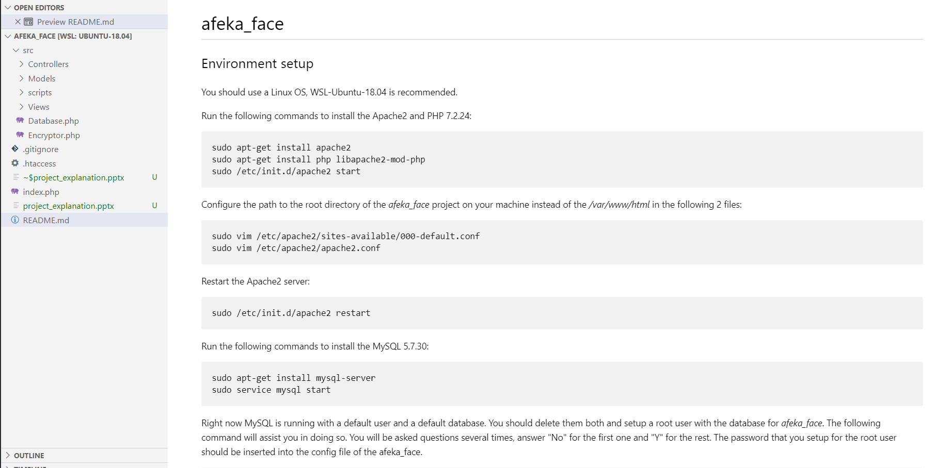
Project details
To run the project, please consult the README.txt in the root directory

