Slide 1

Parallel K-Means Clustering
Authors
Maxim Chantuziay, 321908402
Marat Lis, 328897079

Slide 2
Introduction
A brief overview
K-Means Clustering is a method of vector quantization.
It aims to partition n observations into k clusters.
Each observation belongs to the cluster with the nearest mean value
The scope of our project
We have implemented the clustering of the X,Y coordinates.
We have used the distance from the center of the cluster as the mean value.
A point is appointed to a cluster if it’s mean value is the lowest in comparison to the distances from the centers of the rest of the clusters.

Slide 3
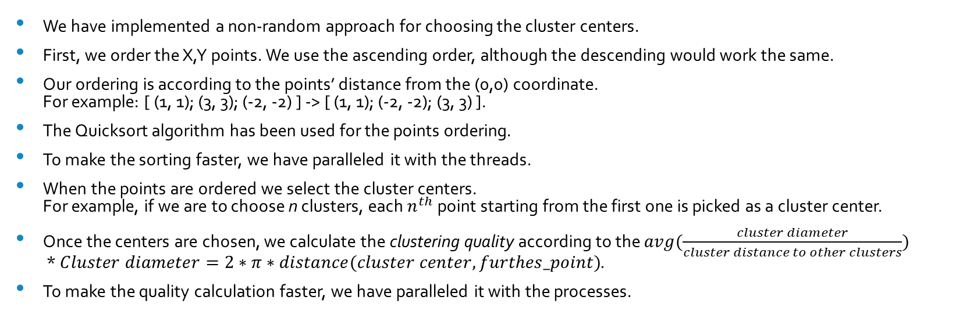
Implementation overview
We have implemented a non-random approach for choosing the cluster centers.
First, we order the X,Y points. We use the ascending order, although the descending would work the same.
Our ordering is according to the points’ distance from the (0,0) coordinate. For example: [ (1, 1); (3, 3); (-2, -2) ] -> [ (1, 1); (-2, -2); (3, 3) ].
The Quicksort algorithm has been used for the points ordering.
To make the sorting faster, we have paralleled it with the threads.
When the points are ordered we select the cluster centers. For example, if we are to choose n clusters, each $n^{th}$ point starting from the first one is picked as a cluster center.
Once the centers are chosen, we calculate the clustering quality according to the $avg(\frac{cluster diameter}{cluster distance to other clusters})$ * $Cluster diameter=2∗π∗distance(cluster center, furthes_point)$.
To make the quality calculation faster, we have paralleled it with the processes.

Slide 4
Quicksort paralleled with threads overview
The object QuickSortParallel performs the sorting by calling the objects QuickSortParallelWorker (one object per thread).
At first, QuickSortParallel recursively calls the self._sort_helper methods. The recursions occur as long as there are at least 4 available threads. Each recursion partitions the elements to be sorted around a pivot element. Before each recursion, the counter of total unused threads is updated with -4.
Once the total unused threads drops below 4, QuickSortParallel starts to return back from the recursion calls. Before each return 2 QuickSortParallelWorker objects are created. One object is to sort the left side elements to the current recursion level pivot. The other object is to sort the right side elements to the current recursion level pivot.
Once the QuickSortParallelWorker are all created and the QuickSortParallel returns from all the recursion calls, QuickSortParallelWorker objects sort their assigned elements.

Slide 5
Quality calculation paralleled with processes overview
KmeansClusteringMaster object creates the multiprocessing.Queue and multiprocessing.JoinableQueue objects. The first queue will store the results, reported by other processes. The second queue will store the tasks for the other processes.
First the KmeansClusteringMaster appoints tasks. Each tasks includes the cluster center and the points that belong to it. Since we know that the points are ordered, if we add the tasks in sequential order starting from the beginning – we know the range of the points that each cluster center has.
Once the tasks are ready, KmeansClusteringMaster initiates the KmeansClusteringSlave objects (one object per process).
KmeansClusteringSlave objects start to pull the tasks from the multiprocessing.JoinableQueue, calculate the cluster quality and report it back to the multiprocessing.Queue
Once all the tasks are executed and their output is reported, the KmeansClusteringMaster calculates their average.

Slide 6
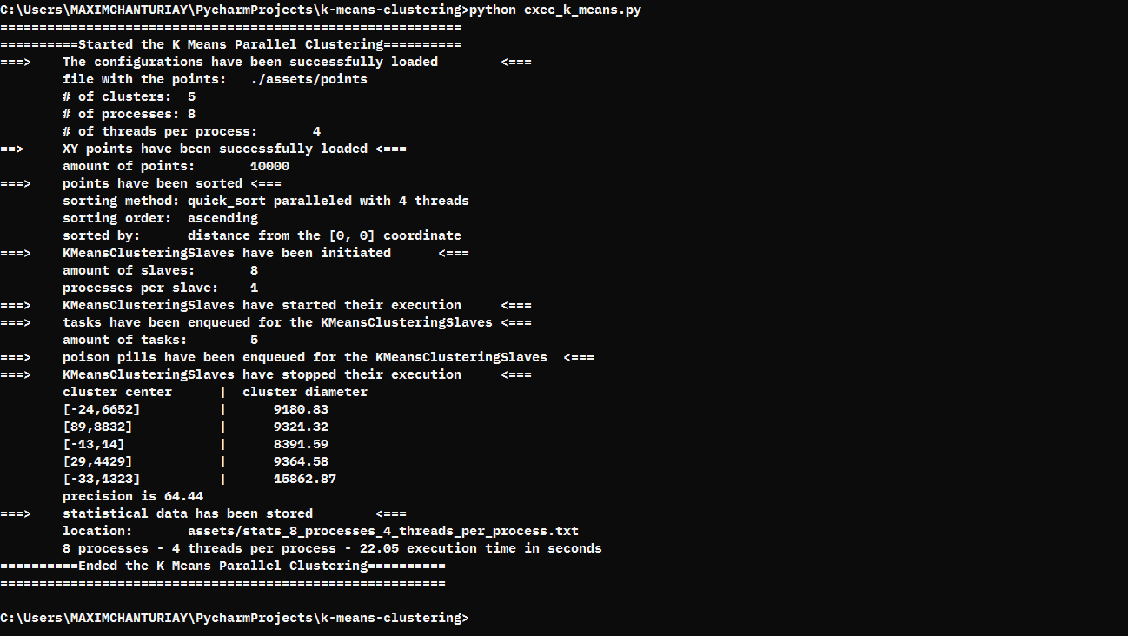
Parallel K-Means Clustering execution example

Slide 7
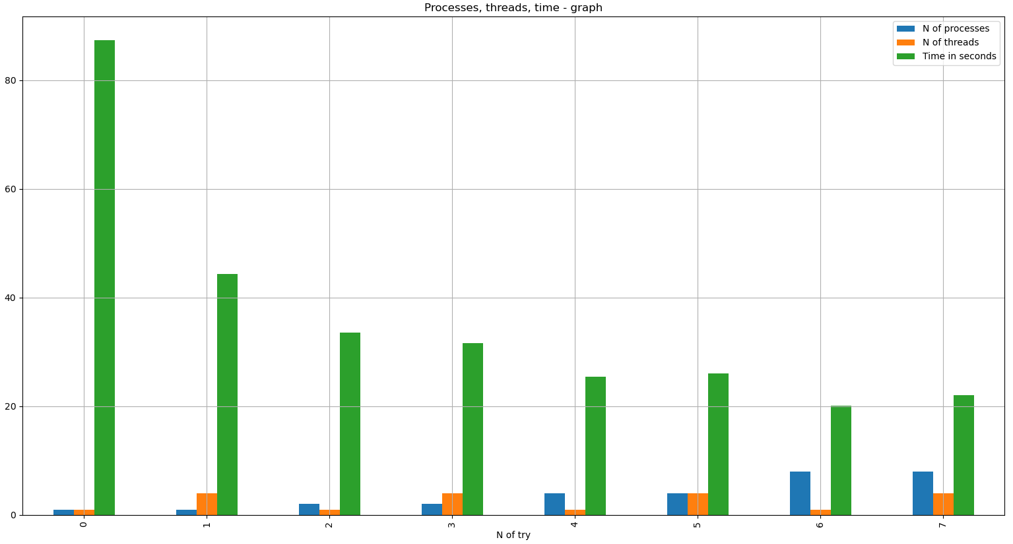
Execution comparisons
We have executed the 5-means clustering for the 10 000 X,Y points with the following configurations: (1) 1 process, 1 thread per process (2) 1 process, 4 threads per process (3) 2 processes, 1 thread per process (4) 2 processes, 4 threads per process (5) 4 processes, 1 thread per process (6) 4 processes, 4 threads per process (7) 8 processes, 1 threads per process (8) 8 processes, 4 thread per process
With the help of Pandas and Matlaplotlib modules, we can see a graphical comparison of their run times.

