Slide 1
Disk Sanitizer
Basic Concept
Wiping all data stored in the selected drive with designated method.
Following the recommendations in US DoD 5220.22-M
Wiping method
DoD 5220.22-M (Wiping with verification)
Three-pass overwriting algorithm
Overwrite all addressable locations with a character, its complement, then a random character and verify (with all passes).
DoD 5220.22-M (E) (Wiping without verification)
Three-pass overwriting algorithm
Overwrite all addressable locations with a character, its complement, then a random character.
Disk sanitizer can only be executed after supervisor password is installed.
User can select which drive to be wiped.
User can select which wiping method to be executed.
The wiping process can be interrupted on demand.

Slide 2
Disk Sanitizer
Flow Chart
BIOS Setup
List all drives and ask for user selection
Prompt warning message of irreversible data lose again
User selects “Disk Sanitizer”
User selects any drive or ESC?
ESC
User Confirms?
N
Prompt warning message of irreversible data lose
ENTER
Y
List all wiping methods and ask for user selection
Start to wipe the selected drive with designated wiping method (show progress and elapsed time)
User Confirms?
Y
User selects any method or ESC?
N
ESC
ENTER
Done

Slide 3
Backup

Slide 4
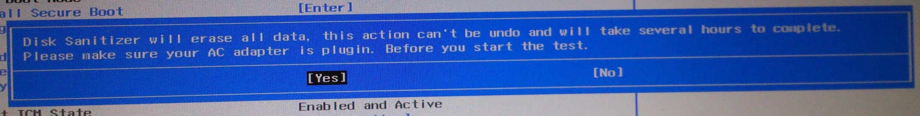
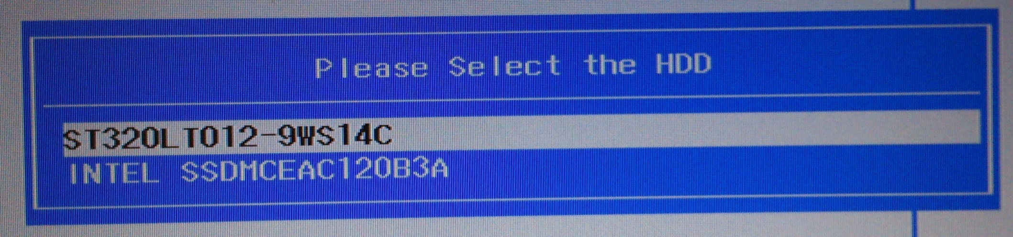
Disk Sanitizer
Reference snapshot

Slide 5
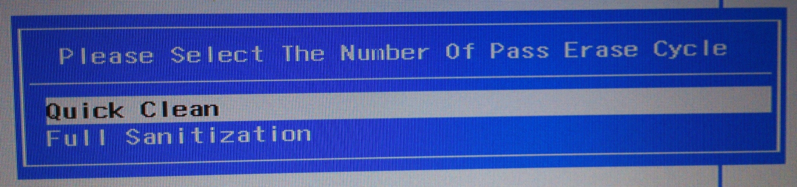
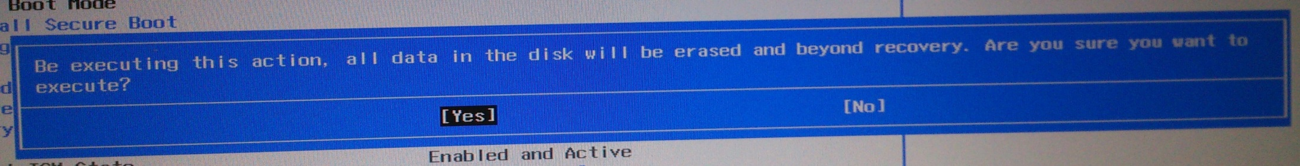
Disk Sanitizer
Reference snapshot

Slide 6
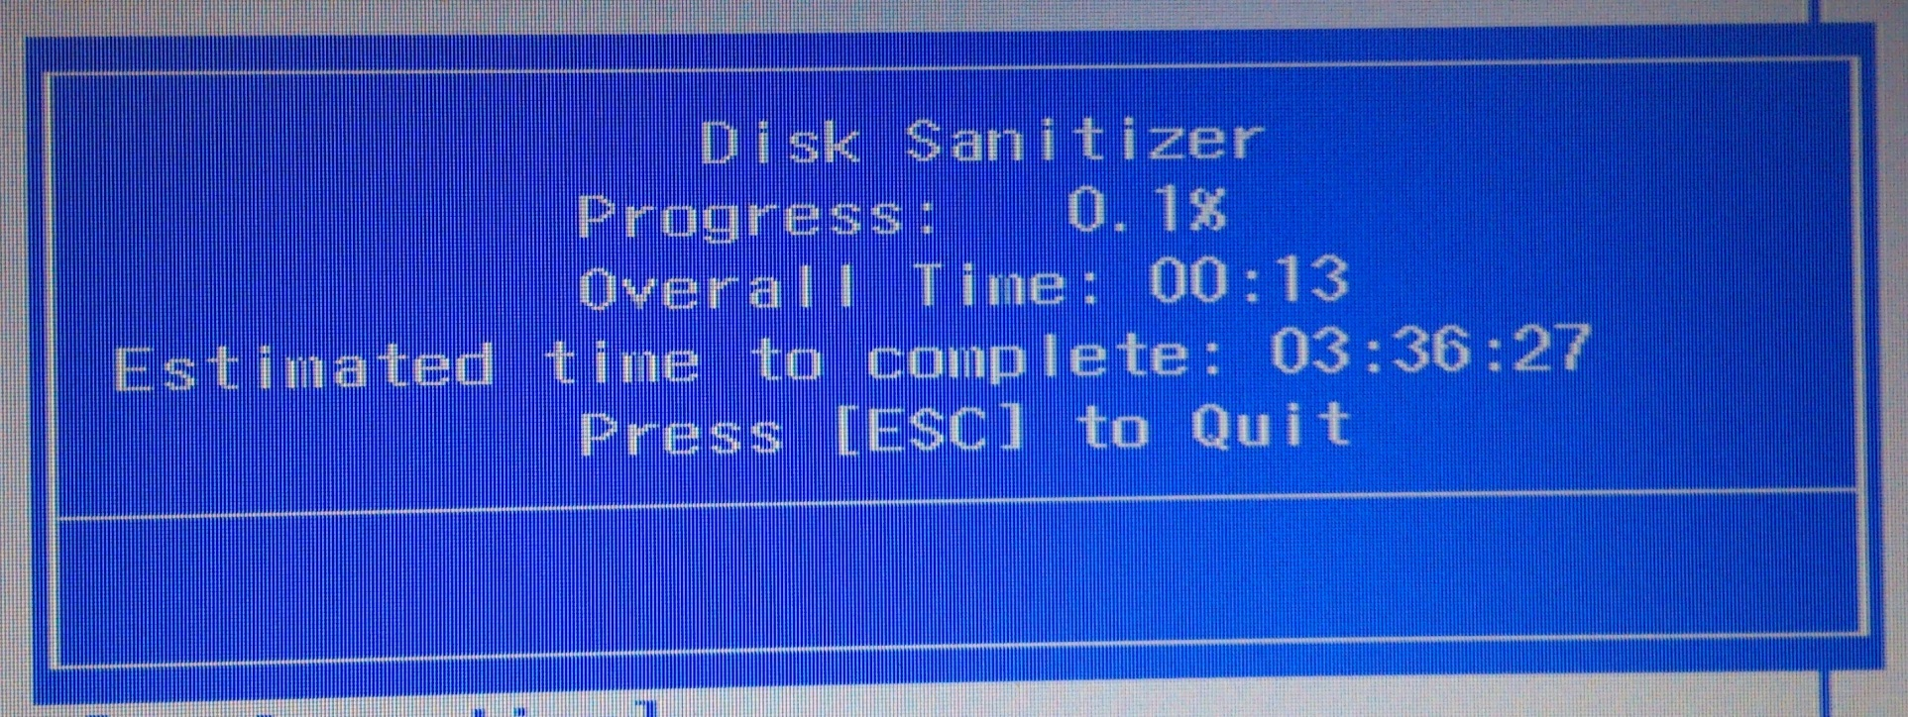
Disk Sanitizer
Reference snapshot

