Slide 1
System Health Indicator II
(Updates from BIOS team)
KY8350
Jovi Liu

Slide 2
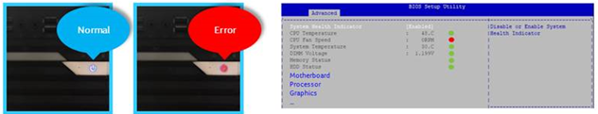
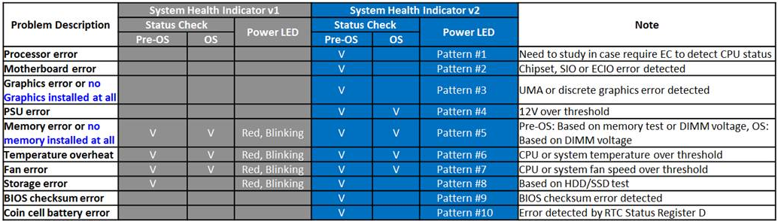
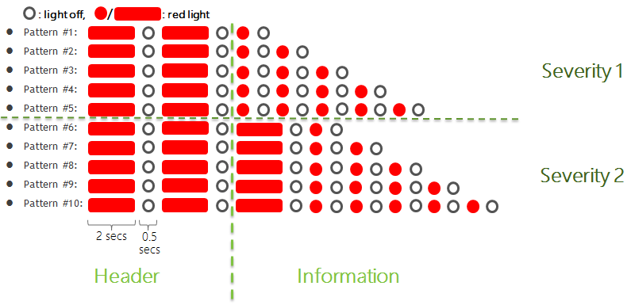
System Health Indicator II
Status: Accomplished
Project: Commercial DT
Schedule: CFL regression
Specification:

Slide 3
System Health Indicator II - Definitions in BIOS
Error Type | Definitions in BIOS
Processor Error | 0x56 Invalid CPU type or Speed 0x57 CPU mismatch 0x58 CPU self test failed or possible CPU cache error 0x59 CPU micro-code is not found or micro-code update is failed 0x5A Internal CPU error 0xD0 CPU initialization error
Motherboard Error | 0xD1 North Bridge initialization error 0xD2 South Bridge initialization error
SIO/ECIO Error | To check status after SIO/ECIO initialization, NOT successful -> error found
Graphics Error | To check class code after PCIe enumeration, no Graphics installed -> error found
BIOS checksum Error | Follow BIOS damage behavior (boot block is alive)
Coin Battery Error | Battery Removal LED -> RED at the beginning of POST LED -> GREEN after restarting from OS Battery Installation from Removal LED -> RED at the beginning of POST LED -> GREEN after restarting from OS
* Make System Health Indicator option independent of loading default

Slide 4
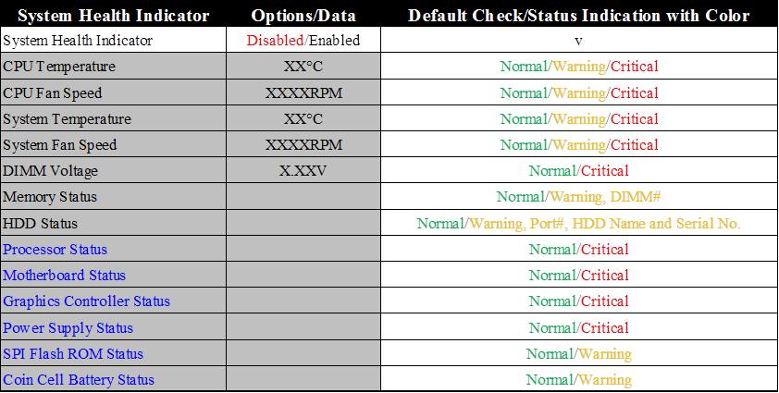
System Health Indicator II – New Items in BIOS Setup Utility

