Slide 1
DT Commercial AIO OSD Menu Spec v1.2
2014.02.20

Slide 2


OSD Button Icon

Slide 3






OSD Menu UI Overview – Icon definition (1 Button Design)
Exit Menu
Monitor Off
Switch to
HDMI-in
OSD Menu
Default
Switch to
PC mode
Adjust
Brightness
2nd Layer
Brightness adjustment
Darkness
Brightness
9 Levels of brightness adjustment
*System design-in 1 button for OSD menu control

Slide 4
OSD Menu UI Overview – Icon definition (2 Button Design)
Exit Menu
Monitor Off
Switch to
HDMI-in
OSD Menu
Default
Switch to
PC mode
Brightness adjustment
Darkness
Brightness
9 Levels of brightness adjustment
*System design-in 2 buttons for OSD menu control

Slide 5


OSD Menu UI Overview – Layout * Size * Position
*OSD area @ bottom left corner
If OSD button @ left side
*Size follow Pisa 2 spec
Icon sequence should follow slide #2 & #3
Acer logo
OSD
area

Slide 6
OSD Menu UI Overview – Layout * Size * Position
*OSD area @ bottom right corner
If OSD button @ right side
*Size follow Pisa 2 spec
Acer logo
Icon sequence should follow slide #2 & #3
Acer logo
OSD
area

Slide 7
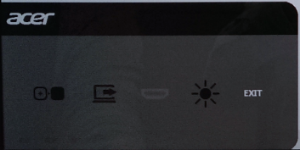
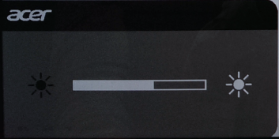
OSD Menu UI Overview – Color definition
 | R | G | B
1.White | 255 | 255 | 255
2.Black | 1 | 1 | 1
3.Gray | 115 | 115 | 115
4.Background | 92 | 92 | 92
Icon sequence should follow slide #2 & #3
1.White
2.Black
1.White
4.Background
3.Gary
2.Black
Main UI
Brightness Adjustment UI

Slide 8
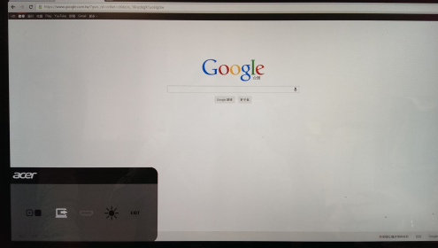
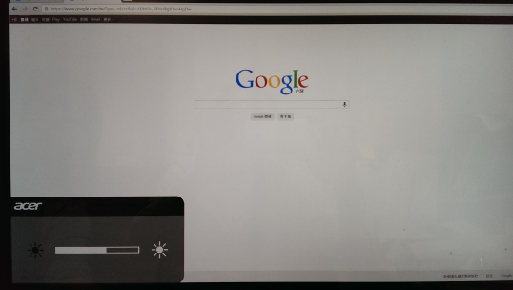
OSD Menu UI Overview – Layout * Size * Position
Icon sequence should follow slide #2 & #3
Notes:
Check location of OSD menu

Slide 9

OSD Menu UI Overview – OSD button Behavior & Flow
Click : Launch OSD / Switch to next option
Under OSD Menu
Idle for 2.5 sec : Enter selected option
Click within 2.5 sec : Switch to next option
The selection is circularly. It will jump to 1st option while selected last option then click.
1st Layer
2nd Layer
Main UI
Brightness Adjustment UI
Icon sequence should follow slide #2 & #3

Slide 10
OSD Menu Overview - OSD button Behavior & Flow
Flow | Display Status | Original Input Source | Action | Remark
0 | Off | PC/HDMI-In mode | Turn on display
1-1 | On | PC mode | Turn off display
1-2 | On | PC mode | Switch to HDMI-In input
1-3 | On | PC mode | Adjust Brightness
2-1 | On | HDMI-In mode | Switch to PC mode
2-2 | On | HDMI-In mode | Adjust Brightness
 | On | HDMI-In mode | Turn off display | Not support

Slide 11


Flow 0 – Turn on Display
0. Display is off. ➔ 1. Click. ➔ 2. Display is turned on.

Slide 12



Flow 1-1: Turn off Monitor
0. Display is on (no matter HDMI/PC mode)
Monitor Off
PC mode
HDMI-in
Brightness
1.Launch OSD
2. Select Monitor Off
3. User no action want wait for 2.5 sec
4. Monitor off

Slide 13



Flow 1-2 – PC Mode Switch to HDMI mode
Default PC Mode
0. Display is on (PC mode)
PC Mode icon is disabled
If HDMI-in is no data, HDMI-in icon is disabled
Display On/Off
PC mode
HDMI-in
Brightness
1.Launch OSD
2. Select HDMI-In
3. User no action and wait for 2.5 seconds
4. Switch to HDMI (Signal)

Slide 14

Flow 2-2 – HDMI Mode Switch to PC mode
Default HDMI Mode
0. Display is on (HDMI mode)
Display on/off icon is disabled
Monitor Mode icon is disabled
If PC is off, PC mode icon is disabled
Display On/Off
PC mode
HDMI-in
Brightness
1.Launch OSD
2. PC mode is selected
3. User no action and wait for 2.5 seconds
4. Switch to PC (Signal)

Slide 15
Flow 1-3, 2-3 – Brightness
0. Display is on (HDMI mode)
Due to MS logo requirements
FW brightness OSD is disabled in Windows
W8: Follow W8 built-in brightness OSD
W7: w/o brightness OSD but still can adjust brightness
Display On/Off
PC mode
HDMI-in
Brightness
1.Launch OSD
2. Select Brightness
3. User no action and wait for 2.5 seconds
4. 2nd layer, brightness adjustment bar shows
5. 9 levels bright adjustment for monitor model , the scale for each level as follow matrix
6. Waiting for 2.5 sec to select & leave
L1 | L2 | L3 | L4 | L5 | L6 | L7 | L8 | L9
23 | 32 | 41 | 50 | 60 | 70 | 80 | 90 | 100

Slide 16
HDMI-IN vs Power Plan
Power Plan | Working Mode
 | S0 | S3 | S4 | S5
Deep Power Off Mode Enable | V | V | V | V
Deep Power Off Mode Disable | V | V | V | V
V : Means support HDMI-in
vSuperb23 supports HDMI-in under “S0” state only
Notes:
Check WST separate HDMI-in & WOL power option

Slide 17




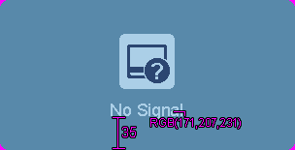
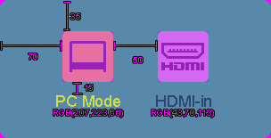
HDMI/PC mode detection spec
HDMI Auto detection duration
HDMI-in (detect 5s, Plug HDMI cable) → if Yes,show HDMI-in icon (pic1-1, 3s) → if No, show HDMI-in no signal icon(pic1-2, 3s)
PC (detect 3s , Power On/unplug HDMI cable) → if Yes,show PC icon (pic2-1, 3s) → if No, show PC no signal icon (pic2-2, 3s)
pic 2-2
pic 1-2
pic 2-1
pic 1-1
icon layout

Slide 18
Appendix

