Slide 1
Power on by Monitor
Justin Chiu / Gerald Hsiao

Slide 2
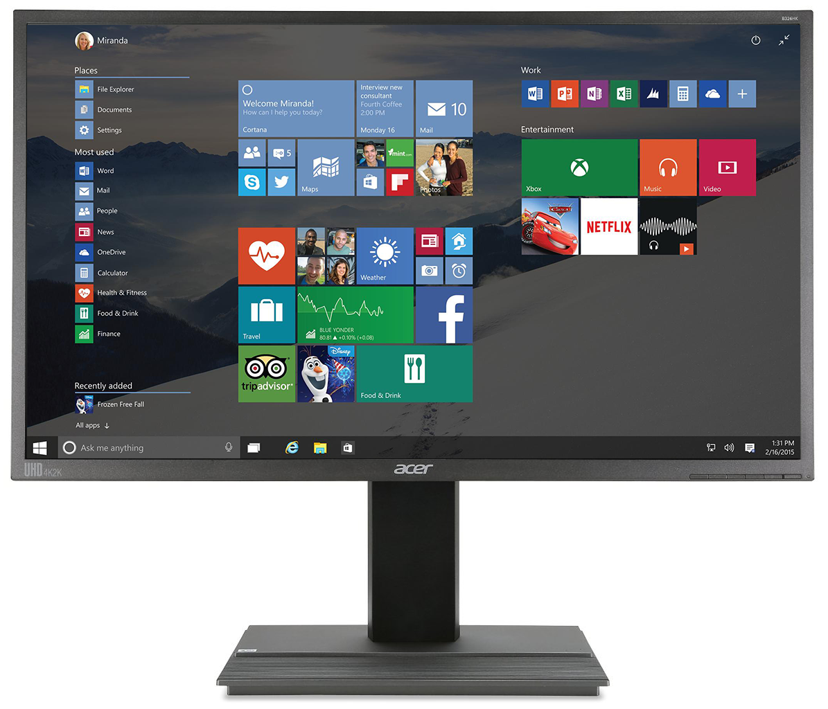

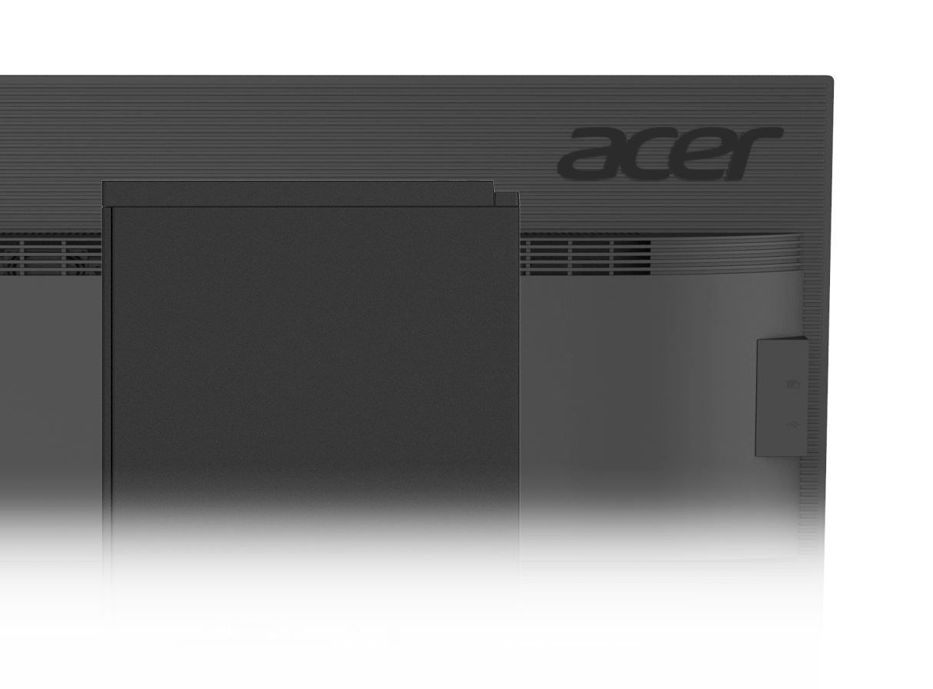


Power on by Monitor
One touch power on
With specific Acer monitors , Veriton PC can be power on by pressing power button of monitor
Supported Monitors:
V206HQLF(V)
V226HQLH(V)
V206HQLG(V)
B246HLB(V+DP)
New commercial BV7 series
*Support L11
ACER CONFIDENTIAL

Slide 3





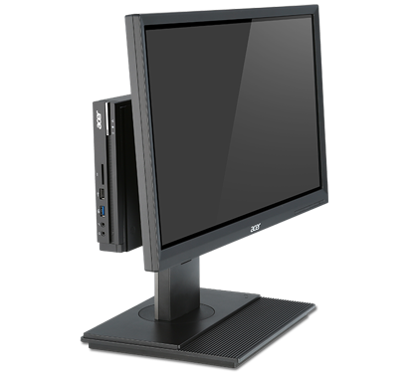
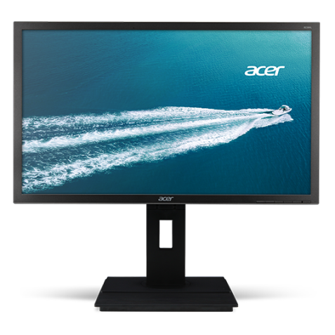
Supported Display Interface & User Scenario
Display Interface
NEW
Veriton N Only
Not Support
D-Sub
DP
HDMI
Type-C
DVI
VGA
DP
User Scenario
System Power On
Processing wake up signal from monitor
Power on & send signal to PC

Slide 4


Power on by Monitor V1 Scenario
Monitor State : Off ➔ On
Monitor State : Standby ➔ Off
System State | System Behavior by pressing monitor power button
S0 | Do Nothing
S3 | Wake Up
S4 | Wake Up
S5 | Power On
G3➔S5 | Power On
System State | System Behavior by pressing monitor power button
S0 | Do Nothing
S3 | Do Nothing
S4 | Do Nothing
S5 | Do Nothing
G3➔S5 | Do Nothing
Monitor State : On ➔ Off
System State | System Behavior by pressing monitor power button
S0 | Do Nothing
S3 | -
S4 | -
S5 | Do Nothing
G3➔S5 | Do Nothing
*Disable by default & Can be enabled through BIOS setting or WMI

Slide 5

EE Design of Power on by Monitor
The equivalent output stage of the Wake-up pin in the DP/D-sub/HDMI/DVI Monitor = a Push-Pull circuit + a pull-down resistor.
I/O port
Monitor Design (I/O supported this function)
3.3V
Mother Board
Push-Pull
A Pulse sent with 3.3V / 200ms
every time press the power BTN
during the off mode.
Onboard VGA Ports
PMOS
Wakeup
Rs = 1Kohm
NMOS
Loss
R = 100Kohm

Slide 6
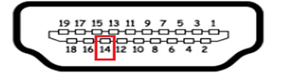
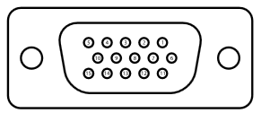
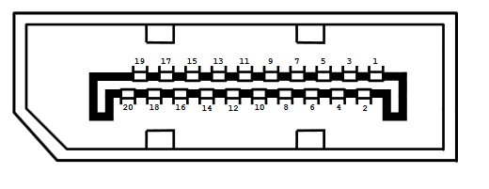
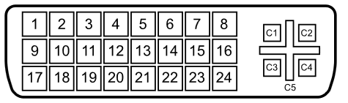
Wakeup Pin definition for each type of VGA port
Wakeup Pin:
D-sub Pin-4 = ID2/NC
HDMI Pin-14 = Utility/HEAC/NC
DVI Pin-8 = Vsync
DP Pin-16 = GND

Slide 7
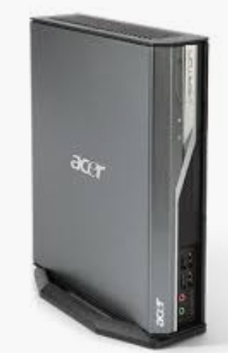
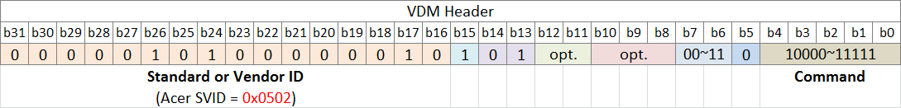
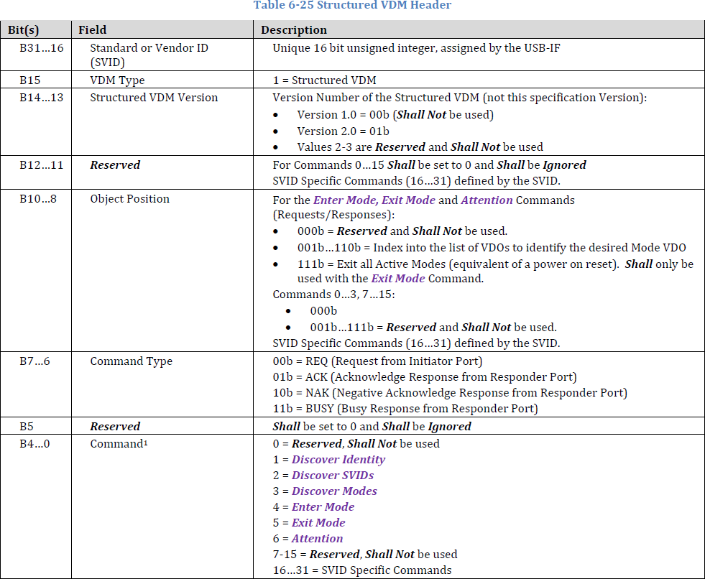
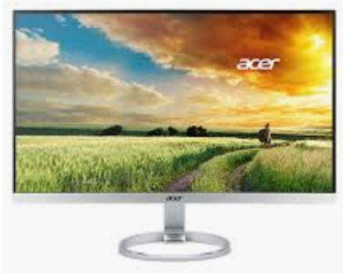

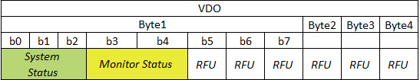
[Design Requirements] Powered on by Monitor through USB Type-C
Status: Planning
Project: vCopperbox2
Schedule: Follow project schedule
Flow and speficication:
Chipset
Wake up/ Power on
LPC
ECIO
I2C
I2C
USB Type-C
PD
PD

Slide 8
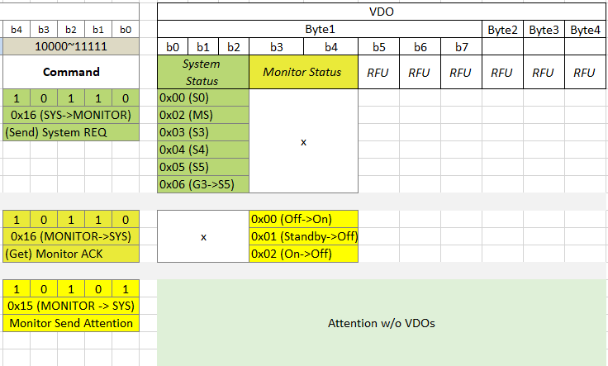
[Design Requirements] VMD Command

Slide 9

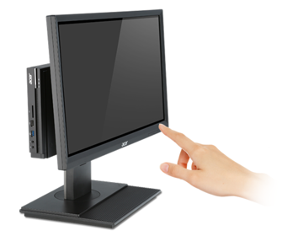
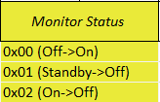
[Design Requirements] VDM CMD Usage Flow
STEP1
When monitor’s power button is pressed, PD sends “Attention” to system. (CMD 0x15)
Attention
STEP2
System’s PD sends “REQ” to monitor with System Status. (CMD 0x16)
REQ
ACK
STEP3
Monitor’s PD replies “ACK” to system with Monitor Status. (CMD 0x16)
STEP4
Powered on or woken up by ECIO design

Slide 10
Backup

Slide 11

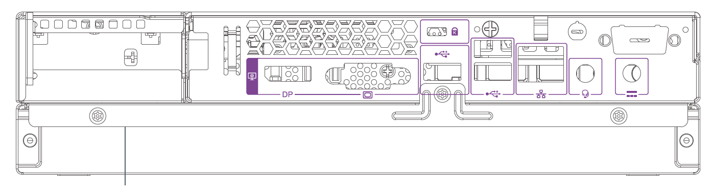
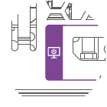
Power on by Monitor Icon Indicator
Planning

Slide 12
Press’N Go V2 Scenario
Monitor State : Off ➔ On
Monitor State : Standby ➔ Press for 1 second ➔ On
System State | System Behavior by pressing monitor power button
S0 | Do Nothing
S3 | Wake Up
S4 | Wake Up
S5 | Power On
G3➔S5 | Power On
System State | System Behavior by pressing monitor power button
S0 | Do Nothing
S3 | Wake Up
S4 | Wake Up
S5 | Power On
G3➔S5 | Power On
Monitor State : Standby ➔ Press then release➔ Off
Monitor State : On ➔ Off
System State | System Behavior by pressing monitor power button
S0 | Do Nothing
S3 | Do Nothing
S4 | Do Nothing
S5 | Do Nothing
G3➔S5 | Do Nothing
System State | System Behavior by pressing monitor power button
S0 | Do Nothing
S3 | -
S4 | -
S5 | Do Nothing
G3➔S5 | Do Nothing
*Disable by default & Can be enabled through BIOS setting or WMI

Slide 13





Press’N Go V2 Scenarios
Planning
Power Off
Standby
Notes:
According to Monitor PM’s feedback , under standby mode while user press power button suggest to remain current monitor behavior.
Maybe can

Slide 14
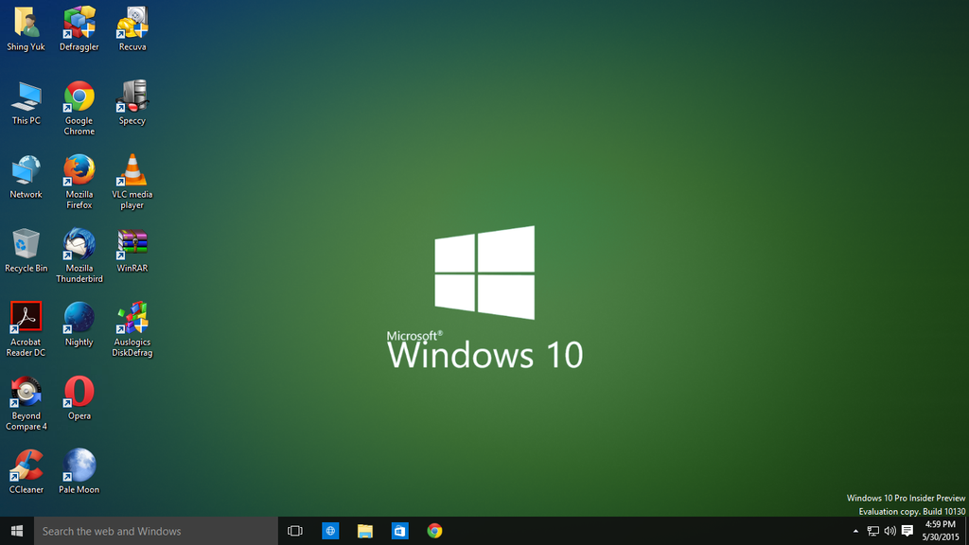
Press’N Go Assistant
Planning
Your system can support Press’N Go technology , do you want to enable it?

Slide 15
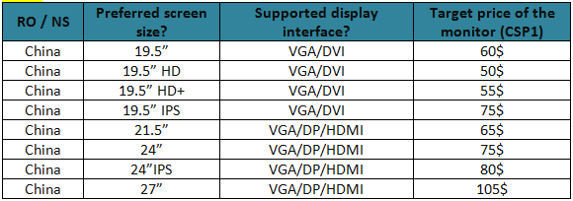
RO’s feedbacks for Power on by Monitor
Region | Preferred Size | Input | Comments
EMEA | 27” 16:9 FHD & WQHD | N/A | 27” B series come with 2 different panel, FHD and WQHD. Since the panel is the difference between the two 27” please let me know if both can be qualified with Power On from Monitor function.
China |  |  | This function performs well bringing convenience, customers do like this function. Lenovo has the patent “boot from keyboard”. “power on by monitor ” can be our weapon to defense it. This is good for sales, especially for KA. Recommend that all monitors should be equipped this function. if cost can be covered。
TWN | 21.5” / 23.8” / 27” | VGA & HDMI | It is value added especially comparing with other competitors.
ACA | 27” | DP + HDMI + VGA | N/A

Slide 16
Supported Model List - PC
Power on from Monitor capable PC | Model Name | DSUB | HDMI | DP
2016 – 2017 model | Veriton X4650G | Y | Y | Y
 | Veriton X6650G | Y | Y | Y
 | Veriton M4650G | Y | Y | Y
 | Veriton M6650G | Y | Y | Y
 | Veriton N4640G | Y |  | Y
 | Veriton N6640G | Y |  | Y
 | Veriton X4210G | Y | Y | Y
 | Veriton F6600G | Y | Y
 | Veriton F4600G | Y | Y
2018 model | Veriton M6660G | Y | Y | Y
 | Veriton S6660G | Y | Y | Y
 | Veriton X6660G | Y | Y | Y
 | Veriton M4660G | Y | Y | Y
 | Veriton S4660G | Y | Y | Y
 | Veriton X4660G | Y | Y | Y
 | Veriton S2660G | Y | Y | Y
 | Veriton X2660G | Y | Y | Y
 | Veriton N6660G | Y | Y | Y
 | Veriton N4660G | Y | Y | Y

Slide 17
Supported Model List - Monitor
Product Name | Display (inch) | Max Resolution | Panel | Input Signal
B227Q | 21.5"H | 1920x1080 @75Hz | IPS | 1. VGA + HDMI + DisplayPort(1.2) + SPK+ Audio in + Audio out + USB3.0x4 (1up 4down) 2. VGA + HDMI + DisplayPort(1.2) + SPK + Audio in+ Audio out 3. VGA + HDMI + DisplayPort(1.2) + SPK+ Audio in + Audio out + USB3.0x3 (1up 3down) + Camera (HD, with mic)
B227Q A | 21.5"H | 1920x1080 @75Hz | VA | 1. VGA + HDMI + DisplayPort(1.2) + SPK+ Audio in + Audio out + USB3.0x4 (1up 4down) 2. VGA + HDMI + DisplayPort(1.2) + SPK + Audio in+ Audio out
B247Y | 23.8"H | 1920x1080 @75Hz | IPS | 1. VGA + HDMI + DisplayPort(1.2) + SPK+ Audio in + Audio out + USB3.0x4 (1up 4down) 2. VGA + HDMI + DisplayPort(1.2) + SPK + Audio in+ Audio out 3. VGA + HDMI + DisplayPort(1.2) + SPK+ Audio in + Audio out + USB3.0x3 (1up 3down) + Camera (FHD, with mic)
B247W | 24"W | 1920x1200 @60Hz | IPS | 1. VGA+HDMI+SPK+Audio in+Audio out 2. VGA+HDMI+DisplayPort(v1.2a)+SPK+Audio in+Audio out 3. VGA+HDMI+DisplayPort(v1.2a)+SPK+Audio in+Audio out+4xUSB 3.0 Hub(1up 4down)
B257Q | 24.5"H | 1920x1080 @75Hz | TN | 1. VGA + HDMI + DisplayPort(1.2) + SPK+ Audio in + Audio out + USB3.0x4 (1up 4down) 2. VGA + HDMI + DisplayPort(1.2) + SPK + Audio in+ Audio out
B277U | 27"H | 2560x1440 @75Hz | IPS | 1. HDMI+ HDMI + DisplayPort(1.2) +miniDisplayPort + SPK + Audio out + USB3.0x4 (1up 4down) 2. HDMI+ HDMI + DisplayPort(1.2) +miniDisplayPort + SPK + Audio out 3. HDMI+ HDMI + DisplayPort(1.2) +miniDisplayPort + SPK + Audio out + USB3.0x3 (1up 3down) + Camera(FHD, with mic)
B277K | 27"H | 3840x2160 @60Hz | IPS | 1. HDMI(2.0)+ HDMI(2.0) + DisplayPort(1.2) +miniDisplayPort + SPK + Audio out + USB3.0x4 (1up 4down) 2. HDMI(2.0)+ HDMI(2.0)+ DisplayPort(1.2) +miniDisplayPort + SPK + Audio out
V227Q | 21.5"H | 1920x1080 @75Hz | IPS | 1. VGA + HDMI + SPK + Audio in + Audio out 2. VGA + HDMI + DisplayPort(1.2) + SPK + Audio in + Audio out 3. VGA + HDMI
V227Q A | 21.5"H | 1920x1080 @75Hz | VA | 1. VGA + HDMI + SPK + Audio in + Audio out 2. VGA + HDMI + DisplayPort(1.2) + SPK + Audio in + Audio out 3. VGA + HDMI
V247Y | 23.8"H | 1920x1080 @75Hz | IPS | 1. VGA + HDMI + SPK + Audio in + Audio out 2. VGA + HDMI + DisplayPort(1.2) + SPK + Audio in + Audio out 3. VGA + HDMI
V247YU | 23.8"H | 2560x1440 @75Hz | IPS | 1. HDMI+ HDMI + DisplayPort(1.2) + SPK + Audio out
V257Q | 24.5"H | 1920x1080 @75Hz | TN | 1. VGA + HDMI + SPK + Audio in + Audio out 2. VGA + HDMI + DisplayPort(1.2) + SPK + Audio in + Audio out 3. VGA + HDMI
V277 | 27"H | 1920x1080 @75Hz | IPS | 1. VGA + HDMI + SPK + Audio in + Audio out 2. VGA + HDMI + DisplayPort(1.2) + SPK + Audio in + Audio out 3. VGA + HDMI
V277U | 27"H | 2560x1440 @75Hz | IPS | 1. HDM I+ HDMI + DisplayPort(1.2) + SPK + Audio out
V277K | 27"H | 3840x2160 @60Hz | IPS | 1. HDMI(2.0)+ HDMI(2.0) + DisplayPort(1.2) + SPK + Audio out

