Slide 1


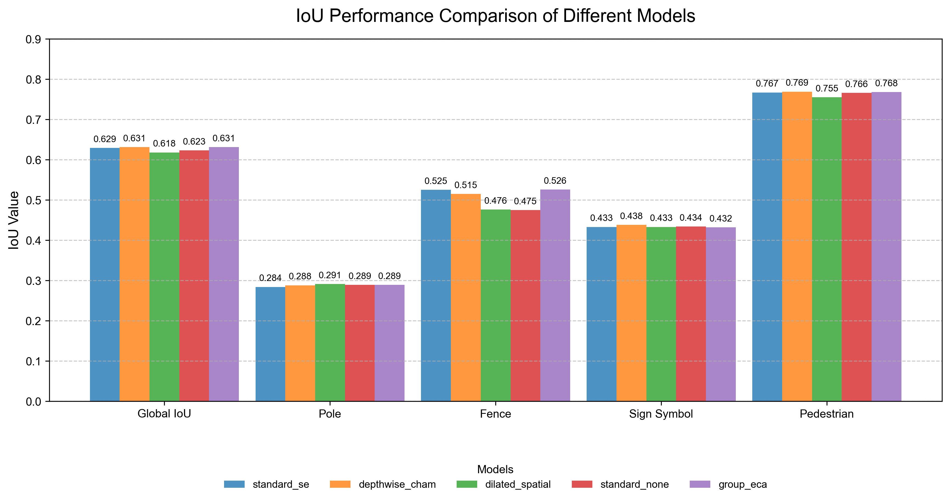
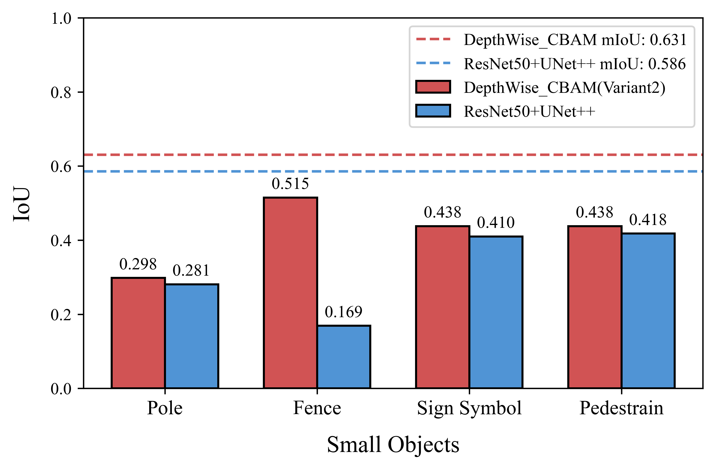
Enhancing Small-Object Segmentation with Meta-Ensemble Architectures
Zihao Chen
Beijing University of Posts and Telecommunications
International school
Beijing, China
z1haoc@bupt.edu.cn
INTRODUCTION
METHODS
In fields such as autonomous driving and medical imaging, semantic segmentation of small objects remains a critical challenge. Traditional models like U-Net, UNet++, and DeepLabV3 often struggle to capture fine-grained details and precise boundaries. U-Net loses fine details during the downsampling process, which renders its skip connections ineffective for identifying tiny targets. UNet++’s nested architecture leads to excessive computational complexity during deployment due to inefficiencies in semantic segmentation stages. DeepLabV3’s ASPP module introduces irrelevant noise due to its fixed dilation rates, limiting its performance on small objects. To address these limitations, this work proposes a novel Meta-Ensemble Architecture. It fuses outputs from ResNet50-based U-Net, UNet++, and DeepLabV3 via a meta-model equipped with depthwise separable convolutions and the CBAM attention module. This framework leverages adaptive refinement to enhance small-object segmentation performance by focusing on the spatial location and discriminative features of small targets.
A. Loss Function Selection: Two loss functions were compared for small-object segmentation: JaccardLoss and DiceLoss. JaccardLoss was selected as optimal, as it better optimizes region overlap and contour precision, achieving a 30% higher average small-object mIoU than DiceLoss.
Backbone Network Selection: Five backbones were evaluated for feature extraction. ResNet50, with residual blocks mitigating vanishing gradients and enabling hierarchical learning of low/high-level features, achieved the highest small-object mIoU (0.320). It outperformed SE-ResNeXt50 (inconsistent calibration), VGG16 (gradient issues), EfficientNet-B3 (compromised fine details), and MobileNetV2 (reduced feature richness), making it the optimal choice.
C. Meta-Ensemble Architecture: A stacking-based ensemble was adopted, with a meta-model trained on outputs from ResNet50+U-Net, ResNet50+UNet++, and ResNet50+DeepLabV3. Its architecture fuses base outputs via entry/standard convolutions, processes them through convolutional layers, attention, and refinement blocks, then integrates features via skip connections before sigmoid activation. Among five variants, Variant 2 (Depthwise Separable Convolution + CBAM Attention) performed best, with CBAM focusing on critical regions and depthwise convolutions reducing complexity .
RESULTS
Loss Function | Model | mIoU | Overall mIoU | mIoU (Small Objects)
DiceLoss | U-net | 0.573 | 0.565 | 0.286
 | Unet++ | 0.534 |  | 0.376
 | Deeplabv3 | 0.587 |  | 0.387
JaccardLoss | U-net | 0.573 | 0.571 | 0.420
 | Unet++ | 0.571 |  | 0.433
 | Deeplabv3 | 0.569 |  | 0.390
Backbone | mIoU | mIoU on Small Objects
ResNet50 | 0.586 | 0.320
SE-ResNeXt50 | 0.599 | 0.293
VGG16 | 0.548 | 0.294
EfficientNet-B3 | 0.570 | 0.259
MobileNetV2 | 0.526 | 0.295
CONCLUSION
This study systematically explores strategies to enhance small-object semantic segmentation, and through comparative experiments, several key insights emerge: JaccardLoss outperforms DiceLoss in optimizing small-object segmentation, as evidenced by a notable 15% increase in UNet++’s small-object mIoU, from 0.376 (with DiceLoss) to 0.433, validating its effectiveness in improving region overlap and contour precision for small targets; ResNet50 stands out as an optimal backbone, with its residual block structure mitigating gradient vanishing to enable hierarchical learning of both low-level details (e.g., edges) and high-level semantics, achieving the highest small-object mIoU of 0.320 among tested backbones like SE-ResNeXt50 and VGG16, proving its superior feature extraction balance for tiny objects; and the proposed Meta-Ensemble Architecture—especially Variant 2 (Depthwise Separable Convolution + CBAM Attention)—delivers significant performance gains, fusing outputs from ResNet50+U-Net, ResNet50+UNet++, and ResNet50+DeepLabV3 to leverage adaptive refinement, raising the overall mIoU to 0.631 (a 7.6% improvement over the strongest single model) and climbing small-object mIoU from 0.319 to 0.433, directly addressing single-model limitations in capturing fine-grained details. For future work, efforts will focus on accelerating the model via TensorRT for real-time inference, lightweighting the architecture to suit edge devices, and further optimizing meta-model hyperparameters to enhance robustness across diverse scenarios.

