Slide 1
Excel and Tableau- Wealth of nations project

Slide 2
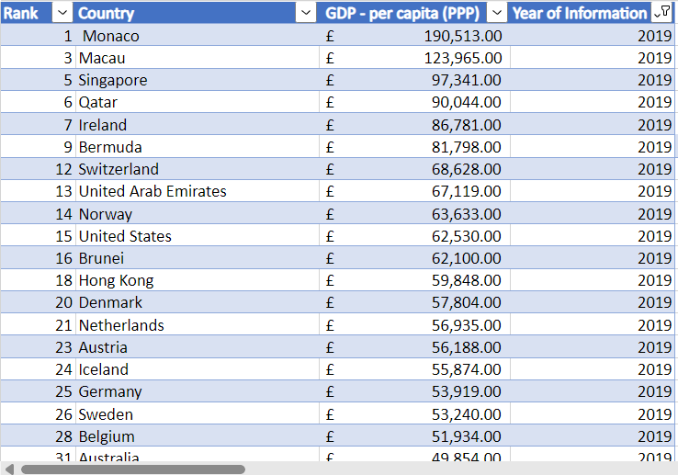
STEPS:
Filtering year of information to 2019
I also arranged by ranking of countries by the GDP.

Slide 3
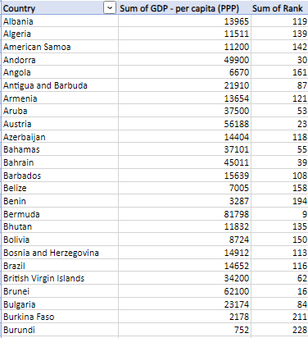
3. Going to GDP to filter country by alphabetical order
4. Filter out any null values as this would affect the graphs that I would be making.

Slide 4
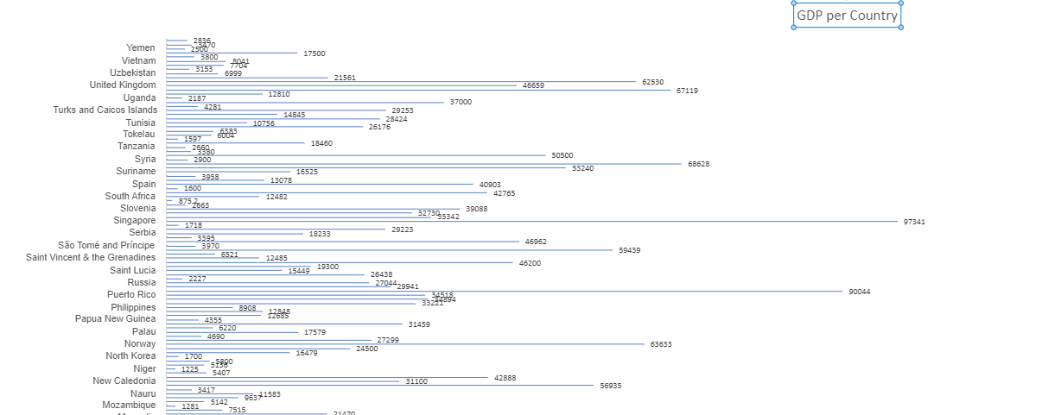

Slide 5
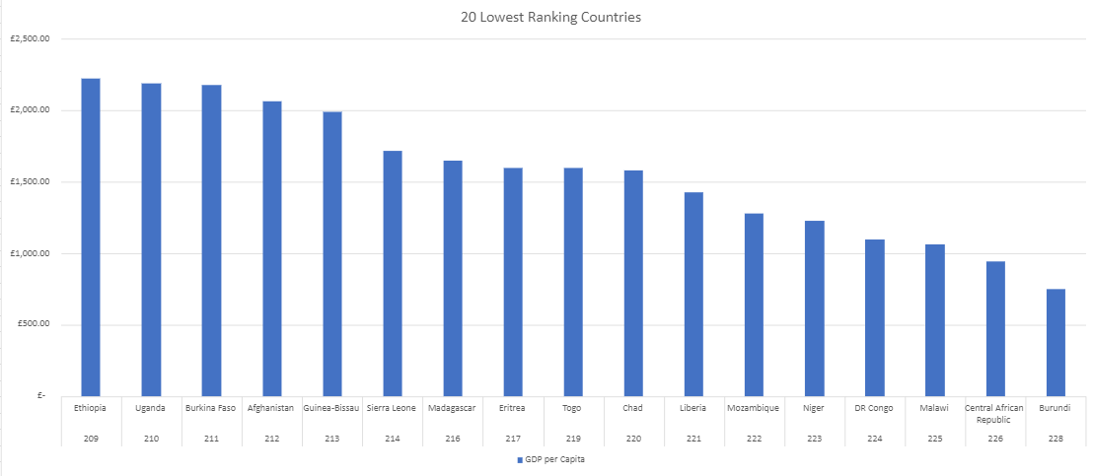
This shows the 20 lowest countries by average GDP which I showed by using a normal bar graph as this is the easiest to see the lowest ranking countries by the height of the graph with adequate distance between them so it can be seen easier.

Slide 6
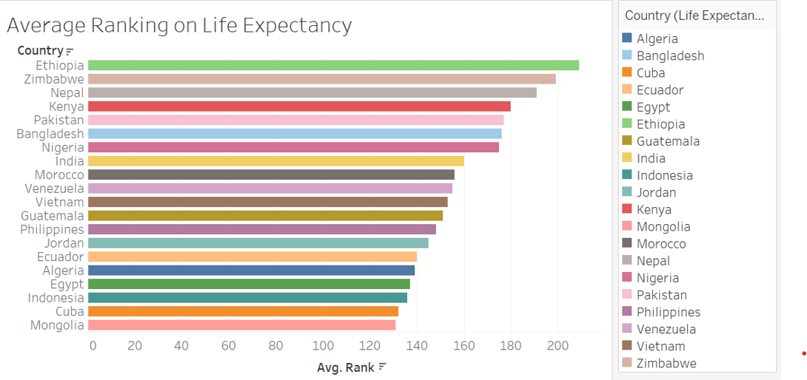
This also shows the 20 lowest countries by average GDP using a coloured bar graph as this is the easiest to differentiate the different countries and makes the dashboard more eye-catching and more pleasing to look at.

Slide 7
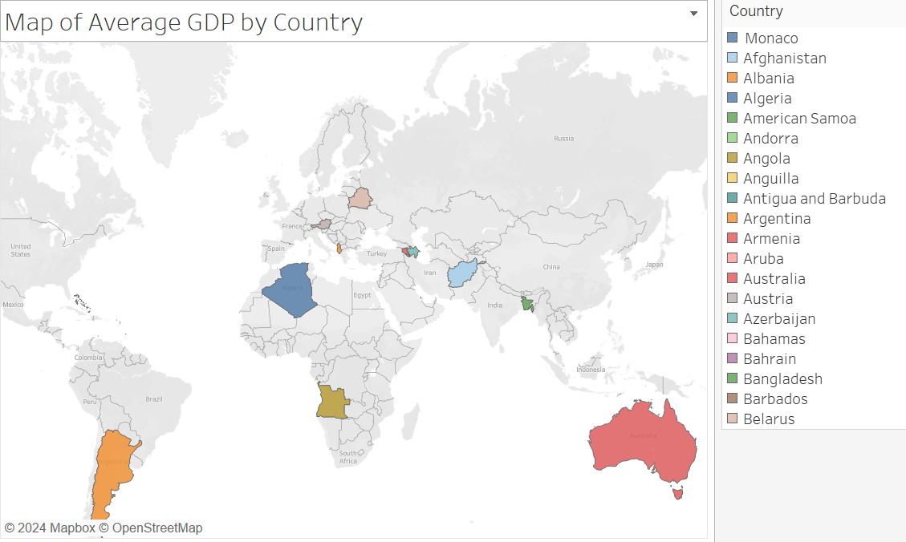
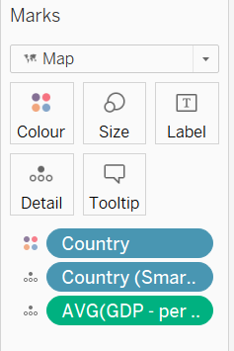
Top 20 countries by average GDP which I showed by using the map as you can easily see where on the map the top countries come from
I used the marks cards to colour co-ordinate the different counties as its easier to identify and added details to the countries when you hover over it

Slide 8
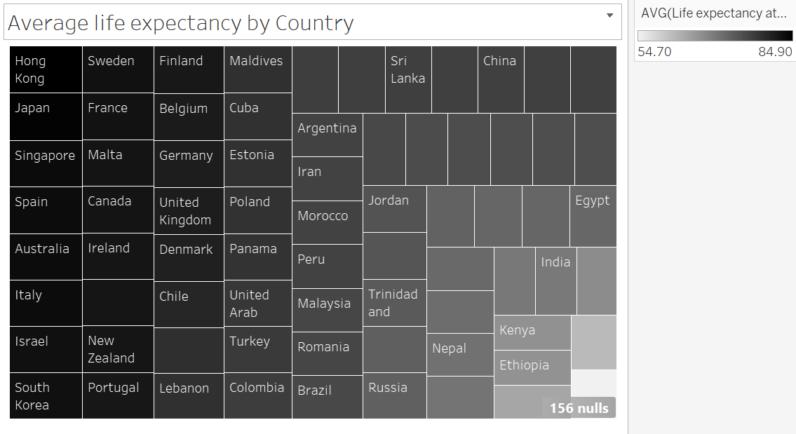
This design is colour blind friendly as its in black and white meaning it would be easier for those people to identify the average life expectancy of the countries at first glance because of the intensity of the black as it slowly fades out to grey then white.

