Slide 1

Background
Method
Results
Future Work
References
MMNeuron
Discovering Neuron-Level Domain-Speciﬁc Interpretation in Multimodal Large Language Model
Jiahao Huo^{1,3}, Yibo Yan^{1,2}, Boren Hu^{1,2}, Yutao Yue^{1,2},Xuming Hu^{1,2}
¹The Hong Kong University of Science and Technology (Guangzhou)
²The Hong Kong University of Science and Technology
³Tongji University
October 18, 2024
MMNeuron
Notes:
Hello everyone. I’m here to introduce our paper “MMNeuron: Discovering Neuron-Level Domain-Speciﬁc Interpretation in Multimodal Large Language Model”. In this work, we detected the domain-specific neurons in multimodal large language models and analyzed their influence on models.

Slide 2
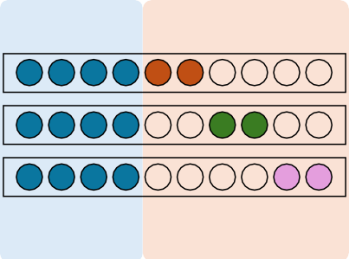
Background
Method
Results
Future Work
References
Background
Language-speciﬁc Neurons in Multilingual Large Language Model
Neurons uniquely responsible for particular languages.
The output language of LLM can be manipulated through deactivating or activating these neurons[1, 2].
Language-agnostic neurons
Language-specific neurons
Input
English neurons
French neurons
Chinese neurons
Output
When you are happy, clap your
Lorsque vous êtes heureux, tapez dans votre
hand
main
当你开心你就拍拍
手
当你开心你就拍拍
🞨🞨
hand
MMNeuron
Notes:
Before discussing domain-specific neurons, I would like to introduce the concept of language-specific neurons in multilingual large language models. As shown in the figure below, when the model receives input in different languages, some neurons will be activated all the time. These blue neurons are therefore called language-agnostic neurons. However, there are other types of neurons, that will only be activated by specific languages, such as the English, French, and Chinese neurons in right. They are then called “language-specific neurons”. More surprisingly, we can manipulate the output language of LLM through deactivating or activating language-specific neurons. If we deactivate Chinese Neurons in LLM, the output language will be changed from Chinese to English.

Slide 3
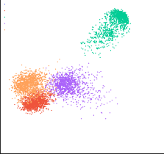
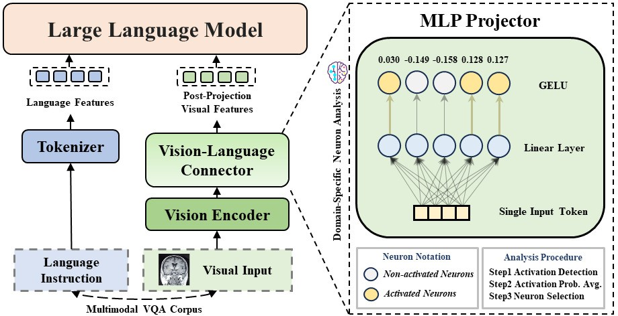

Background
Method
Results
Future Work
References
Motivation
What if transferring to multimodal large language models (MLLM) ?
There are obvious gaps among different image domains (Common life, Remote Sensing, Document, etc.)
It’s still unclear how MLLMs understand visual information from vision encoder[3, 4].
PCA Visualization of Domain-Specific Visual Features
Auto Driving Medical
⁸ Remote Sensing
Common
6 ^{Document}
4
2
0
−2
−4
−6
−8 −6 −4 −2 0 2 4 6 8
PCA Component 1
PCA Component 2
Figure 1: PCA visualization.
Figure 2: Framework of MLLM.
MMNeuron
Notes:
It’s natural to wonder whether there are similar neurons in multimodal large language models, that are specific to the target domain. As we all know, there are obvious gaps among images from different domains, which have also been displayed in the PCA visualization below. More than that, it’s also unclear how MLLMs understand visual information from the vision encoder. We want to handle this challenge through the lens of domain-specific neurons.

Slide 4
Background
Method
Results
Future Work
References
Method
Domain Activation Probability Entropy
We use domain activation probability entropy (borrowed from [1]) to select domain-speciﬁc neurons.
The activation probability of a neuron u in domain D_{i} is:
M
u,i
p = ,
(1)
u,i
^{N}u,i
Then the probability distribution (normalized through L1 normalization) of neuron u across all domains is:
_{P}′
P
u,i
P′ = (p′ , p′ , ..., p′ ), where =
.
(2)
u u,1 u,2 u,k u,i
∑
k
^{P}u,j
j=1
Finally, calculate its corresponding entropy as domain activation probability entropy (DAPE) as:
k
DAPE = − p log p .
(3)
∑
u u,j u,j
j=1
MMNeuron
Notes:
To detect domain-specific neurons in MLLM, we designed a metric named Domain Activation Probability Entropy (DAPE). For a single neuron u, we can obtain its activation probability in domain D by dividing its activation frequency by the number of all tokens in corpora of domain D. Then we calculate the activation probability vector across all domains and normalize it through L1 normalization. The normalized vector can be seen as a probability distribution, and we further calculate its entropy, obtaining the score of DAPE. We select the top one percent of neurons with the lowest DAPE as domain-specific neurons.

Slide 5
Background
Method
Results
Future Work
References
Method
Explanation
Each token has only one activation value on each neuron during forward process.
Before calculating entropy, the cross-domain activation probability must validated through normalization (ensuring the sum is 1).
Intuitively, a lower entropy indicates a tendency for activation in response to one or two domains, with reduced activation probabilities for others.
MMNeuron
Notes:
There are some key points in this algorithm. First, each token has only one activation value on each neuron during the forward process. Secondly, Before calculating entropy, the cross-domain activation probability must validated through normalization to ensure the sum is 1. Last but not least, a lower entropy indicates a tendency for activation in response to one or two domains, with reduced activation probabilities for others.

Slide 6
Background
Method
Results
Future Work
References
Results
Model
Deactivated Module(s) VQAv2 PMC-VQA LingoQA RS-VQA DocVQA None 74.9 34.4 20.6 42.5 59.2
100
Language Model Module
80
70
60
50
40
S0 20
10
Q-Former Module
Vision Encoder Module
LLaVA-NeXT
Vision Encoder MLP Projector LLM
All
75.8
74.9
75.7
73.5
34.3
34.4
34.5
34.5
24.6
24.2
24.2
24.2
42.1
42.5
41.0
38.5
58.3
59.2
59.0
57.0
80
100
Auto Driving Medical Remote Sensing Common Document
Neuron Num
60
Neuron Num
Neuron Num
80
60
40
40
None
66.1
28.1
20.6
34.7
24.0
20
20
Vision Encoder
66.9
31.0
21.8
34.8
23.8
0 0 0
InstructBLIP | Q-Former | 67.1 | 32.4 | 20.0 | 33.1 | 24.6
 | LLM | 67.1 | 32.6 | 24.2 | 35.5 | 24.4
 | All | 68.6 | 30.9 | 18.0 | 33.6 | 23.8
0 5 10 15 20 25 S0 2 4 6 8 10 12 0 5 10 15 20 25 S0 S5 40
Layers Layers Layers
Figure 3: Neuron distribution of InstructBLIP[5].
Table 1: Accuracy (%) on selected domains.
Baseline Module VQAv2 PMC-VQA LingoQA DocVQA RS-VQA
Random (Avg.) 8.41 18.90 16.04 21.81 32.76
140
120
100
80
60
40
20
0
Language Model Module
20
MLP Projector Module
Vision Encoder Module
15
150
Auto Driving Medical Remote Sensing Common Document
LLaVA-NeXT LLM 0.01
0.01
30.98
0.0
30.98
0.02
35.74
0.0
35.74
0.10
46.75
0.0
46.75
0.02
49.90
0.0
49.90
Neuron Num
Neuron Num
Neuron Num
100
Vision Encoder 17.19
10
MLP Projector All
0.0
17.19
5
50
0 5
0
Random (Avg.)
5.13
8.15
8.57
14.85
9.91
10 15 20 25 S0 Layers | 0 Domains | 0 5 10 15 20 25 Layers |  | LLM | 6.84 | 12.13 | 9.62 | 7.80 | 11.98
 |  |  | InstructBLIP | Vision Encoder | 2.44 | 17.93 | 5.33 | 26.11 | 23.76
 |  |  |  | Q-Former | 2.93 | 11.61 | 6.95 | 14.58 | 6.52
Figure 4: Neuron distribution of LLaVA-NEXT[6].
All 8.00 24.84 12.77 29.04 26.58
Table 2: The deviation (%) of hidden states.
MMNeuron
Notes:
This page displays the main results of our work. The figures on the left show the neuron distribution in InstructBLIP and LLaVA-NEXT. In the vision encoder, despite a gathering around bottom layers, neurons specific to Remote Sensing and Document also have a peak in immediate layers. Considering that tasks in remote sensing are often related to counting, area, and shape, this peak may indicate the ability to build global features of images. And so as neurons for the document.
What’s more, two obvious turning points can be observed in both LLaVA-NeXT and InstructBLIP’s language model, one in the intermediate layer and the other near the output layer. The tables on the right show the change in models’ accuracy and hidden states after deactivating domain-specific neurons. We found that although deactivating these neurons would result in a large deviation of models’ hidden states, the performance of the model was not influenced significantly. We therefore deduced that the ability of MLLM is largely generalized and domain-specific information hasn’t been fully utilized by the model.

Slide 7
Background
Method
Results
Future Work
References
Discussion
Findings
Domain-speciﬁc information in different semantic levels.
Gap between the ability of MLLM to handle visual and lingual instructions.
Hypothesis: Three-phase workﬂow of MLLMs.
1 Multimodal features are embedded into a uniform representation space.
2 Further generalize and understand multimodal features.
3 Generating responses to the input.
MMNeuron
Notes:
Based on the observation above, we proposed a three-stage mechanism of LLM understanding multimodal features:
In the first several layers, the multimodal features are embedded into a uniform representation space, where included domain-specific information needs to be processed by more domain-specific neurons.
2) Transitioning into the second phase, features are further generalized and understood by language models, where domain-specific neurons decrease sharply.
3)In the third stage, language models generate responses to the input, showing a rise of neurons specific to target tasks. We further verify our hypothesis through other methods, please check our original paper for more information.

Slide 8
Background
Method
Results
Future Work
References
Future Work
Downstream Application
Model editing and hallucination mitigation.
Efﬁcient training for general cross-domain MLLM.
Fine-tuning of speciﬁc neurons.
Interpretability
Finding modality-speciﬁc neurons across more modalities.
Mechanism interpretation for vision-language alignment.
MMNeuron
Notes:
There are also more problems we plan to address in the future. We plan to make use of our insights in model editing and fine-tuning to build more general multimodal LLMs across various domains. We also plan to extend our work to any2any multimodal LLMs to find modality-specific neurons in them and uncover the mechanism of modality alignment.

Slide 9
Background
Method
Results
Future Work
References
Bibliography
Tianyi Tang et al. “Language-Speciﬁc Neurons: The Key to Multilingual Capabilities in Large Language Models”. In: arXiv preprint arXiv:2402.16438 (2024).
Takeshi Kojima et al. “On the Multilingual Ability of Decoder-based Pre-trained Language Models: Finding and Controlling Language-Speciﬁc Neurons”. In: arXiv preprint arXiv:2404.02431 (2024).
Gaurav Verma et al. “Mysterious Projections: Multimodal LLMs Gain Domain-Speciﬁc Visual Capabilities Without Richer Cross-Modal Projections”. In: arXiv preprint arXiv:2402.16832 (2024).
Yuhui Zhang et al. “Why are Visually-Grounded Language Models Bad at Image Classiﬁcation?” In: arXiv preprint arXiv:2405.18415 (2024).
Wenliang Dai et al. “Instructblip: Towards general-purpose vision-language models with instruction tuning”. In: Advances in Neural Information Processing Systems 36 (2024).
Haotian Liu et al. LLaVA-NeXT: Improved reasoning, OCR, and world knowledge. 2024. URL:
https://llava-vl.github.io/blog/2024-01-30-llava-next/.
MMNeuron
Notes:
This page shows part of the references.

Slide 10
Background
Method
Results
Future Work
References
Thanks for listening !
Jiahao Huo, Yibo Yan
{jiahaohuotj, yanyibo70}@gmail.com
MMNeuron
Notes:
That’s all, thank you!

