Slide 1
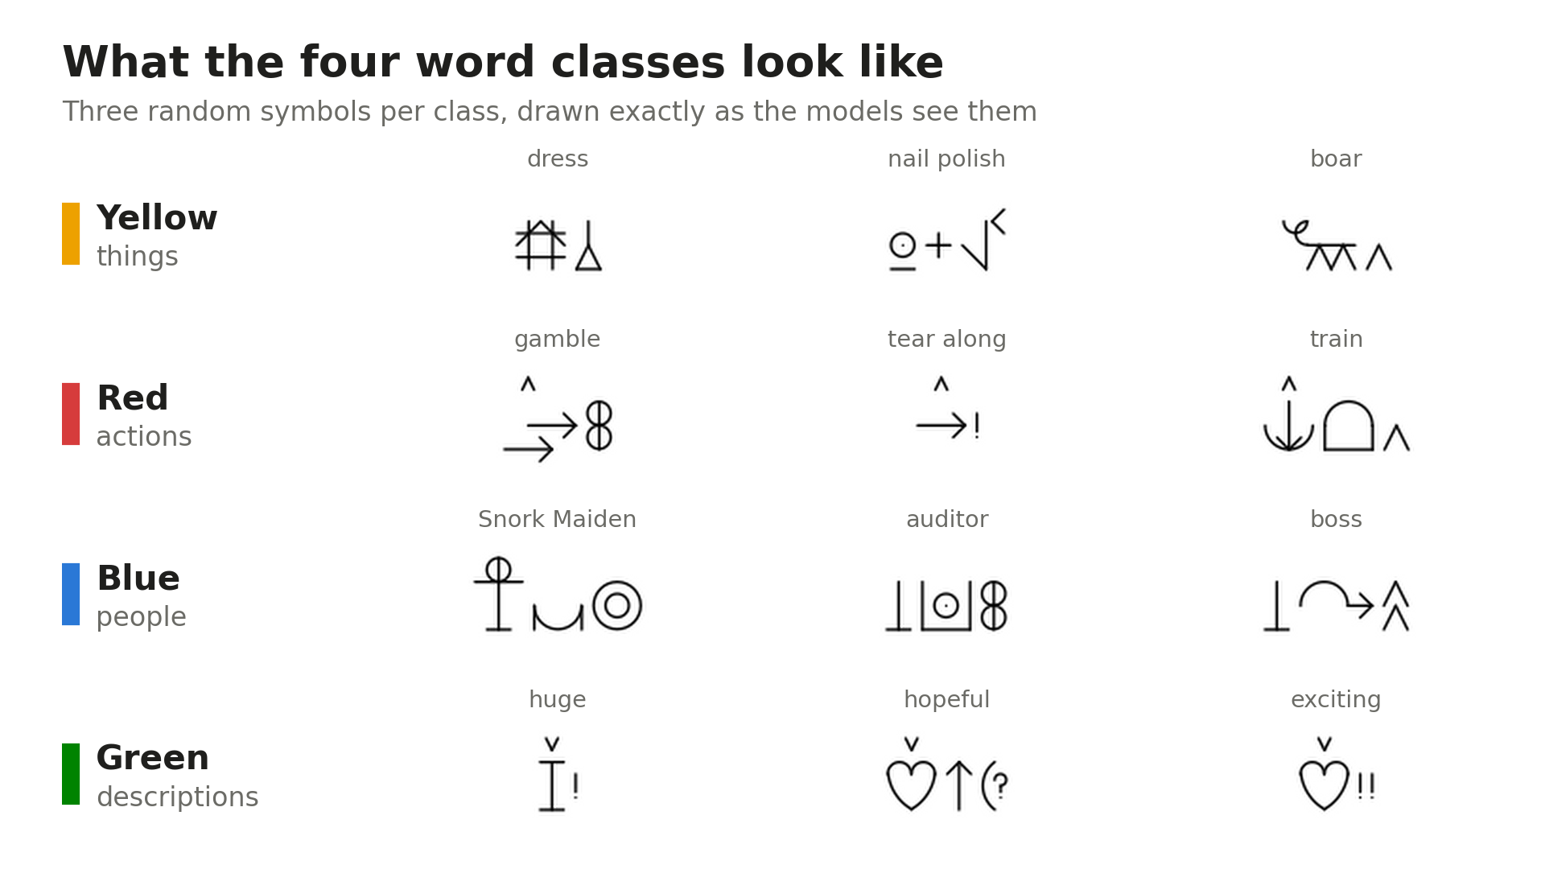
Can a model read the word class off a Bliss symbol?
Classical machine learning vs deep learning on Blissymbolics
Zee Mehmood
MSc Artificial Intelligence, University of Essex Online
Track A: Computer Vision
Three random symbols per class, as the models see them
Parts herein © Blissymbolics Communication International (BCI), distributed under the Creative Commons BY-SA 4.0 licence.
Notes:
Hello, I'm Zee Mehmood. This presentation compares classical machine learning with deep learning on a computer vision task. Blissymbolics is a written language made of symbols. Non-speaking people use it to communicate, often through a communication aid. Every Bliss symbol belongs to a word class: a thing, an action, a person or a description. On screen are three random symbols from each class.
My question has two parts. Can a model read the word class off the drawing alone? And if it can, does deep learning earn its extra cost over a classical model? The short answer is that both get there, but the classical model only got there because I used how Bliss is actually written.

Slide 2
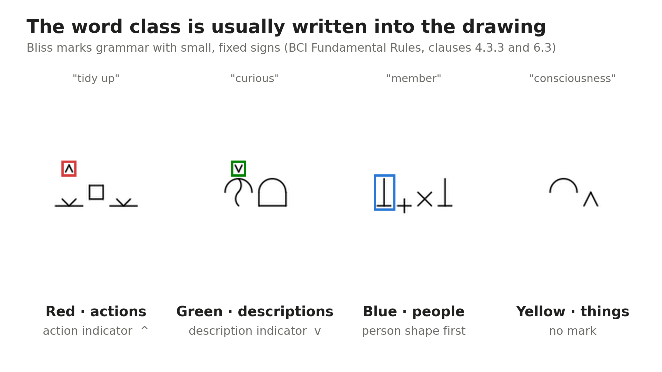
Parts herein © Blissymbolics Communication International (BCI), distributed under the Creative Commons BY-SA 4.0 licence.
Notes:
BCI, the organisation that looks after Bliss, colour codes every symbol, and the colours line up with the four word classes. What makes this interesting is that the class is often written into the drawing itself. Actions carry a small upward mark, boxed in red. Descriptions carry a small downward mark, in green. People usually start with the person shape, boxed in blue. Things carry no mark at all. These rules come from BCI's own Fundamental Rules, clauses 4.3.3 and 6.3.
So in theory the answer is sitting in the picture. In practice those marks are tiny, about five pixels high, and some symbols carry no mark at all. That tension comes back throughout the talk.

Slide 3
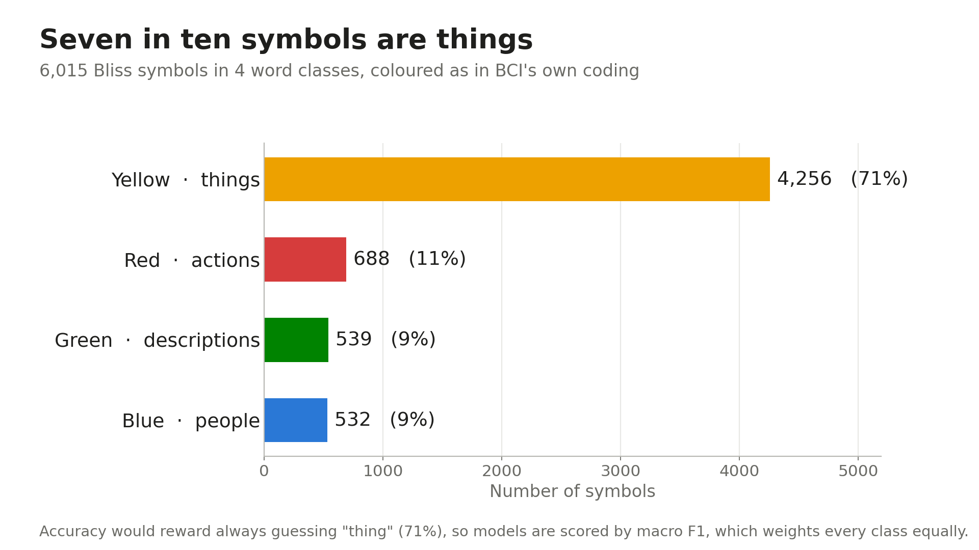
Notes:
For data, I went to the source rather than a scraped copy: the official BCI Authorised Vocabulary, July 2026 release. It's licensed under Creative Commons BY-SA 4.0, so I can use it for study as long as I credit BCI and say what I changed. I kept the four content-word classes, which leaves 6,015 symbols.
Machine learning has been used on Bliss images before, to generate symbols in IDRC's Baby Bliss Bot, and Karlsson's 2026 thesis predicted attributes of a different symbol set, ARASAAC. In a bounded search, I didn't find any work classifying Bliss symbols into word classes.
The chart shows the catch. Seven in ten symbols are things. A model that always guessed 'thing' would get 71% accuracy but only 0.21 macro F1. Macro F1 combines precision and recall for each class and averages them, so every class counts equally. That's my headline metric.

Slide 4
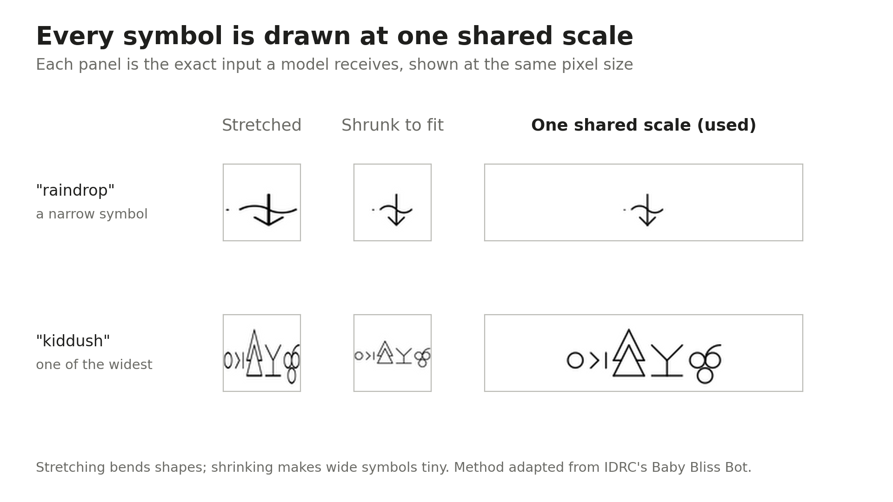
Parts herein © Blissymbolics Communication International (BCI), distributed under the Creative Commons BY-SA 4.0 licence.
Notes:
Each symbol arrives as an SVG drawing, and widths vary hugely. The two usual tricks both fail here. Stretching into a square bends the shapes, as you can see with 'raindrop'. Shrinking to fit keeps the shape, but makes wide symbols like 'kiddush' tiny, and their marks with them.
So I drew every symbol at one shared scale. The Bliss grid is always 64 pixels tall, and the width follows, padded onto a 64 by 264 canvas. Nothing is bent and nothing is shrunk. I adapted this from Baby Bliss Bot, which faced the same problem preparing images for its generator.
I also ran a pixel-level duplicate check. It found three pairs of identical drawings, which I kept together in the split so they couldn't leak.

Slide 5
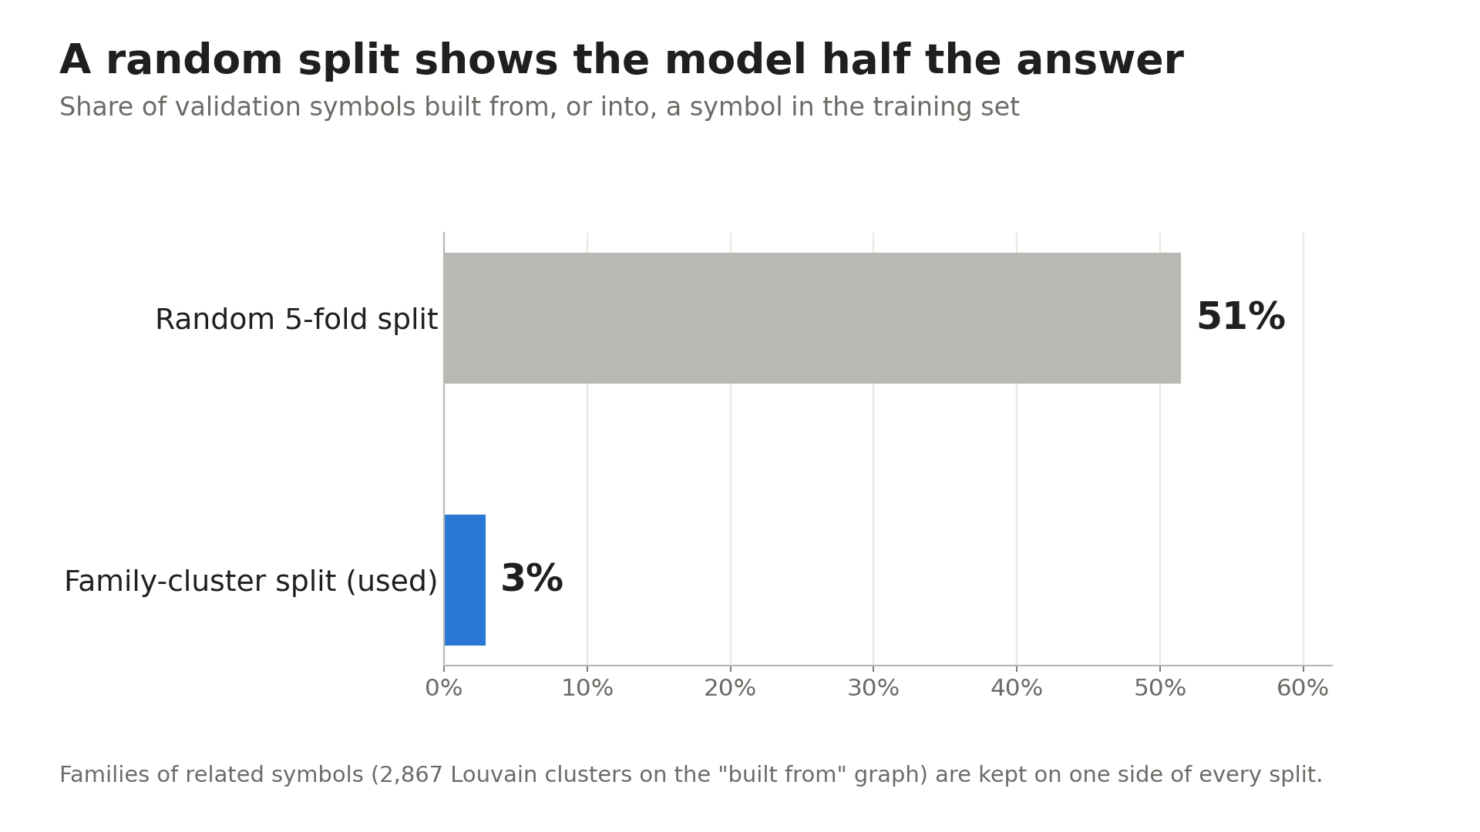
Notes:
How do you test this fairly? First, I held back 10% of the symbols as a test set and didn't touch it until the very end. The rest went into five-fold cross-validation, stratified so every fold keeps the same class mix. Validation matters because a model scored on data it has seen measures memory, not generalisation, and hides overfitting.
But Bliss has a trap. Symbols are built from each other. With a random split, 51% of validation symbols are built from, or into, a symbol in training, so a model could score by recognising the shared part. So I grouped related symbols into families, 2,867 clusters found with the Louvain method, and kept each family on one side of every split. That drops the overlap to 3%. The scores come out lower, but honest.

Slide 6
Three models, same images, same folds
Classical
Deep, from scratch
Deep, pretrained
HOG + SVM
Small CNN
ResNet18
Edge directions in 8 × 8 cells (HOG)
Learns its own features from pixels
Starts from 1.2 million photos (ImageNet)
SVM separates the classes
Softened class weights
Fine-tuned on Bliss
Grid search inside each training fold
Learning rate from a range test
Early stopping on held-back loss
scikit-learn
PyTorch
PyTorch
Notes:
I compared three approaches, on the same images and the same folds. The classical model is HOG plus an SVM. HOG describes the direction of the edges in small eight-by-eight patches, which suits line drawings: the strokes are the whole image, so edge direction carries most of the information. The SVM then separates the classes, and its settings were tuned by a grid search inside each training fold, so the validation fold never influenced them. An SVM is a strong, well-understood classifier for features like these, and it's cheap to train.
For deep learning I trained two models. A small CNN built from scratch, to see what a modest network learns on its own. And ResNet18, pretrained on 1.2 million photos and fine-tuned on Bliss, to test whether knowledge borrowed from photos helps with drawings. I used scikit-learn for the classical side and PyTorch for the deep models.

Slide 7
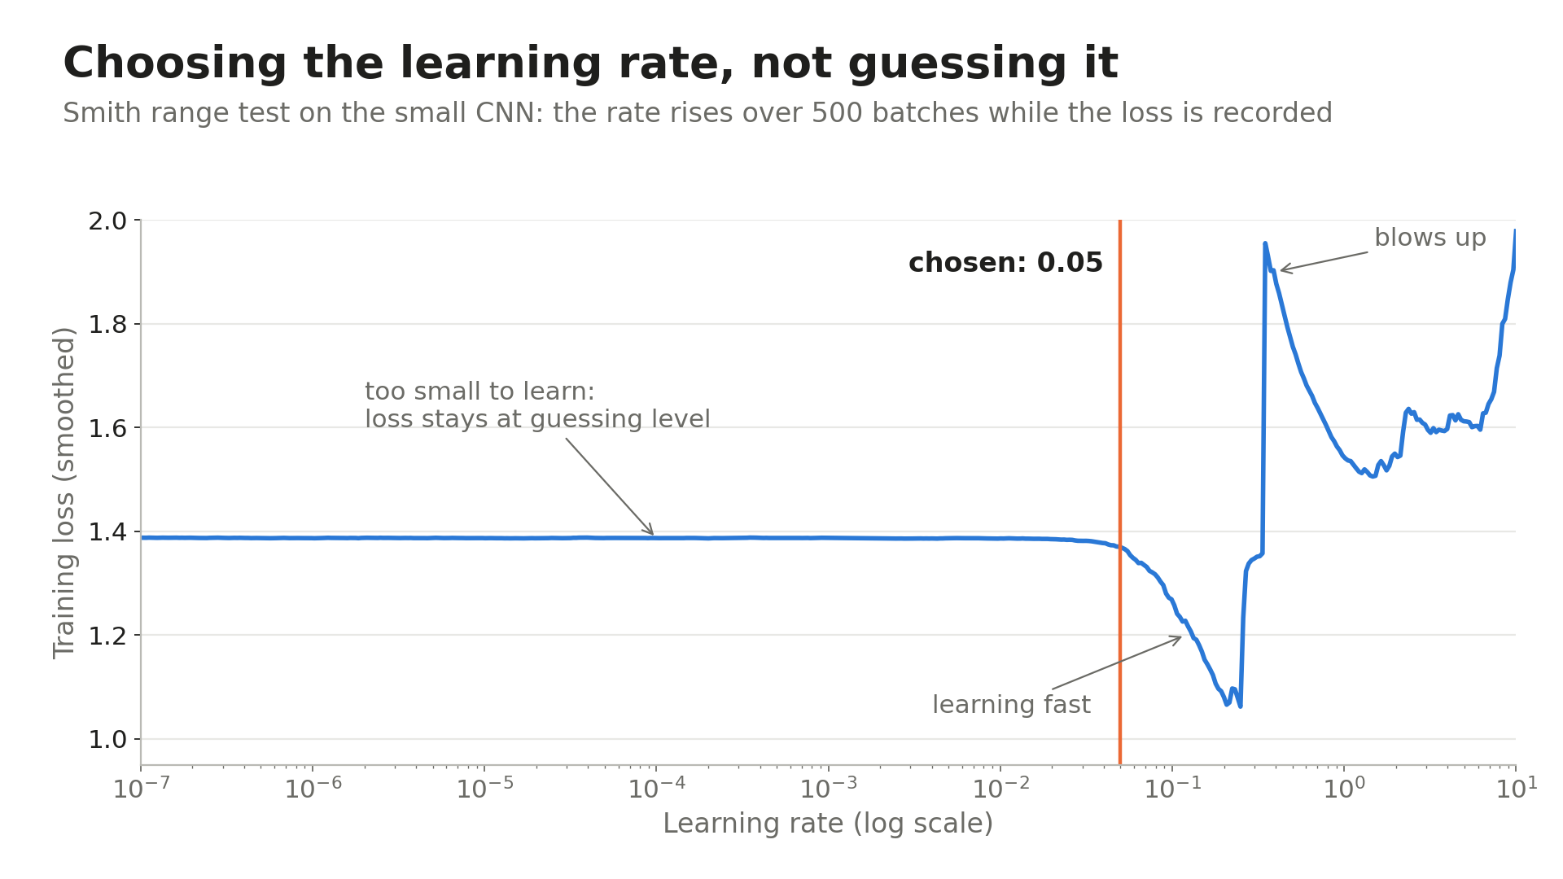
Notes:
The learning rate is the setting reviewers question most, so for the small CNN I chose it with Smith's range test rather than guessing. The rate rises over 500 batches while the loss is recorded. Too small, and the loss sits flat at guessing level. Then it falls fast, and past a point it blows up. I picked 0.05, inside the fast fall and short of the blow-up.
Training also used early stopping: each model keeps its weights from the epoch with the lowest held-back loss, before overfitting starts. There's a backup slide showing this.

Slide 8
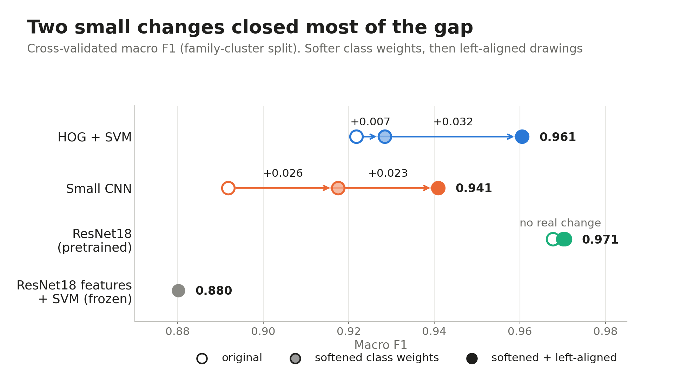
Notes:
This is the heart of the comparison. All scores are cross-validated macro F1 on the family split.
Start with the hollow dots. In the first round, ResNet18 scored 0.968, HOG plus SVM 0.922, and the small CNN 0.892. Pretrained deep learning led.
Then I looked at why the small CNN was behind. It was calling too many symbols 'people'. Its class weights made a people mistake cost eight times a things mistake, so when unsure, it said 'people'. Square-rooting the weights lifted it by 0.026.
Then the big one. Bliss rules say the first character of a symbol sets its category. HOG describes fixed patches, so with a centred drawing, that first character lands in different patches depending on the symbol's width. Drawing every symbol from the left edge lifted HOG plus SVM to 0.961. It also lifted the small CNN, but did nothing for ResNet18, because its last layer averages each feature over the whole image, so position doesn't matter to it.
Finally, the grey dot. Frozen photo features with an SVM on top scored worst, 0.880. So ResNet18's strength isn't its photo features; it's fine-tuning them on Bliss. That matches Singer and colleagues, where an ImageNet network scored 0.14 on drawings until it was fine-tuned.
Every change was written down with its success rule before it ran, which is why I trust these results.

Slide 9
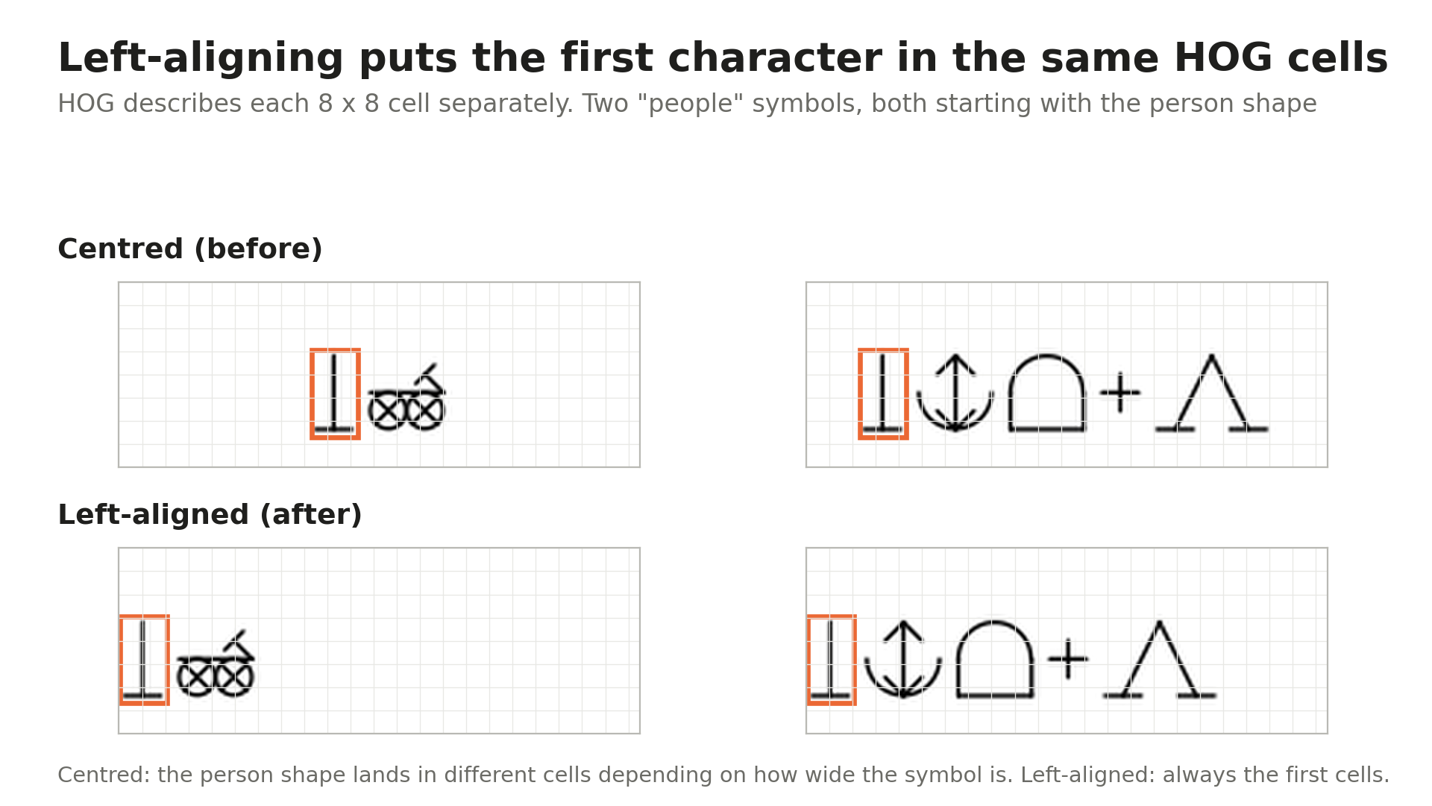
Parts herein © Blissymbolics Communication International (BCI), distributed under the Creative Commons BY-SA 4.0 licence.
Notes:
Here's why left-aligning worked. These are two people symbols, and the orange box is the person shape at the start of each. Centred, that shape lands in different cells, because the symbols are different widths, so to the SVM they're different features. Left-aligned, the person shape always sits in the same first cells, so the SVM can learn one consistent pattern. It's a small change to the preprocessing, but it comes straight from BCI's rule that the first character sets the category.

Slide 10
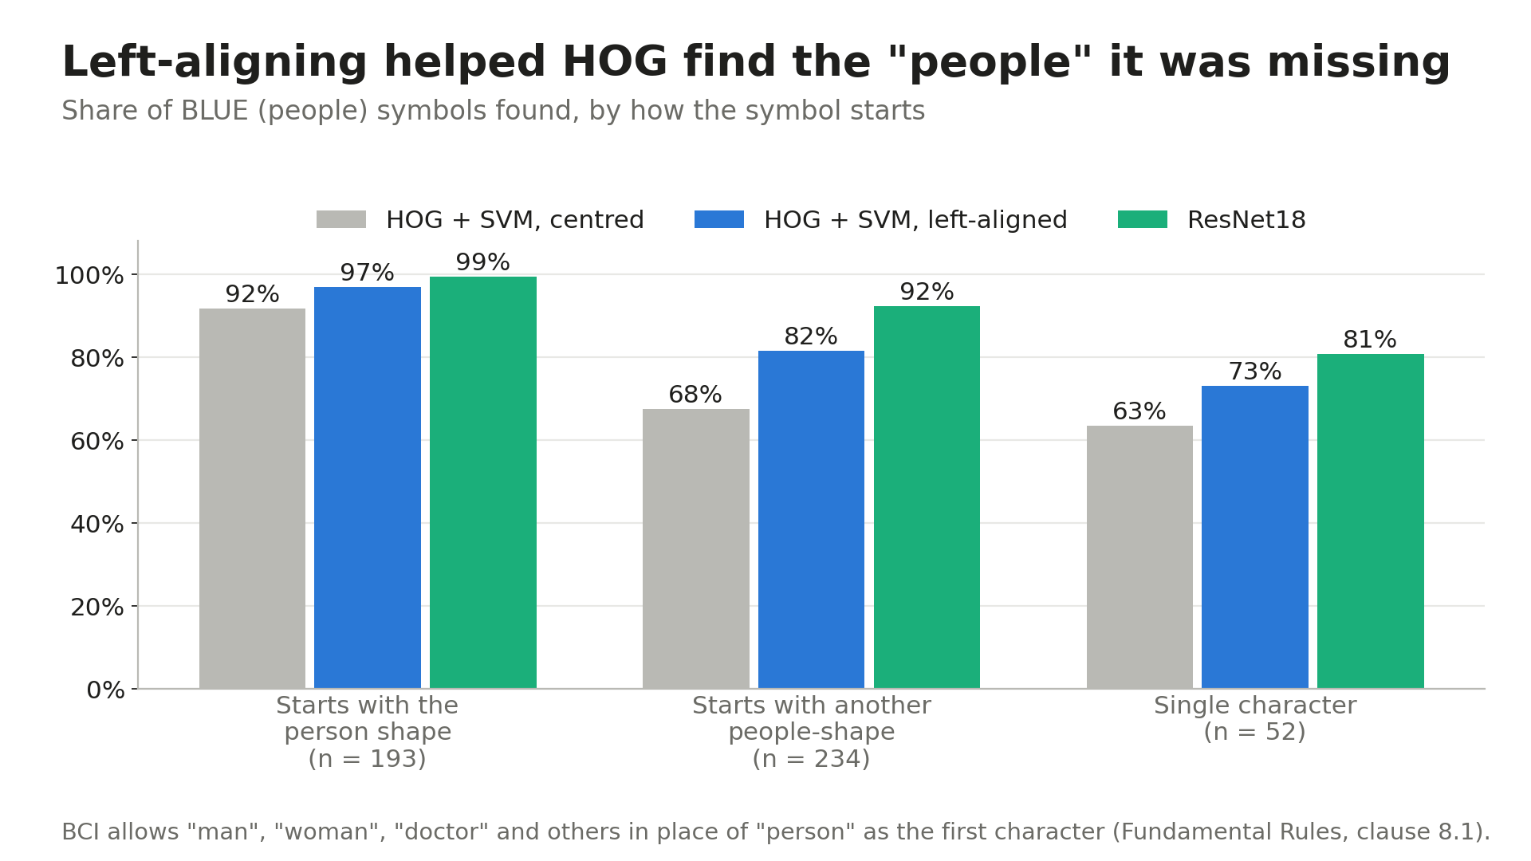
Notes:
BCI also lets man, woman, doctor and others stand in for 'person' as the first character. The centred SVM found only 68% of those symbols. Left-aligned, it found 82%. Single-character people symbols improved too, from 63% to 73%. ResNet18, in green, is still ahead on every group, but the gap closed sharply. This is domain knowledge doing work that a bigger model would otherwise do.

Slide 11
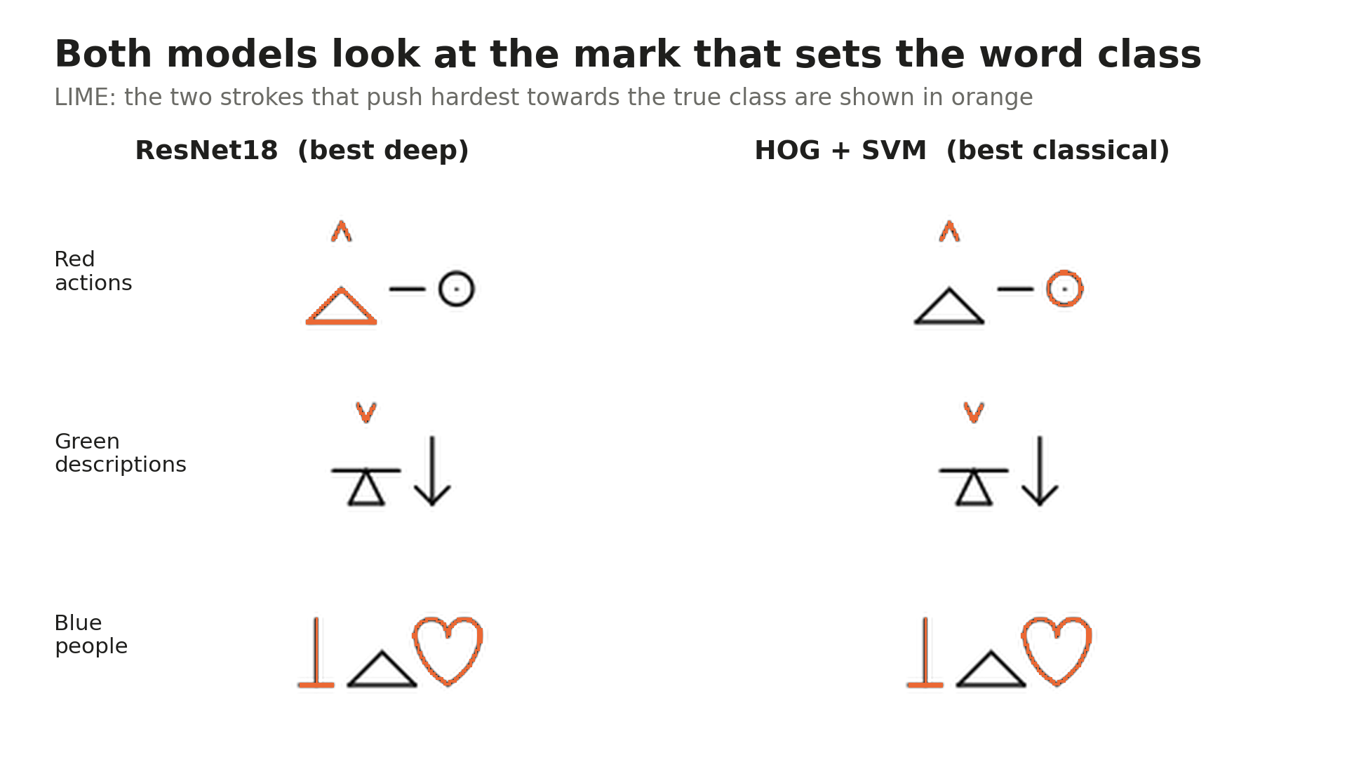
Parts herein © Blissymbolics Communication International (BCI), distributed under the Creative Commons BY-SA 4.0 licence.
Notes:
LIME answers that by hiding strokes one at a time and watching how the prediction changes. The orange strokes are the two that push hardest towards the true class.
I checked 30 action and description symbols. For both headline models, the indicator mark was the most important stroke 30 times out of 30. Grad-CAM, which shows where a CNN's attention falls, tells the same story on the small CNN: 56% of its attention for actions sits in the indicator band, four and a half times what you'd expect by chance. For people, both models look at the person shape.
So two very different models learned the rule a person would use. That's reassuring, and it also tells us where they'll fail: when the mark is missing or misleading.

Slide 12
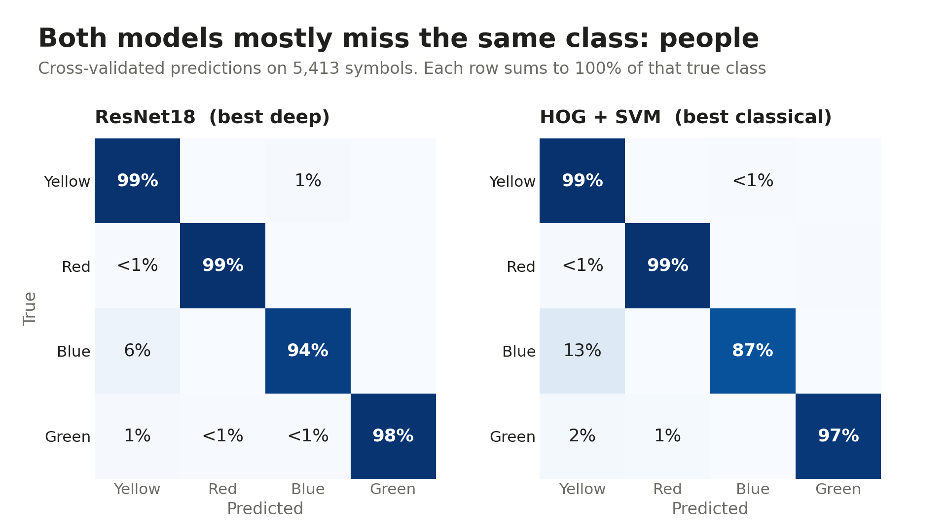
Notes:
Which brings me to errors. Both models are close to perfect on things, actions and descriptions. Both mostly miss people, and when they do, they call them things. The SVM misses 13% of people symbols, ResNet18 6%. In this application, that's the mistake that matters most, and I'll come back to it under ethics. Accuracy alone would have hidden this, because people are only 9% of the data.

Slide 13
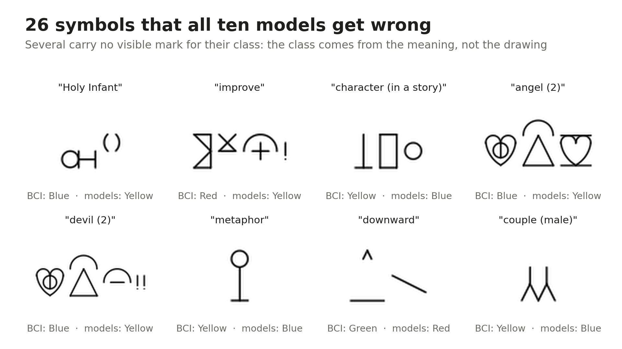
Parts herein © Blissymbolics Communication International (BCI), distributed under the Creative Commons BY-SA 4.0 licence.
Notes:
Across all ten model versions, 26 symbols beat every one. Look at 'Holy Infant' or 'metaphor'. Many carry no visible mark for their class: the class comes from what the word means, not how it's drawn. No image model can fix those. That's a limit of the task, not of a particular model, and it points to my next step: adding the symbol's meaning, not just its drawing.

Slide 14
Bias: left-aligning made the SVM fairer, too
HOG + SVM accuracy by symbol width, cross-validated
Centred (before)
Left-aligned (after)
0.969
0.932
0.978
0.971
Narrow symbols
Wide symbols
Narrow symbols
Wide symbols
Gap 0.037
Gap 0.007
ResNet18 was flat across every subgroup.
Notes:
For bias, my subgroups are symbol types, because the data describes symbols, not people. The natural risk was width: a model reading fixed patches could treat wide symbols worse. And it did. Before left-aligning, the SVM scored 0.969 accuracy on narrow symbols but 0.932 on wide ones. Left-aligned, it's 0.978 against 0.971. The change that made it more accurate also made it fairer. ResNet18 was flat across every subgroup, which is one genuine advantage of the deep model.

Slide 15
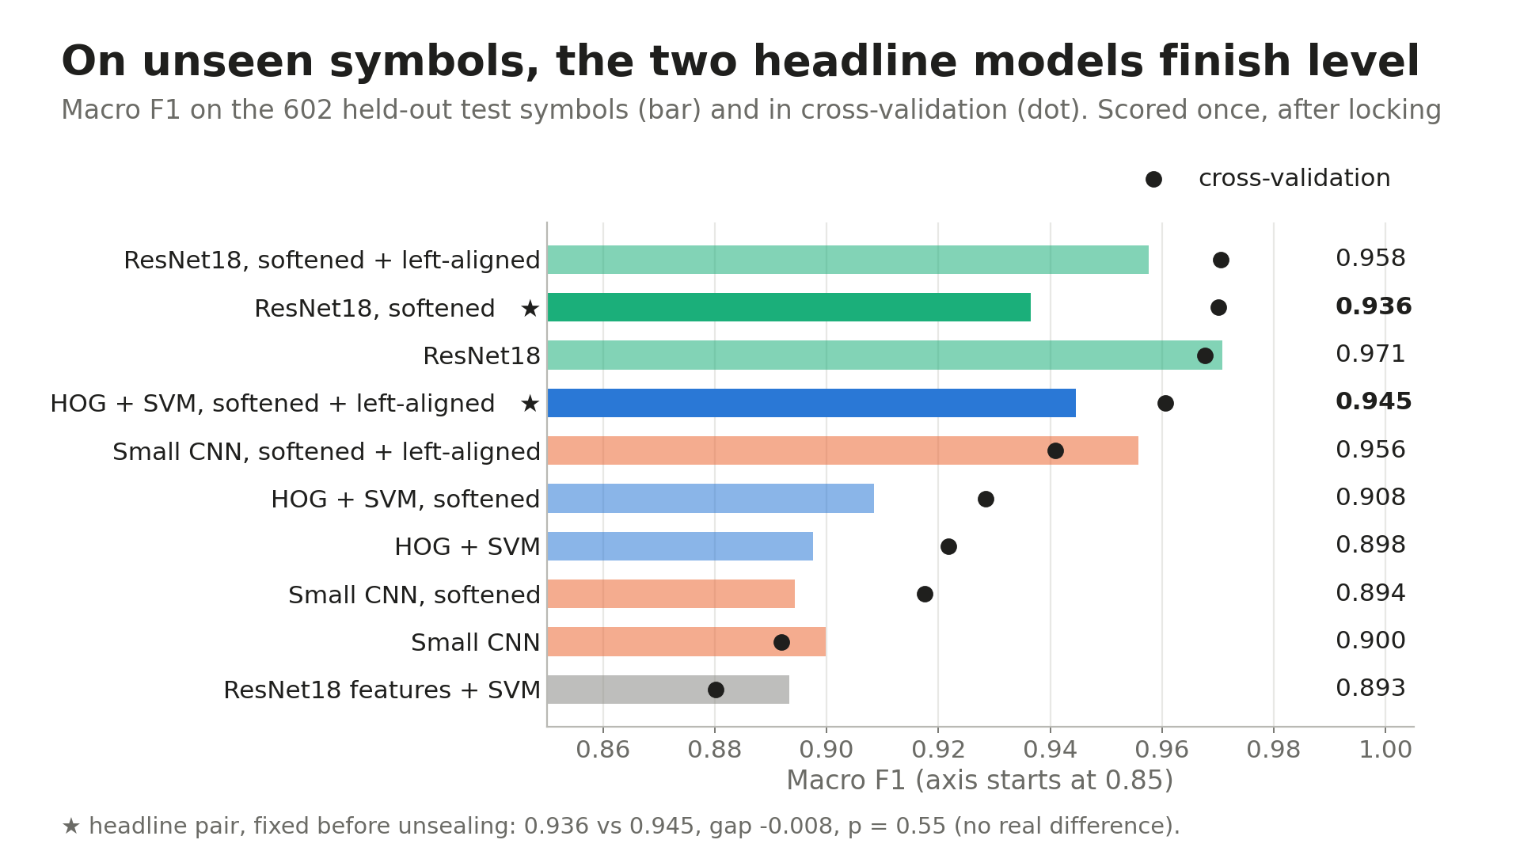
Notes:
Now the test set. Before opening it, I locked every model and picked the two headline models on cross-validation, marked with stars: the softened ResNet18, and the softened, left-aligned SVM. Then I ran each locked model once on 602 symbols none of them had ever seen. That's the real demonstration of how they behave on new data.
They finish level: 0.936 for ResNet18 and 0.945 for the SVM, and a paired randomisation test gives p equals 0.55. No real difference.
The original ResNet18 actually scored best here, 0.971. I didn't switch to it, because picking a winner after seeing the test is exactly what locking prevents.

Slide 16
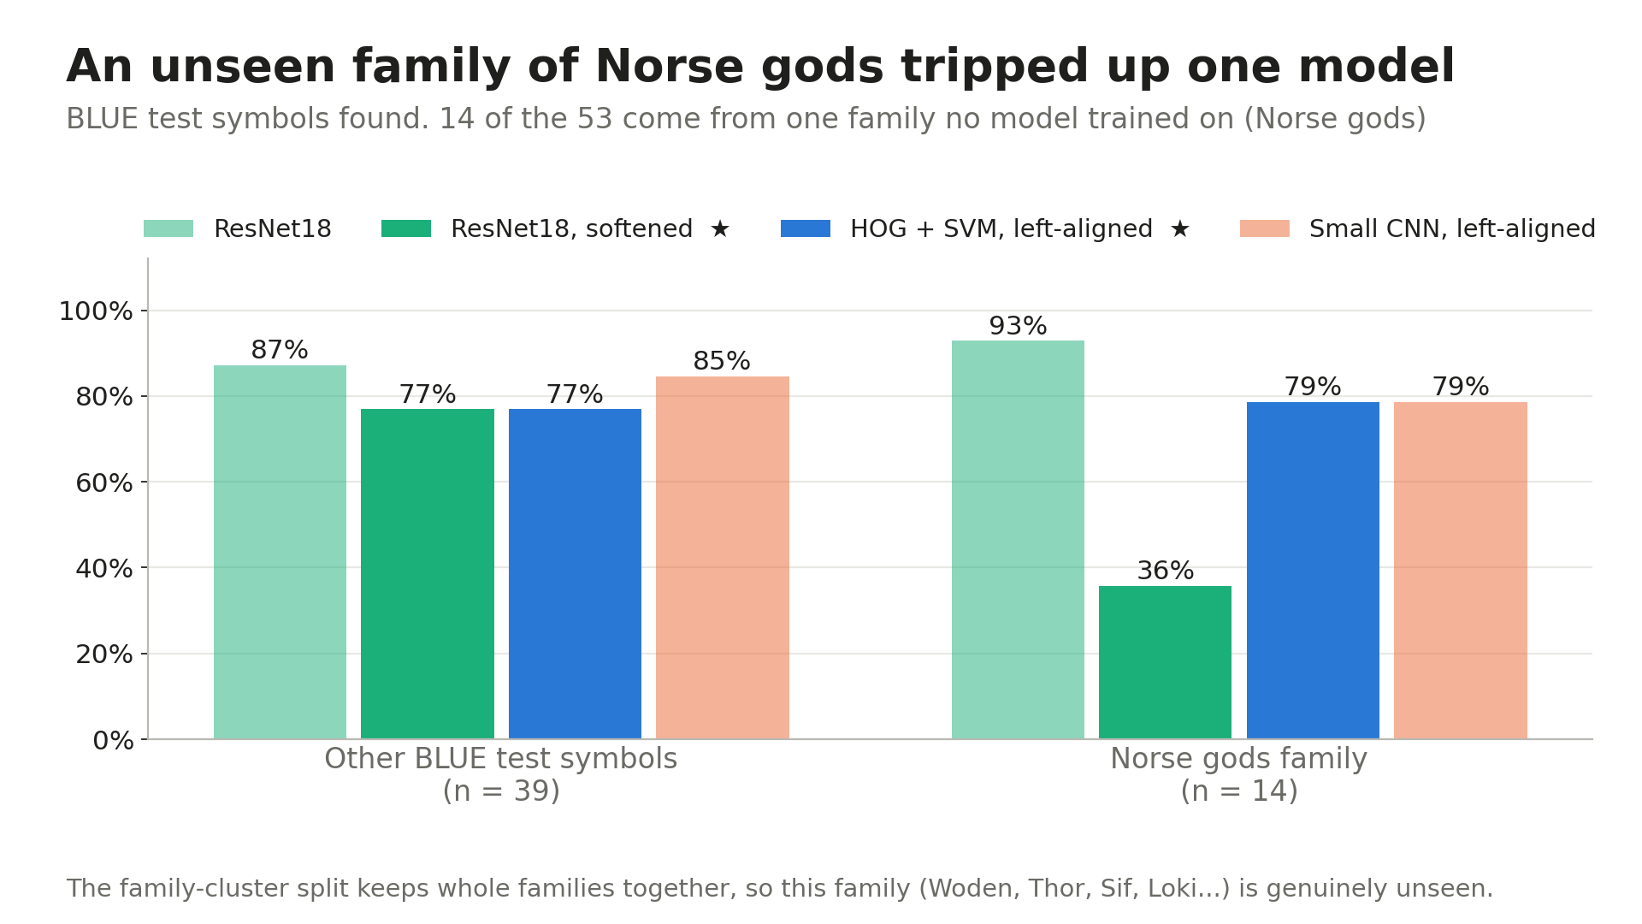
Notes:
So why did the deep model drop? Fourteen of the 53 people symbols in the test set are one family, the Norse gods: Woden, Thor, Sif, Loki and others. Because my split keeps families together, no model trained on them. The softened ResNet18 found only 36%; the original found 93%, and the SVM 79%.
A random split would have hidden this. So a bad-looking result is actually the strongest evidence that the split was honest.

Slide 17
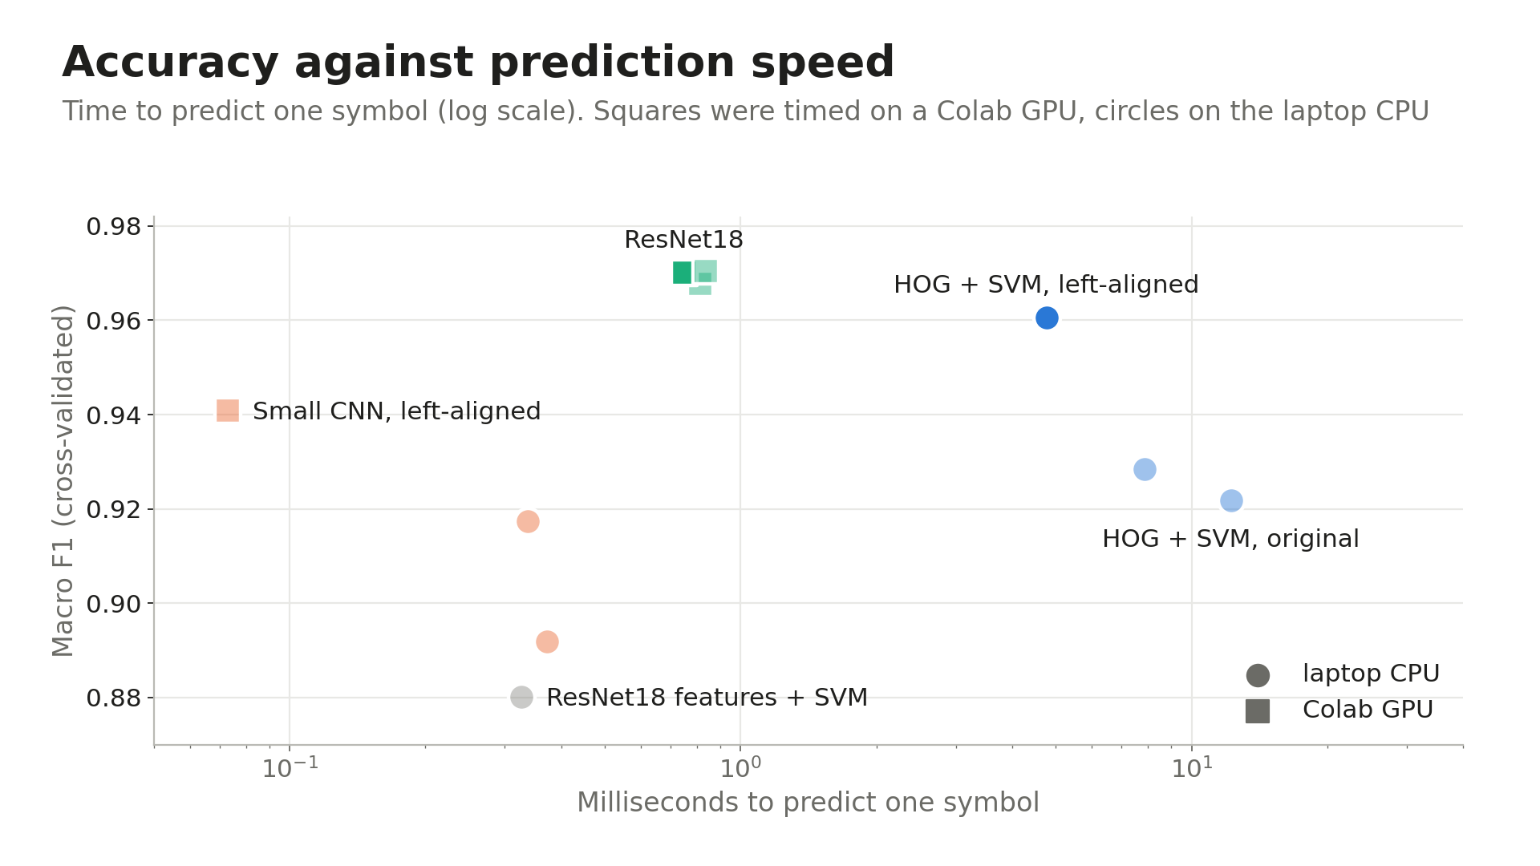
Notes:
So which model would I deploy? One caveat first: these timings come from different machines, a Colab GPU for the deep models and my laptop CPU for the others, so read this as the shape of the trade-off, not exact speeds.
On unseen data the two headline models are level, so cost decides. The SVM needs no GPU, it's cheap to retrain, and every step can be explained. It's slower per symbol on a CPU, but for a few hundred new symbols that's seconds. If the accuracy gap were real, deep learning would earn its cost. Here it isn't, so I'd ship the SVM.

Slide 18
Deployment: a quality check with a person in the loop
Yes: accept as is
New symbols added
Render: shared scale, left-aligned
HOG + SVM predicts the class
Prediction matches BCI colour?
No
Flag for a person to review
Already found: “improve” (red) and “improvement” (yellow) are the same drawing
Run
Monitor
Retrain
Scheduled job or simple API; Azure ML or SageMaker if hosted
Flag rate and reviewer agreement
With each vocabulary release
Notes:
The realistic use is a quality check for BCI. When new symbols are added, each one is rendered with the same pipeline and classified by the SVM. If the prediction doesn't match the colour BCI gave it, the symbol is flagged for a person to review. The duplicate check already found one real case: 'improve' and 'improvement' are the same drawing with different colours.
The model is small, so it could run as a scheduled job or behind a simple API, on a service like Azure ML or SageMaker if BCI wanted it hosted. I'd monitor the flag rate and how often reviewers agree, and retrain with each vocabulary release.

Slide 19
Ethics: the real risk is in the mistakes
Privacy
Mistakes
Safeguards
No personal data: symbols, not people
Open licence, credited (CC BY-SA 4.0)
Dissertation data firewalled off
False positive: a reviewer loses seconds
False negative: a wrong colour reaches users
Worst error: calling a person a thing
The tool flags; a person decides
Report per-family results, not just averages
Publish known weak spots
Stakeholders
Non-speaking users and families
Speech and language therapists
NHS AAC services
Symbol software makers
BCI
Notes:
Privacy first: the data holds no personal information. These are symbols published openly by BCI, and my dissertation's data was kept firewalled from this work.
The real ethical risk is in the mistakes. A false positive, a correct symbol flagged by mistake, costs a reviewer a few seconds. A false negative, a wrong colour slipping through, reaches users. Calling a person a thing is the worst error, because for someone who builds sentences from these symbols, word class shapes how they're put together. and it's the class the models find hardest. And whole families can fail at once, as the Norse gods showed, which an average score hides.
So the tool flags and suggests, a person decides, and its weak spots are published alongside it. The stakeholders are non-speaking users and their families, speech and language therapists, NHS AAC services, symbol software makers, and BCI.

Slide 20
What I learned, and what's next
1
Domain knowledge beat model size
Left-aligning, from BCI's own rule, closed most of the gap to a pretrained network
2
Small settings matter
One loss setting moved a model more than the gap between model types
3
Pre-declare, then test
My own explanations were wrong twice; written success rules caught it
Next Combine the drawing with the symbol's English word; try the method on other symbol sets
Notes:
To finish. First, domain knowledge beat model size: one change based on how Bliss is written closed most of the gap to a pretrained network. Second, one loss setting moved a model more than the gap between model types. Third, my own explanations were wrong twice; I first blamed unseen families for the small CNN, when it was mostly the class weights. Pre-declaring every test is what caught it.
Next, I'd combine the drawing with the symbol's English word, to fix the cases where meaning decides the class, and try the method on other symbol sets. Thank you for listening.

Slide 21
References
BCI Fundamental Rules Working Group (2003) The fundamental rules of Blissymbolics: creating new Blissymbolics characters and vocabulary. Available at: https://www.evertype.com/standards/by/bliss-rules-20030921.pdf (Accessed: 9 October 2026).
Blissymbolics Communication International (2026) BCI Authorised Vocabulary (BCI-AV), July 2026 release. Available at: https://www.blissymbolics.org/ (Accessed: 9 October 2026).
Blondel, V.D., Guillaume, J.-L., Lambiotte, R. and Lefebvre, E. (2008) 'Fast unfolding of communities in large networks', Journal of Statistical Mechanics: Theory and Experiment, P10008.
Dalal, N. and Triggs, B. (2005) 'Histograms of oriented gradients for human detection', IEEE CVPR 2005, pp. 886–893. Available at: https://doi.org/10.1109/CVPR.2005.177.
He, K., Zhang, X., Ren, S. and Sun, J. (2015) 'Deep residual learning for image recognition', arXiv. Available at: https://arxiv.org/abs/1512.03385.
Inclusive Design Research Centre (no date) Baby Bliss Bot. Available at: https://github.com/inclusive-design/baby-bliss-bot (Accessed: 9 October 2026).
Karlsson, L. (2026) AI-driven multi-label attribute prediction for augmentative and alternative communication symbols. MSc thesis. Örebro University.
Razavian, A.S., Azizpour, H., Sullivan, J. and Carlsson, S. (2014) 'CNN features off-the-shelf: an astounding baseline for recognition', arXiv. Available at: https://arxiv.org/abs/1403.6382.
Ribeiro, M.T., Singh, S. and Guestrin, C. (2016) '“Why should I trust you?”: explaining the predictions of any classifier', arXiv. Available at: https://arxiv.org/abs/1602.04938.
Selvaraju, R.R., Cogswell, M., Das, A., Vedantam, R., Parikh, D. and Batra, D. (2019) 'Grad-CAM: visual explanations from deep networks via gradient-based localization', International Journal of Computer Vision. Available at: https://arxiv.org/abs/1610.02391.
Singer, J.J.D., Seeliger, K., Kietzmann, T.C. and Hebart, M.N. (2022) 'From photos to sketches: how humans and deep neural networks process objects across different levels of visual abstraction', Journal of Vision, 22(2). Available at: https://doi.org/10.1167/jov.22.2.4.
Smith, L.N. (2017) 'Cyclical learning rates for training neural networks', IEEE WACV 2017. Available at: https://arxiv.org/abs/1506.01186.
Yeh, A. (2000) 'More accurate tests for the statistical significance of result differences', COLING 2000. Available at: https://arxiv.org/abs/cs/0008005.

Slide 22
Backup slides
Only if asked: all ten models, early stopping, and where the indicator marks sit

Slide 23
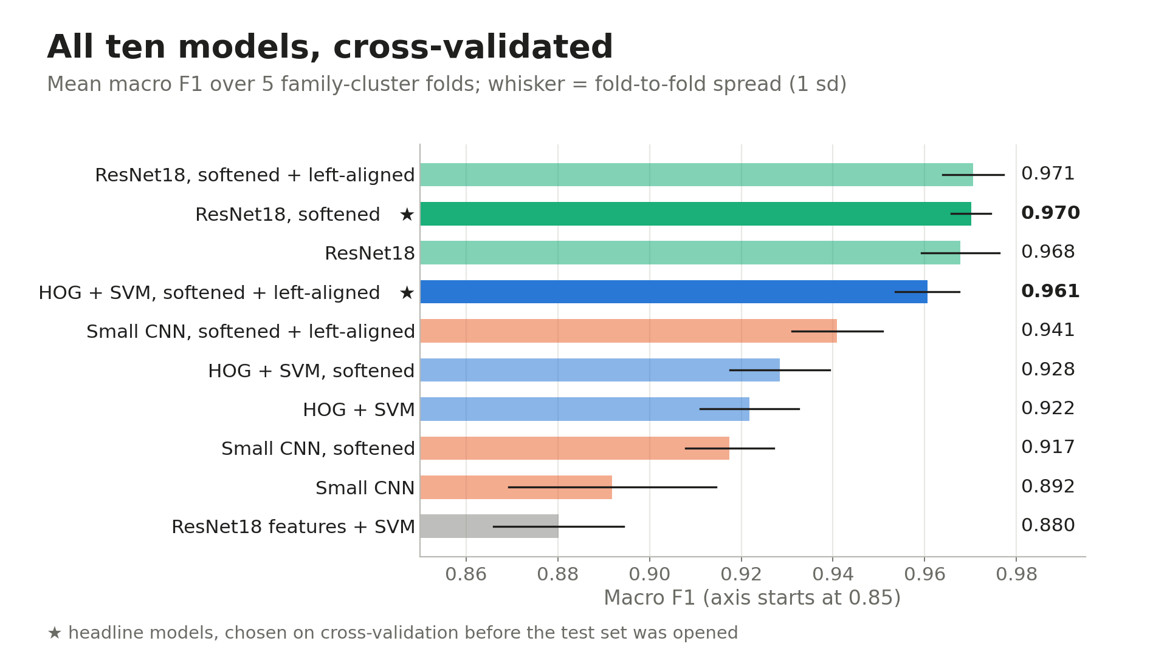
Notes:
Backup. All ten models with fold-to-fold spread. Starred models were chosen on cross-validation before the test set was opened. The ResNet18 vs SVM gap in cross-validation is borderline, not significant: p = 0.0028 against a corrected line of 0.0024.

Slide 24
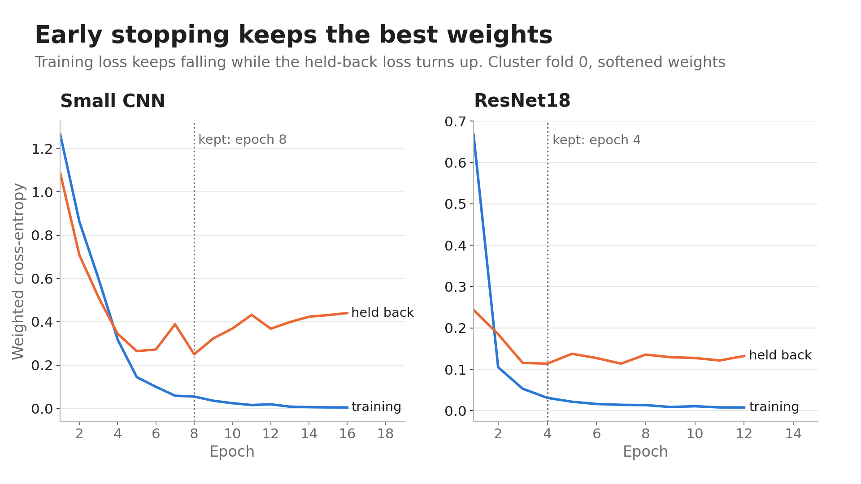
Notes:
Backup. Early stopping: training loss keeps falling while the held-back loss turns up. The small CNN keeps epoch 8, ResNet18 epoch 4.

Slide 25
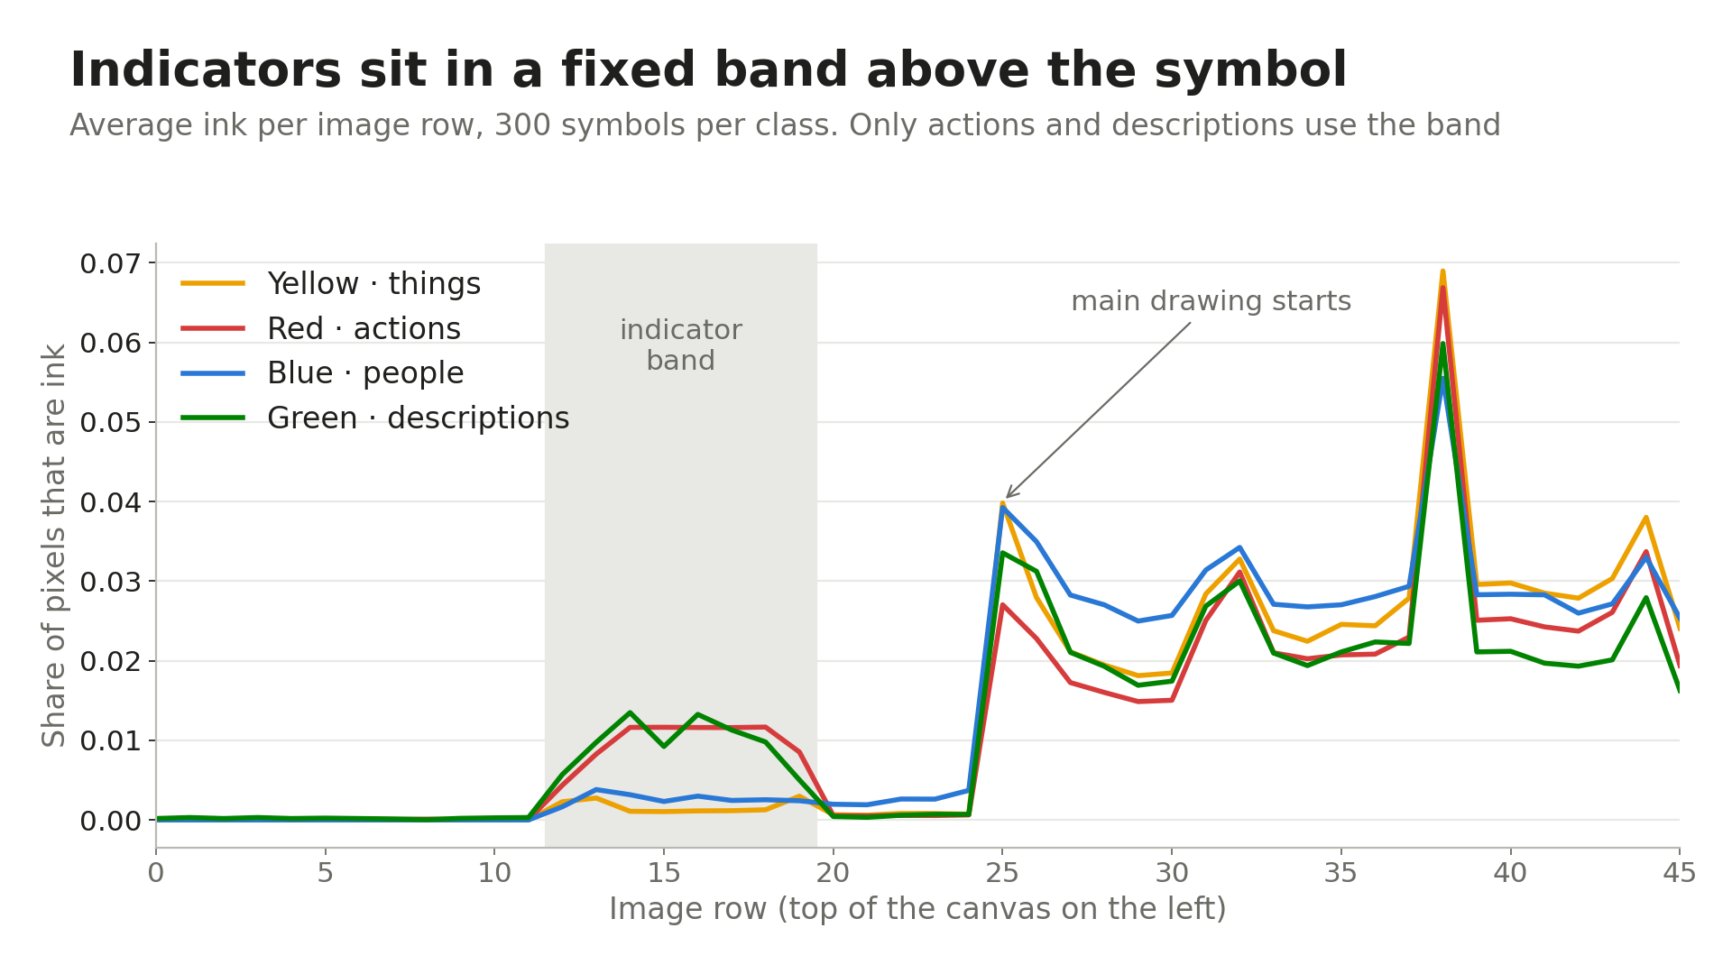
Notes:
Backup. Average ink per image row, 300 symbols per class. Only actions and descriptions use the indicator band above the main drawing, which is why Grad-CAM attention in that band means the model is reading the mark.

