Slide 1
Z3 Internals
Nikolaj Bjørner, Microsoft Research, RiSE
Clemens Eisenhofer, TU Wien
POPL tutorials, January 14, 2023

Slide 2
Overview
x
s

Slide 3
The usual z3 intro slides

Slide 4
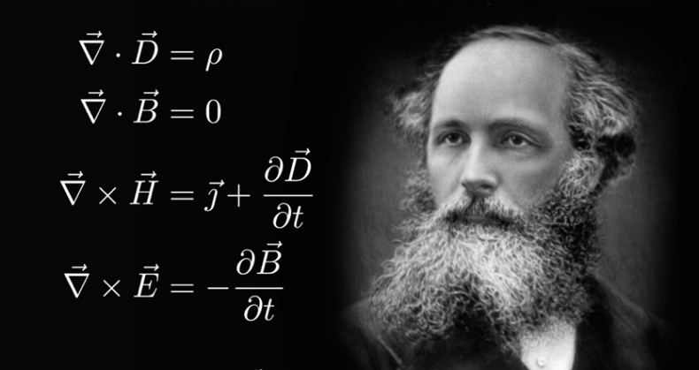
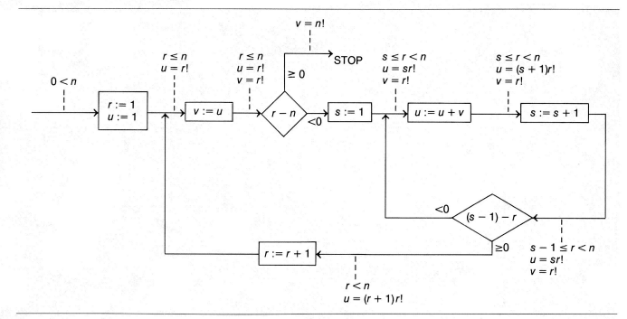
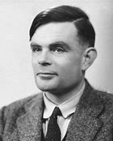


Logic: The Calculus of Computation
Invariants
Differential, Integral Calculus
Logic
Dynamics, Conduction,..
Matlab, Mathemetica, Simulink
Computation
Claim: Practically all modern program analysis tools involve solving logical formulas

Slide 5
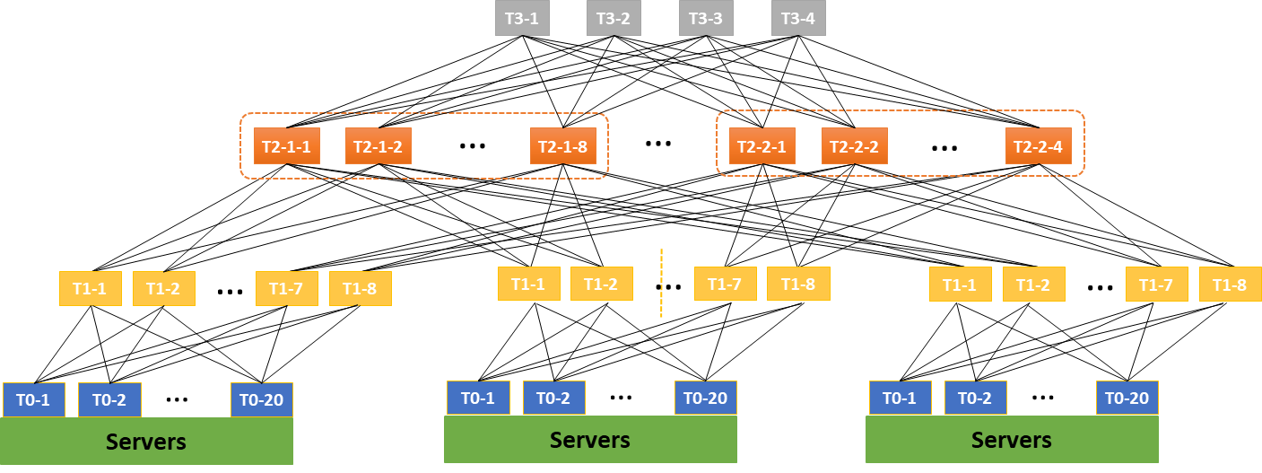

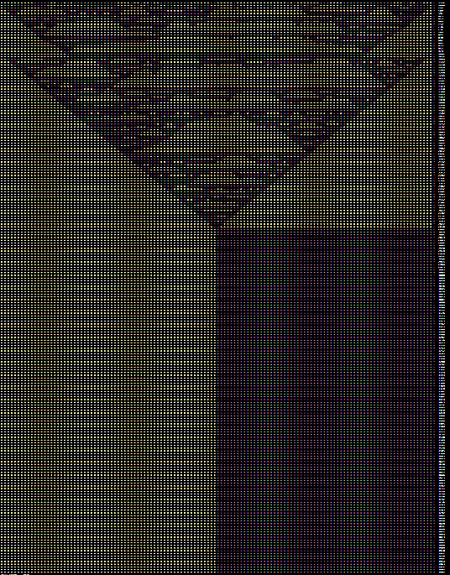
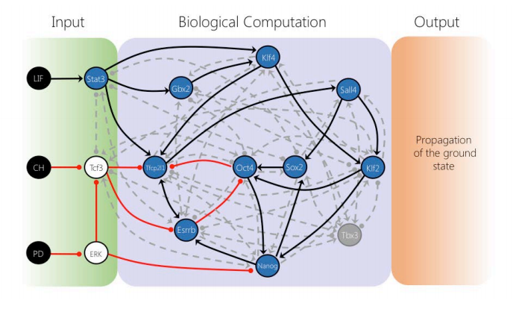



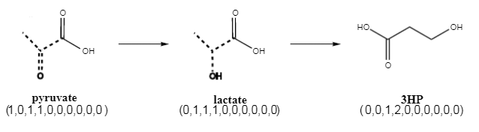


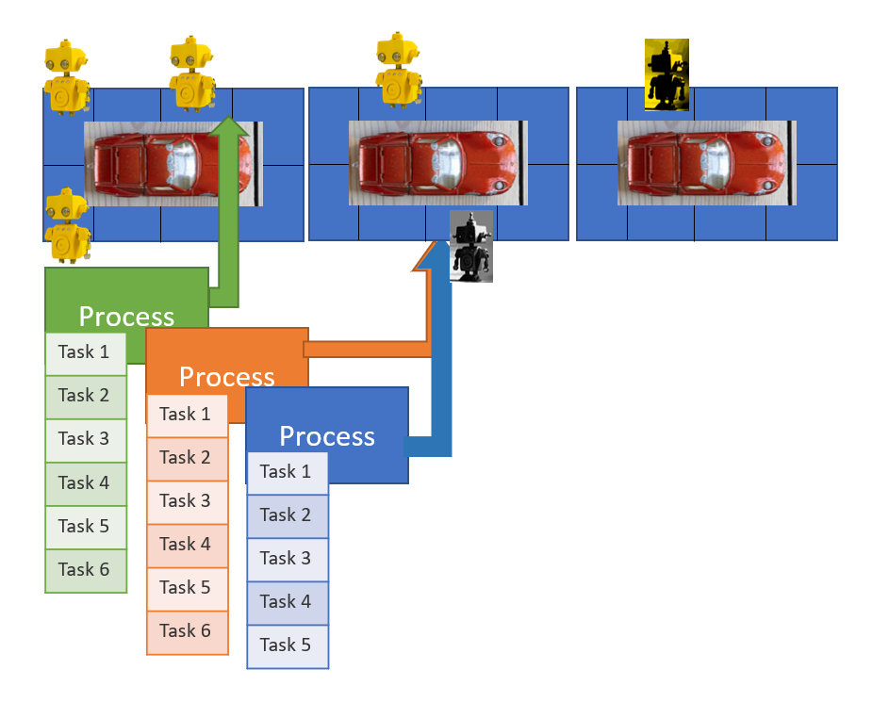



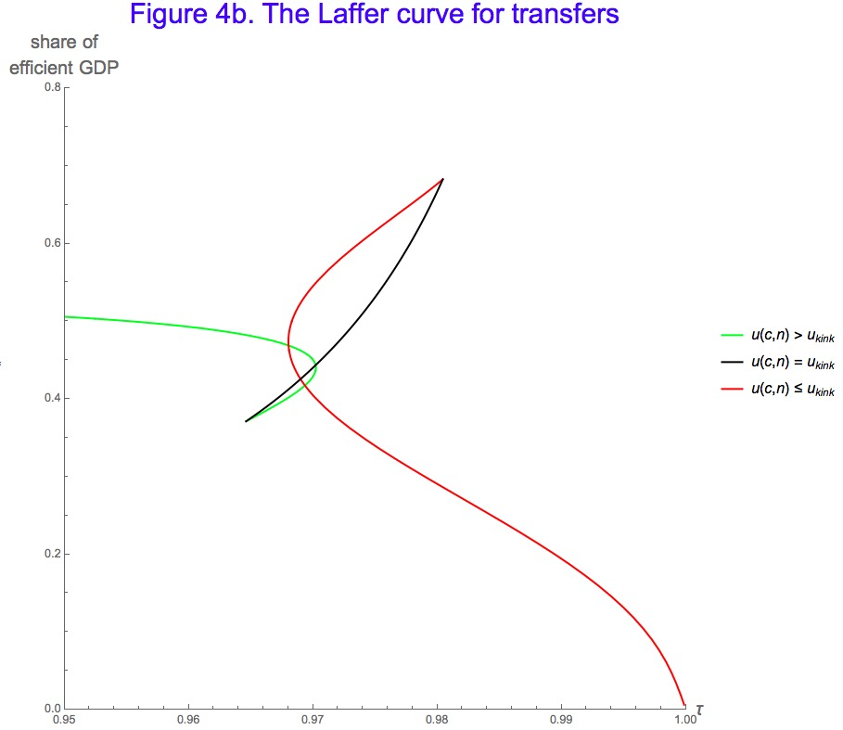
for Software +…
Azure Network
Verification
Verifying C
Compiler
Quantum
Compilation
Biological
Computations
Verified Crypto
Libraries & Protocols
Dynamics
AX
SVACE
Static Analysis Engines
Artificial
Life
Security Risk Detection
Smart Contract
Verification
ALIVE2
Translation Validation
for LLVM & Visual C++
Axiomatic
Economics
Assembly Line
Optimization

Slide 6
Material
z3 on github – https://github.com/z3prover/z3
Tutorial document - https://z3prover.github.io/papers/z3internals.html
Online tutorial - https://microsoft.github.io/z3guide

Slide 7
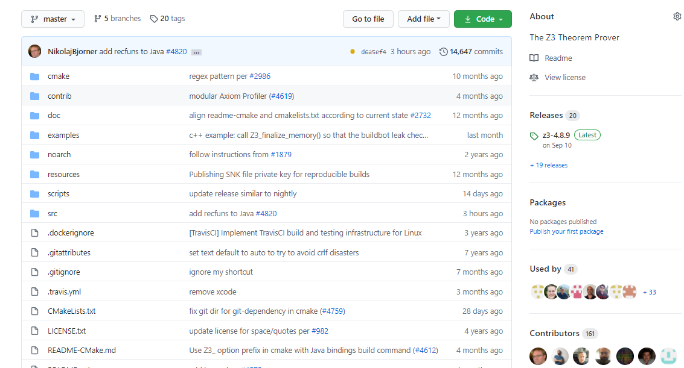
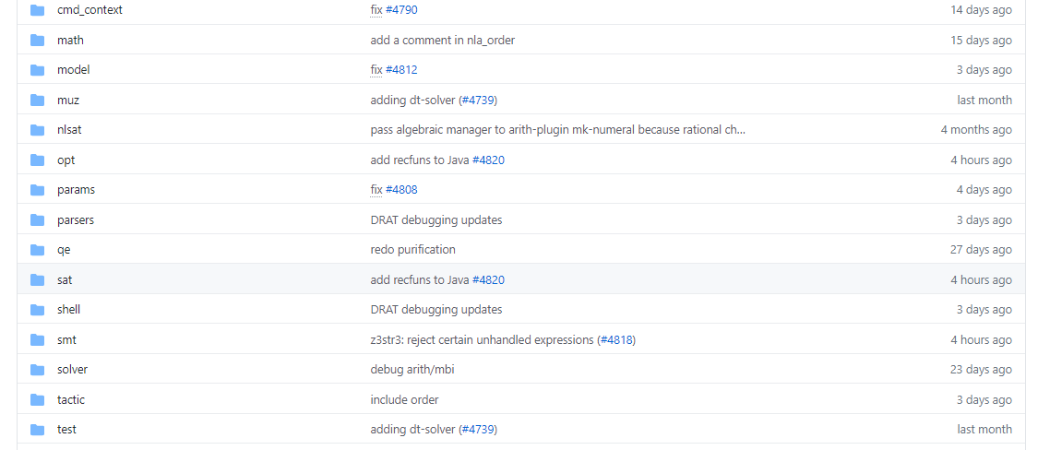
overview
Scope of this tutorial

Slide 8
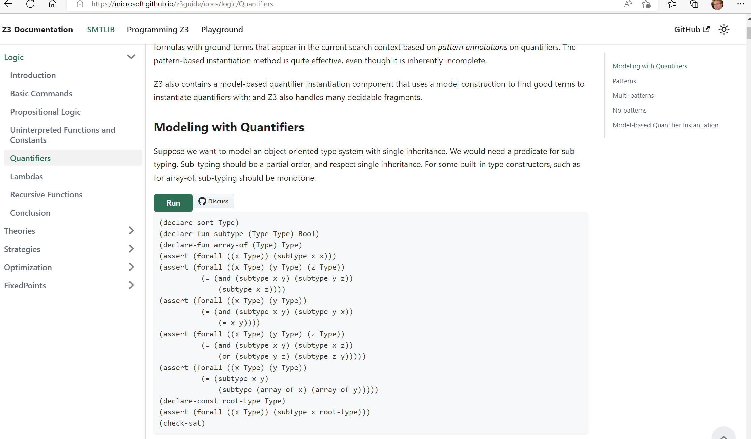

Slide 9
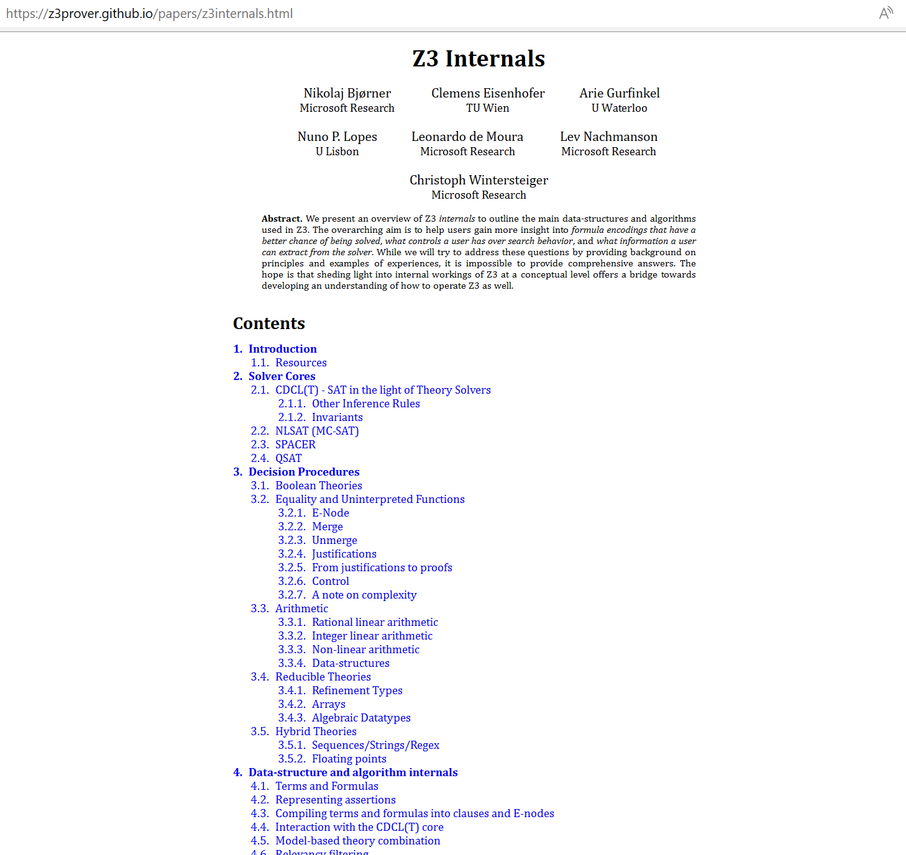
Tutorial notes

Slide 10
What to expect when expecting a z3 internals tutorial?

Slide 11
What users may want to learn
How can I tune formulas to be solved by Z3?
How can I have Z3 provide feedback on solving?
What features of Z3 should I use for solving formulas?
how can I determine which strategies apply to my formulas?
Can I control the output of Z3
models (to be diverse, random)?

Slide 12
What a developer likes to talk about
Solvers
Algorithms
Data-structures
Logic features
Proof systems
Heuristics
Anatomy of Congruence Closure
How do solvers interact (with the core)?
How do solvers implement search?

Slide 13
Tutorial format
Understand Core Concepts
Understand where to dig further
Use cases shaped by anecdotes

Slide 14
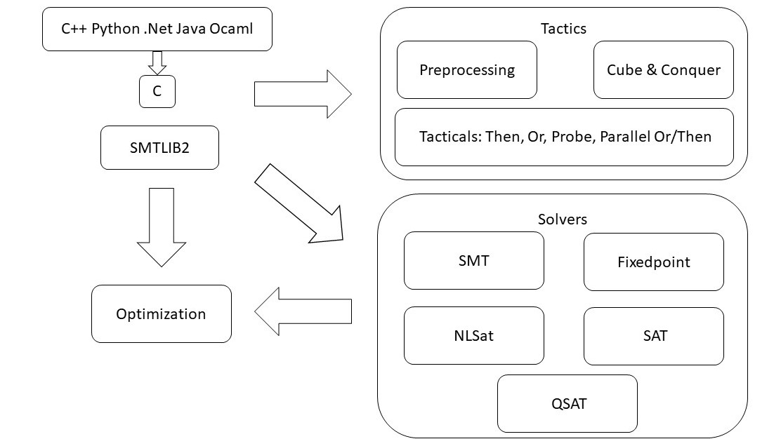
overview

Slide 15
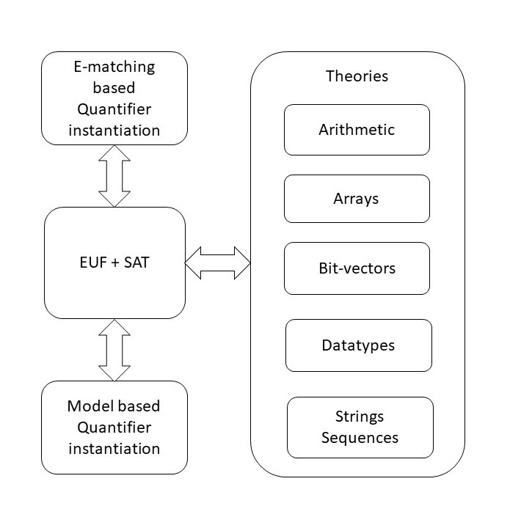
overview
Scope of this talk
Motivation
Solvers drive what applications can do
A big recent development in Z3 is a new arithmetic solver
Other solvers are in active development (regex, user-supplied propagation)
Technologies are ripe for a next generation

Slide 16
Interfacing with Z3
A Quiz and some Answers

Slide 17
Efficiency
Scale
Technology Landscape
Propositional
Satisfiability Solving
SAT
Breakthroughs in 2000s
Cheap local Inferences
Garbage collect useless clauses
Hardware Design
Automation
Breakthroughs late 2000s
SAT + global inferences +
global propagators
Mixed Integer
Programming
MIP
Breakthroughs in 1960s
Harnessed since 1990s
LP: global Inferences
IP: Cuts, Branch and Bound
Satisfiability Modulo Theories
Operations
Research
CP-SAT
SMT
Z3
Constraint
Programming
Software Development +…
CP
Breakthroughs since 1990s
Powerful domain-tailored
global propagators
Expressive Power

Slide 18
Satisfiability Modulo Theories (SMT)
Is formula ϕ satisfiable modulo theory T ?
SMT solvers have specialized algorithms for T

Slide 19
Formulating Formulas for Z3
Capturing Finite domains as propositional theories
SAT
BV = SAT or SAT + equality propagation
PB = SAT + cardinality + weighted Boolean inequalities
Symmetries
Programming With Quantifiers

Slide 20
Controlling Search
SAT engine control
Variable phases
Sat.threads, parallel.enable
Lookahead Solving
Ackermann reduction
Arithmetic and finite domains

Slide 21
Retrieving Information
Model, Core, Proof
Clausal Proof Logs, Trace
API Log, SMT log, Lemma log

Slide 22
Tactics

Slide 23
Example tactic
What is a tactic
Properties of tactics
Use case of Alive2

Slide 24
Online reference to tactics
Classification of tactics
Incremental tactics

Slide 25
Solver Engines
CDCL(T) SPACER NLSAT QSAT

Slide 26
overview

Slide 27

CDCL(T)
SAT
Theory
Solvers
SMT
Equality + UF
Arithmetic
Bit-vectors
…
Case Analysis

Slide 28
CDCL(T)
Basic Idea
x ≥ 0, y = x + 1, (y > 2 ∨ y < 1)
Abstract (aka “naming” atoms)
p₁, p₂, (p₃ ∨ p₄)
p₁ ≡ (x ≥ 0), p₂ ≡ (y = x + 1),
p₃ ≡ (y > 2), p₄ ≡ (y < 1)

Slide 29
CDCL(T)
Basic Idea
x ≥ 0, y = x + 1, (y > 2 ∨ y < 1)
Abstract (aka “naming” atoms)
p₁, p₂, (p₃ ∨ p₄)
p₁ ≡ (x ≥ 0), p₂ ≡ (y = x + 1),
p₃ ≡ (y > 2), p₄ ≡ (y < 1)
SAT
Solver

Slide 30
CDCL(T)
Basic Idea
x ≥ 0, y = x + 1, (y > 2 ∨ y < 1)
Abstract (aka “naming” atoms)
p₁, p₂, (p₃ ∨ p₄)
p₁ ≡ (x ≥ 0), p₂ ≡ (y = x + 1),
p₃ ≡ (y > 2), p₄ ≡ (y < 1)
SAT
Solver
Assignment
p₁, p₂, ¬p₃, p₄

Slide 31
CDCL(T)
Basic Idea
x ≥ 0, y = x + 1, (y > 2 ∨ y < 1)
Abstract (aka “naming” atoms)
p₁, p₂, (p₃ ∨ p₄)
p₁ ≡ (x ≥ 0), p₂ ≡ (y = x + 1),
p₃ ≡ (y > 2), p₄ ≡ (y < 1)
SAT
Solver
Assignment
p₁, p₂, ¬p₃, p₄
x ≥ 0, y = x + 1,
¬(y > 2), y < 1

Slide 32
CDCL(T)
Basic Idea
x ≥ 0, y = x + 1, (y > 2 ∨ y < 1)
Abstract (aka “naming” atoms)
p₁, p₂, (p₃ ∨ p₄)
p₁ ≡ (x ≥ 0), p₂ ≡ (y = x + 1),
p₃ ≡ (y > 2), p₄ ≡ (y < 1)
SAT
Solver
Assignment
p₁, p₂, ¬p₃, p₄
x ≥ 0, y = x + 1,
¬(y > 2), y < 1
Unsatisfiable
x ≥ 0, y = x + 1, y < 1
Theory
Solver

Slide 33
CDCL(T)
Basic Idea
x ≥ 0, y = x + 1, (y > 2 ∨ y < 1)
Abstract (aka “naming” atoms)
p₁, p₂, (p₃ ∨ p₄)
p₁ ≡ (x ≥ 0), p₂ ≡ (y = x + 1),
p₃ ≡ (y > 2), p₄ ≡ (y < 1)
SAT
Solver
Assignment
p₁, p₂, ¬p₃, p₄
x ≥ 0, y = x + 1,
¬(y > 2), y < 1
New Lemma
¬p₁∨¬p₂∨¬p₄
Unsatisfiable
x ≥ 0, y = x + 1, y < 1
Theory
Solver

Slide 34
CDCL(T)
New Lemma
¬p₁∨¬p₂∨¬p₄
Unsatisfiable
x ≥ 0, y = x + 1, y < 1
Theory
Solver
AKA
Theory conflict

Slide 35
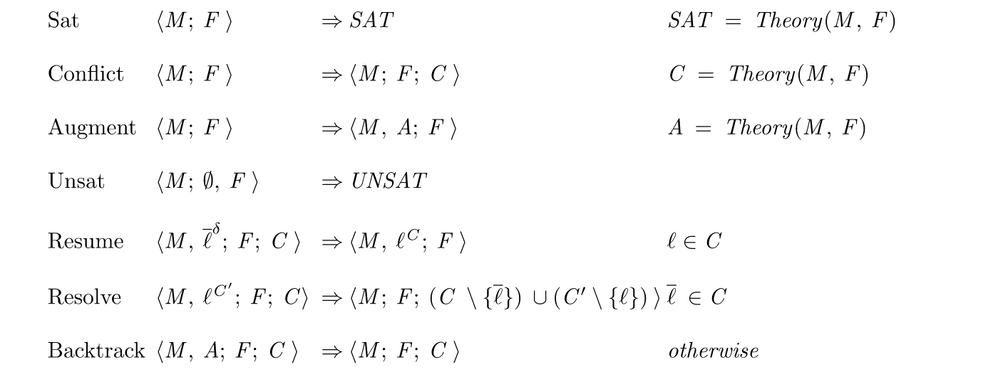
CDCL(T) as inference rules

Slide 36
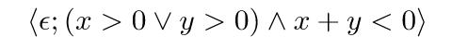

CDCL(T) as inference rules

Slide 37
CDCL(T) as inference rules

Slide 38
CDCL(T) as inference rules

Slide 39
CDCL(T) as inference rules

Slide 40
CDCL(T) as inference rules

Slide 41
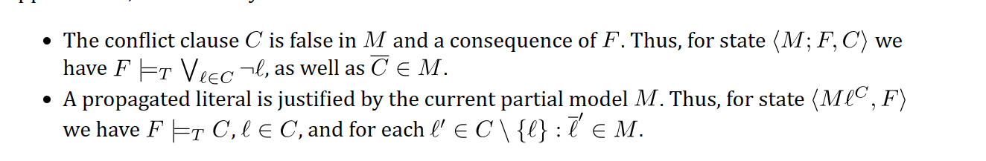
CDCL(T) - Invariants

Slide 42
CDCL(T) – Dual Model/Proof search
Figure, material from MOD / FN notes

Slide 43
CDCL(T) - Implementation

Slide 44
CDCL(T) - implementation
SAT vs SMT engine
When are variables pure?
The cost of restarts
The cost/benefit of propagation -> probing
Phase selection
Compiling from SMT to SAT
Fresh Variables

Slide 45
SPACER, NSLSAT, QSAT

Slide 46
Core Decision Procedures

Slide 47
Classification

Slide 48
Finite Domains

Slide 49
EUF

Slide 50
Arithmetic

Slide 51
Data-types, Arrays

Slide 52
User Theories

Slide 53
Data-structure Internals

Slide 54
Terms and Formulas

Slide 55
Assertion Internals

Slide 56
Compiling Assertions To Search State

Slide 57
Core <-> Solver interface

Slide 58
Model-based Theory Combination

Slide 59
Relevancy Filtering

Slide 60
Ackermann reductions

Slide 61
Iterative Deepening

Slide 62
Models

Slide 63
Model Formats

Slide 64
Extracting Models

Slide 65
Certificates

Slide 66
Certificate Formats

Slide 67
Using Certificates

Slide 68
Quantifiers

Slide 69
E-matching

Slide 70
MBQI

Slide 71
MBP

Slide 72
SAT + Theory Solvers A basis for SMT

Slide 73
A Universe of Theories and Solvers

Slide 74
A universe of theories
Boolean | finite domains
Base | arithmetic and uninterpreted functions
Reducible | reduce to base theories
Hybrid | non-disjoint combinations
External | propagation rules

Slide 75
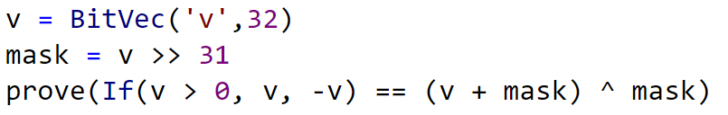
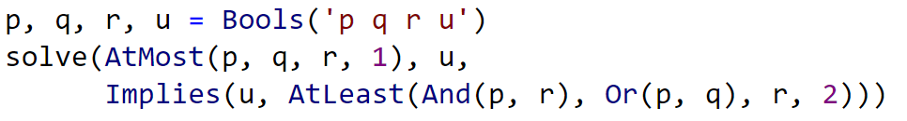
A universe of theories
Boolean | finite domains

Slide 76
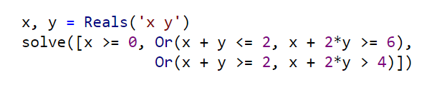
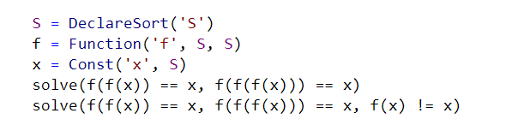
A universe of theories
Base | arithmetic and uninterpreted functions (EUF)

Slide 77
Solving Arithmetic
SAT/SMT Backtracking
Search
Propagation
+ Conflicts
Assert bounds on integer/real variables
Solve for Reals Use Simplex to find solutions to constraints + bounds
Bounds propagation Infer equalities and bounds from existing bounds
Solve for Integers
Cube
GCD test
Branch and Bound
Hermite Normalize
Gomory Cuts
Solve for multiplications
Bounds propagation
Horner expansion
Gröbner solving
Incremental linearization
NL-SAT
SAT

Slide 78

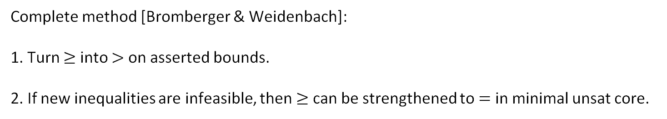




Propagating Equalities
SAT/SMT Backtracking
Search
$$x=z$$
$$x+1=y$$
Assert bounds on integer/real variables
$$y −1=z$$
Complete method [Bromberger & Weidenbach]:
1. Turn $≥$ into $>$ on asserted bounds.
2. If new inequalities are infeasible, then $≥$ can be strengthened to $=$ in minimal unsat core.
Bounds propagation Infer equalities and bounds from existing bounds
$$\underline{x+1=y y −1=z}$$
$$x=z$$

Slide 79
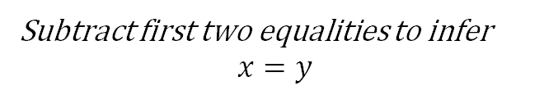
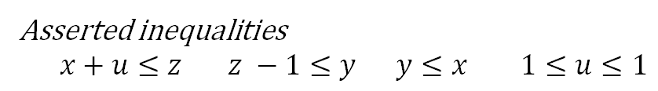

Propagating Equalities
Equality inferences require addition/subtraction operations
Asserted inequalities
$x+u≤z z −1≤y y≤x 1≤u≤1$
$$\underline{x+1=y y −1=z}$$
$$x=z$$
How the solver sees the constraints
$x+u+s_{1}=z z −1+s_{2}=y y+s_{3}=x 1≤u≤1 0≤s_{1} 0≤s_{2} 0≤s_{3}$
After pivoting
$$x=z−u −s_{1} y=z −1+s_{2} s_{3}={−s}_{2}− {u+1− s}_{1} 1≤u≤1 0≤s_{1} 0≤s_{2} 0≤s_{3}$$
After propagating bounds on $s_{1}, s_{2},s_{3}$
$$x=z−u −s_{1} y=z −1+s_{2} s_{3}={−s}_{2}− {u+1− s}_{1} 1≤u≤1 0≤s_{1}≤0 0≤s_{2}≤0 0≤s_{3}≤0$$
Subtract first two equalities to infer
$$x=y$$
Subtle complexity: Every row can have many fixed variables. Adding values of constant bounds requires significant runtime.

Slide 80


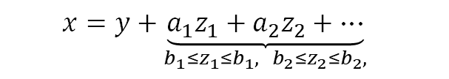
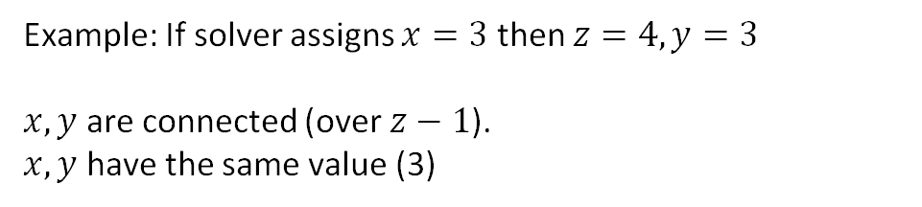
Propagating Equalities - efficiently
$$\underline{x=z−u −s_{1} y=z −1+s_{2} 1≤u≤1 0≤s_{1}≤0 0≤s_{2}≤0 0≤s_{3}≤0}$$
$$x=y$$
Instead of adding up rows to prove implied equality
Use fact all variables have values assigned by Simplex solver
Then two variables are equal if
They are connected through offset equalities
They have the same value
offset equality
$$x=y+{\underset{{b_{1}≤z}_{1}≤b_{1}, { b}_{2}≤z_{2}≤b_{2},}{\underbrace{{a_{1}z}_{1}+a_{2}z_{2}+…}}}_{}$$
Example: If solver assigns $x=3$ then $z=4, y=3$
$x, y$ are connected (over $z−1$).
$x, y$ have the same value (3)

Slide 81


A universe of theories
Reducible | reduce to base theories
Compile into EUF
UNSAT

Slide 82

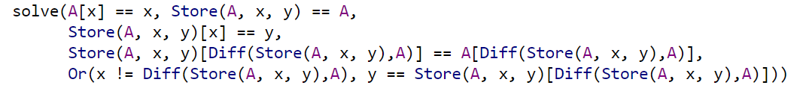
A universe of theories
Reducible | reduce to base theories
Convert EUF solution to
solution over arrays
Compile into EUF

Slide 83
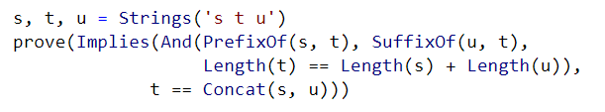

A universe of theories
Hybrid | non-disjoint combinations
$$\frac{s=\text{"}\text{abcd}\text{" }u=\text{"}\text{def}\text{"} |t|=\text{7}}{t="\text{abcddef}"}$$

Slide 84
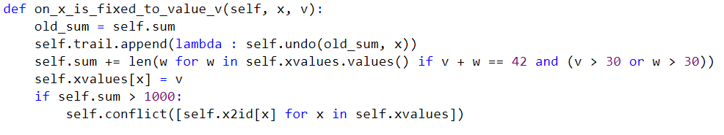
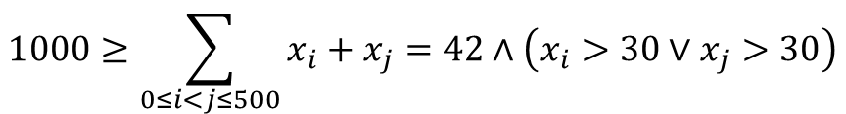
A universe of theories
External | propagation rules
When encodings into existing theories is too expensive
$$1000≥\sum_{0≤i<j≤500}{x_{i}+x_{j}=42∧\left(x_{i}>30∨x_{j}>30\right)}$$
As code:
Introduces one callback + conflicts on demand
As constraints:
Introduces 100Ks
atomic formulas

