Slide 1
Core Theories
Nikolaj Bjørner, Microsoft Research, RiSE
TU Wien 2025
A Laura Kovacs guest lecture production

Slide 2

CDCL(T)
Theory
Solvers
SMT
SAT
Equality + UF
Arithmetic
Bit-vectors
…
Case Analysis

Slide 3
Core Decision Procedures

Slide 4
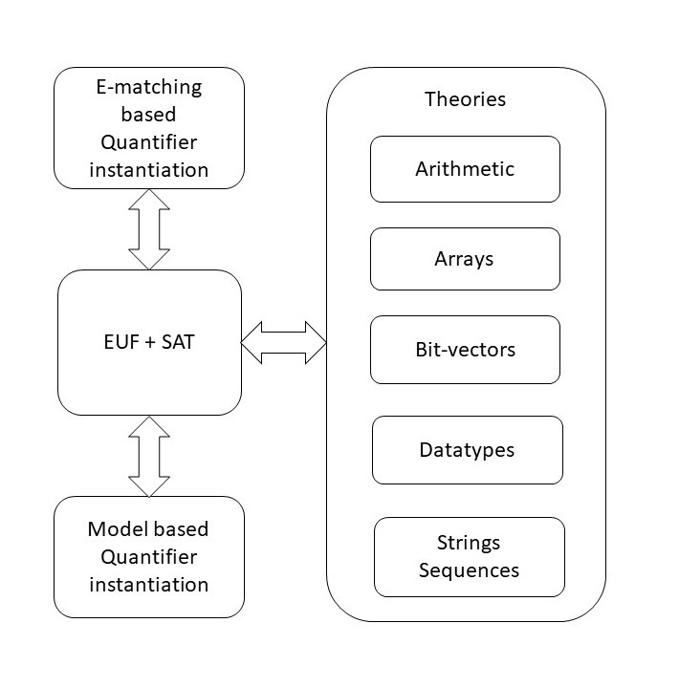

overview

Slide 5
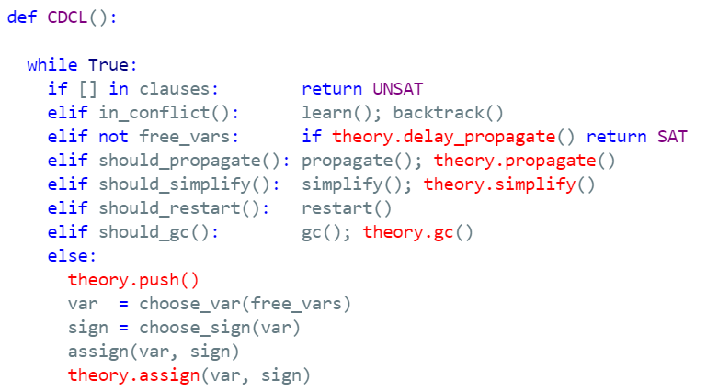
CDCL(T)

Slide 6
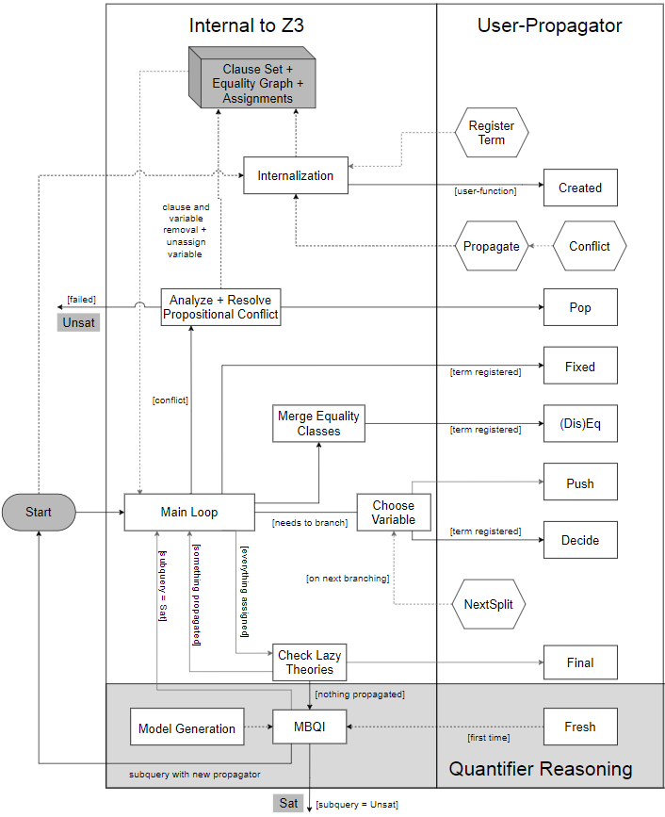
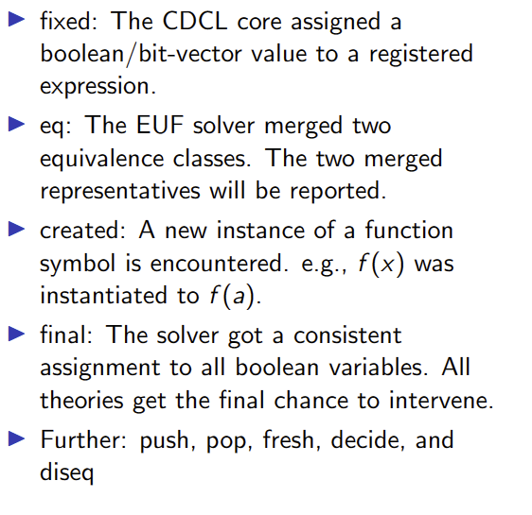
Custom Theories

Slide 7
Classification
Arrays
Finite Domains
ADTs
EUF
Arithmetic
Hybrid
str.len, bv2nat
User-Propagator

Slide 8
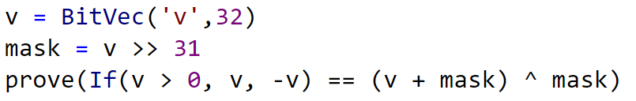
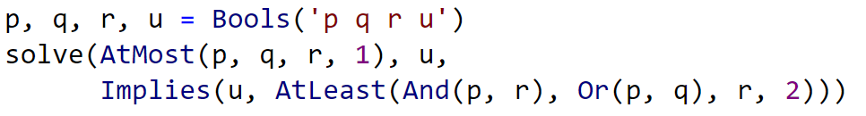
Finite Domain Theories

Slide 9
Finite Domains and CDCL(T)
Compile to SAT Compile to SAT + E Word level

Slide 10
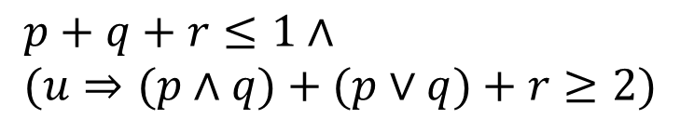
Finite Domains and CDCL(T)
$$p+q+r≤1∧ \\ (u⇒(p∧q)+(p∨q)+r≥2)$$
Compile to CDCL
Compile to CDCL + PB propagation

Slide 11
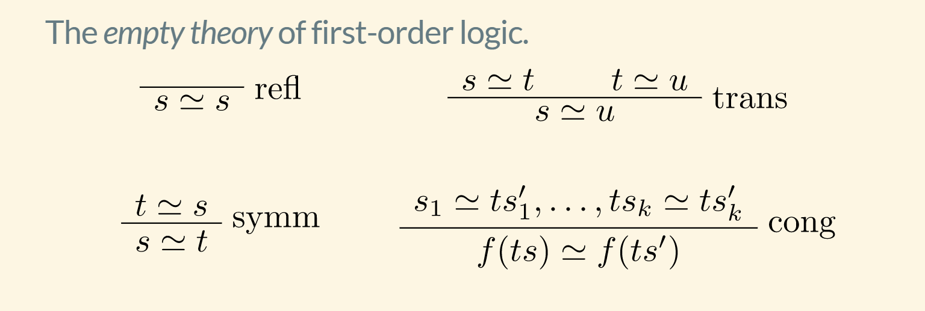
EUF

Slide 12
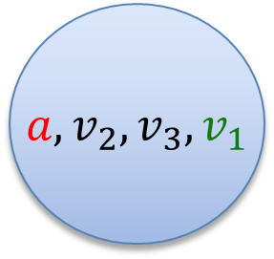
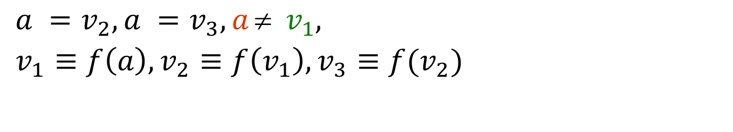
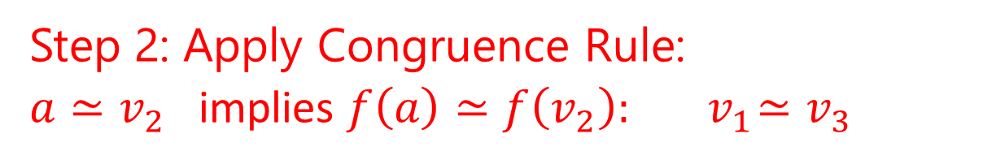
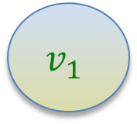
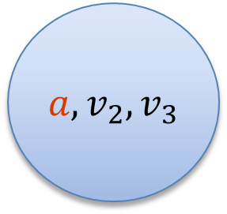
EUF
$$a = f(f(a)), a = f(f(f(a))), a  f(a)$$
Produce Proofs
Incremental Updates
Propagate Literals
$a =v_{2}, a =v_{3}, a  v_{1},$
$v_{1}≡f\left(a\right), v_{2}≡f\left(v_{1}\right), v_{3}≡f(v_{2})$
$a, v_{2}, v_{3}$
$$v_{1}$$
Union Find
Step 1: Equivalence classes from equalities
$a, v_{2}, v_{3}, v_{1}$
Step 2: Apply Congruence Rule:
$a≃v_{2}$ implies $f\left(a\right)≃f\left(v_{2}\right):{ v}_{1}≃v_{3}$
E-graph

Slide 13
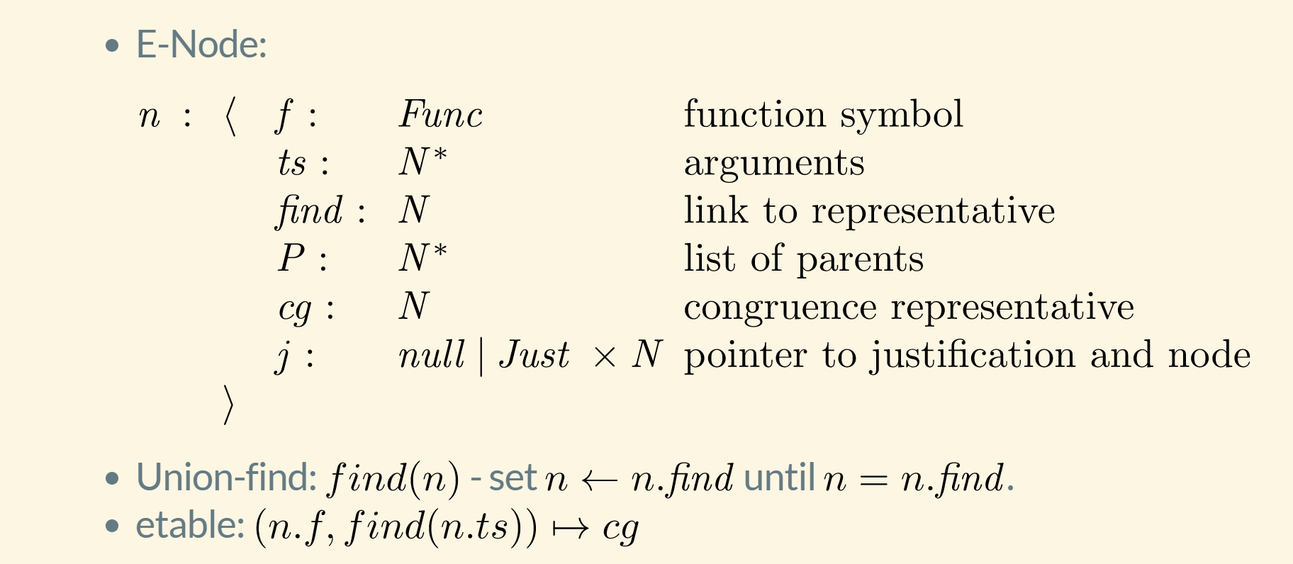
EUF – data-structure

Slide 14






EUF – union-find w. path compression, siblings
Z3 uses path compression to ensure roots are within a single hop of find
Maintain separate singly linked cyclic list of siblings
$$a≃f(c)$$
$$b≃c$$
$$c≃f(c)$$
a
a
b
b
$$b≃c$$
$$a≃f(c)$$
f(b)
f(b)
f(c)
f(c)
c
c
$$cc:f(b)≃f(c)$$

Slide 15
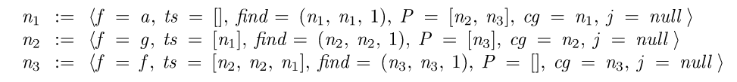

EUF - internalize
$$f(g\left(a\right), g\left(a\right), a)$$
Terms are “hash-consed”
Roots are initialized to self
etable: $[a↦n_{1},g\left(\left[n_{1}\right]\right)↦n_{2}, f\left(\left[n_{2},n_{2},n_{1}\right]\right)↦n_{3}]$

Slide 16
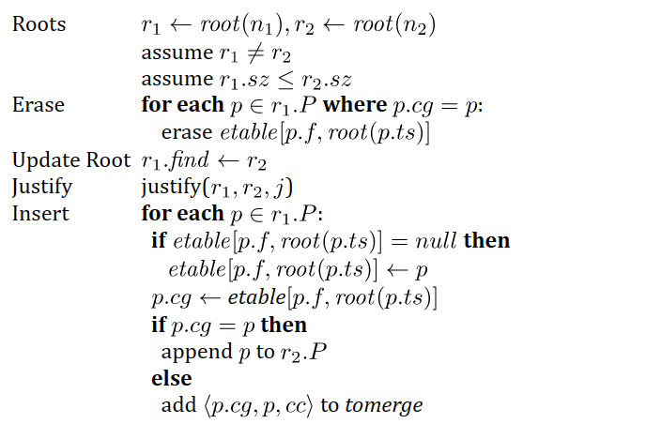
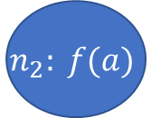
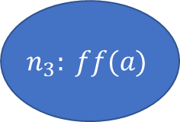

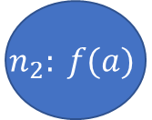



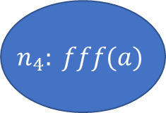
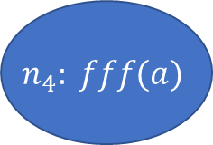

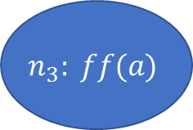
EUF - merge
$$a = f(f(a)), a = f(f(f(a))), a  f(a)$$
$$n_{2}: f(a)$$
$$n_{3}: ff(a)$$
$$n_{4}: fff(a)$$
$$n_{1}:a$$
$${merge(n}_{1},n_{3})$$
$etable\left[f,n_{1}\right]←null$ (since $n_{2}∈n_{1}.P)$
$$n_{1}.find←n_{3}$$
$$n_{2}: f(a)$$
$$n_{3}: ff(a)$$
$$n_{4}: fff(a)$$
$$n_{1}:a$$
($n_{2}∈n_{1}.P)$
$n_{2}.cg←etable[f, {root(n}_{1})]=$ $n_{4}$
$add \left\langle n_{2},n_{4}\right\rangle$ to tomerge

Slide 17


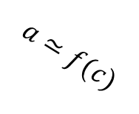



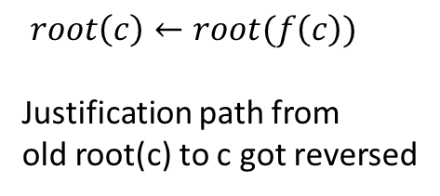


EUF - Justifications
a
b
Union – find link
$$a≃f(c)$$
$$b≃c$$
Justification link
f(b)
f(c)
c
$$cc:f(b)≃f(c)$$
a
After merge
$$c≃f(c)$$
b
$$a≃f(c)$$
$root\left(c\right)←root(f\left(c\right))$
Justification path from
old root(c) to c got reversed
$$b≃c$$
f(b)
f(c)
$$cc:f(b)≃f(c)$$
c
$$c≃f(c)$$

Slide 18

EUF - internals
Nodes from Boolean literals contain fields:
value : { true, false, undef}
boolVar : a number referring to Boolean variable as known by SAT solver
Equality nodes are special: When n1, n2 are merged, the parent n5 is equality, value = false -> conflict
$$a  f(a)$$
$n_{5}=⟨≃, [n_{1},n_{2}], \left(n_{5},n_{5},1\right), P=ε, cg=n_{5},j=nil, value=false, boolVar=27⟩$

Slide 19
EUF – internals: equalities and values
Values: If a node comes from a term that denotes a value (5, 42, 2/3, cons(1,nil)), it is always a root
When two roots with terms based on different values are merged -> conflict
Who reasons about equalities of Booleans? EUF vs. CDCL
E-nodes based on Bool do by default not merge with other nodes.
Default is overridden if E-node occurs under a non-connective.
E-graph propagates equalities to theories and Booleans to SAT
$n_{5}=\left\langle ≃, \left[n_{1},n_{2}\right], \left(n_{5},n_{5},1\right), P=ε, cg=n_{5},j=nil, value=undef, boolVar=27\right\rangle$
$n_{1}.find←n_{2}$ -> value is set to true and assignment to boolVar 27 is propagated to CDCL core

Slide 20


Arrays
Reducible | reduce to base theories
Compile into EUF
UNSAT

Slide 21

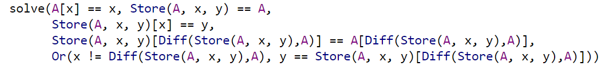
Arrays
Reducible | reduce to base theories
Convert EUF solution to
solution over arrays
Compile into EUF

Slide 22
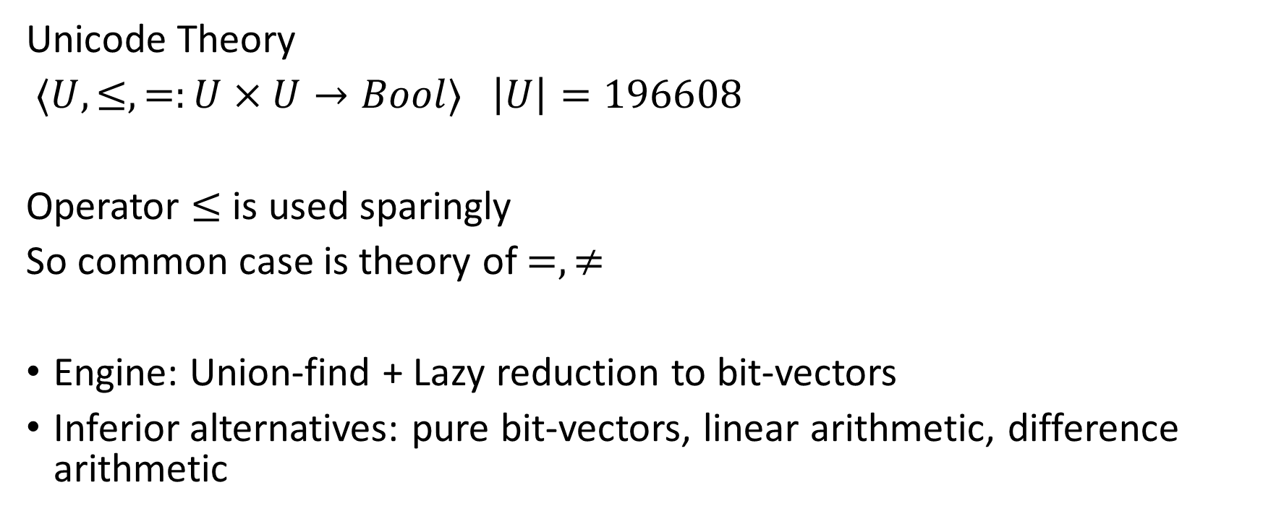
A Solver for Unicode Characters
Unicode Theory
$⟨U, ≤,=:U×U→Bool⟩$ $\left|U\right|=196608$
Operator $≤$ is used sparingly
So common case is theory of $=,≠$
Engine: Union-find + Lazy reduction to bit-vectors
Inferior alternatives: pure bit-vectors, linear arithmetic, difference arithmetic

Slide 23

A Solver for $⟨U, ≤,=:U×U→Bool⟩$ $\left|U\right|=196608$
Equality
Union Find
a
b
c
d
e
s
t
a = b, b = c, d = e, b = s, d = t, a≠ e, a≠ s
a,b,c,s
d,e,t

Slide 24
A Solver for $⟨U, ≤,=:U×U→Bool⟩$ $\left|U\right|=196608$
Equality
Union Find
a
b
c
d
‘e’
s
‘t’
a = b, b = c, d = ‘e’, b = s, d = ‘t’, a≠ e
a,b,c,s
d,’e’,’t’

Slide 25



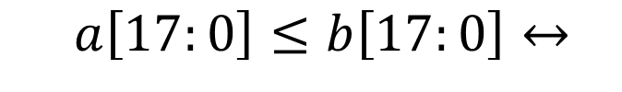
A Solver for $⟨U, ≤,=:U×U→Bool⟩$ $\left|U\right|=196608$
$$a≤b$$
Inequality
Bit-blasting
$\left(a\left[17\right]→b\left[17\right]\right)$
$∧\left(\begin{aligned}(a\left[17\right]↔b\left[17\right])→ \\ a\left[16:0\right]≤b\left[16:0\right]\end{aligned}\right)$
$$a\left[17:0\right]≤b\left[17:0\right]↔$$
$$⋮$$
$$a\left[0:0\right]≤b\left[0:0\right]↔\left(a\left[0\right]→b\left[0\right]\right)$$

Slide 26
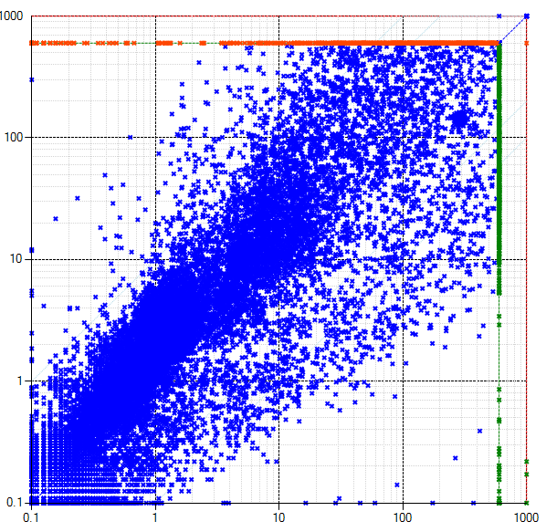


A Solver for $⟨U, ≤,=:U×U→Bool⟩$ $\left|U\right|=196608$
Combining two views
$$a=b$$
$$a≤b$$
Equality View
Bit-Blast View
$$⟨U, ≤,=:U×U→Bool, bv2char :Bool^{18}→U,$$
$$\left[0\right]:U→Bool, \left[1\right]:U→Bool, …, \left[17\right]:U→Bool⟩$$
This solver
$$bv2char\left(a\left[17\right], …, a\left[0\right]\right)=a$$
Bit-vector solver

Slide 27
Custom Theories

Slide 28
Finite Sets
Let us develop a solver for finite sets

Slide 29
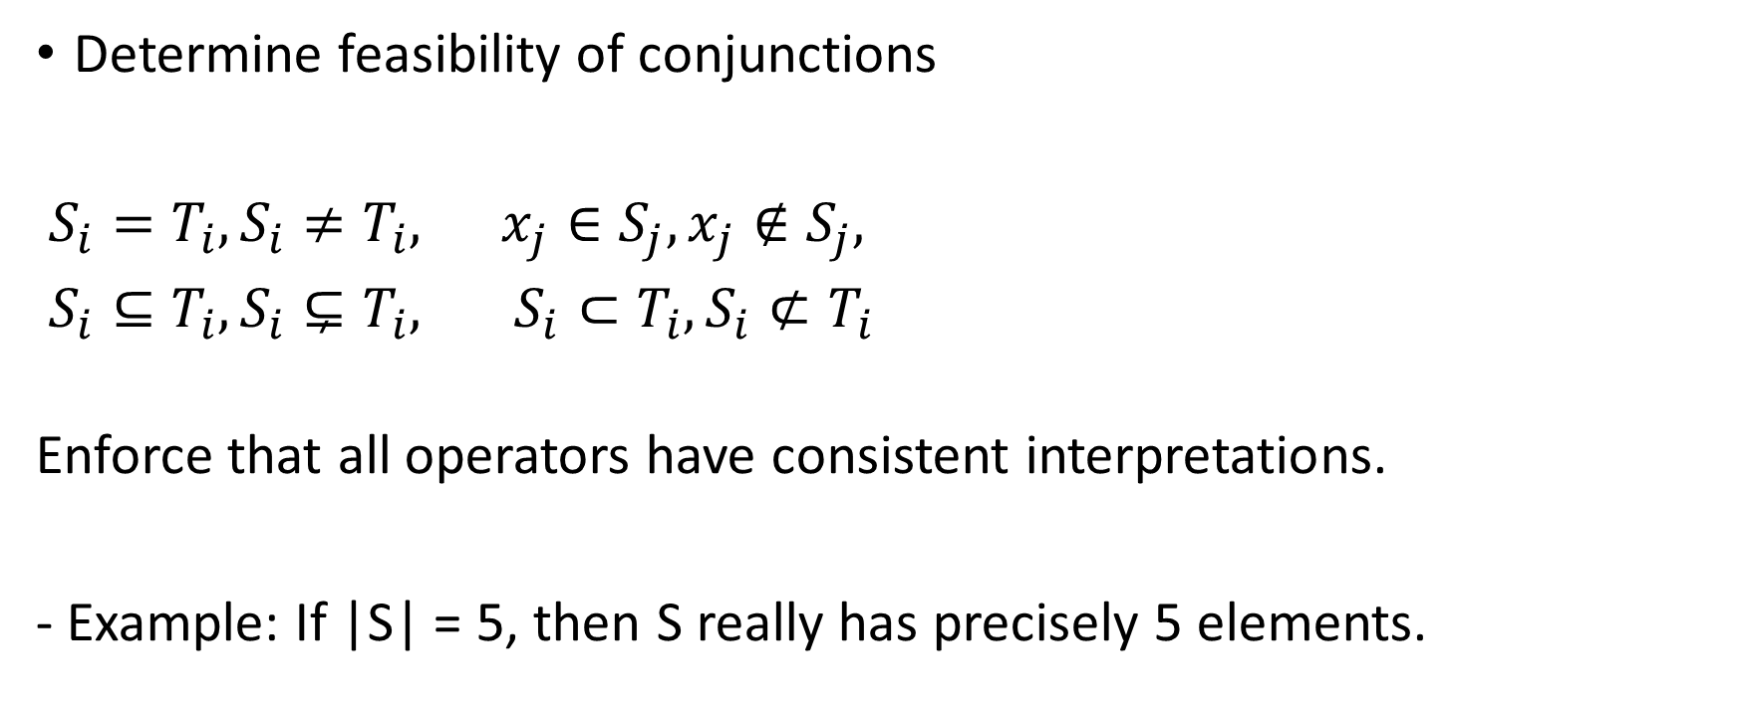
Core functionality
Determine feasibility of conjunctions
$S_{i}=T_{i}, S_{i}≠T_{i}, x_{j}∈S_{j}, x_{j}∉S_{j},$
$S_{i}⊆T_{i}, S_{i}⊊T_{i}, S_{i}⊂T_{i}, S_{i}⊄T_{i}$
Enforce that all operators have consistent interpretations.
- Example: If |S| = 5, then S really has precisely 5 elements.

Slide 30
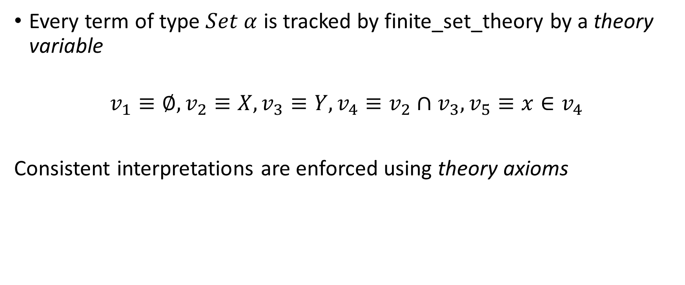
Representation
Every term of type $Set α$ is tracked by finite_set_theory by a theory variable
$$v_{1}≡∅, v_{2}≡X, v_{3}≡Y, v_{4}≡v_{2}∩v_{3}, v_{5}≡x∈v_{4}$$
Consistent interpretations are enforced using theory axioms

Slide 31
Theory Axioms
x \in v_k := T, v_j \equiv v_k \cup v_j -> x \in v_k \rightarrow x \in v_j
x \not\in v_i, v_i \equiv v_k \cup v_j -> x \not in v_k \land v \not \in v_i

Slide 32
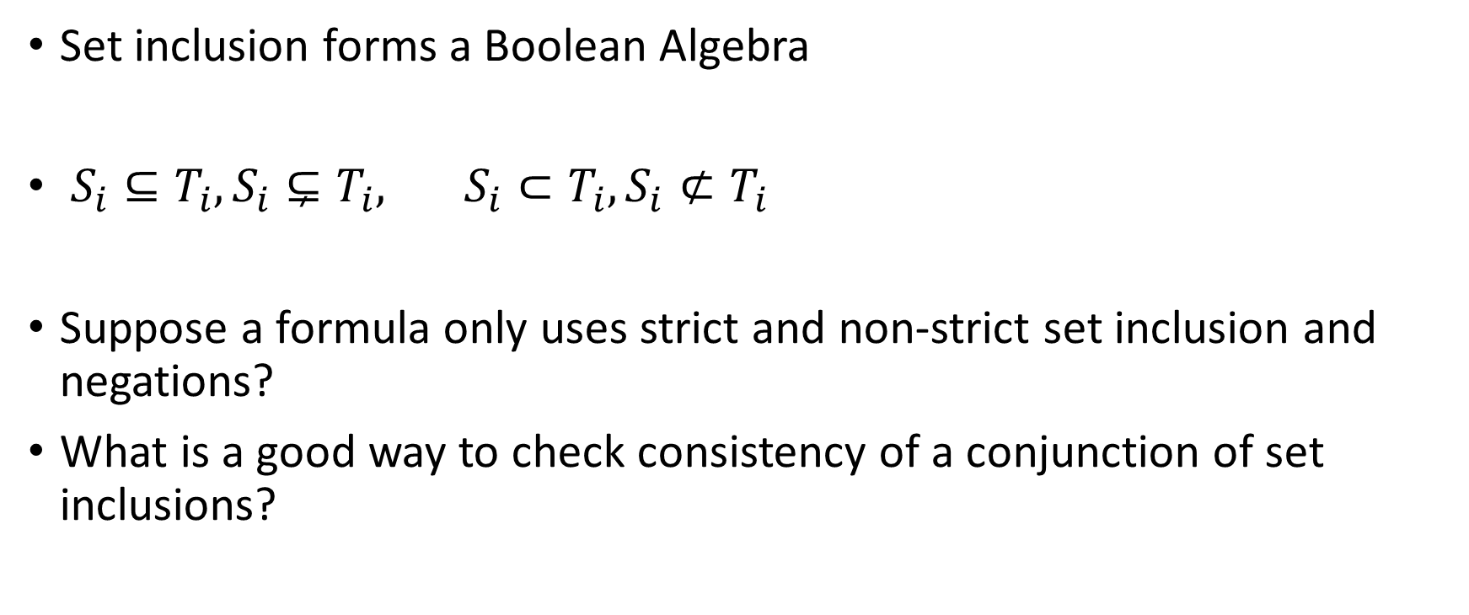
Boolean Algebras
Set inclusion forms a Boolean Algebra
$S_{i}⊆T_{i}, S_{i}⊊T_{i}, S_{i}⊂T_{i}, S_{i}⊄T_{i}$
Suppose a formula only uses strict and non-strict set inclusion and negations?
What is a good way to check consistency of a conjunction of set inclusions?

